Slide 1
Building a Gamification Framework on DNN
Scott McCulloch
F5 Networks
s.mcculloch@f5.com

Slide 2
About this Session
Technical Session (Yes, there will be a little code)
Introduce the concept of Gamification
Walkthrough an implementation on the DNN Framework
Show you F5’s gamified site (devcentral.f5.com)
Give you some code to try and build upon
Apologies for using the terms Gamification, Gamifying and Gamified which are not real words!

Slide 3
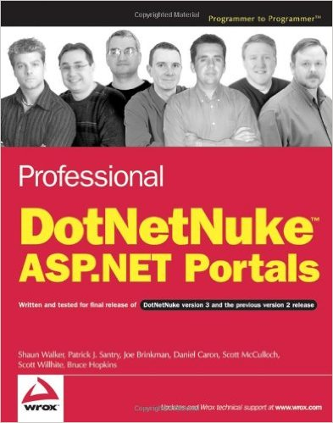
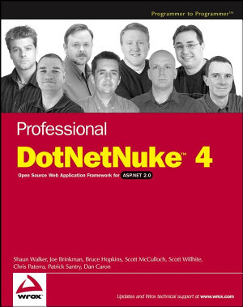
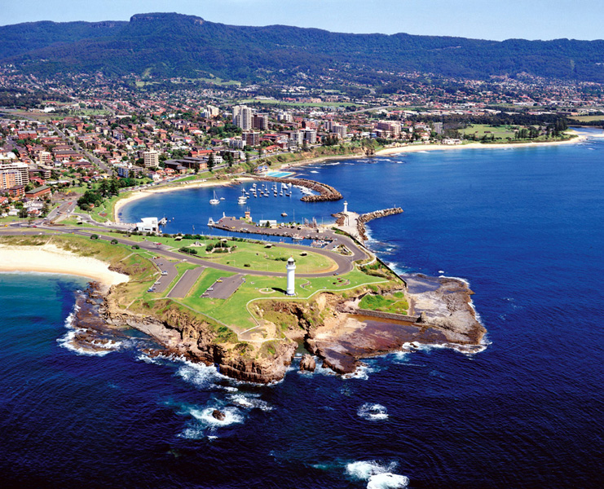

About Me
Scott McCulloch
Wollongong, Australia
F5 Networks
DNN Community since IBuySpy
DNN Books
Ventrian Modules

Slide 4
What is a Gamification?
‘The application of typical elements of game playing (point scoring, competition with others, rules of play) to other areas of activity’
The purpose is to motivate participation, engagement and loyalty with any given product or service.
Taps into the basic desires and needs of users around the idea of status and achievement
An alternate way to measure success than simple page views
Examples:
StackOverflow – reputation, badges, rank and upvotes for programmers
Fitness Bands, NikeFuel – competition based on physical activity
Khan Academy – skill-growth trees to unlock new classes and new skills

Slide 5
Core Concept – Measurement through “Actions”
An action is any online activity performed by a user
e.g. ask a question, vote up a question, submit a video.
Gamifying these actions requires placing a value on these actions.
Value is measured by two metrics:
Reputation
Positive or Negative
Generally given to another person
Experience (Participation/Engagement)
Positive only
Given to the person that performed the action
Not publicly displayed

Slide 6
Setting the rules of play
Action | Reputation Points | Experience Points
Ask a Question | 1 | 1
Your Question voted up | 10 | 0
Your Question voted down | -2 | 0
Add an Answer | 1 | 1
Your Answer accepted | 15 | 1
Your Answer voted up | 15 | 0
Your Answer voted down | 10 | 0
Add a comment | 1 | 1

Slide 7
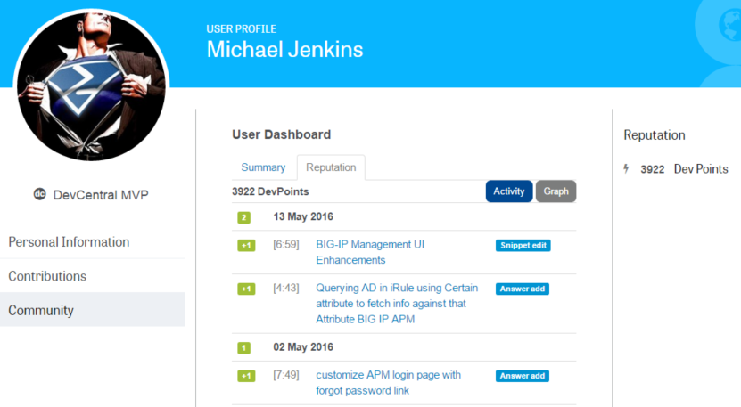
Accumulating Points

Slide 8
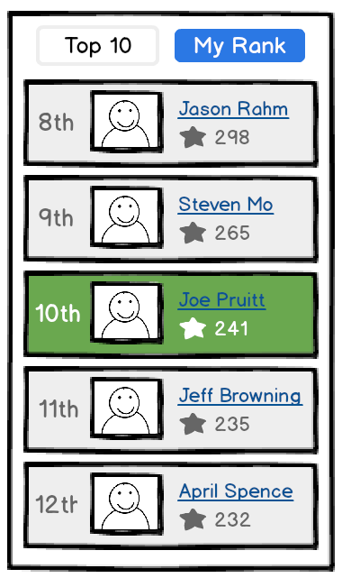
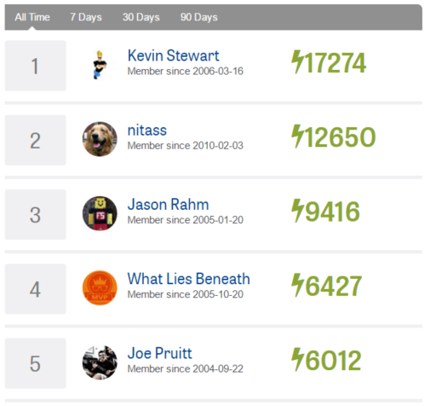
Using Reputation Points: User vs User Leaderboard
Rewards a user with a tangible user # based on Reputation

Slide 9
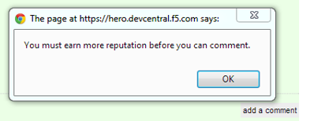
Using Reputation Points: Privileges
Rewards a user with the ability to perform certain actions based upon their Reputation
Privilege | Reputation Points
Ask Questions | 0
Comment Everywhere | 50
Vote Down | 125
Flag Questions | 15
Vote Up | 15

Slide 10
Using Reputation Points: Levels (Labels)
Rewards a user with a label based upon Reputation
Level | Description | Reputation
Newbie | You may post questions | 0
Lurker | You may post more questions. | 50
Explorer | Post answers and vote "up" other members' questions and answers. | 100
Local | Approve other members' answers and propose your own posts as answers. | 200
Citizen | Promote other members' posts as answers. | 300
Advocate | Promote and demote answers. | 500
Evangelist | Publish articles, get DevCentral swag. | 1000
Elite Contributor | Propose content for featured status. | 2000
Champion | Get a super cool badge. | 3000
I am VIPRION! | Get a super cool badge and t-shirt. | 5000+
MVP | Nominated by other members. Winner selected by F5 DevCentral team. | N/A

Slide 11
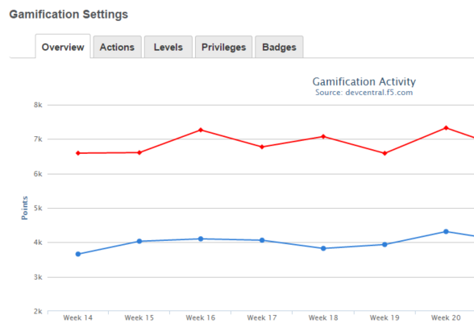
Using Reputation (and Experience!) Points – Site Activity
Before Gamification (BG)
Page Views
User Registrations
Content Created
After Gamification (AG)
Reputation earnt overall
Reputation earnt by individual user
Experience earnt (separate metric)

Slide 12
Guidelines for an Extensible API
Action features:
Register a new Action Type
Register/Remove an Action
Retrieve the current Reputation for a user
Retrieve the list of Actions for a user
Check if a user has performed an Action
Privilege features:
Register a new Privilege Type
Check if user meets Privilege Requirement
Level (label) features:
Register/Remove Levels based upon Reputation
Retrieve the current Level for a user

Slide 13
Database Schema
ActionType
ActionTypeID | Int
DesktopModuleID | Int
Name | Nvarchar(100)
FriendlyName | Nvarchar(255)
ReputationPoints | Int
ExperiencePoints | Int
Active | Bit
ActionLog
ActionID | Int
ActionTypeID | Int
OriginUserID | Int
TargetUserID | Int
PortalID | Int
ExperiencePoints | Int
ReputationPoints | Int
Context | Int
ContentItemID | Int
DateCreated | DateTime
Level
LevelID | Int
PortalID | Int
Name | Nvarchar(100)
LevelType | Int
PointStart | Int
PointEnd | Int
RoleID | Int
PrivilegeType
ActionTypeID | Int
DesktopModuleID | Int
Name | Nvarchar(100)
FriendlyName | Nvarchar(255)
ReputationPoints | Int
Score
UserID | Int
PortalID | Int
ExperiencePoints | Int
ReputationPoints | Int
LastUpdated | DateTime

Slide 14
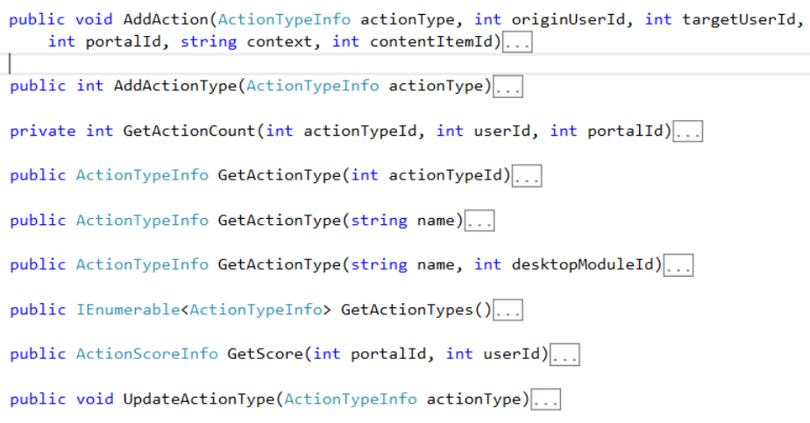
API Details :: ActionController

Slide 15
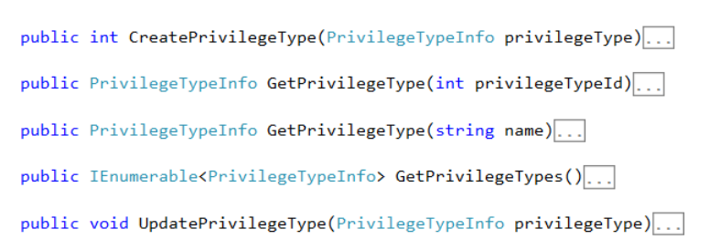
API Details :: PrivilegeController

Slide 16
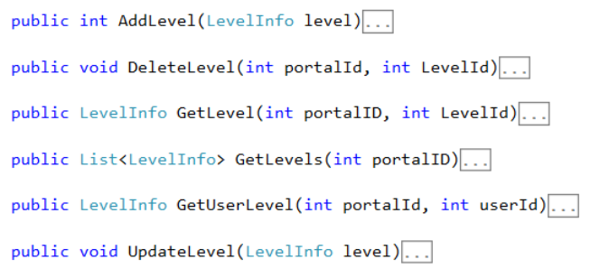
API Details :: LevelController

Slide 17
Game Rules for the Demo
Beer Vendor Module
Reputation = Intoxication, Experience = Money Spent
Register ActionType (Beer Purchase, Food Purchase)
Perform an Action (Buy Beer, Buy Food)
Retrieve my Reputation (Intoxication) & Experience (Money spent)
Display my User Level
Action | Intoxication (Rep) | Money Spent (Exp)
Buy Beer | 5 | 1
Buy Food | -1 | 2
Level | Reputation
Sober | 0
Tipsy | 1-19
Drunk | 20-49
Really Drunk | 50+

Slide 18
Tweaking the Game Rules for the Demo
Adjust Points
Raise the points value for Buy Beer
Adjust Levels
Insert a new state after “Really Drunk”
Unlock a Privilege
Sleep it off
Level | Reputation
Sober | 0
Tipsy | 1-19
Drunk | 20-49
Really Drunk | 50-99
??? | 100+
Action | Intoxication (Rep) | Money Spent (Exp)
Buy Beer | 10 | 1
Buy Food | -1 | 2
Sleep it off | -100 | 40

Slide 19
Managing the Game – Administrator Tools
Activity Graphs
Reputation & Experience over time
Manage Actions
Adjust point values for actions
Only affects new actions
Manage Levels
Adjust/insert new levels
Manage Privilege Thresholds
Adjust point values required

Slide 20
More Gamification: Badges!
Badges are a way of publicly recognizing an achievement of a user.
3 types of badges:
Action-based: badges are awarded for performing an action X number of times (e.g. purchase 10 beers, answer voted up 10 times)
Administrator-based: manually assigned (e.g. MVP 2016)
Event-based: modules can expose a number of events that a badge can be based on (e.g. question receives 500 views)

Slide 21
Badges Database Schema
Badge
BadgeID | Int
DesktopModuleID | Int
Name | Nvarchar(100)
FriendlyName | Nvarchar(255)
Description | Nvarchar(max)
Icon | Nvarchar(100)
BadgeType | Int
BadgeEventID | Int
ActionTypeID | Int
NumberOfTimes | Int
BadgeCount | Int
Deleted | Bit
BadgeLog
BadgeID | Int
UserID | Int
PortalID | Int
DateAchieved | DateTime
BadgeEvent
BadgeEventID | Int
DesktopModuleID | Int
Name | Nvarchar(100)
FriendlyName | Nvarchar(255)

Slide 22
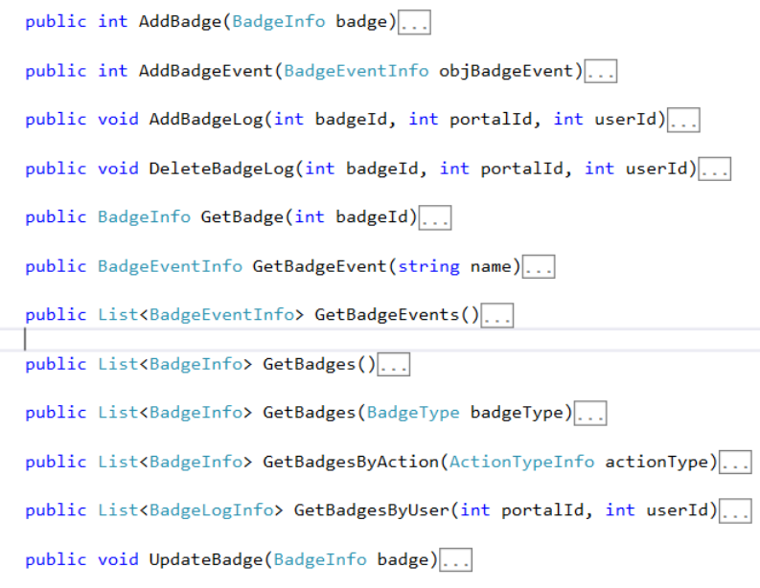
Badge API

Slide 23
Badge Demo
Create “action” Badge for X amount of actions
Create “event” based badge for X amount of experience (money spent) earnt

Slide 24
Gamification API 1.0 Summary
Available at www.ventrian.com/modules/gamification
Includes core API:
ActionController, BadgeController, LevelController, PrivilegeController
Includes administration modules:
Activity Graph, Actions, Badges, Levels, Privileges.
Documentation
Coming soon!

Slide 25
Coming in API 1.1 :: Leaderboard & Leader Position Module

Slide 26
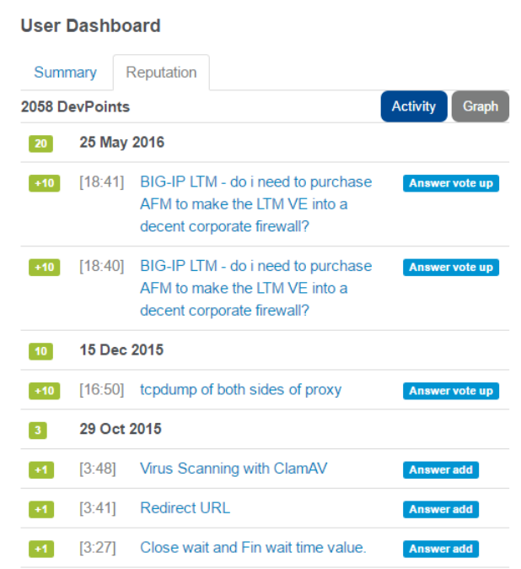
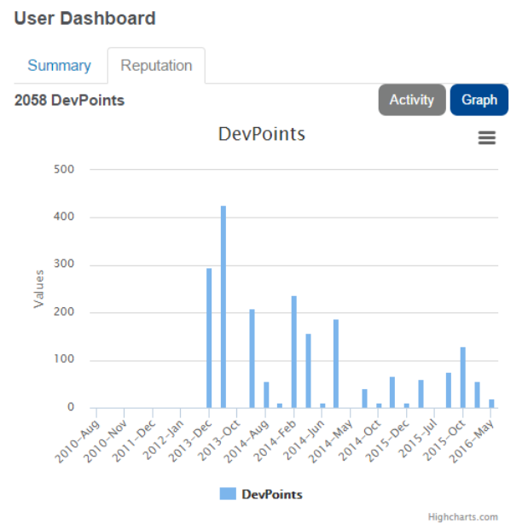
Coming in API 1.1 :: Action Log

Slide 27
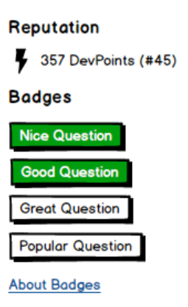
Coming in API 1.1 :: User Profile
Razor Based module for accessing Reputation, Experience, Levels, Position & Badges.
Perfect for dropping on user profile (?userid=XX) pages.

Slide 28
F5 DevCentral (https://devcentral.f5.com)
Technical community for F5 Network’s products & solutions
https://devcentral.f5.com
Q&A, Codeshare, Snippets, Articles, User Profile – all Gamified
https://devcentral.f5.com/questions
250,000+ person leader board
https://devcentral.f5.com/users
MVP Program
https://devcentral.f5.com/mvp
Since October 2013
200,000+ actions
550,000+ reputation points

Slide 29
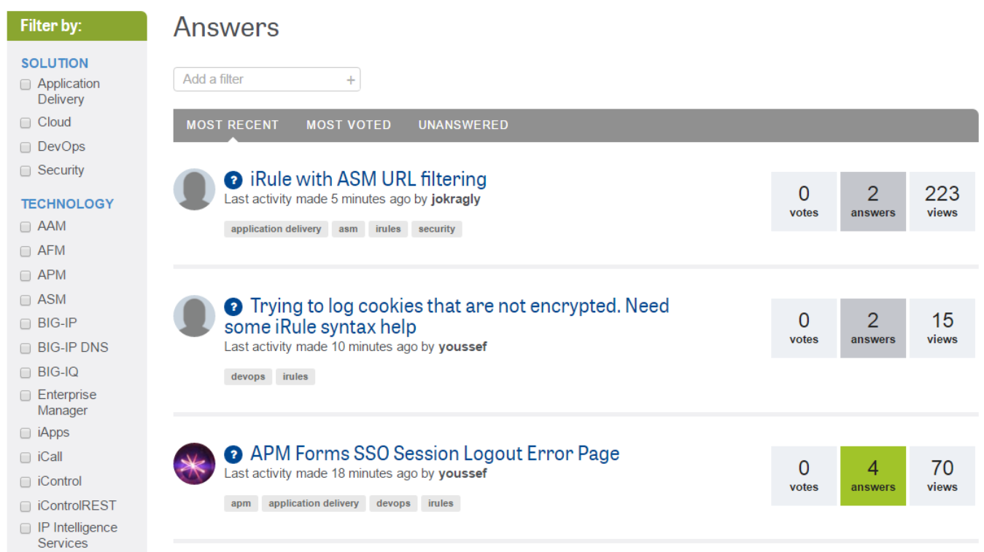
DevCentral Q&A

Slide 30
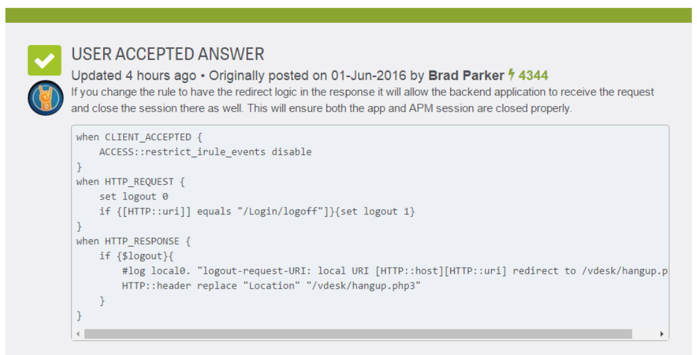
DevCentral Q&A – Accepted Answers

Slide 31
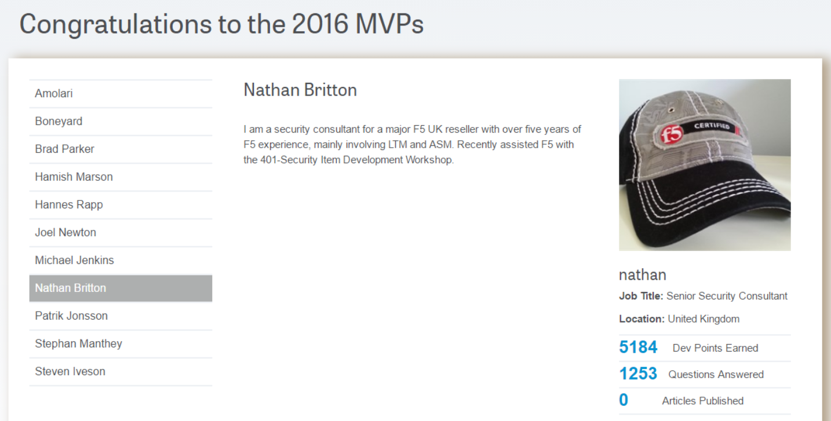
DevCentral MVP

Slide 32
DevCentral Learnings
Leaderboard user positions for a 250k+ community cannot be done on the fly – scheduled job
Reputation allowed us to solve a SPAM problem
1 post per hour until X reputation reached (privilege API)
Exclude profile from search engines until in the top %
Skip Akismet checking until X reputation reached (privilege API)
People “gaming” the system
Splitting articles into 5 to generate more activity – reward less for initial contribution and more for upvote signals
Incentives & recognition are the key
MVP & public recognition (leaderboards, newsletter)

Slide 33
Summary
Why you should use gamification?
Core concepts: Actions, Privileges, Levels, Badges
Implementation on DNN 8.0
Module is freely available – let’s collaborate!

Slide 34
Thank you

