Slide 1
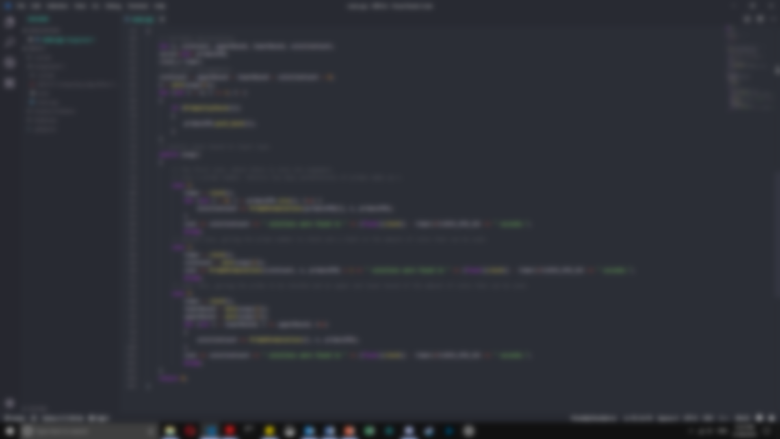
2801ICT – Assignment 1
Prime Partitions of A Given Integer.

Slide 2
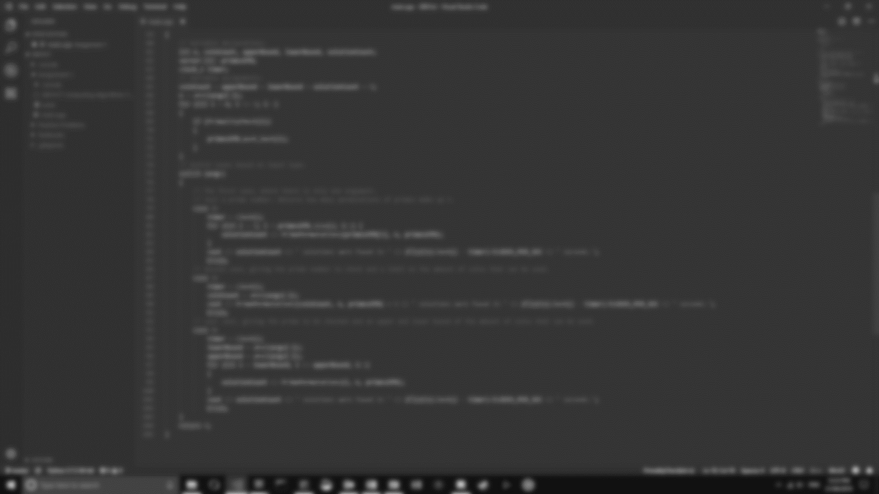
Contents
Overview
Algorithm Description
Function: Primality Checker
Algorithm: Prime Partitions
Pruning
Pseudocode
Results & Algorithmic Analysis
Algorithmic Time Complexities
Primality Checker
Prime Partitions
Results

Slide 3
Overview
Implementing an algorithm to solve the problem of finding the number of ways a dollar amount can be paid in coins.
A limit can also be given on the amount of prime coins (including 1) that can be used to calculate the integer, either with an upper limit or both an upper and lower limit.
For example, the amount of prime coins 5 has is six:
5 | 2 + 3 | 1 + 2 + 2
1 + 1 + 3 | 1 + 1 + 1 + 2 | 1 + 1 + 1 + 1 + 1

Slide 4
Overview
Note that 2 + 3 and 3 + 2 are the same sum. If given a lower limit of 2 and an upper limit of 5, 8 has ten partitions:
1 + 7 | 5 + 3
3 + 3 + 2 | 5 + 2 + 1
2 + 2 + 2 + 2 | 5 + 1 + 1 + 1
3 + 2 + 2 + 1 | 3 + 3 + 1 + 1
1 + 1 + 2 + 2 + 2 | 1 + 1 + 1 + 2 + 3

Slide 5
Algorithm Description
Two algorithms are used; the first calculates all primes up to (and possibly including) a given integer.
The second is the focus of this report and it calculates all solutions to the given problem.
A third function is the driving part of the entire program.

Slide 6
Function: Primality Checker
A rudimentary execution of an iterative method for calculating prime numbers, a brute force approach was employed.
Given an integer n, this function will check for any number x less than n and greater than 1 if the modulus of n and x is 0.
If the result is 0 then the function returns false but if no statements evaluate to 0 it will return true.
Hence, if there is no such number less than n (that is not 1) that n can be evenly divided by, then n is a prime.
PrimalityCheck(n): // Input: n // Output: True if the integer is prime, false if it isn’t. for i ← n – 1 down to i > 1 do: if n % i = 0: return false end if end for return true

Slide 7
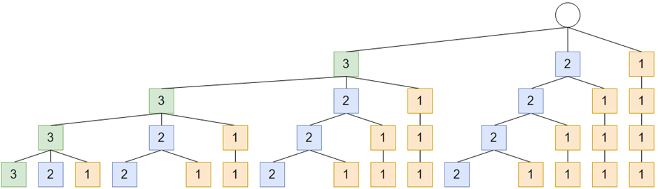
Algorithm: Prime Partitions
This algorithm performs the search for solutions to the problem using a branch and bound programming paradigm.
It uses three variables; one to keep track of the amount of coins that can be used (limited by the input), the current sum of primes, and a list of primes for each branch of the search tree.
Each node of the tree is a prime, n, and its children are all of the primes of n greater than or equal to n (Figure 1).

Slide 8
Algorithm: Prime Partitions
Every node at each level has it’s prime subtracted from the current sum, the number of usable coins decremented, and is then passed into a recursive call.
There are various cases in which the recursion will stop:
Cases which return a solution:
If the algorithm has used up the total amount of coins given to it initially and the sum has reached 0. This means that the algorithm has found a list of integers whose sum is equal to n and it has done so within the limit of coins provided.
It could go the other way and if both the sum and coins allotted are equal, a solution has been found.

Slide 9
Algorithm: Prime Partitions
Cases which return a failure:
Any number of combinations of the sum and allowed coins that weren’t mentioned above will return a failure.
This is because the sum and number of coins must align. I.e., if we have more coins left to create a sum, but the sum has reached 0 or n, then it has not satisfied the requirement that is must use m coins to sum up to n.
The same can be said for the reverse; if limit of coins has been exhausted but there are more numbers that need to be added to the sum, that is another failure.

Slide 10
Pruning
Already the tree that is used to search for solutions has one form of pruning applied to it; each node’s children will only contain primes less than or equal to itself.
In this way the algorithm will never move backwards but can add numbers to a sum more than once.
Pruning based on digit limit allows the algorithm to ignore primes if the potential sum will exceed or fall under the limit of coins provided by a lower and upper bound.

Slide 11
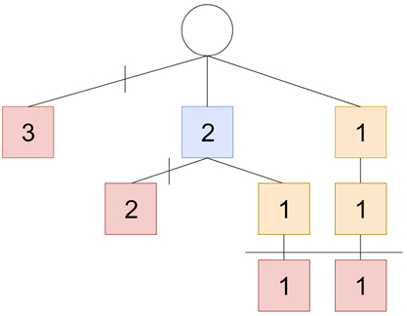
Pruning
For instance, if the algorithm needs to find a sum for n = 3 with only two coins then it can only have the sum:
2 + 1
Hence the search space can be drastically limited (Figure 2) as there are no other branches that can both use two coins in the sum and sum up to 3.

Slide 12
Pruning
Conversely, the same logic can be applied to the sum of primes being searched.
When a sum solution has been found, but the number of coins used does not meet the requirements then no more solutions will be found in the current branch.
Once all branches have been searched, the resulting number of solutions is returned.

Slide 13
Algorithm: Prime Partitions Pseudocode
PrimePartitions(coins, sum, primes) // Input: coins → an integer representing the limit of coins that can be used in a sum. // sum → an integer to keep track of the sum of the primes in the current branch. // primes → a list to keep track of the current primes being used to calculate solutions. // Output: The amount of solutions that were found in the search space. if coins = 0 and sum = 0 or coins = sum: return 1 end if if sum ≤ 0 and coins ≠ 0 or coins = 0 and sum = 0: return 0 end if solutions ← 0 for i ← 0 to primes.length do: newPrimes ← primes[i…primes.length] coins ←coins – 1 sum ←sum – primes[i] solutions ←solutions + PrimePartitions(coins, sum, newPrimes) end for return solution

Slide 14
Results & Algorithm Analysis
Predictions, analysis, and results for this solution will be detailed in this section of the report.
Space complexity of the main algorithm and prime calculation function are not considered, however their time complexity in both the worst and best cases will be analysed.
Once calculated these results will be used to make assumptions on the way the algorithm will behave based on different input sizes.
Then those assumptions will be compared with the actual results.

Slide 15
Algorithmic Time complexities

Slide 16

Primality Checker
To properly assess the time efficiency of this function, input will be measure as the magnitude of the given integer n. The basic operation of the function is:
$$if n \% i=0$$
Representing this statement with x gives a summation of:
$$\sum_{i=n−1}^{2}{(x)}$$

Slide 17

Primality Checker
Therefore, the best-case scenario is if n = 1, in which the function will simply return true. Hence:
$$T{\left(n\right)}_{best}= Ω\left(1\right)$$
However, for magnitudes of n that are larger than 1 the basic operation will be executed n amount of times. In this case, the functions time complexity can be given by:
$$T{\left(n\right)}_{worst}= O(n)$$

Slide 18

Prime partitions
The time complexity of this algorithm relies on the number of coins that are allowed for a solution and the size of the list of primes being passed to it with each call.
But the recursive call is dependant of the size, n, of the prime list, so that is used to assess the overall time efficiency.
For each call of the function, several comparisons are made to check the base cases. These take 1 unit of time to complete.
When the function recurs, it does so n times and each time with one less list element each time.
Therefore, the following recurrence relation can be used:
$$T\left(n\right)=\left\{\begin{aligned}1 n=0 \\ nT\left(n−1\right)+1 n>0\end{aligned}\right.$$

Slide 19

Prime partitions
Solving the previous relation gives:
$$T\left(n\right)=n^{k}T\left(n−k\right)+n^{k−1}+n^{k−2}⋯+1$$
$$n−k=0$$
$$∴n=k$$
$$∴T\left(n\right)= n^{n}+n^{n−1}+n^{n−2}+…+1$$
This gives a summation of:
$$T\left(n\right)=\sum_{k=0}^{n}{n^{k}}=O(n^{n})$$

Slide 20
Results
Input | Output | CPU Time (seconds)
5 | 6 | 0
6 2 5 | 7 | 0
6 1 6 | 9 | 0
8 3 | 2 | 0
8 2 5 | 10 | 0
20 10 15 | 57 | 0
100 5 10 | 14839 | 0.109
100 8 25 | 278083 | 5.125
300 12 | 4307252 | 43.36
300 10 15 | 32100326 | 451.449

