Slide 1
Classifying Traffic Signs with Convolutional Neural Networks
COMP 4449: Capstone | Summer 2023
Sammantha Firestone
Notes:
Hello my name is Sammy Firestone and I will be presenting how I classified traffic signs with Convolutional Neural Networks (CNNs)

Slide 2
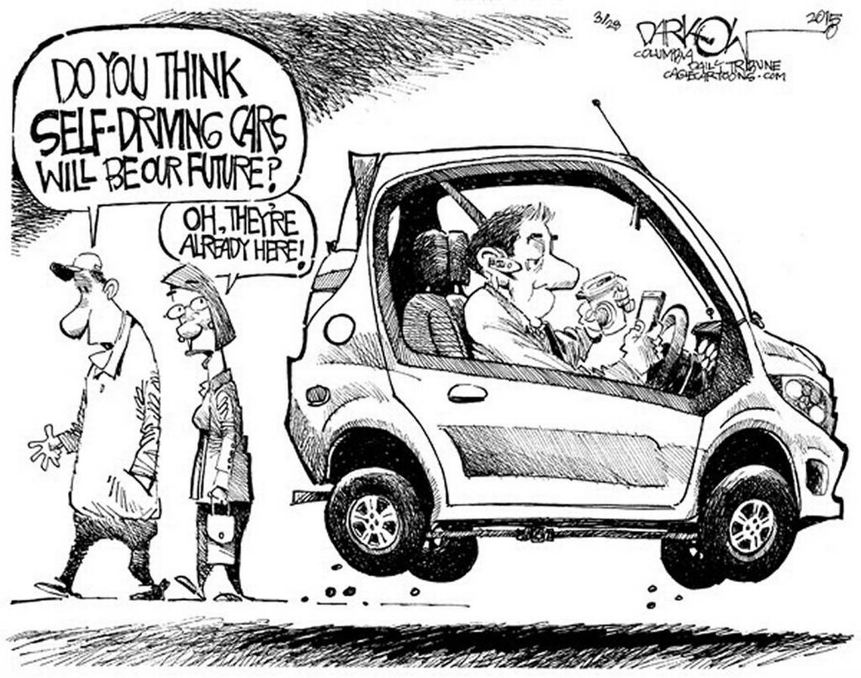
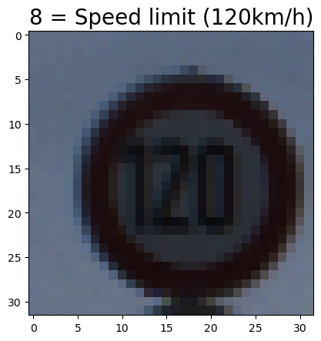
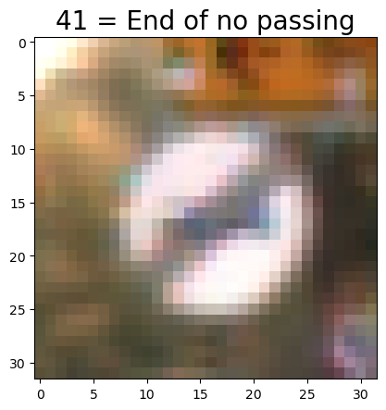
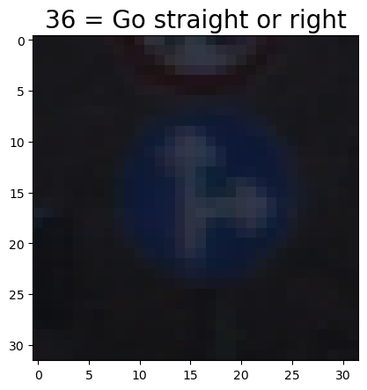
Significance
Overall Goal
It’s critical for autonomous vehicles to correctly detect and classify the world around them.
Develop an CNN model capable of accurately classifying traffic signs in real life images.
Notes:
Autonomous vehicles are revolutionizing the transportation industry. These vehicles leverage advance technology to navigate the roads, and it is critical that they can detect and classify the world around them safely!
My overall goal with this project is to develop an CNN model capable of accurately classifying traffic signs in real life images, as well as, explore the impact of various hyperparameters on the model’s performance.

Slide 3
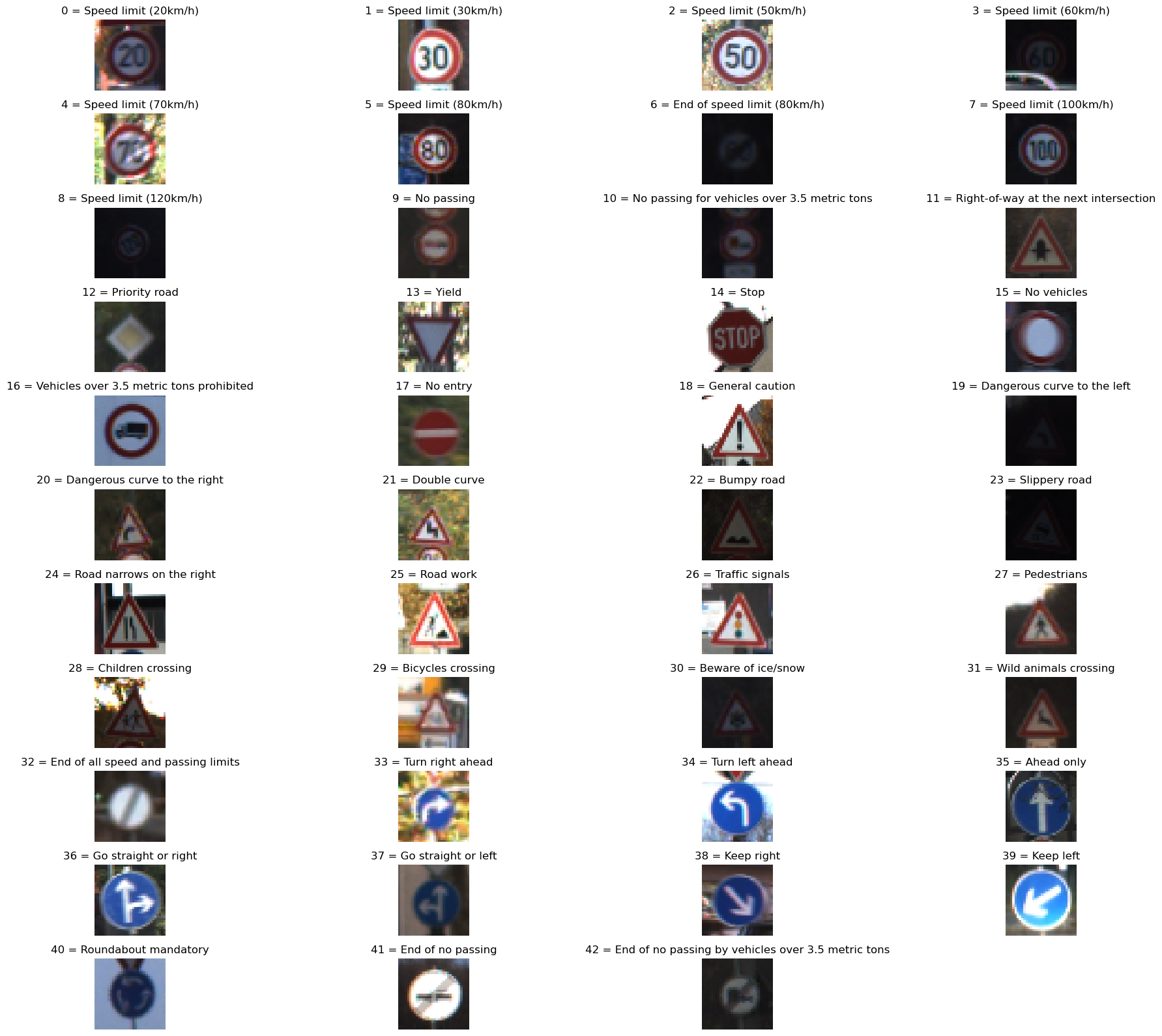
Data Exploration
Data Summary
Traffic Sign Images
TRAIN: 12,630 | VALID: 34,799 | TEST: 4,410
Features: 4D Array (image index, width, height, RGB)
Shape: (# of images, 32, 32, 3)
Each image is 32 x 32 pixels
Labels: 1D Array (image label ID)
Sign Names
43 SIGN NAMES
Key-Value Pair: {image label ID: sign name}
Notes:
For this project, there are 43 different signs to be classified.
The traffic sign images were already split into a training, validation and testing datasets.
The features of the traffic sign images were in a 4d array – the image index, image width, image height, and the RGB (red, green, blue) pixel values
Each image in these data sets are 32 x 32 pixels.
And each image has a label ID that corresponds to a sign name that is mapped in the the sign names data set.
Here you can see sample images for each different types of traffic signs.

Slide 4
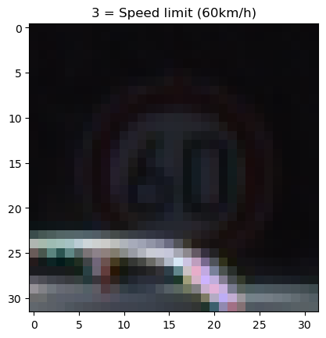
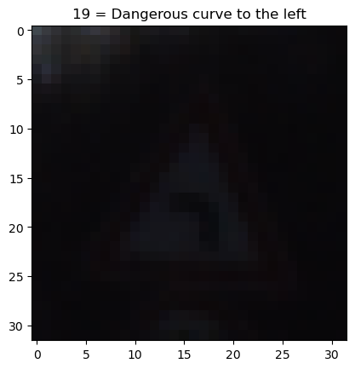
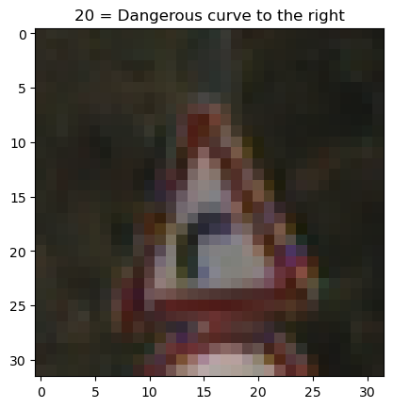
Data Exploration
Understanding the Images
Real-life images are messy!
Obstructed by other objects
Dark and noisy
Not the same size and orientation
Notes:
First thing I wanted to note, is that all images in these dataset are from real-life images– which means they are no are not perfect
Some images like this one is obstructed by a car
This image is extremely dark and noisy
And this image appears slightly rotated.

Slide 5
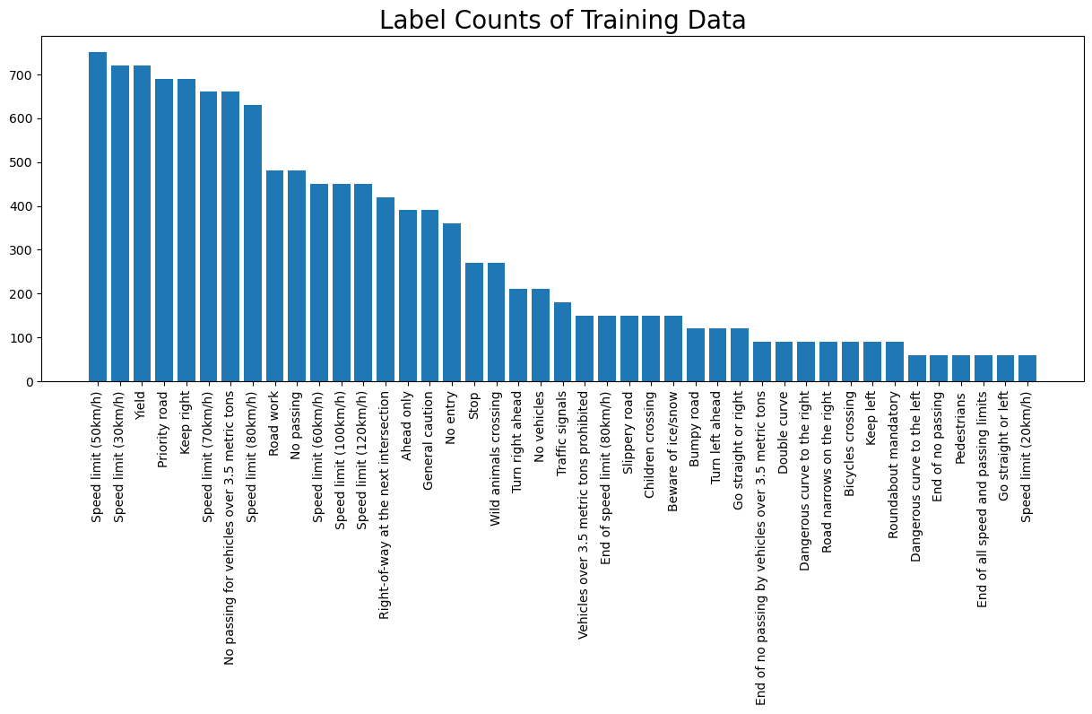
Data Exploration
Data Distribution
Number of images per class varies greatly
- - - - - - - - - - - - - - - - - -
True of all three datasets
Notes:
Next thing I did was look at the distribution of images for each label.
As you can see the number of images per label greatly varies and this was true for all three datasets

Slide 6
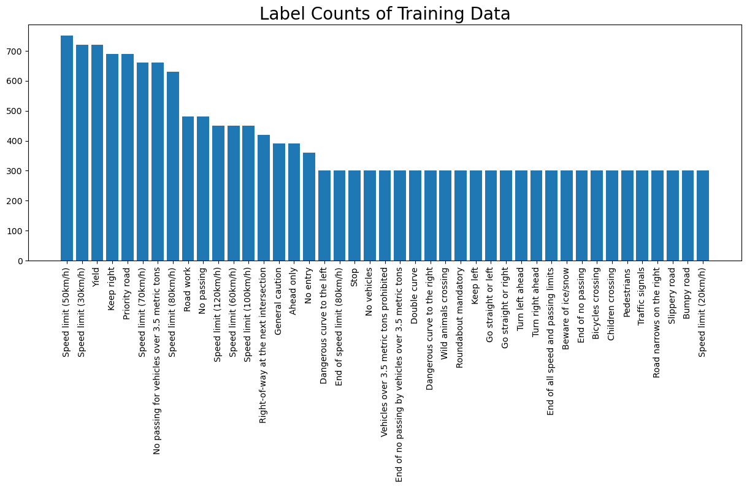
Data Preprocessing
Random Oversampling
Randomly duplicate images from minority classes
(minimum = 300)
Before oversampling:
(12630, 32, 32, 3) (28890,)
After oversampling:
(17190, 32, 32, 3) (28890,)
Notes:
To help those minority classes, I performed random oversampling – I randomly duplicated images from any label that had less than 300 images– thus I added about 5,000 images

Slide 7
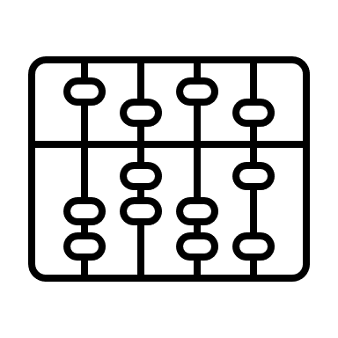

Data Preprocessing
Normalize & Shuffle Images
Normalize
Shuffle
Convert RGB Values
0, 255 → 0, 1
Randomize the Order of Images
indices = np.arange(len(images))
np.random.shuffle(indices)
return images[indices], labels[indices]
return np.divide(images, 255.0)
RGB Value before normalizing: [52 40 38]
RGB Value after normalizing: [0.204 0.157 0.149]
Labels Before shuffling: [ 16 1 38 33 11 …]
After shuffling: [ 2 10 11 4 12 …]
Notes:
Next I normalized my training, validation and testing datasets to prepare for my model.
Then I shuffled all of my training images to break any artificially imposed ordering in the data, thus hopefully reduce overfitting. Back to that later ☺

Slide 8
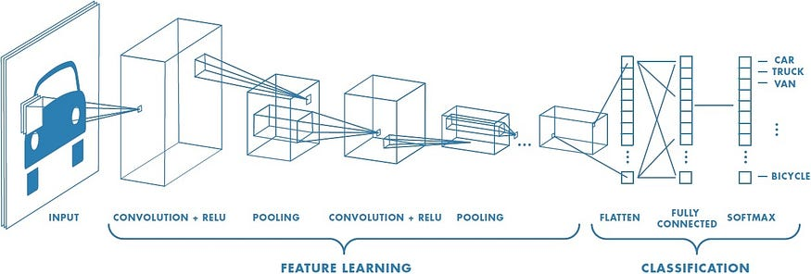
Model Training
Convolutional Neural Network (CNN) Overview
TRAINED WITH TWO MODELS:
Basic CNN
LeNet5-Based CNN
https://medium.com/@RaghavPrabhu/understanding-of-convolutional-neural-network-cnn-deep-learning-99760835f148
Notes:
I actually trained two CNN models.
One is a basic architecture CNN, and the other is a LeNet5 based CNN
I won’t go into all the details about CNNs at this moment, but at an high level they:
Utilize convolutional layers with small kernels to extract features from the input image– capturing patterns, and spatial relationships
Pooling layers then reduce the spatial dimensions of those features, only keeping whats important–
Eventually the output from this is flattened into a column of nodes, and then put threw a good-ole neural network
One type of CNN is LeNet-5, created by Yann LeCun in the 1990s, for digit recognition. It differs from other CNNs at the time by introducing concepts like convolutional and averaging pooling layers.
The general process of CNNs is that it takes an image, applies a filter across the entire image to create a feature map, which is run threw an activation functions. Then another filter is applied to that new post-activation feature map, but this time not all the values in that kernel are mapped, but instead the Max or Average value in that region of the image is mapped– this is the pooling layer. This is repeated for however many times we wish, and then the data is flattened into a column of input nodes that can then be plugged into your run-of-the-mill neural network.

Slide 9
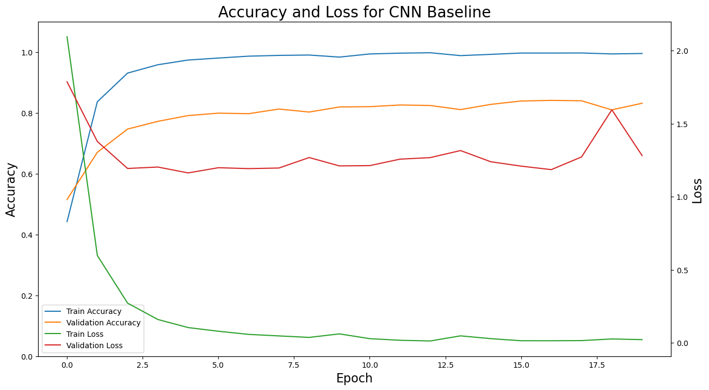
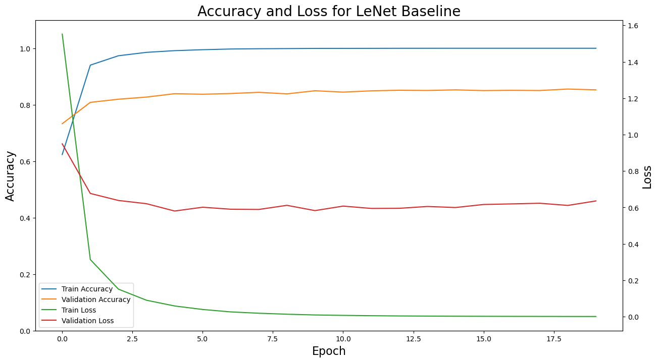
Model Training
Training & Validation Performance
Train Categorical Accuracy | Valid Categorical Accuracy | Train Loss | Valid Loss | Execution Time (minutes)
99.01% | 84.41% | 0.0364 | 1.0879 | 2.19
Train Categorical Accuracy | Valid Categorical Accuracy | Train Loss | Valid Loss | Execution Time (minutes)
100% | 84.72% | 0.0011 | 0.6386 | 2.59
Both models are overfit!
Notes:
When I trained both models, it was apparent that both of them were overfit
Both models had ~100% accuracy on the training data but ~85% accuracy on the validation data.
The validation loss curve for both models is significantly larger than the training loss.
Accuracy is the fraction of predictions that are correct. Categorical accuracy is the fraction of predictions that are correct for each class.
Multi-Class Cross-Entropy Loss

Slide 10
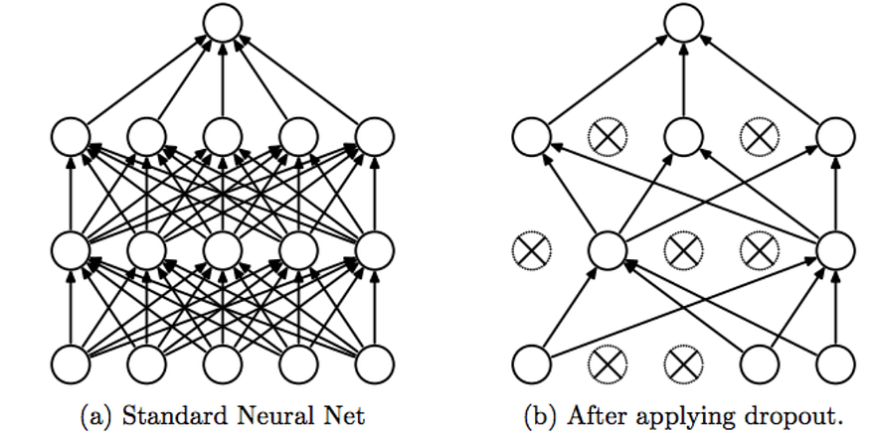
Model Training
Adding Regularization and Dropout
To reduce overfitting and improve performance on the validation data–
Regularization
Add penalty to the loss function
L2 of 0.001
Dropout Layers
Randomly drop neurons during training
40% neurons dropped
Srivastava, Nitish, et al. ”Dropout: a simple way to prevent neural networks from overfitting”, JMLR 2014
Notes:
To combat for overfitting and improve my overall model performance of the validation data, I implement ridge regularization to the loss function in my NNs I used an ridge penalty of 0.001
I also added some dropout layers that essentially will “Dropout” a specific percentage of neurons during training. This just helps the network prevent over reliance of specific neurons– it promotes a more diverse learning environment.

Slide 11
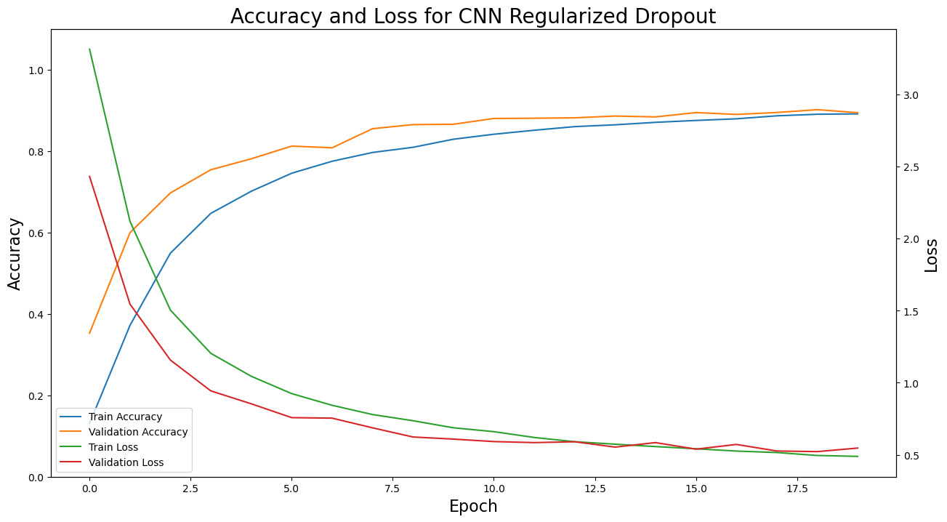
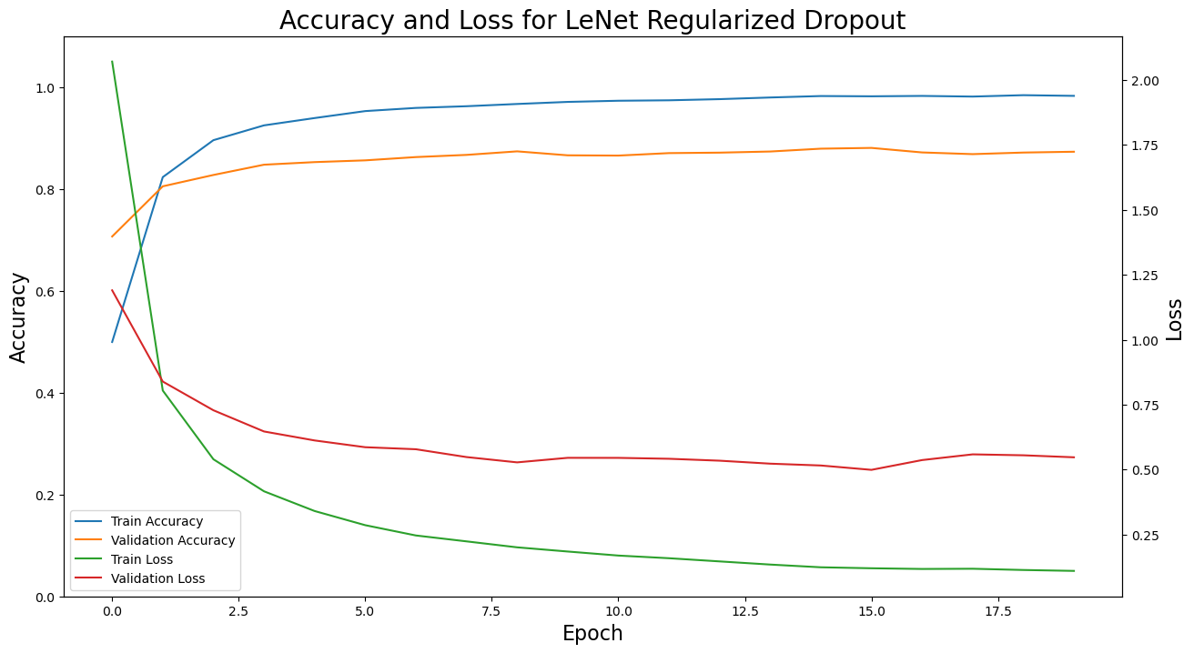
Model Training
Regularized & Dropout Training Performance
4.71% accuracy increase for validation!
2.98% accuracy increase for validation!
Train Categorical Accuracy | Valid Categorical Accuracy | Train Loss | Valid Loss | Execution Time (minutes)
88.55% | 88.12% | 0.5017 | 0.6198 | 2.31
Train Categorical Accuracy | Valid Categorical Accuracy | Train Loss | Valid Loss | Execution Time (minutes)
98.59% | 87.70% | 0.1037 | 0.5243 | 2.28
Notes:
Once I added those in, both models’ performance improved.
By the 12th epoch in my Basic CNN, the accuracy for the training and validation data was approximately the same, and the loss function doesn’t look too shabby either.
My LeNet5 model still appears slight overfit but the model did see some improvement.
Accuracy is the fraction of predictions that are correct. Categorical accuracy is the fraction of predictions that are correct for each class.
Multi-Class Cross-Entropy Loss

Slide 12
Model Evaluation
Model Performance on the Test Set
 | Basic CNN w/ Regularized Dropout | LeNet5 CNN w/ Regularized and Dropout
Test Categorical Accuracy | 90.07% | 88.78%
Test Loss | 0.4851 | 0.5044
^ WINNER! ^
Notes:
Then I ran both models on the test data and got decent results.
The Basic CNN did slightly better with an accuracy of 90%– which makes sense as the LetNet5 model was still slightly overfit.
With all that in mind, I dubbed my basic CNN model w/ regularization & drop out the winner.
And if you’re curious of how this Basic CNN model makes its predictions..
However, I was really curious of why my CNN model predicted images correctly and misclassified others, so I did some digging…

Slide 13
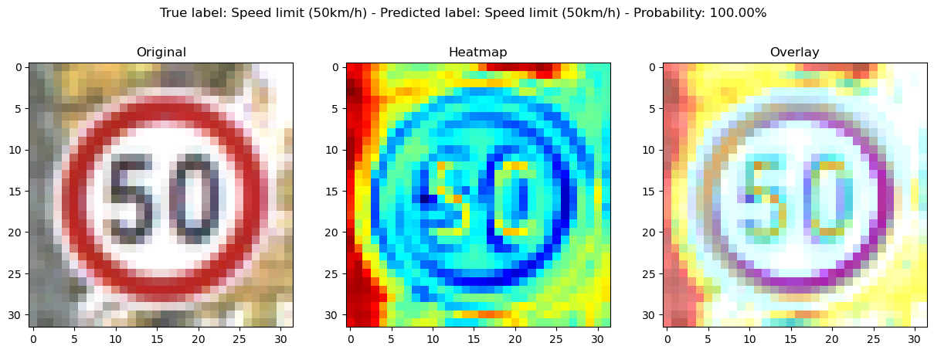
Activation Heatmap – Conv – Layer 1
Correctly Classified for Basic CNN Model w/ Regularized & Dropout
Notes:
I made some activation heatmaps of my first convulation layers and this just shows the most important regions to input image that contributes that most to its prediction.
Here’s an image that was correctly classified for my CNN model– You can see the lines and edges around the sign, as well the 50.
Gradient Weighted Class Activation Mapping (Grad-CAM)

Slide 14
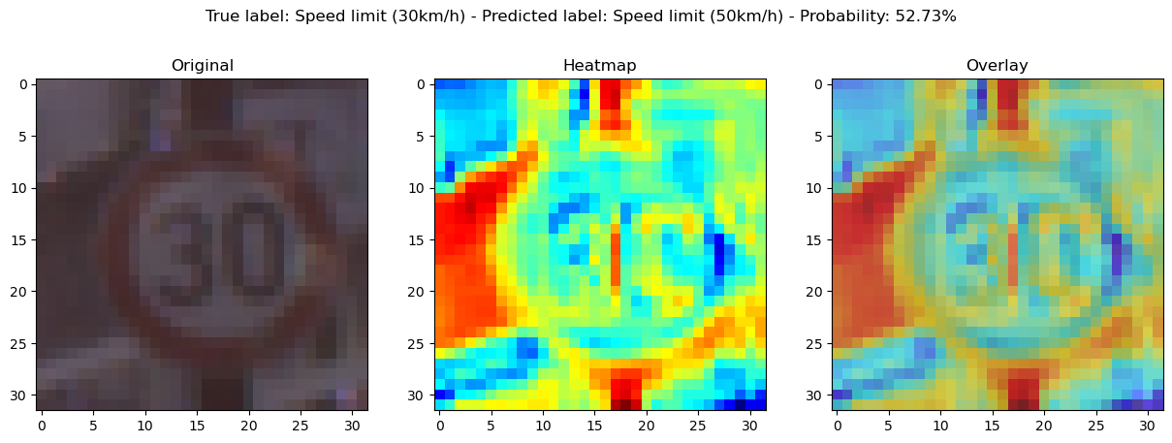
Activation Heatmap – Conv – Layer 1
Misclassification for Basic CNN Model w/ Regularized & Dropout
Notes:
And here’s a sign that is misclassified– It roughly detect the sign edges, but didn’t do as well detecting the lines for the 30 like it did for the 50
Gradient Weighted Class Activation Mapping (Grad-CAM)

Slide 15
Conclusion
CNNs were able to correctly classify real-life traffic signs with ~90% categorical accuracy
Future steps can include:
Removing a percentage of distorted images from the training data
Add random noise to the random oversampled images
Further tuning to each model!
Notes:
Overall, I was able to create a CNN model that could correctly classify real-life traffic signs with ~89% accuracy.
In the future, I’d like to see how the models behave if you remove a percentage of distorted images from the training data, how it would behave if add random noise to the random oversampled images (i.e change the orientation of image, add some blur, etc.), and of course further tune each model!

Slide 16
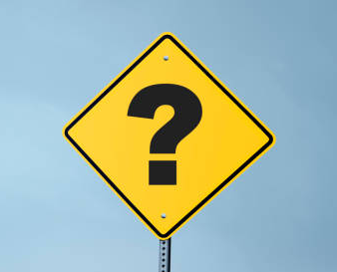
THANK YOU
Questions?

Slide 17
BACKUP SLIDES
FUN CNN VISUALIZATION LINK!

Slide 18
Model Training
Baseline CNN Architecture Overview
 | Basic CNN: `cnn_baseline` | LeNet-5 Based CNN: `lenet_baseline`
Layer 1 | Conv2D (32 filters, kernel size 3x3, stride 1x1, 'valid' padding, ReLU activation) | Conv2D (6 filters, kernel size 5x5, stride 1x1, 'same' padding, tanh activation)
Layer 2 | MaxPooling2D (pool size 2x2) | AveragePooling2D (pool size 2x2)
Layer 3 | Conv2D (32 filters, kernel size 3x3, 'valid' padding, ReLU activation) | Conv2D (16 filters, kernel size 5x5, 'valid' padding, tanh activation)
Layer 4 | MaxPooling2D (pool size 2x2) | AveragePooling2D (pool size 2x2)
Layer 5 | Flatten | Conv2D (120 filters, kernel size 5x5, 'valid' padding, tanh activation)
Layer 6 | Dense (64 units, ReLU activation) | Flatten
Layer 7 | Dense (43 units, softmax activation) | Dense (84 units, tanh activation)
Layer 8 |  | Dense (43 units, softmax activation)
Different number of convolutional layers
Different number of filters
Different kernel sizes
Different activation functions
Different pooling
Notes:
When I first started, I had no idea what a CNN was… so…
The first model I trained is this basic cnn, and the second is a LeNet5 based CNN.
They differ in the number of convolutional layers, you can see the basic one only has two, and the LeNet has 3.
They use a different number of filters and different kernel sizes.
As different activation functions, I used the typical ReLu activation function for my Basic CNN, while LeNet5 uses an hyperbolic tangent function
As show on the previous slide, LeNet5 uses AveragePooling layers, while my basic CNN model uses MaxPooling()

Slide 19
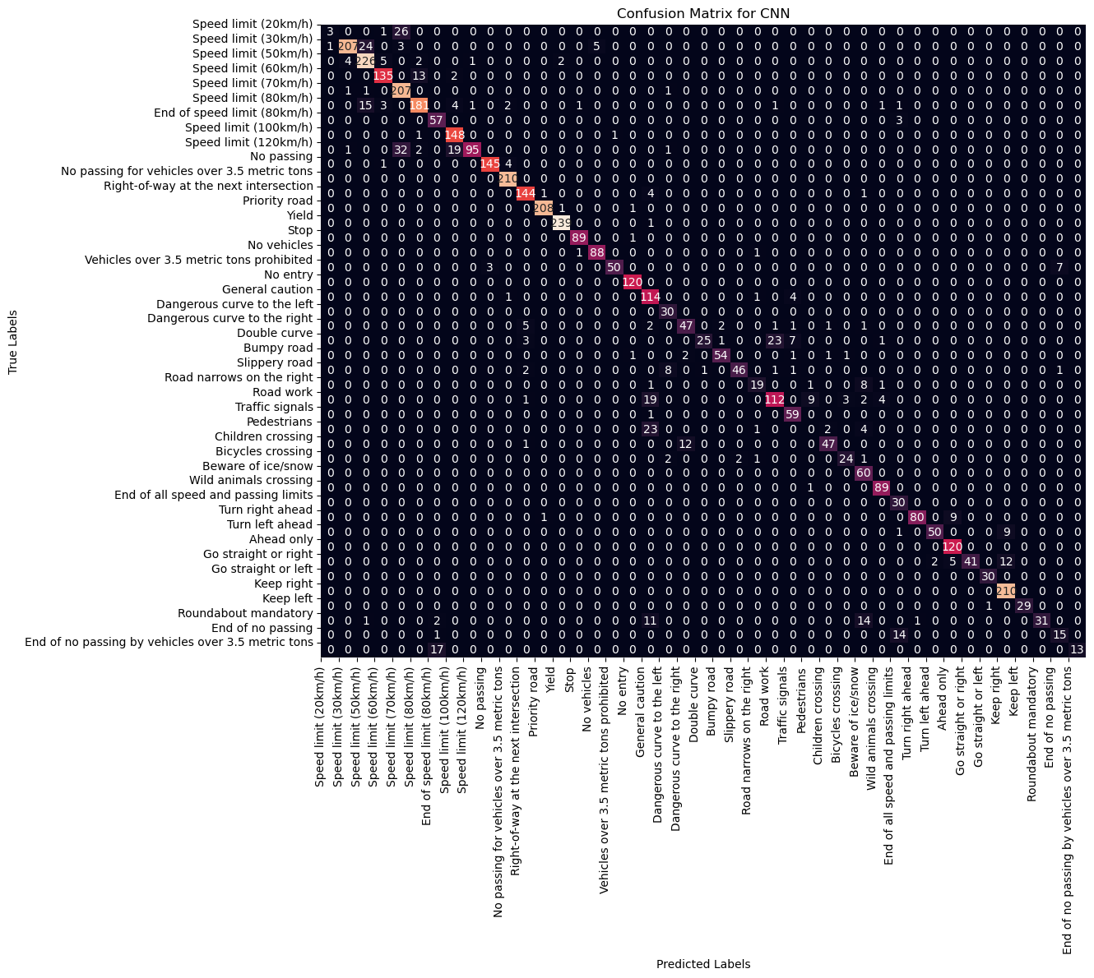
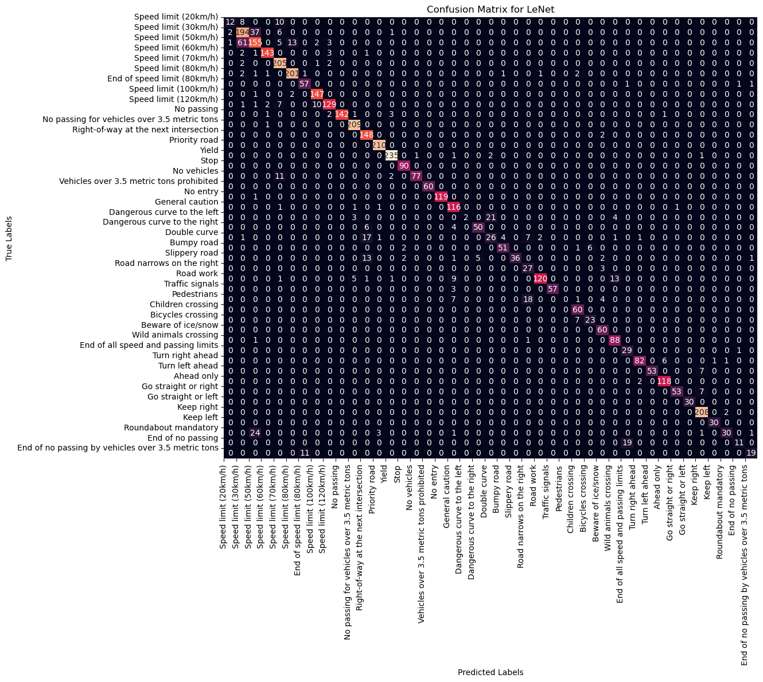
Model Evaluation
Confusion Matrix – Models w/ Regularized & Dropout

Slide 20
Model Evaluation
Gradient Weighted Class Activation Mapping (Grad-CAM)
Grad-CAM is a technique that generates a heatmap to highlight the important regions in an input image that contribute the most to prediction.
Analyzes the gradients of the predicted class
Visualizes the areas of the image that are crucial to decision-making
Applied To…
Convolutional Layer 1:
Basic features
Edges
Lines
Simple textures
Notes:
And found Gradient Weighted Class Activation Mapping (aka Grad-CAM)
This technique generates a heatmap to highlight important regions to an input image that contributes that most to its prediction.
You can implement GradCam to any convolutional layer in a CNN model, but I chose to highlight the first layer, as it highlights the basic features of the images like edges lines simple textures etc.

Slide 21
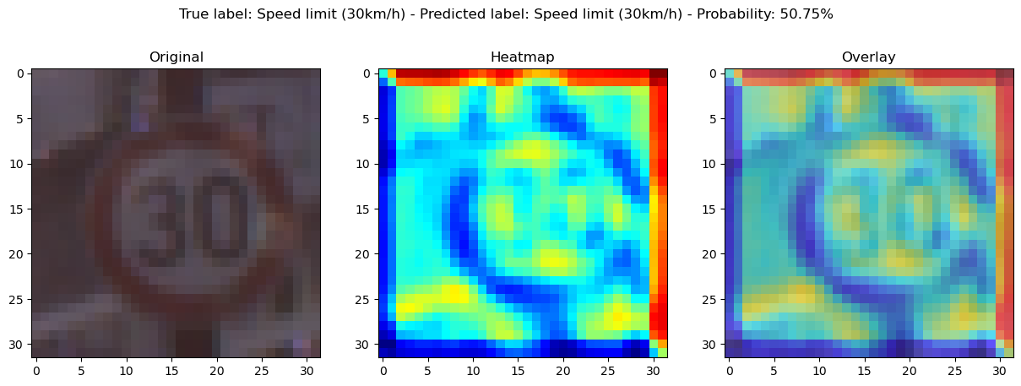
Grad-Cam – Layer 1
Correctly Classified for LeNet5 CNN Model
This sign was misclassified for the Basic CNN!

Slide 22
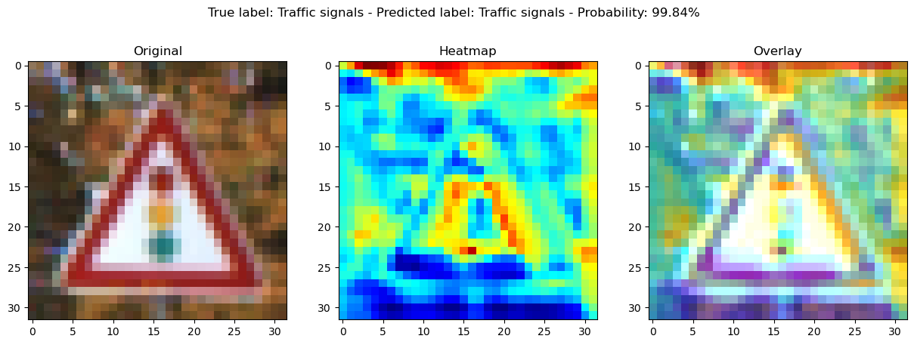
Grad-Cam – Layer 1
Correctly Classified for LeNet5 CNN Model

Slide 23
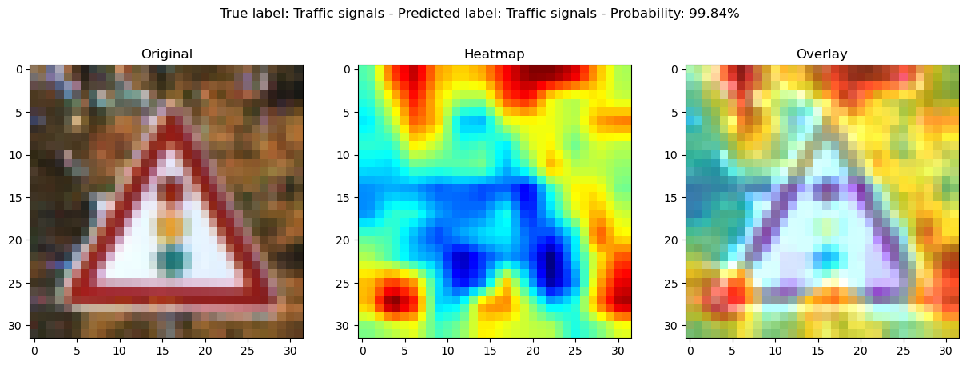
Grad-Cam – Layer 2
Correctly Classified for LeNet5 CNN Model

Slide 24
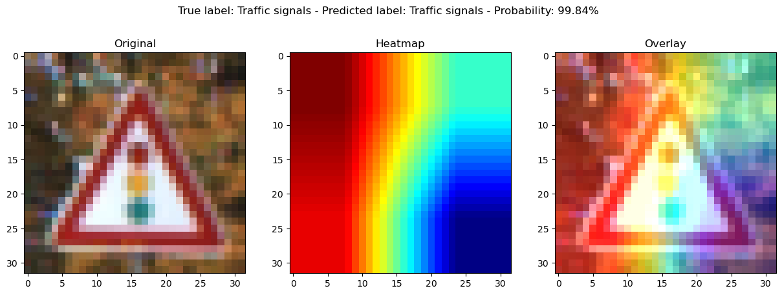
Grad-Cam – Layer 3
Correctly Classified for LeNet5 CNN Model

Slide 25
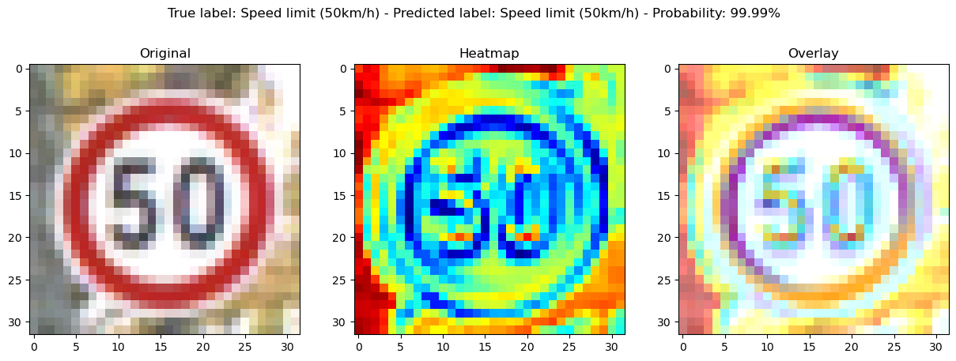
Grad-Cam – Layer 1
Correctly Classified for Basic CNN Model

Slide 26
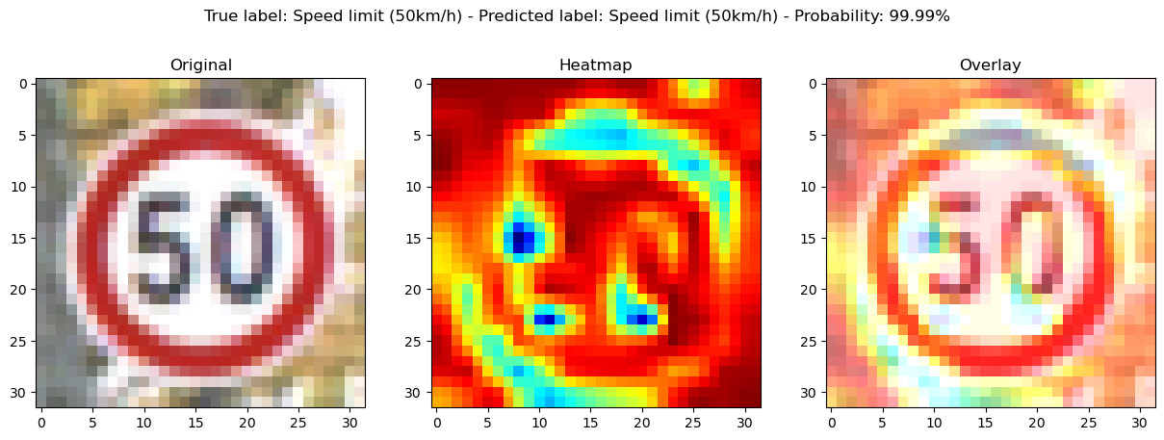
Grad-Cam – Layer 2
Correctly Classified for Basic CNN Model

