Slide 1
Beer and Brewery Analysis
By Kevin Thompson and Stuart Miller

Slide 2
Overview

Slide 3
Overview
Discussion Of Prior Beliefs

Slide 4
Overview
Discussion Of Prior Beliefs
Exploratory Analysis

Slide 5
Overview
Discussion Of Prior Beliefs
Exploratory Analysis
Updated Pre-Estimation Beliefs

Slide 6
Overview
Discussion Of Prior Beliefs
Exploratory Analysis
Updated Pre-Estimation Beliefs
Estimation of Relationship between ABV and IBU

Slide 7
Overview
Discussion Of Prior Beliefs
Exploratory Analysis
Updated Pre-Estimation Beliefs
Estimation of Relationship between ABV and IBU
Facts of Interest

Slide 8
Overview
Discussion Of Prior Beliefs
Exploratory Analysis
Updated Pre-Estimation Beliefs
Estimation of Relationship between ABV and IBU
Facts of Interest
Conclusions

Slide 9
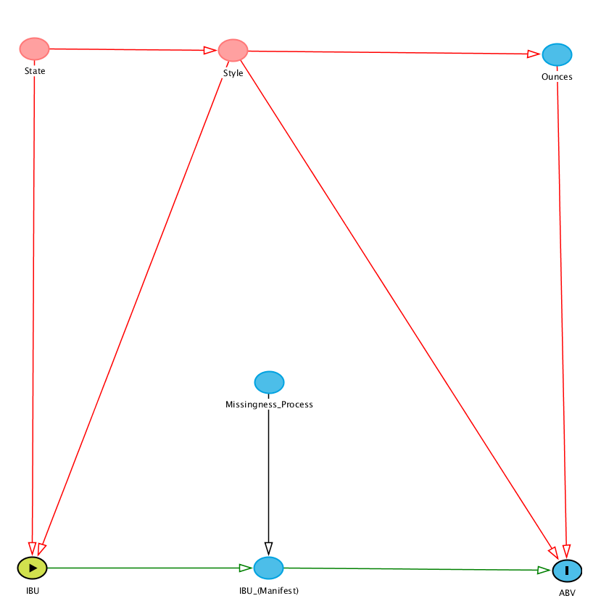
Discussion of Prior Beliefs
Some Implications:
1) Style Depends on State
2) Ounces Depends on Style
3) Missingness is MCAR
4) ABV Depends on Ounces
5) ABV Depends on Style
6) ABV Depends on IBU
7) ABV Unrelated to the Missingness of IBU

Slide 10
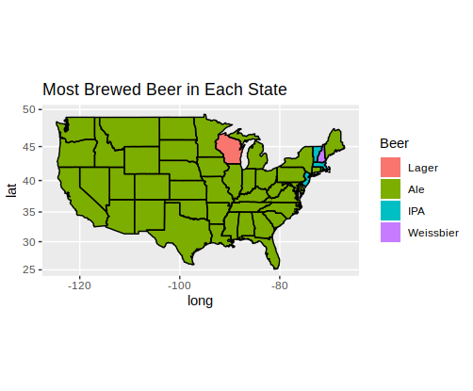
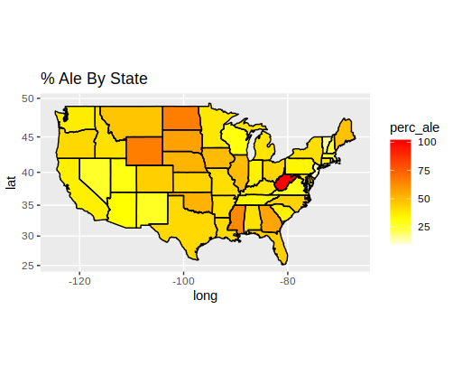
Exploratory Analysis
Style By State

Slide 11
Exploratory Analysis
Style By State
Indication of a relationship between State and Beer Style

Slide 12
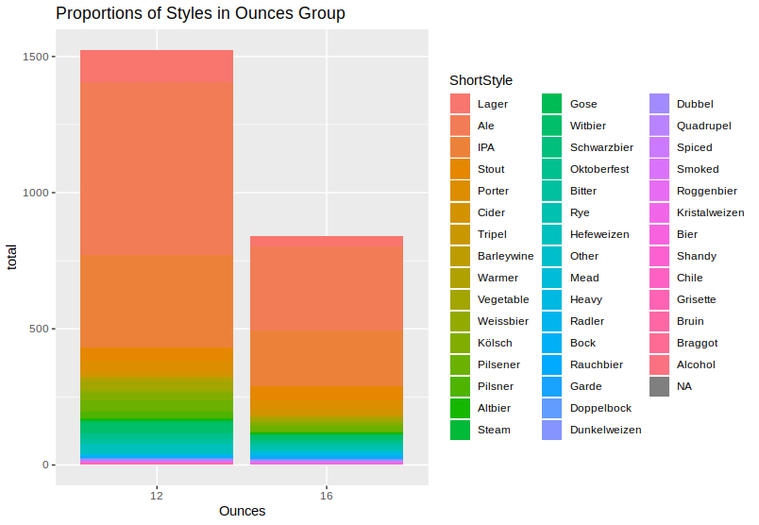
Exploratory Analysis
Ounces And Style

Slide 13
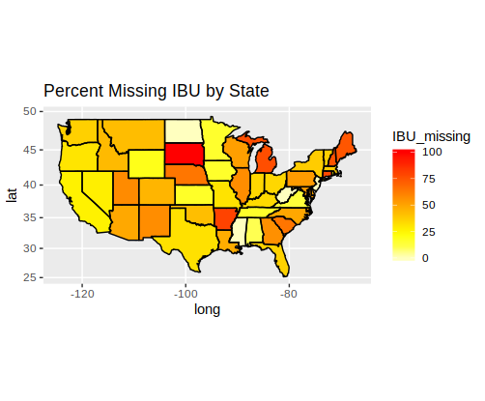
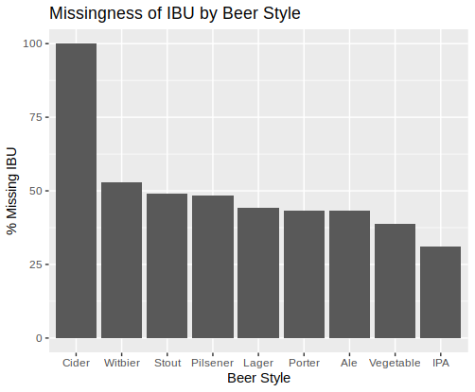
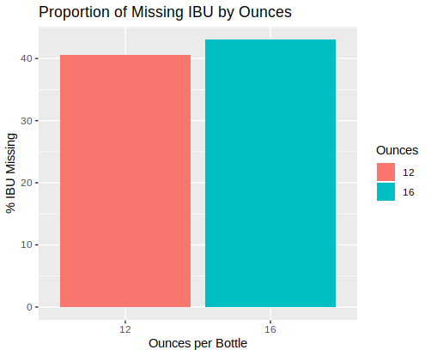
Exploratory Analysis: IBU Missingness
Missingness By State, Style, Ounces

Slide 14
Exploratory Analysis: Missingness
Missingness By State, Style, Ounces
1) Missingness isn’t completely at random

Slide 15
Exploratory Analysis: Missingness
Missingness By State, Style, Ounces
1) Missingness isn’t completely at random
2) Missingness depends largely on State and Style

Slide 16
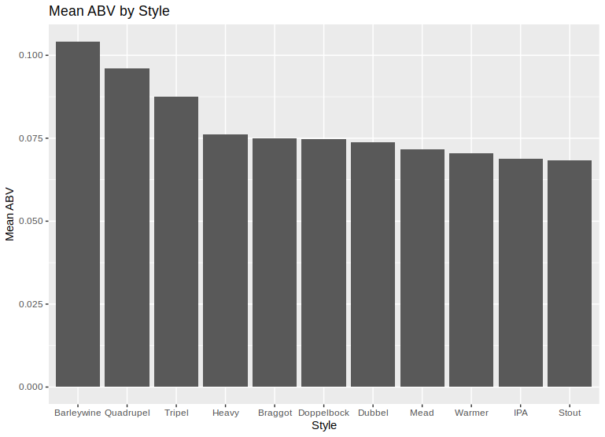
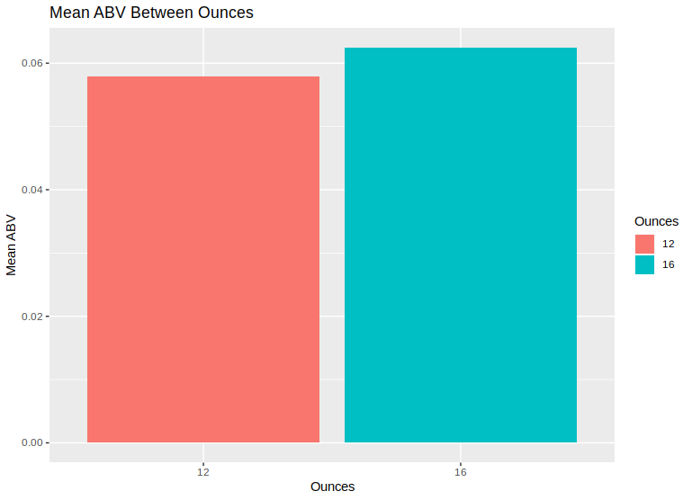
Exploratory Analysis: ABV
Ounces and Style on ABV

Slide 17
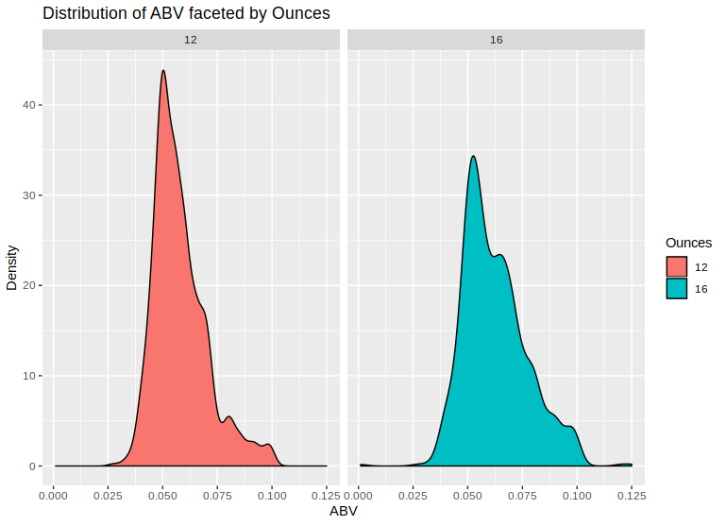
Exploratory Analysis: ABV
Is there a relationship between Ounces and ABV?
The data seems quite friendly to the t-test and the large sample size should yield sufficient statistical power.
A paired t-test yields no evidence of a significant difference between the 12 ounce and the 16 ounce group (p = 0.57) with a confidence interval [-0.06%, 0.03%].
The data is very conformable with there being no difference in mean ABV values between the two groups.

Slide 18
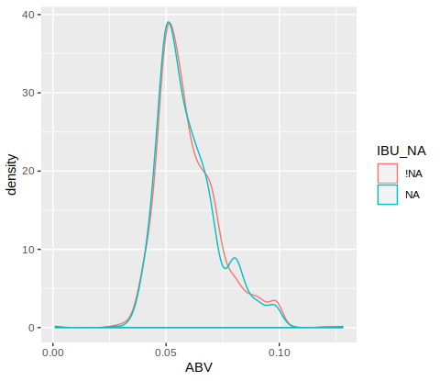
Exploratory Analysis: ABV
ABV and Missingness of IBU

Slide 19
Exploratory Analysis: ABV
ABV and Missingness of IBU
There is a very strong sign of independence between ABV and the missingness of IBU.

Slide 20
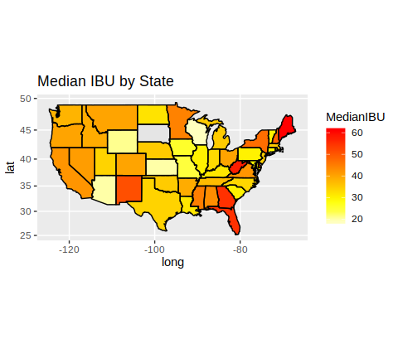
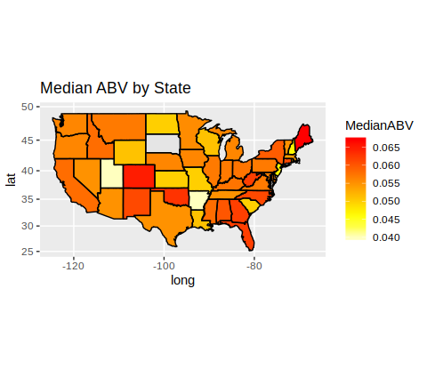
IBU and ABV by State

Slide 21
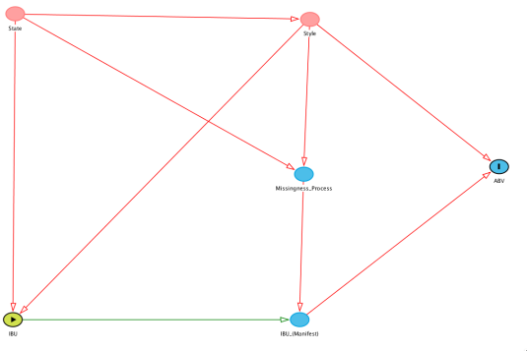
What We Have Learned

Slide 22
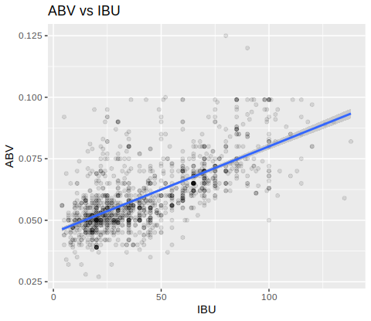
Estimation: ABV vs IBU
We impute the missing values for IBU using a linear model and then regress ABV on IBU to get the following results:
MODEL | Imputation W/ IBU | Imputation W/ IBU and Style | No Imputation
Coefficient (t-value) | .00032*** (23.37) | .00036*** (23.37) | .00035*** (33.86)
Each coefficient is very statistically significant and suggests that a one point increase in IBU is associated with a .03% absolute increase in ABV. Given the respective ranges of ABV and IBU, this is actually not insignificant.

Slide 23
Interesting Facts
Measurement | State | Maximum Value
Breweries Per State | Colorado | 47
ABV | Kentucky | 12.8%
IBU | Maine | 138

Slide 24
Conclusions
There is a critical assumption in the modeling of IBU that, if violated, would significantly bias most estimates involving IBU:

Slide 25
Conclusions
There is a critical assumption in the modelling of IBU that, if violated, would significantly bias most estimates involving IBU:
If missingness of IBU is caused by IBU being low, then consistent estimators involving IBU are impossible.

Slide 26
Conclusions
There is a critical assumption in the modelling of IBU that, if violated, would significantly bias most estimates involving IBU:
If missingness of IBU is caused by IBU being low, then consistent estimators involving IBU are impossible.
Therefore, it is in the interest of our data strategy to investigate the missingness of IBU and develop policies to promote IBU reporting.

Slide 27
Conclusions
There is a critical assumption in the modelling of IBU that, if violated, would significantly bias most estimates involving IBU:
If missingness of IBU is caused by IBU being low, then consistent estimators involving IBU are impossible.
Therefore, it is in the interest of our data strategy to investigate the missingness of IBU and develop policies to promote IBU reporting.
If IBU does not influence its own missingness, then recovering good, consistent estimates will usually be feasible, but may require extracting additional data. This will depend on a literature review or iterative investigation.

Slide 28
Conclusions
There is a critical assumption in the modelling of IBU that, if violated, would significantly bias most estimates involving IBU:
If missingness of IBU is caused by IBU being low, then consistent estimators involving IBU are impossible.
Therefore, it is in the interest of our data strategy to investigate the missingness of IBU and develop policies to promote IBU reporting.
If IBU does not influence its own missingness, then recovering good, consistent estimates will usually be feasible, but may require extracting additional data. This will depend on a literature review or iterative investigation.
The primary contribution of this analysis is that we find a positive, strong association between ABV and IBU that is robust to style and imputation, assuming that the missingness was at random.

Slide 29
Thank you for your time!

