Slide 1
Beer and Brewery Analysis
By Kevin Thompson and Stuart Miller

Slide 2
Overview

Slide 3
Overview
Discussion Of Prior Beliefs

Slide 4
Overview
Discussion Of Prior Beliefs
Exploratory Analysis

Slide 5
Overview
Discussion Of Prior Beliefs
Exploratory Analysis
Updated Pre-Estimation Beliefs

Slide 6
Overview
Discussion Of Prior Beliefs
Exploratory Analysis
Updated Pre-Estimation Beliefs
Estimation of Relationship between ABV and IBU

Slide 7
Overview
Discussion Of Prior Beliefs
Exploratory Analysis
Updated Pre-Estimation Beliefs
Estimation of Relationship between ABV and IBU
Conclusions

Slide 8
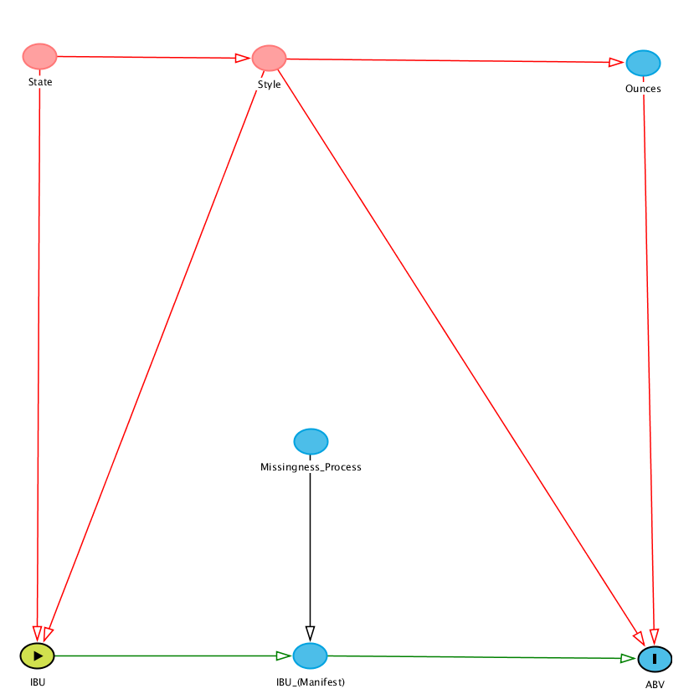
Discussion of Prior Beliefs
Some Implications:
1) Style Depends on State
2) Ounces Depends on Style
3) Missingness is MCAR
4) ABV Depends on Ounces
5) ABV Depends on Style
6) ABV Depends on IBU
7) ABV Unrelated to the Missingness of IBU

Slide 9
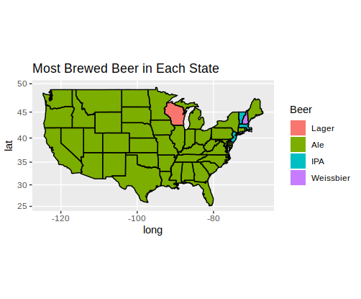
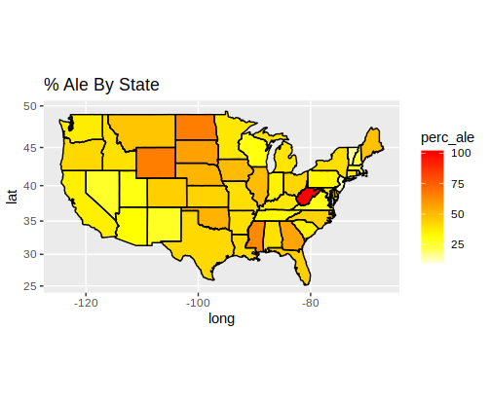
Exploratory Analysis
Style By State

Slide 10
Exploratory Analysis
Style By State
Indication of a relationship between State and Beer Style

Slide 11
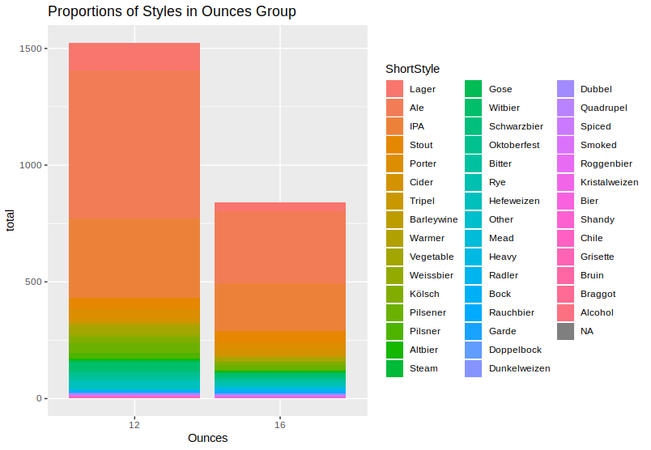
Exploratory Analysis
Ounces And Style

Slide 12
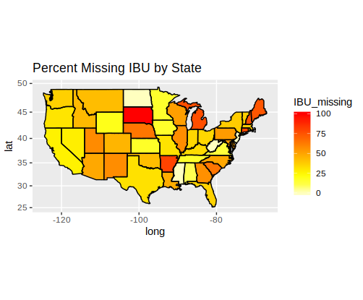
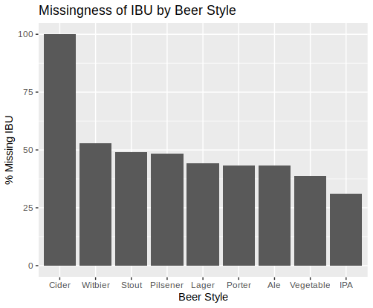
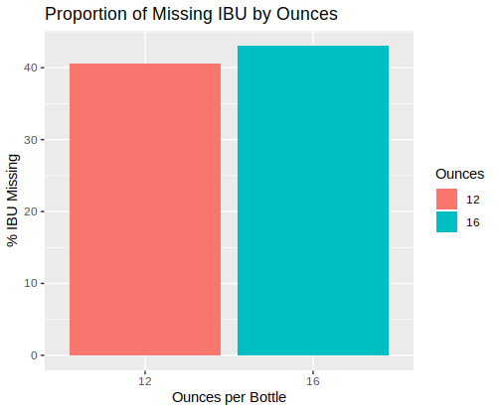
Exploratory Analysis: IBU Missingness
Missingness By State, Style, Ounces

Slide 13
Exploratory Analysis: Missingness
Missingness By State, Style, Ounces
1) Missingness isn’t completely at random

Slide 14
Exploratory Analysis: Missingness
Missingness By State, Style, Ounces
1) Missingness isn’t completely at random
2) Missingness depends largely on State and Style

Slide 15
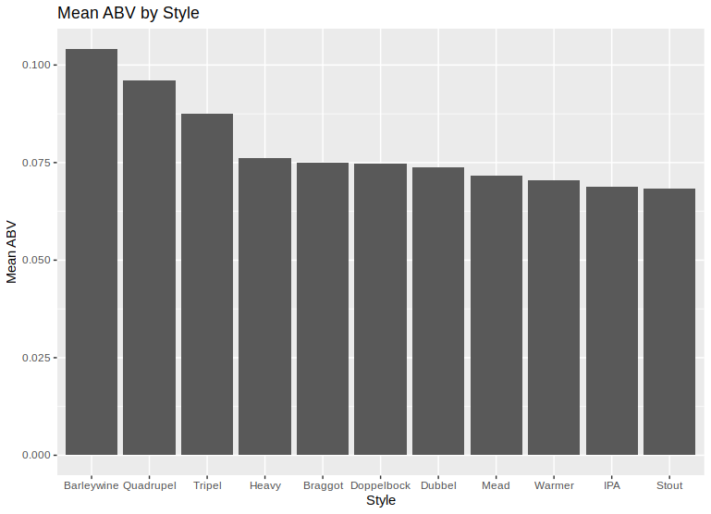
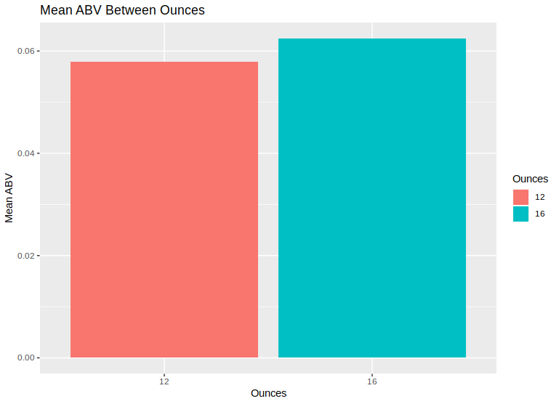
Exploratory Analysis: ABV
Ounces and Style on ABV

Slide 16
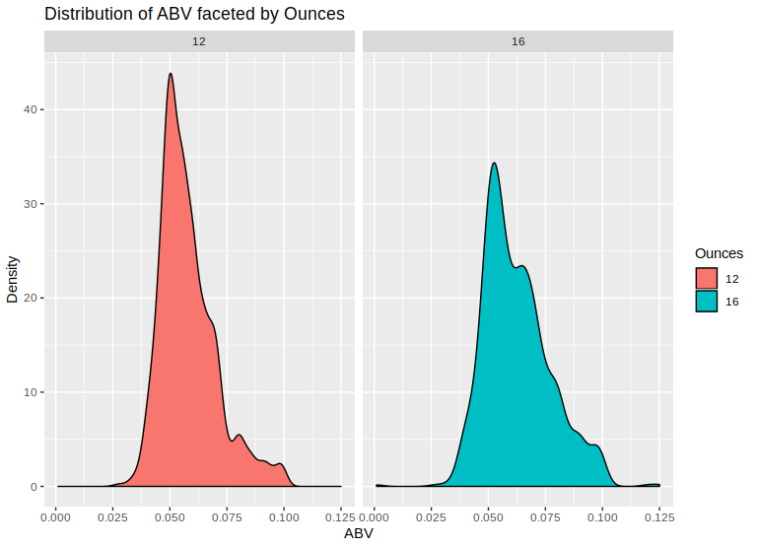
Exploratory Analysis: ABV
Is there a relationship between Ounces and ABV?
The data seems quite friendly to the t-test and the large sample size should yield sufficient statistical power.
A paired t-test yields no evidence of a significant difference between the 12 ounce and the 16 ounce group (p = 0.57) with a confidence interval [-0.06%, 0.03%].
The data is very conformable with there being no difference in mean ABV values between the two groups.

Slide 17
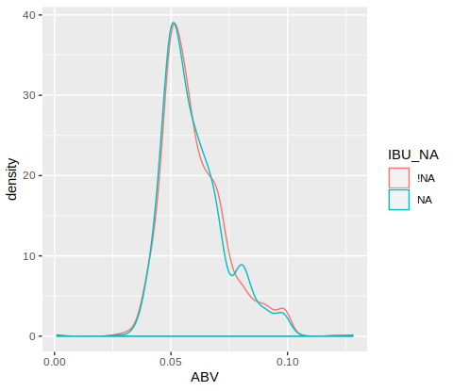
Exploratory Analysis: ABV
ABV and Missingness of IBU

Slide 18
Exploratory Analysis: ABV
ABV and Missingness of IBU
There is a very strong sign of independence between ABV and the missingness of IBU.

Slide 19
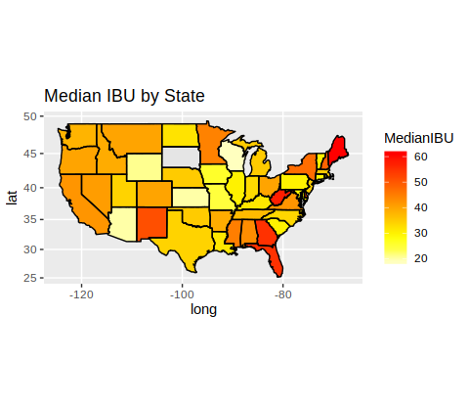
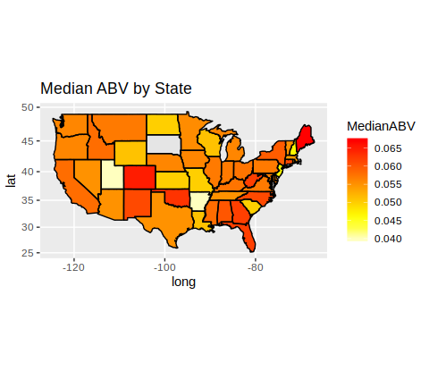
IBU and ABV by State

Slide 20
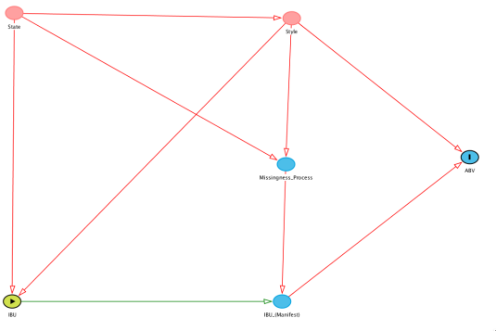
What We Have Learned

Slide 21
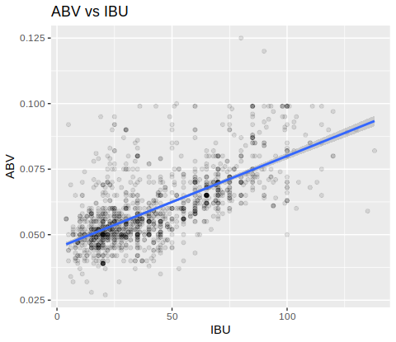
Estimation: ABV vs IBU
We impute the missing values for IBU using a linear model and then regress ABV on IBU to get the following results:
MODEL | Imputation W/ IBU | Imputation W/ IBU and Style | No Imputation
Coefficient (t-value) | .00032*** (23.37) | .00036*** (23.37) | .00035*** (33.86)
Each coefficient is very statistically significant and suggests that a one point increase in IBU is associated with a .03% absolute increase in ABV. Given the respective ranges of ABV and IBU, this is actually not insignificant.

Slide 22
Conclusions
There is a critical assumption in the modeling of IBU that, if violated, would significantly bias most estimates involving IBU:

Slide 23
Conclusions
There is a critical assumption in the modelling of IBU that, if violated, would significantly bias most estimates involving IBU:
If missingness of IBU is caused by IBU being low, then consistent estimators involving IBU are impossible.

Slide 24
Conclusions
There is a critical assumption in the modelling of IBU that, if violated, would significantly bias most estimates involving IBU:
If missingness of IBU is caused by IBU being low, then consistent estimators involving IBU are impossible.
Therefore, it is in the interest of our data strategy to investigate the missingness of IBU and develop policies to promote IBU reporting.

Slide 25
Conclusions
There is a critical assumption in the modelling of IBU that, if violated, would significantly bias most estimates involving IBU:
If missingness of IBU is caused by IBU being low, then consistent estimators involving IBU are impossible.
Therefore, it is in the interest of our data strategy to investigate the missingness of IBU and develop policies to promote IBU reporting.
The primary contribution of this analysis is that we find a positive, strong association between ABV and IBU that is robust to style and imputation, assuming that the missingness was at random.

Slide 26
Thank you for your time!

