Slide 1



Final Project Kickoff

Slide 2

Agenda
Logistics
Development process
Questions

Slide 3
Logistics

Slide 4
Logistics
Schedule:
Get project approval
Fill out Google sheet posted in Discord
Dry run
Submit a recording
Presentation during lecture
Demo day (optional)
Length: 5 minutes (strict)
Practice and time yourself
Questions / discussion after presentations
Speak to a mentor ASAP to get your project cleared

Slide 5
Development Process

Slide 6
Project Scope
Essential:
What is the problem that you are solving?
Is Machine Learning necessary?
What is the dataset and is there one available?
What are the inputs/outputs of the model (as numbers)?
What do you want to do with your model (if anything)?
Additional considerations
Unless you want a big challenge, avoid having to learn something new (eg. reinforcement learning, GANs)
Is there prior work to help you out?
Is it computationally expensive?

Slide 7
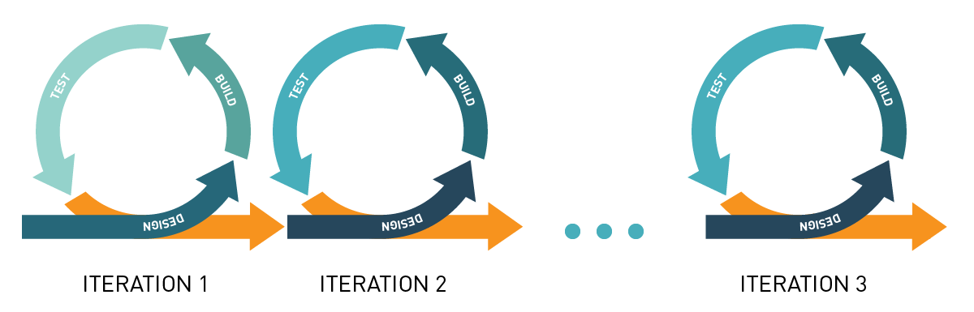
Iterative Progress and Difficulty
Make a minimum viable product (MVP) early
Dataset difficulty (simple or synthetic data before complex real world)
Model complexity (linear regression before XGBoost)
Task complexity (simplest solution before multifaceted)

Slide 8
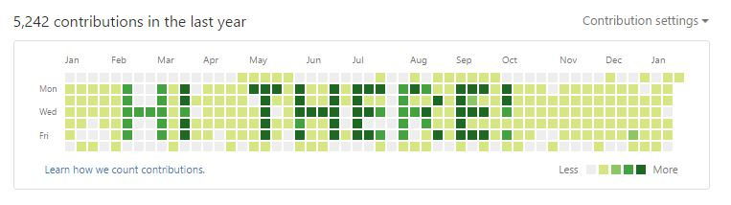
Why Use Git?
Public: Employers can see all the projects you’ve worked on
Versioned: you will have a history and can roll back to old commits
Server deployment: Just git pull to any new machine
Teamwork: Everyone can work on their own copy and working versions to a master copy

Slide 9
Examples on Github
https://github.com/GovindSuresh/reducing-bias-in-toxicity-classification
https://github.com/nomadtomas/sentweetment_analysizer
https://github.com/Greenford/billboard

Slide 10
Deployment and Demo Options
Don’t need to deploy or demo anything; good figures can be just as good
If you have something like an image emotion classifier, a live demo can be cool
If you have something like a cancer classifier, just show us some performance metrics
Consider whether your demo is too long or too risky (30 - 45 seconds)
Deployment options:
Flask API (might demo with Postman)
Flask app with UI (harder! need to write HTML)
AWS remote Flask app (if you need a faster machine and have money)
https://www.pythonanywhere.com/ (free for one app)
https://www.streamlit.io/ (good if you want UI, but learning a new library)
https://www.heroku.com/ (no longer free)

Slide 11
Code
Define functions wherever possible (eg. clean_data(df))
Use pipelines for joint preprocessing, feature engineering and model
Save trained models and only retrain when needed
Use .py files (.ipynb notebooks for EDA and rough work) so that you can split the project up into multiple files (eg data_cleaning.py, training.py, app.py)
Avoid showing any code in your presentation

Slide 12
Code Quality: Modularization
repo/
├── data
│ ├── raw_data.csv
│ └── preprocessed_data.csv
├── src
│ ├── modules
│ │ ├── data_preprocessing.py
│ │ └── modeling.py
│ │ └── figure_generation.py
│ ├── tests
│ │ ├── test_data_preprocessing.py
│ │ └── test_modeling.py
│ └── experiments.ipynb
├── output
│ ├── predictions.csv
│ ├── figures
│ │ ├── process_schematic.jpg
│ └── └── cluster_visualizations.jpg
└── README.md
# data_preprocessing.py
...
def load_preprocessed_data():
...
return X, y
...
# experiments.ipynb
from modules.data_preprocessing import load_preprocessed_data
from modules.modeling import train_models
...
X, y = load_preprocessed_data()
best_model, cv_performance = train_models(X, y)
...

Slide 13
Compare to Baselines
How good is your model? Contextualize it with a baseline
Classification: always predicting the most frequent y value
Eg. always predicting no-cancer if it is the most common class in the dataset
Regression: always predicting the mean y value (implicit in r²)
Eg. always predicting the mean flight delay
Forecasting: using a moving average model
Eg. always predicting the stock price tomorrow with the average over the past week
Any problem: hard-code a naive solution
Eg. for hockey, always predict that the team with the better collective stat will win the game

Slide 14
Presentation Structure
Motivation: What is the problem? Why is it important (either business, public good, or research perspective)?
Task: Problem from a technical perspective. Description of the dataset, algorithm inputs/outputs, analyses done using model
Modeling: Important aspects of your approach. How did you process the data or engineer features? What model did you use? Use schematics!
Results: Visuals! Show metrics and experiments. Demo (if any)
Conclusions: What worked? What didn’t (and why)? How are we better off? Where would the project go next?

Slide 15
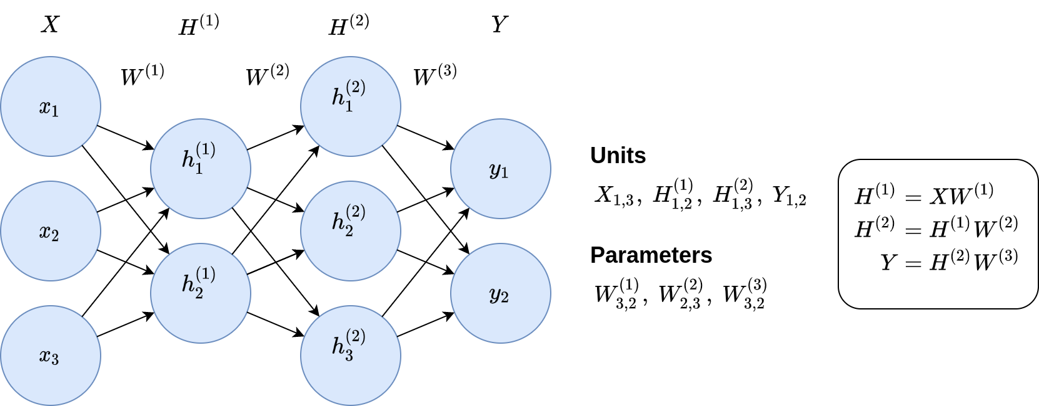
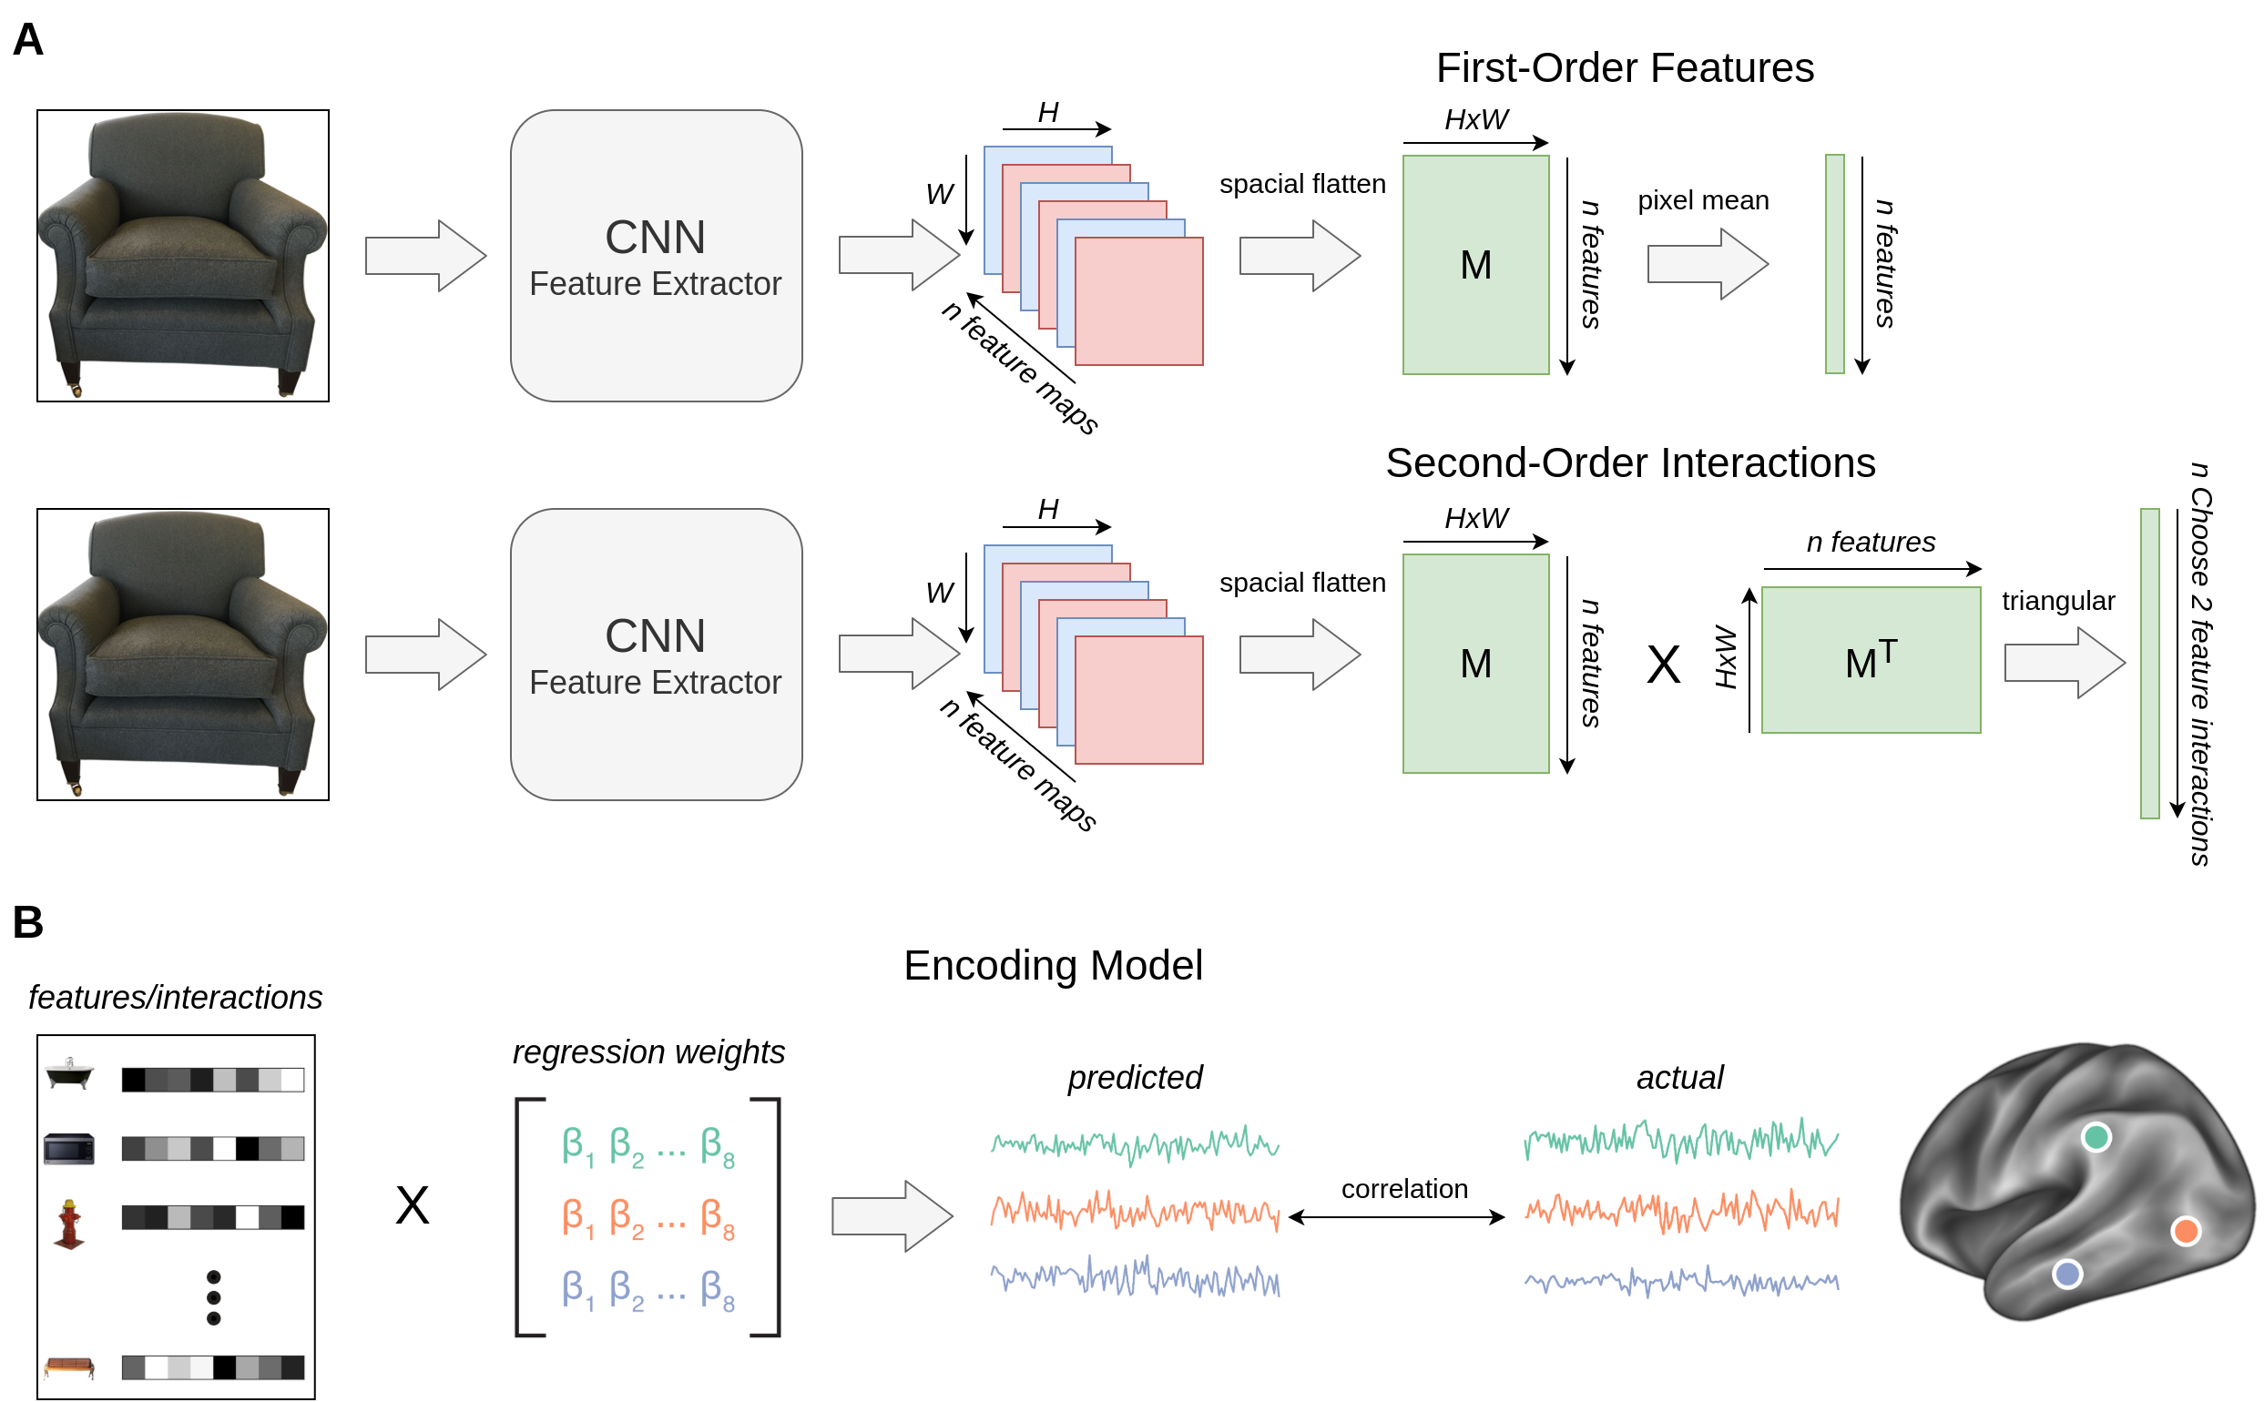
Figures: draw.io / lucidchart.com
Good for schematics, model diagrams, shapes, math typesetting, etc

Slide 16
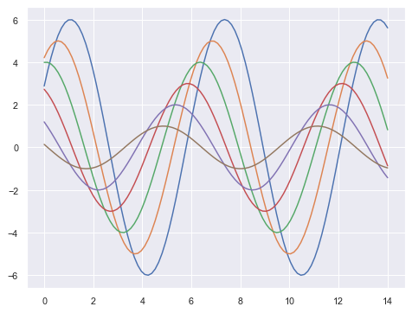
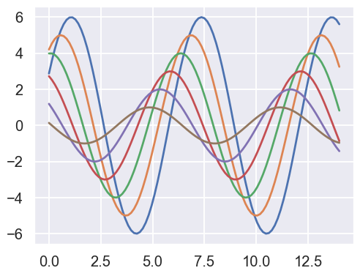
Figures: Seaborn
# Right after importing seaborn (could also use 'whitegrid')
sns.set_theme(style='darkgrid', context='talk')
context=’talk’

Slide 17
Questions

