Slide 1
DenseNet
발표자 : 182605 이윤수

Slide 2
Index
Introduction & Related Work
DenseNet
Experiment
Discussion

Slide 3
Introduction
Convolutional neural networks have become the dominant machine learning approach for visual object recognition
Improvements in computer hardware and network structure have enabled the training of truly deep CNN
ex) LeNet5
VGGNet 19 ResNet, HighwayNet 100~

Slide 4
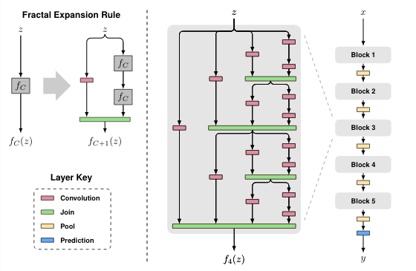
Introduction
As information about the input or gradient passes through many layers, it can vanish
- ResNets, HighwayNetwork : by-pass signal from one layer to the next via identity connections
- Stochastic depth : shortens ResNets by randomly dropping layers during training
- FractalNets : repeatedly combine several parallel layer sequences with different number of convolutional blocks to obtain a large nominal depth
Create short path from early layers

Slide 5
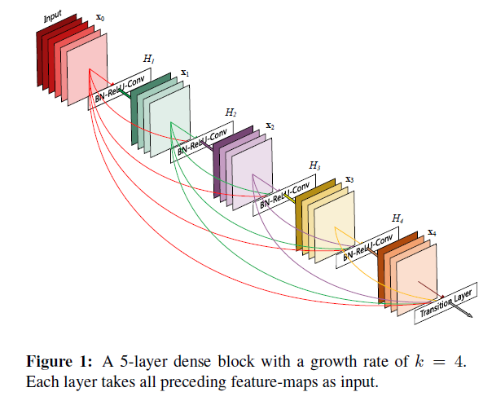
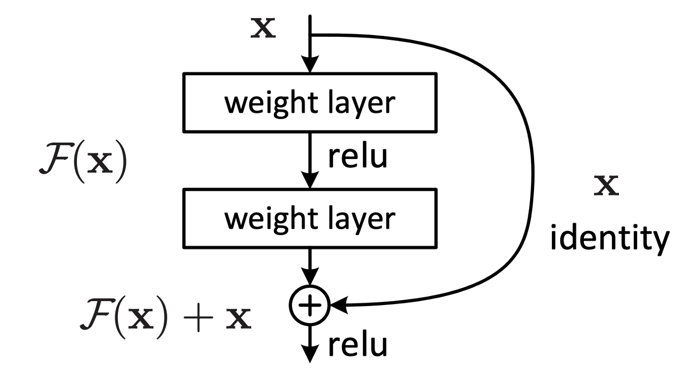
Introduction
To ensure maximum information flow between layers in the network, connect all layers In contrast to ResNets, we never combine features through summation before they are passed into a layer, instead we combine features by concatenating them.
This introduces L(L+1)/2 connections in an L-layer network

Slide 6
Introduction
A possibly counter-intuitive effect of this dense connectivity pattern is that it requires fewer parameters than traditional convolutional networks, no need to relearn redundant feature-maps
Number of parameters of ResNets is substantially larger because each layer has its own weights
-> DenseNet architecture explicitly differentiates between information that is added to the network and information that is preserved
: adding only a small set of feature-maps and keep the remaining feature-maps unchanged improved flow of information and gradients throughout the network, which makes them easy to train

Slide 7
Introduction
DenseNet Abstract
Alleviate the vanishing gradient problem
strengthen feature propagation
encourage feature reuse
substantially reduce the number of parameters

Slide 8


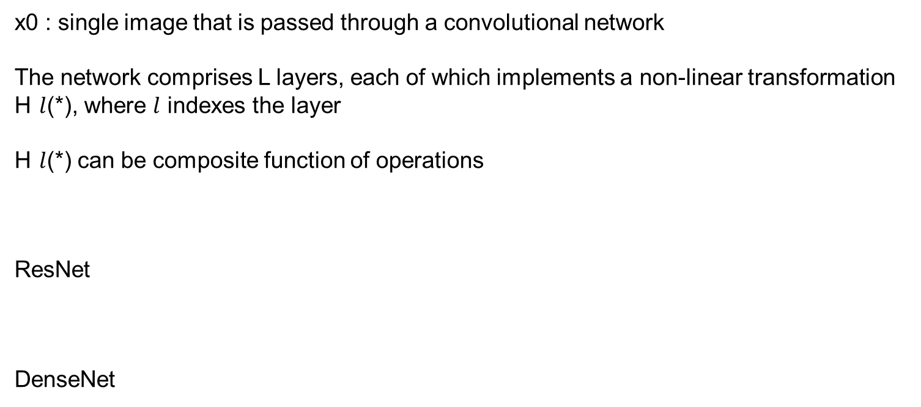
DenseNet
x0 : single image that is passed through a convolutional network
The network comprises L layers, each of which implements a non-linear transformation H $l$(*), where $l$ indexes the layer
H $l$(*) can be composite function of operations
ResNet
DenseNet

Slide 9
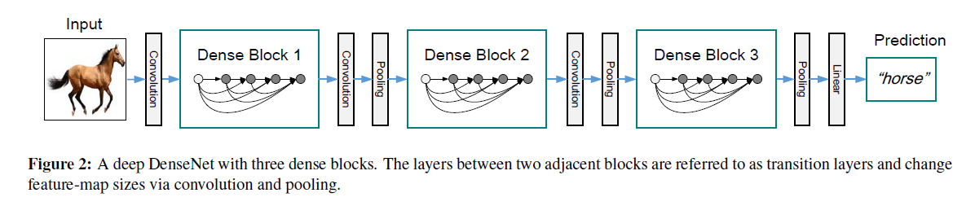
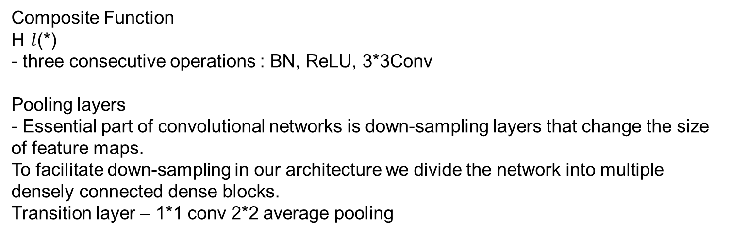
DenseNet
Composite Function H $l$(*) - three consecutive operations : BN, ReLU, 3*3Conv
Pooling layers - Essential part of convolutional networks is down-sampling layers that change the size of feature maps. To facilitate down-sampling in our architecture we divide the network into multiple densely connected dense blocks. Transition layer – 1*1 conv 2*2 average pooling

Slide 10
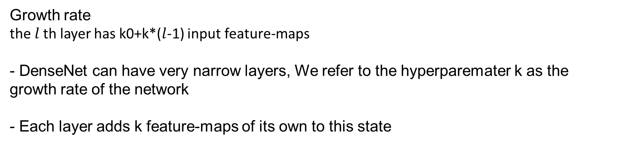
DenseNet
Growth rate the $l$th layer has k0+k*($l$-1) input feature-maps
- DenseNet can have very narrow layers, We refer to the hyperparemater k as the growth rate of the network - Each layer adds k feature-maps of its own to this state

Slide 11
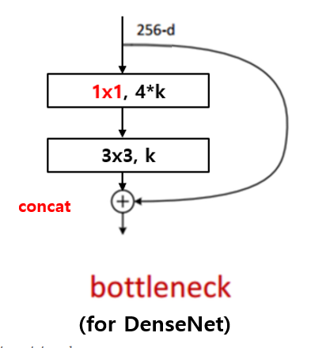
DenseNet
Bottleneck layers
BN-ReLU-Conv(1*1)-BN-ReLU-Conv(3*3) 1*1 convolution produce 4k feature-maps DenseNet-B

Slide 12
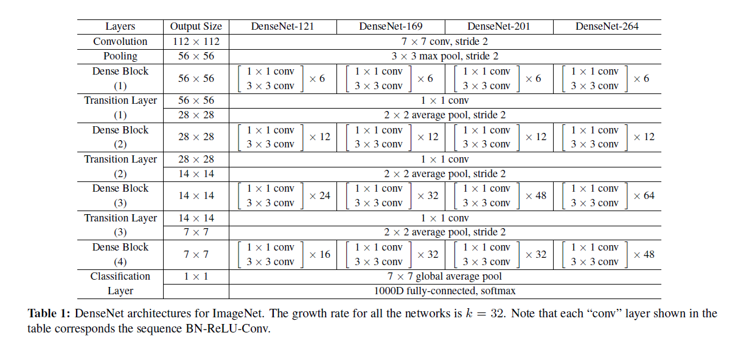
DenseNet

Slide 13
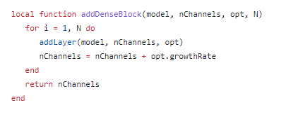
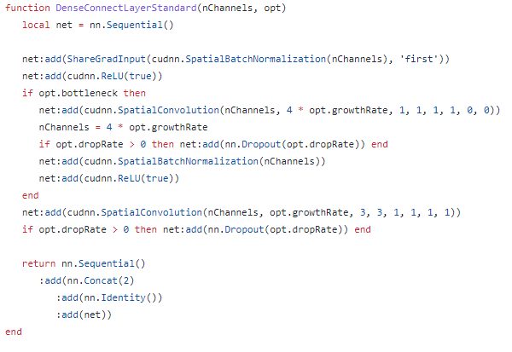
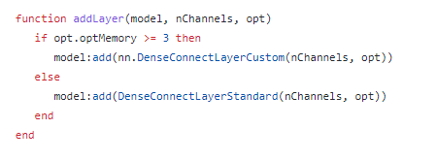
DenseNet

Slide 14
Q & A

