Slide 1
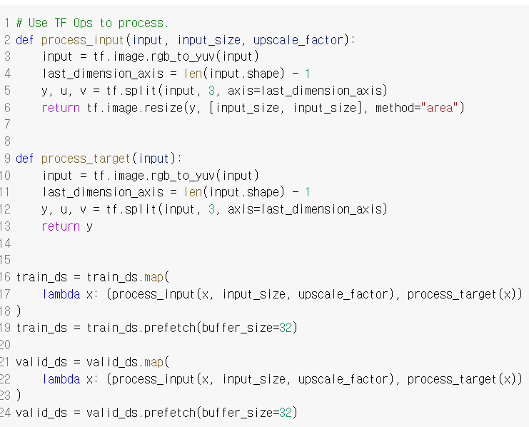
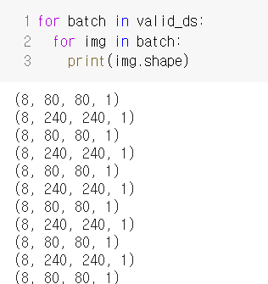
Code Explanation

Slide 2
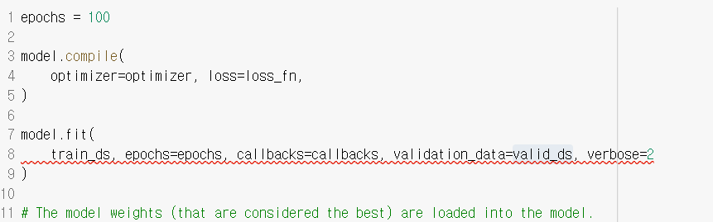
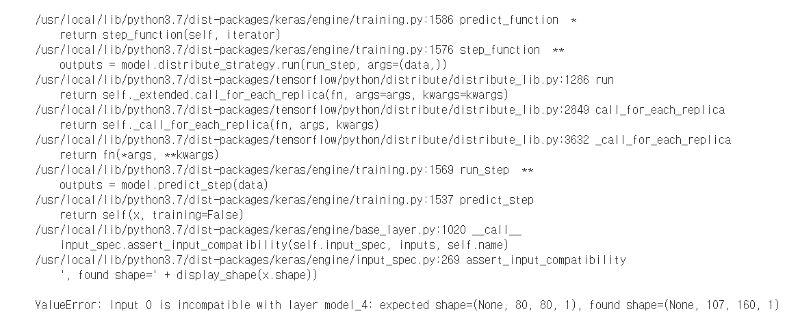
Code Explanation

Slide 3
DenseNet (Densely Connected Convolutional Networks)
발표자 : 182605 이윤수

Slide 4
Index
Experiment
Discussion

Slide 5
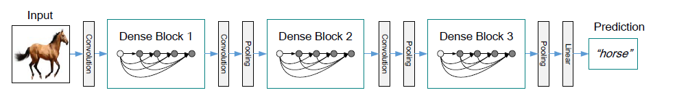
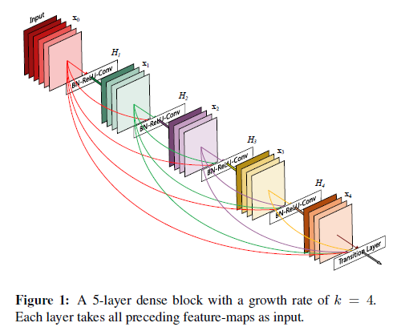
Experiment

Slide 6
Experiment
CIFAR
SVHN
ImageNet

Slide 7
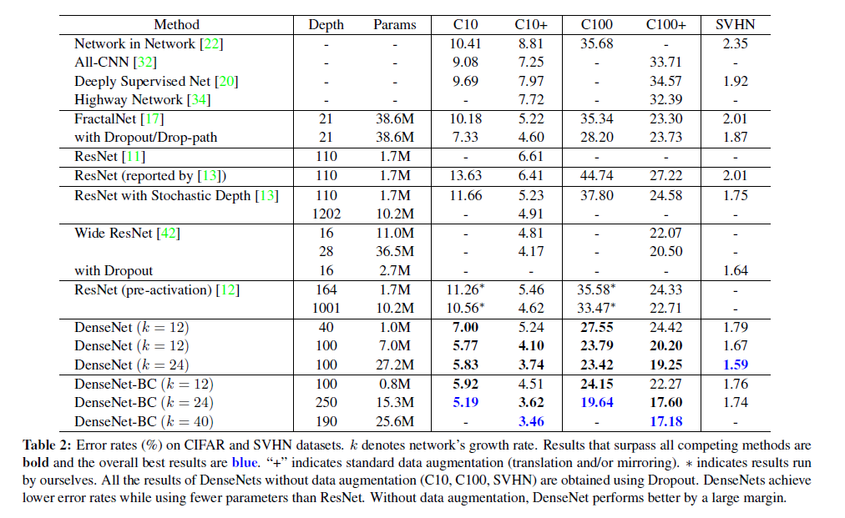
Experiment

Slide 8
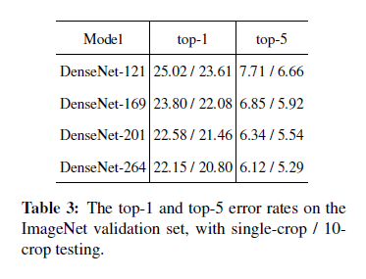
Experiment

Slide 9
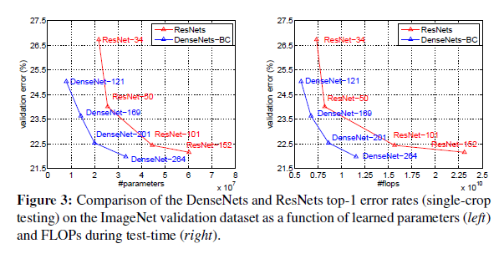
Experiment

Slide 10
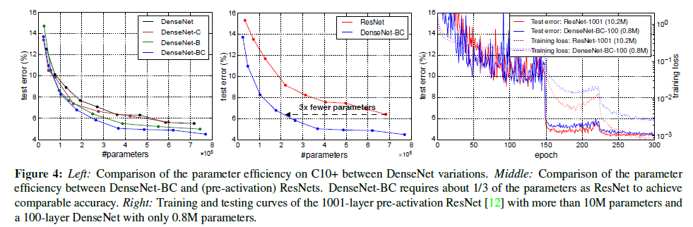
Discussion

Slide 11
CSPNET (A New Backbone that can enhance capability of CNN)
발표자 : 182605 이윤수

Slide 12
Index
Introduction
Method
Experiment

Slide 13
Introduction
[Abstract] We propose CSPNet(Cross Stage Partial Network) to mitigate the problem that previous works require heavy inference computations from the network architecture perspective.
We attribute the problem to the duplicate gradient information within network optimization.
Reduces computation by 20% with equivalent or even superior accuracy in our experiments.
CSPNet is easy to implement and general enough to cope with architectures based on ResNet, ResNeXt and DenseNet

Slide 14
Introduction
CNN : deeper, wider -> a lot more computations
Light-weight computing has gradually received stronger attention since real-world applications usually require short inference time on small devices, which poses a serious challenge for computer vision algorithms
The main purpose of designing CSPNet is to enable this architecture to achieve a richer gradient combination while reducing the amount of computation. This aim is achieved by partitioning feature map of the base layer into two parts and then merging them through a proposed cross-stage hierarchy
Our main concept is to make the gradient flow propagate through different network paths by splitting the gradient flow. In this way, we have confirmed that the propagated gradient information can have a large correlation difference by switching concatenation and transition steps.

Slide 15
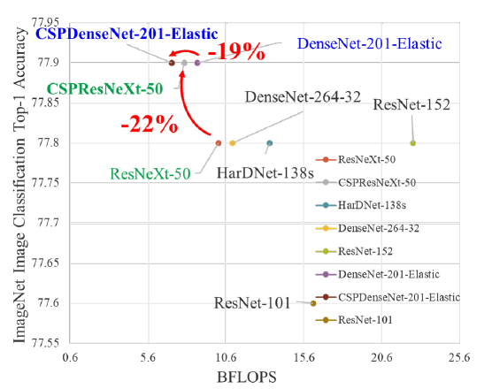
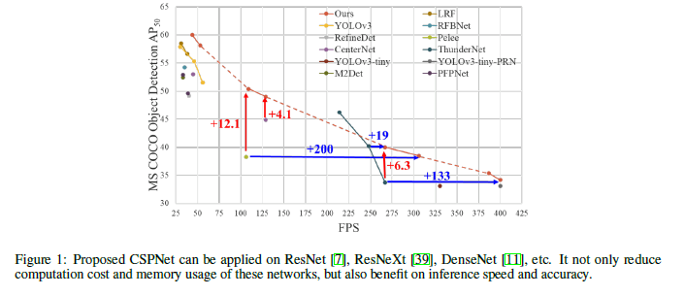
Introduction

Slide 16
Introduction
CSPNet-based object detector deals with the three problems:
1) Strengthening learning ability of a CNN 2) Removing computational bottlenecks : we can evenly distribute the amount of computation at each layer in CNN 3) Reducing memory costs

Slide 17
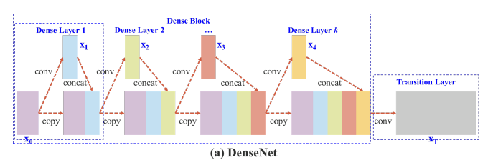
Method

Slide 18
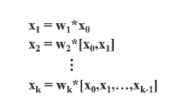
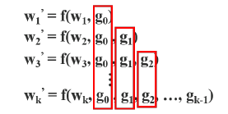
Method
If one makes use of a backpropagation algorithm to update weights the equations of weight updating can be written like this :
Where * reprents the convolution operator, [] means to concatenate, and w and x are the weights and output of the dense leayer
F is the function of weight updating and g represents the gradient propagated to the ith dense layer. We can find that large amount of gradient information are reused for updating weights of different dense layers

Slide 19
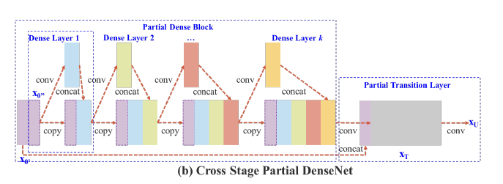
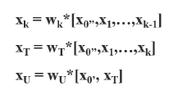
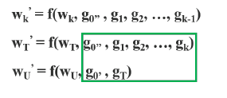
Method
First, the output of dense layers will undergo a transition layer. Second, the output of this transition layer xT will be concatenated with x’ and generate xU
We can see that gradients coming from the dense layers are separately integrated. On the other hand, the feature map x’ that did not go through the dense layers is also separately integrated.

Slide 20
Method
Overall Speaking the proposed CSPDenseNet preserves the advantages of DenseNet’s feature reuse characteristics but at the same time prevents an excessively amount of duplicate gradient information by truncating the gradient flow.

Slide 21
Method
Partial Dense Block
1) Increase gradient path : Through the split and merge strategy, the number of gradient paths can be doubled 2) Balance computation of each layer : usually, the cannel number in the base layer of a DenseNet is much larger than the growth rate. 3) Reducing memory traffic

Slide 22
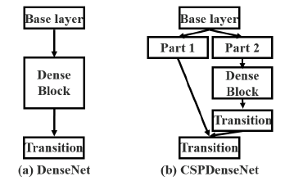
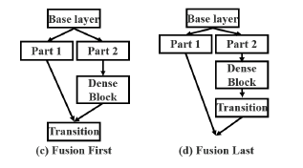
Method
Partial Transition Layer
The purpose of designing partial transition layers is to maximize the difference of gradient combination. 3(c), 3(d) show two different fusion strategies. 3(c) : a large amount of gradient information will be reused 3(d) : the gradient information will not be reused since the gradient flow is truncated.

Slide 23
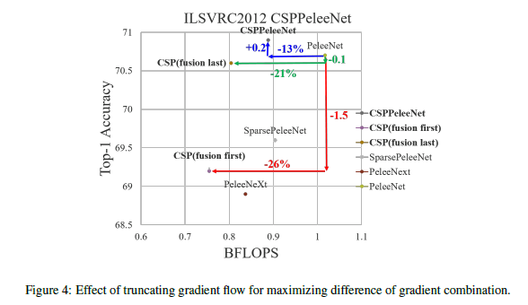
Method

Slide 24
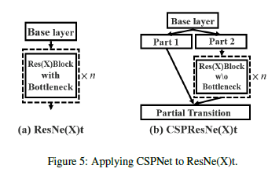
Method

Slide 25
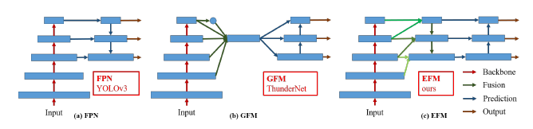
Method
Exact Fusion Model
We propose EFM that captures an appropriate Field of View (FoV) for each anchor, which enhances the accuracy of the one-stage object detector.
Since the concatenated feature maps from the feature pyramid are enormous, we incorporate the Maxout technique to compress the feature maps.

Slide 26
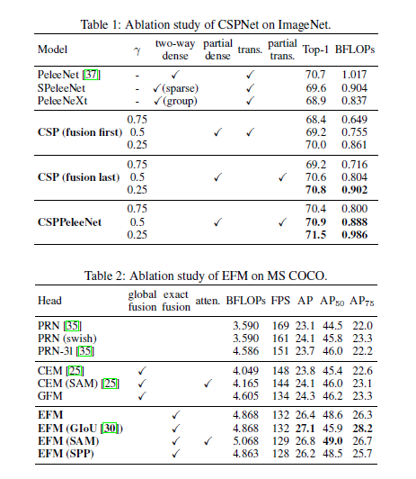
Experiment

Slide 27
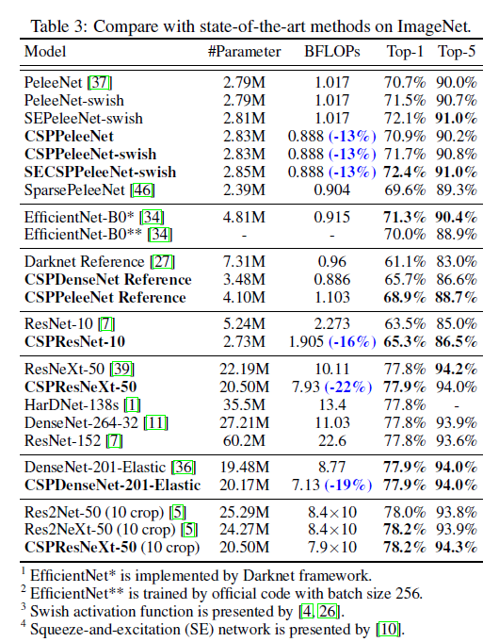
Experiment

Slide 28
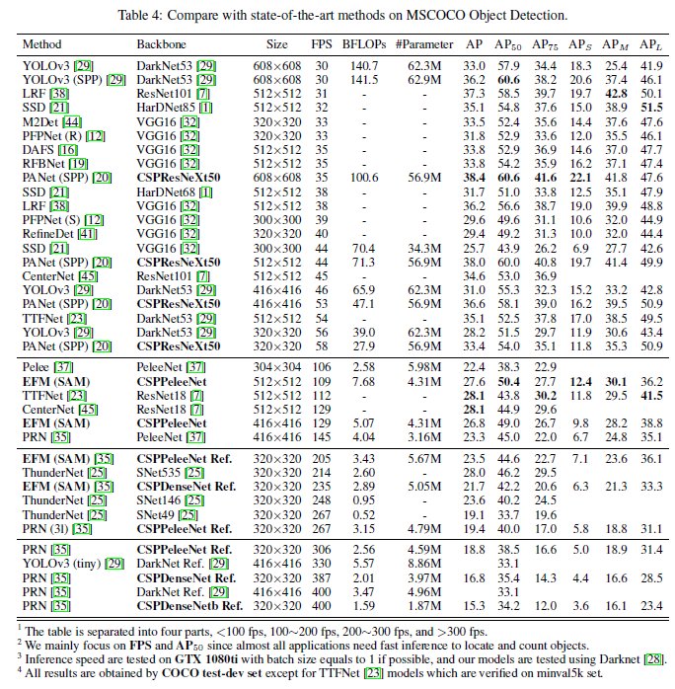

Slide 29
Q & A

