Slide 1
DPN (Detail-Preserving Network with High Resolution Representation for Efficient Segmentation of Retinal Vessels)
발표자 : 182605 이윤수

Slide 2
Index
Introduction
Network
Experiment

Slide 3
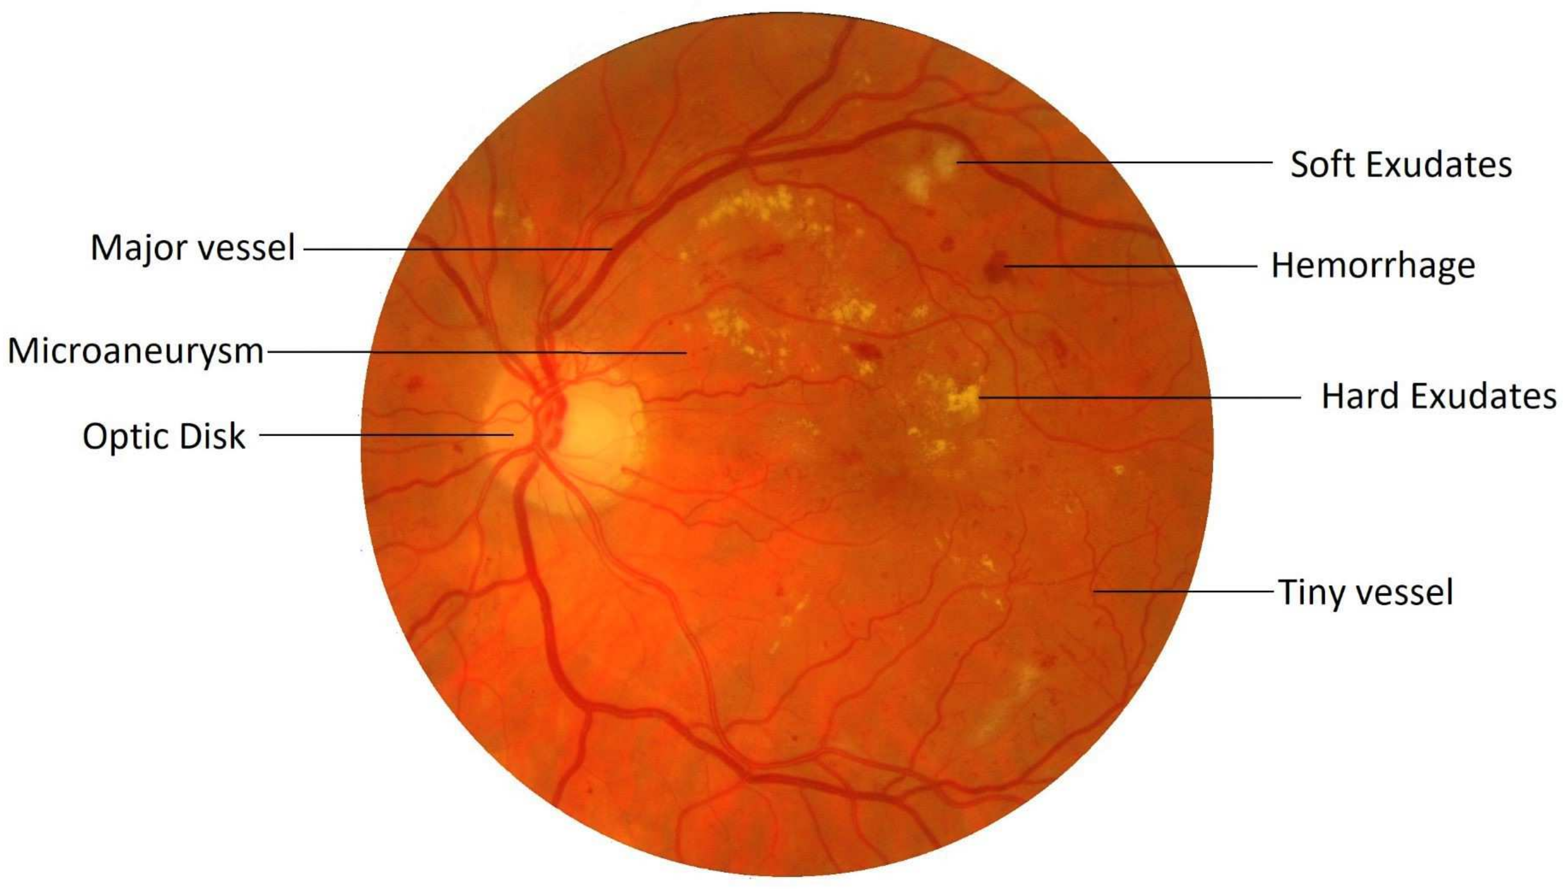
Introduction
Retinal vessels (provide blood to the inner retinal neurons) are important biomarkers for many ophthalmological and cardiovascular diseases
ex) diabetic retinopathy, cataract
Retinal blood vessels and cerebral blood vessels are similar in anatomical, physiological and embryological characteristics.
Accurate segmentation of blood vessels is the basic step of efficient CAD(computer-aided diagnosis)

Slide 4
Introduction
Good vessel segmentation model for CAD should satisfy the following two conditions
High accuracy
Fast processing speed

Slide 5
Introduction
Existing vessel segmentation methods could be divided into two categories
unsupervised methods :
Utilize human-designed low-level features and rules such as edge, line, and color. A major limitation of the unsupervised method is that the features and rules are designed by a human. It is hard to design a satisfactory feature that works well on large-scale fundus images.

Slide 6
Introduction
Existing vessel segmentation methods could be divided into two categories
2) supervised methods :
Consist of two procedures : feature extraction, classification.
First, features were extracted by human-designed rules, just as that did un unsupervised methods. Second, supervised classifiers were employed to classify these extracted features into vessels or non-vessels

Slide 7
Introduction
Deep learning – based methods
classification-based methods :
the category for each pixel is determined by its surrounding small imaged patch This kind of method does not make full use of contextual information
2) segmentation-based methods :
existing methods follow the architecture FCN, where the resolution of feature maps are first down-sampled to encode structural information
Although successive down-sampling operations could reduce the model’s computational complexity and increase the model’s receptive field, it inevitably loses detailed information.

Slide 8
Introduction
U-Net model was proposed, which could utilize intermediate layers in the up-sampling path to fuse more spatial information to generate fine segmentation maps.
Although the detailed information could be utilized in the U-Net, the extra noise also introduced.
Moreover, U-Net variant models require multiple forward passes to generate a segmentation map for one testing image, they show slow segmentation speed and the contextual information is not fully utilized.
Inspired by HRNet the DPN learns the full- resolution representation directly rather than the low-resolution representation

Slide 9
Introduction
Overall, our contributions are summarized as follows.
We present the detail-preserving block, which could learn the structural information and preserve the detailed information
We present the detail-preserving network, which mainly consists of eight serially connected DP-Blocks.
We conducted experiments over three public datasets.

Slide 10
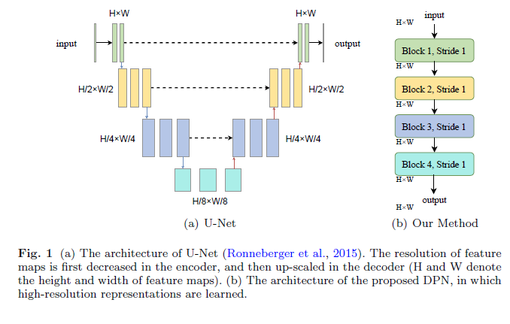
Network

Slide 11
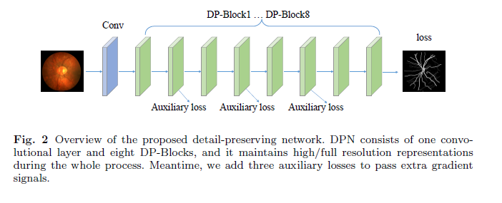
Network
No down-sampling operations
For DP-Block, the receptive field of the output neuron could be as large as four times that of the input neuron, while the detailed information could also be preserved.
Different from U-Net that utilized ResNet or VGGNet as the backbone, which incurs a large number of parameters
The input of DPN is the entire image so that it could integrate more contextual information

Slide 12
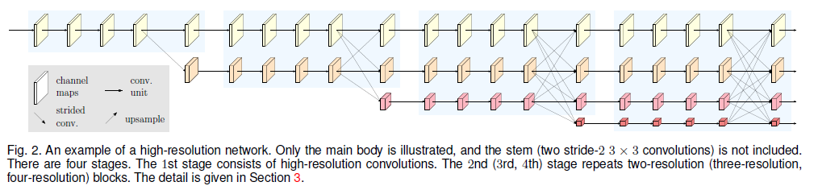
Network
Proposed DPN only maintains one kind of resolution the high-resolution stream and multi-scale feature is employed in DP-Blocks While HRNet maintains multi-streams with different resolutions and multi-scale fusion is employed among these streams
The method for multi-scale feature fusion is different

Slide 13
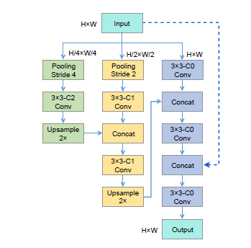
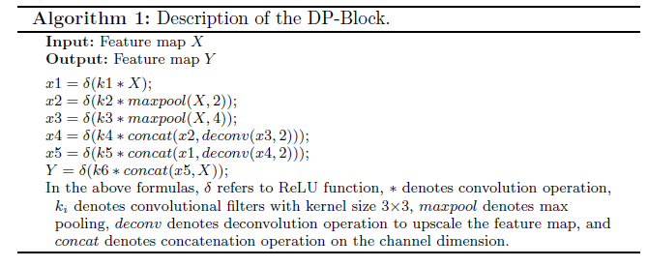
Network

Slide 14

Network
To solve existing class imbalance problem in vessel segmentation, we adopted class balanced cross-entropy loss which uses a weight factor to balance vessel pixels and non-vessel pixels.
p is a probability map obtained by a sigmoid operation
pj denotes the probability that the jth pixel belongs to vessel
y denotes the ground truth
θ denotes model parmeters
N+ denotes the number of vessel pixels
N- denotes the number of non-vessel pixels

Slide 15
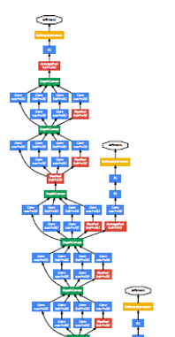

Network
We add three auxiliary losses to the intermediate layers of DPN to pass extra gradient.

Slide 16
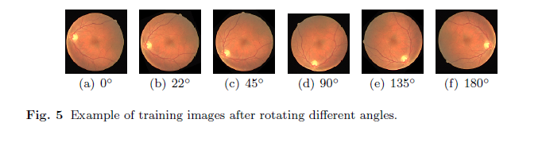
Experiments
1) DRIVE(Digital Retinal Images for Vessel Extraction) : dataset contains 40 color fundus images captured with a 45° FOV, Each image has the same resolution, 565*584
2) CHASE_DB1 :
contains 28 fundus images (999*960) captured with a 30° FOV
3) HRF(High Resolution Fundus) :
45 high-resolution fundus images, with resolution 2336*3504 15 – diabetic retinopathy, 15 – glaucoma, 15 – healthy
raw color fundus images augment the training set – flipping and rotation

Slide 17
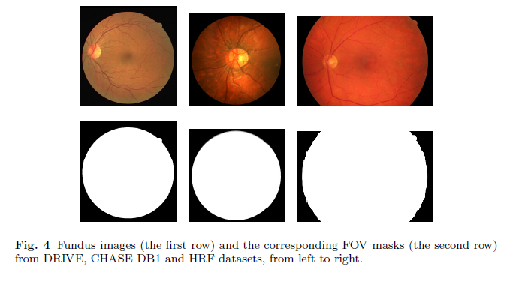
Experiments

Slide 18
Experiments
Based on open-source deep learning framework caffe
NVIDIA RTX 2080ti GPU
learning rate : e-3
iteration 100K/ 100K/ 70K
To reduce computational complexity, cropped into 512*512/632*632/588*588

Slide 19




Experiments
TP – true positive : the number of vessel pixels classified correctly
TN – true negative : the number of non-vessel pixels classified correctly
FP – false positive : the number of non-vessel pixels misclassified as vessels FN – false negative : the number of vessel pixels misclassified as non-vessels
Evaluation Method
Se – Sensitivity
Sp – Specificity
Acc – Accuracy
AUC – the Area Under the receiving operator characteristics Curve
F1 – F1score
SSIM – Structural Similarity Index Measure
PSNR – Peak Signal to Noise Ratio

Slide 20
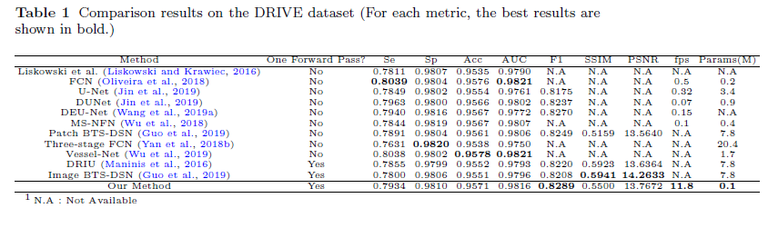
Experiments

Slide 21
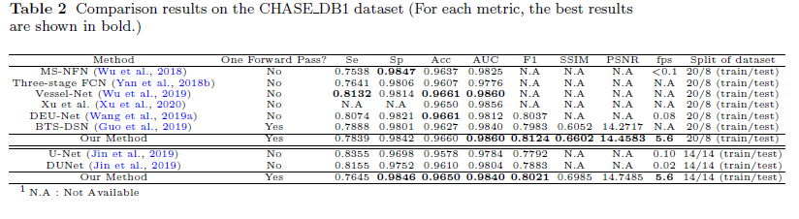
Experiments

Slide 22
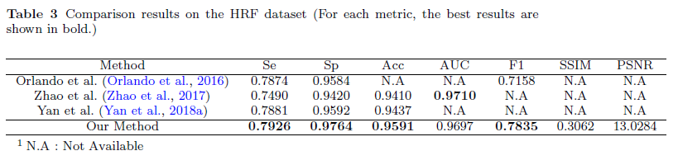
Experiments

Slide 23
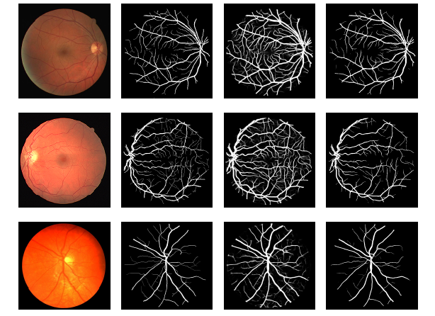
Experiments

Slide 24
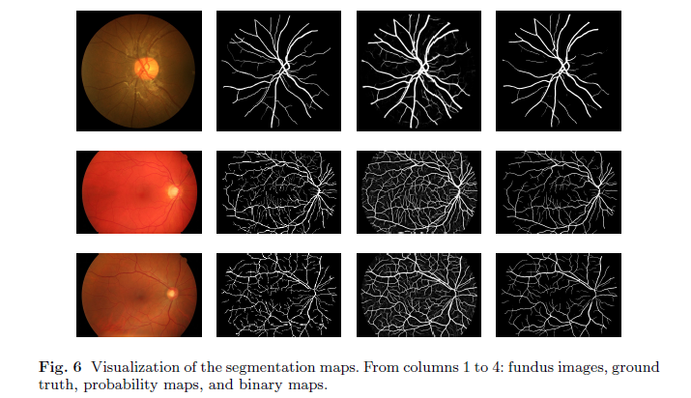
Experiments

Slide 25
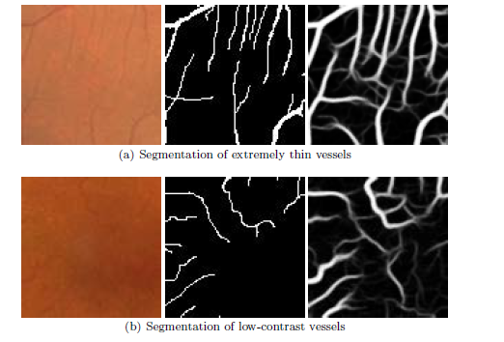
Experiments

Slide 26
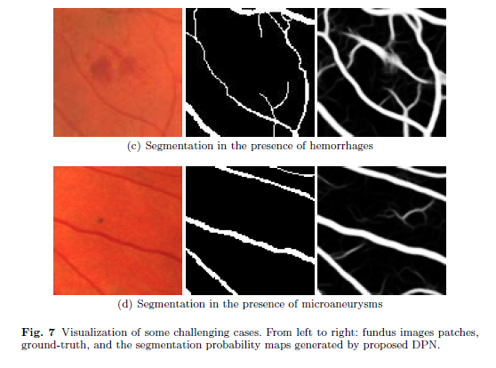
Experiments

Slide 27
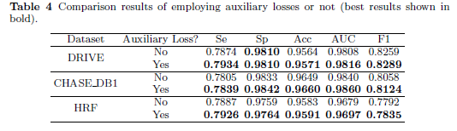
Experiments

Slide 28
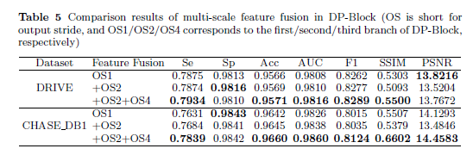
Experiments

Slide 29
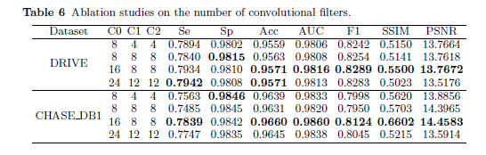
Experiments

Slide 30
Q & A

