Slide 1
GoogleNet(Inception)
발표자 : 182605 이윤수

Slide 2
Introduction
More powerful hardware, larger datasets, bigger models
recognition detection
New ideas, algorithms and improved network architectures

Slide 3
Introduction
ILSVRC 2014 classification and detection challenge
Inception

Slide 4
Motivation
1. Improving the performance of deep neural networks is by increasing their size (depth, width) depth : number of levels width : the number of units at each level
Bigger size : larger number of parameters -> enlarged network more prone to overfitting overfitting – 과하게 학습하는 것
2. Increased use of computational resources
Ultimately moving from fully connected to sparsely connected architecture, even inside the convolutions

Slide 5
Architectural Details
Main idea : an optimal local sparse structure and repeat it spatially
Lower layer : covered by a layer of 1*1 convolutions To avoid patch-alignment issues : 1*1, 3*3, 5*5
Add alternative parallel pooling path

Slide 6
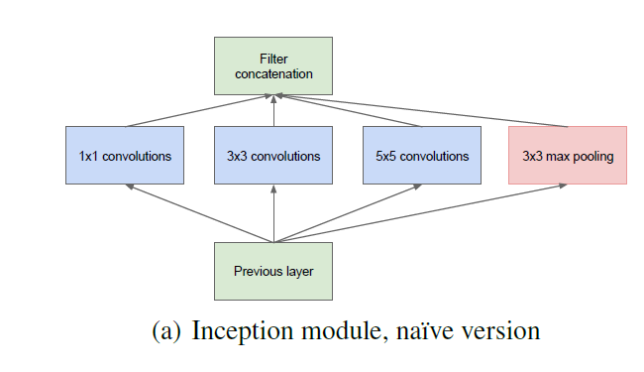
Architectural Details
-5*5 convolutions can be prohibitively expensive
-pooling units are added to mix

Slide 7
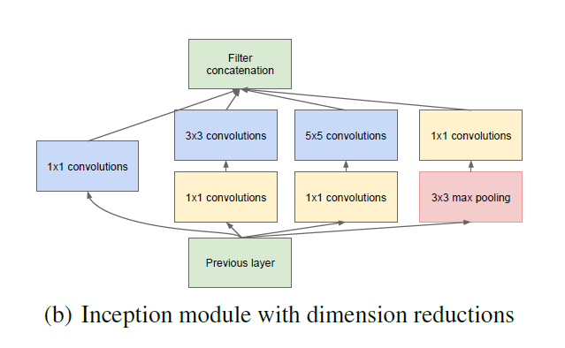
Architectural Details
1*1 convolutions are used to compute reductions before the expensive 3*3, 5*5 convolutions
Start using Inception modules only at higher layers (memory efficiency)

Slide 8
Architectural Details
Beneficials
Allow increasing the number of units without uncontrolled blow-up
Improved use of computational resources allows for increasing each stage

Slide 9
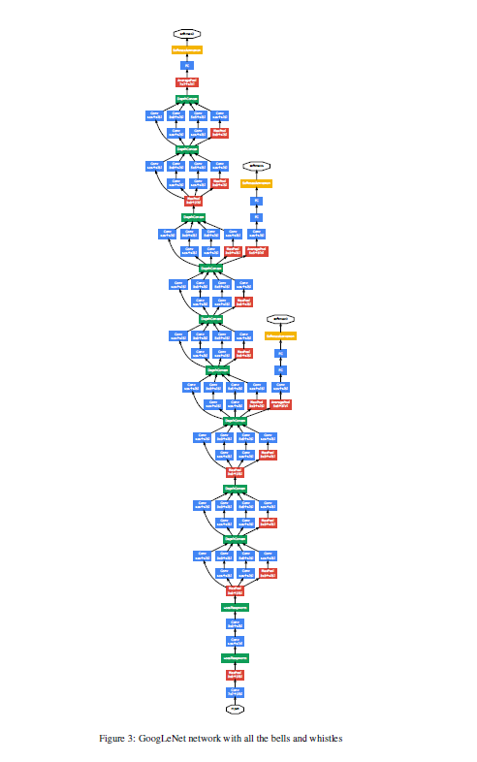

Slide 10
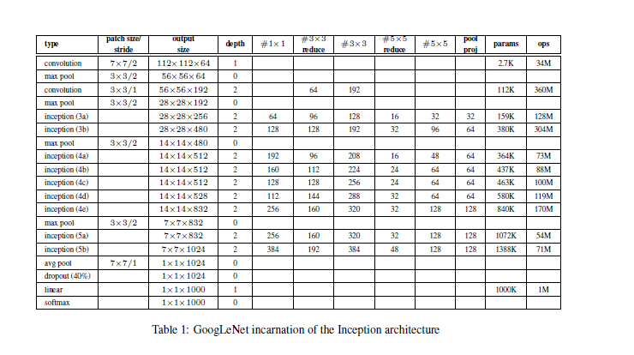

Slide 11
Introduction
Still the complexity of the Inception architecture makes it more difficult to make changes to the network
-> architecture scaled up naively, computational gains can be lost
Does not provide a clear description
-> This makes it harder to adapt it to new usecases

Slide 12
General Design Principles
Avoid representational bottlenecks, especially early in the network
Higher dimensional representations are easier to process locally within a network
Spatial aggregation can be done over lower dimensional embeddings without much or any loss in representation power
Balance the width and depth the network
It is not straightforward to use them to improve The idea is to use them in ambiguous situations

Slide 13
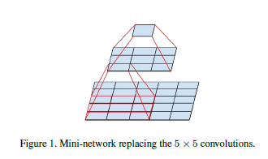
Details
Factorization into smaller convolutions
Convolutions with larger spatial filters tend to be expensive in terms of computation

Slide 14
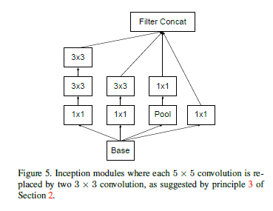
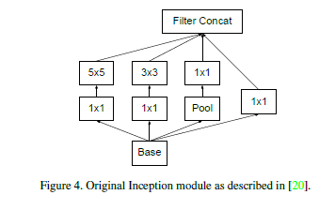
Details
Factorization into smaller convolutions

Slide 15
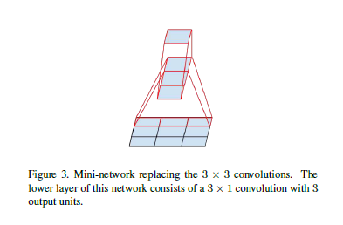
Details
Spatial Factorization into Asymmetric Convolutions
Whether one should factorize them into smaller, ex) 3*3->2*2
However, it turns out that one can do even better into n*1 ex) 3*3 -> 3*1, 1*3

Slide 16
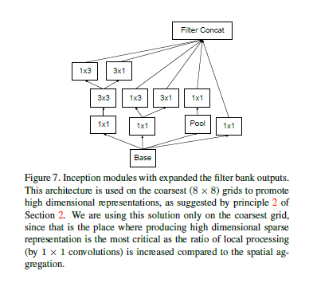
Details
Spatial Factorization into Asymmetric Convolutions

Slide 17
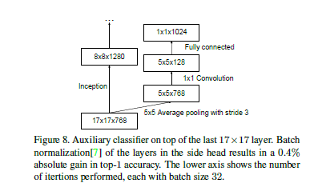
Details
Utility of Auxiliary Classifiers
We found that auxiliary classifiers did not result in improved convergence early in the training

Slide 18
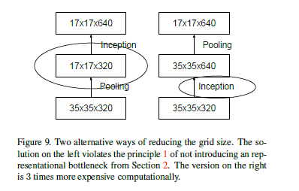
Details
Efficient Grid Size Reduction
Traditionally, Convolutional networks used some pooling operation to decrease the grid size of the feature maps.
In order to avoid a representational bottleneck,
before applying maximum or average pooling the activation dimension of the network filters is expanded

Slide 19
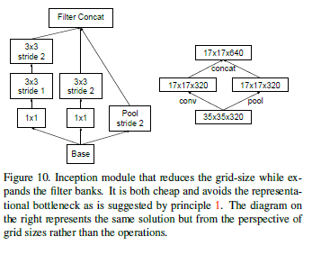
Details
Efficient Grid Size Reduction

Slide 20
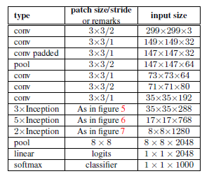
Details
Our network is 42layers deep, our computation cost is only about 2.5 higher than that of GoogleNet

Slide 21
Details
Model Regularization via Label Smoothing
Here we propose a mechanism to regularize the classifier layer by estimating the marginalized effect of label–dropout during training

Slide 22
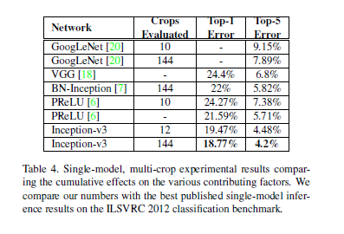
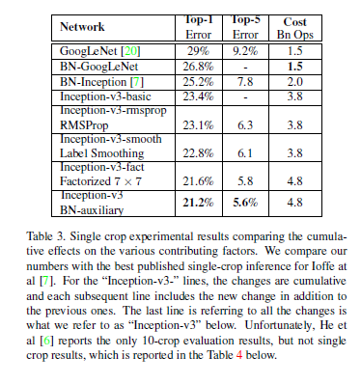
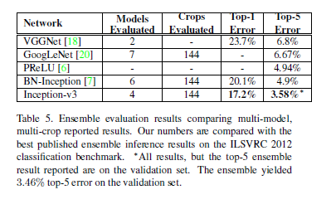
Details

Slide 23
고찰
단어의 차이 ex) naïve deeper등의 용어
수치상으로만 보고 얼마정도의 차이가 나는지 가늠이 안된다.
큰 틀은 보이지만 세부적으로는 이해가 가지 않는다.
유명한 내용이라 다른 참고자료가 많았다.

Slide 24
Q & A

