Slide 1
GoogleNet(Inception)
Code
발표자 : 182605 이윤수

Slide 2
Index
Code Explanation

Slide 3
Code
https://colab.research.google.com/drive/1lj5MGPPVWMwhPioRWTHufQVZshRdEwHP?usp=sharing

Slide 4
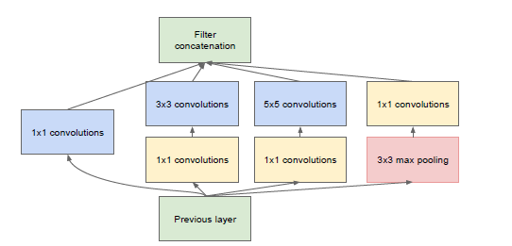

Slide 5
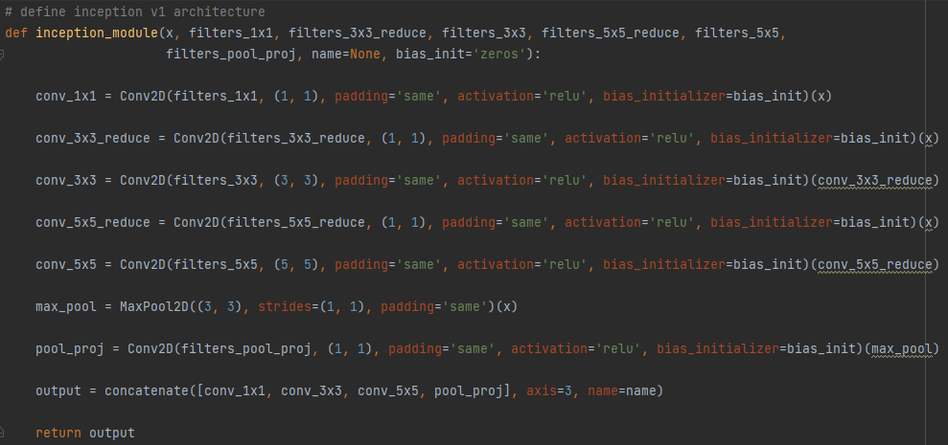

Slide 6

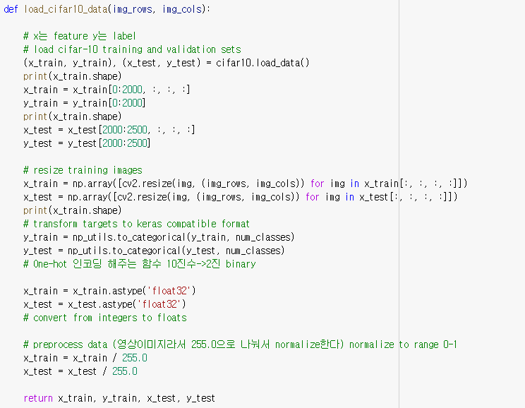

Slide 7



Slide 8
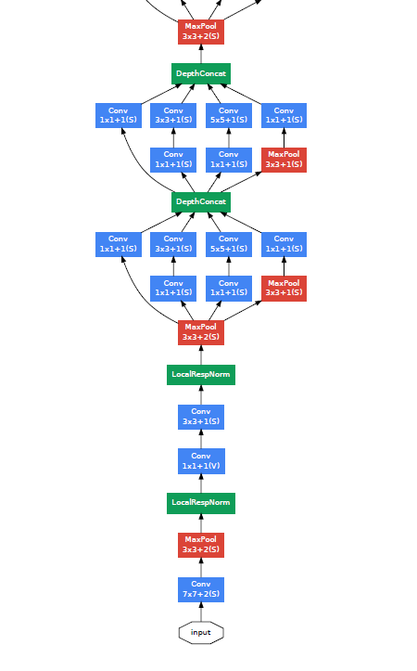
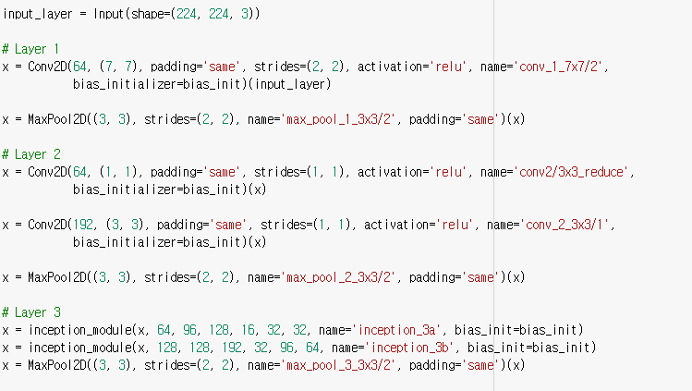

Slide 9
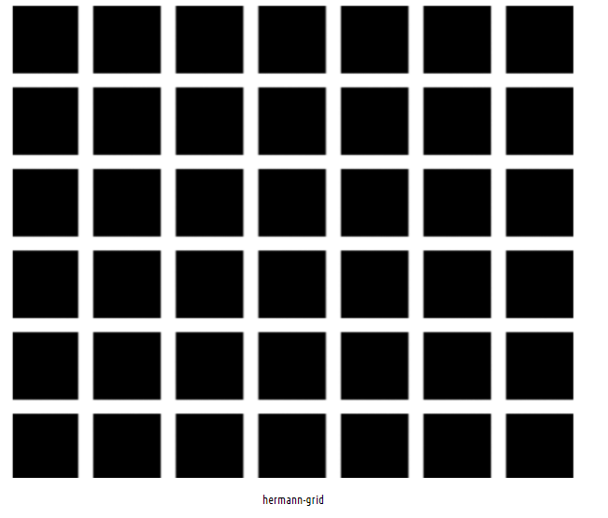
Local Response Normalization
is a normalization layer that implements the idea of lateral inhibition

Slide 10
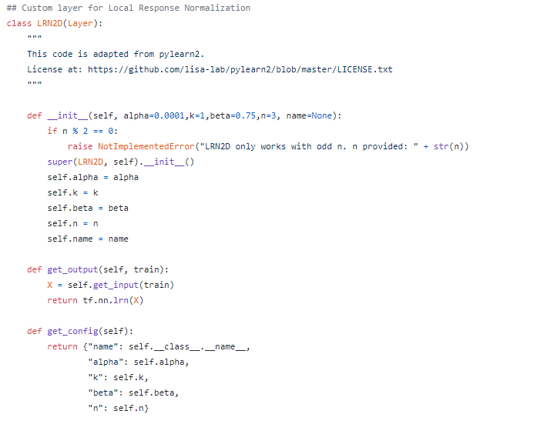

Slide 11
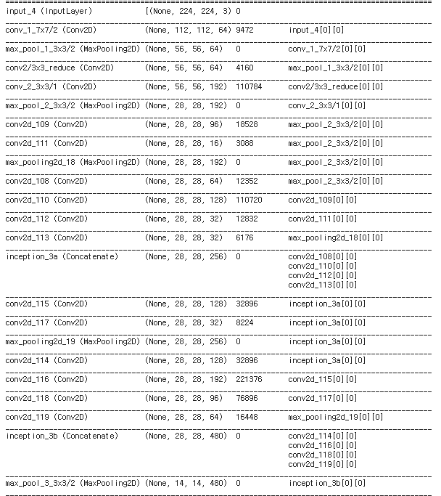
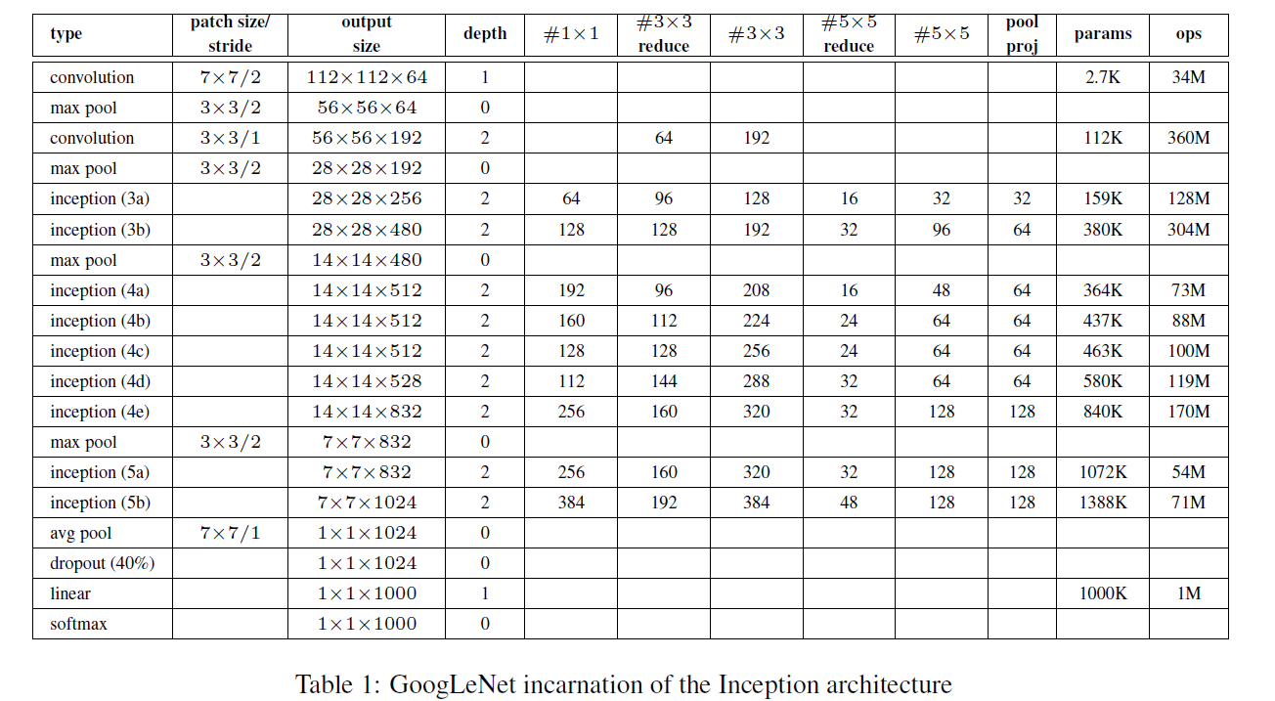

Slide 12
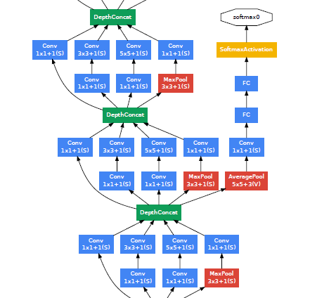
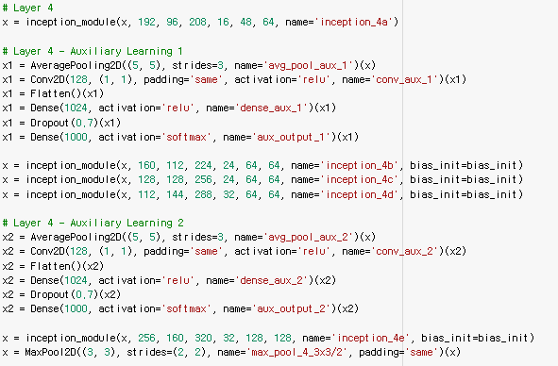

Slide 13
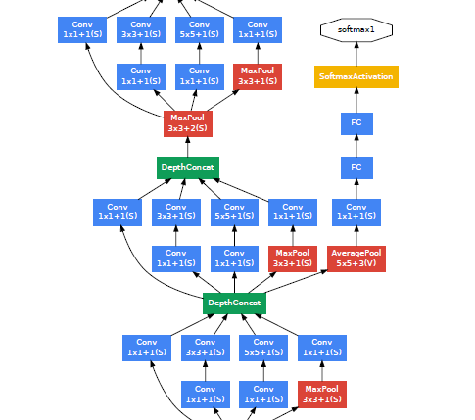

Slide 14
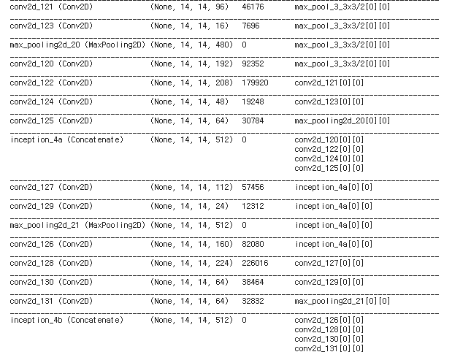

Slide 15
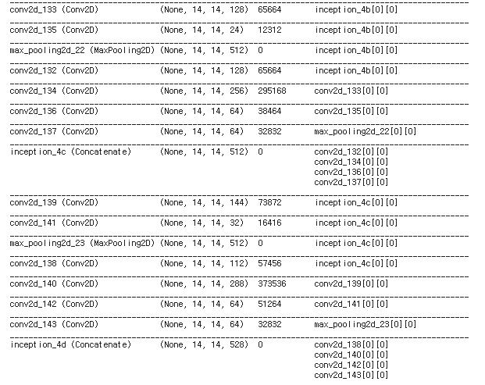

Slide 16
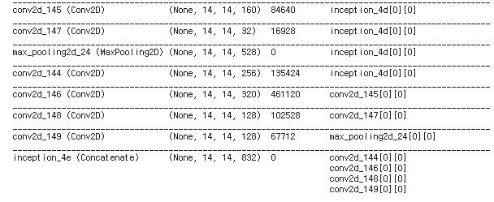

Slide 17
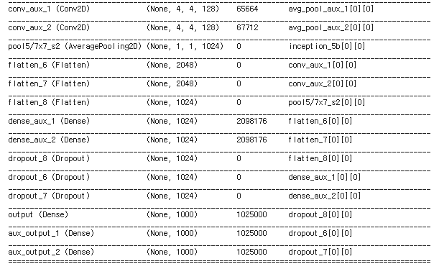

Slide 18
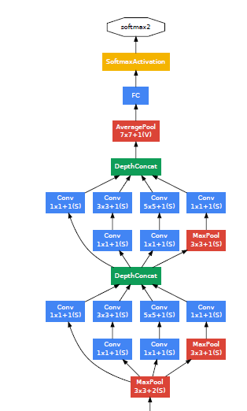
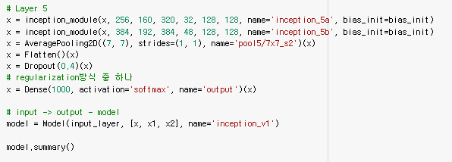

Slide 19
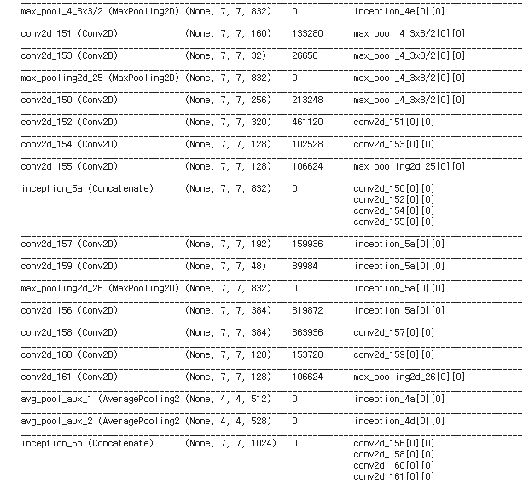

Slide 21
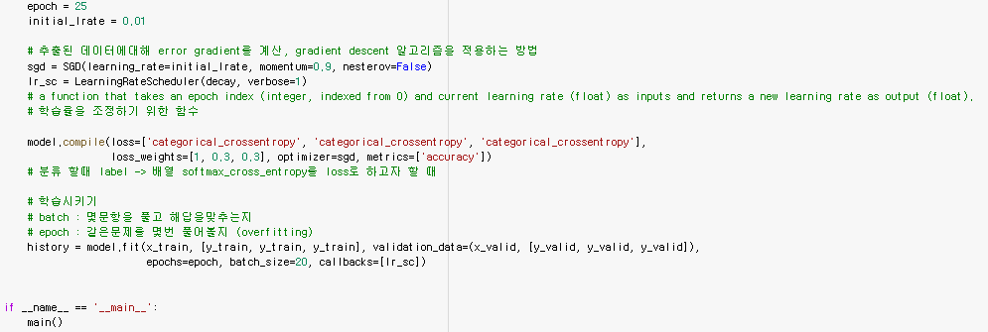
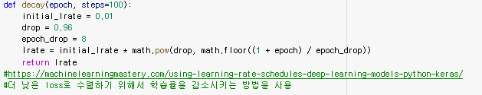

Slide 22
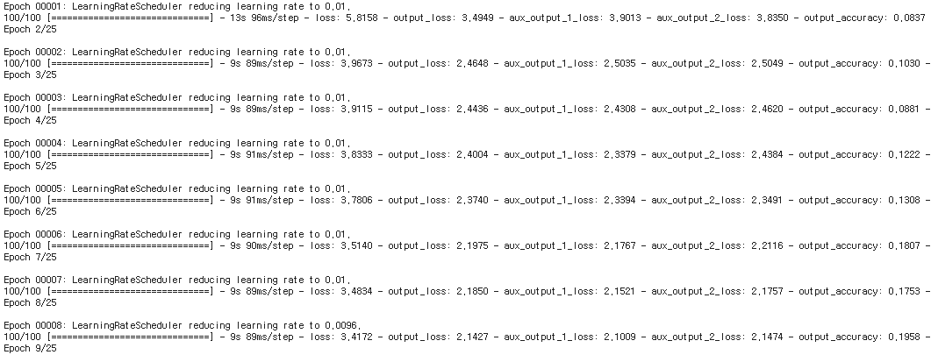

Slide 23
Epoch 00001:
loss: 5.8158 - output_loss: 3.4949 - aux_output_1_loss: 3.9013 - aux_output_2_loss: 3.8350 - output_accuracy: 0.0837 - aux_output_1_accuracy: 0.0831 - aux_output_2_accuracy: 0.0890 - val_loss: 3.9092 - val_output_loss: 2.4379 - val_aux_output_1_loss: 2.4371 - val_aux_output_2_loss: 2.4676 - val_output_accuracy: 0.0860 - val_aux_output_1_accuracy: 0.0820 - val_aux_output_2_accuracy: 0.0820
Epoch 00025:
loss: 2.5407 - output_loss: 1.6130 - aux_output_1_loss: 1.5239 - aux_output_2_loss: 1.5683 - output_accuracy: 0.3908 - aux_output_1_accuracy: 0.4258 - aux_output_2_accuracy: 0.4135 - val_loss: 2.5458 - val_output_loss: 1.6142 - val_aux_output_1_loss: 1.5555 - val_aux_output_2_loss: 1.5497 - val_output_accuracy: 0.3900 - val_aux_output_1_accuracy: 0.4080 - val_aux_output_2_accuracy: 0.4100

Slide 24
Q & A

