Slide 1
squeezenet

Slide 2
1. 지난 발표 보충
2. squeezenet 코드해석

Slide 3
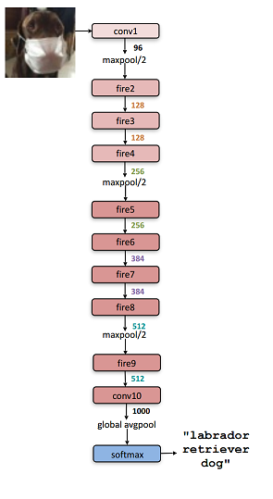
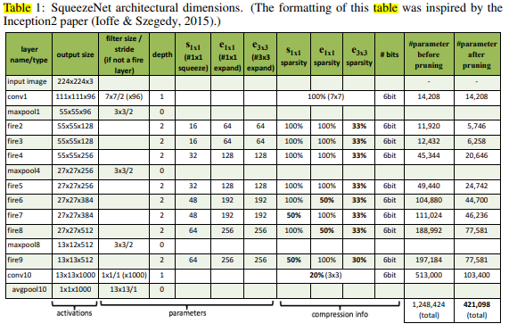
224x224x3
${base}_{e}$=128, ${incr}_{e}$=128, ${pct}_{3x3}=0.5$, SR = 0.125

Slide 4
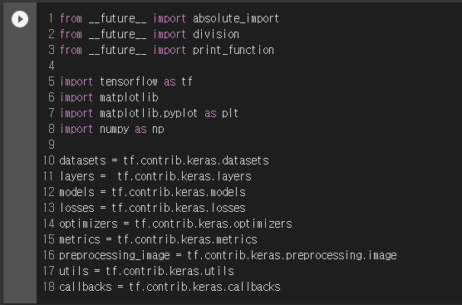
Imports
ModuleNotFoundError: No module
named 'tensorflow.contrib'
!pip uninstall tensorflow
!pip install tensorflow==1.15

Slide 5
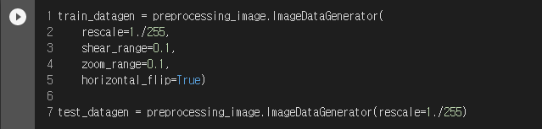
Load Cifar10 Datset
Image Preprocessing and Augmentation
참고: https://keraskorea.github.io/posts/2018-10-24-little_data_powerful_model/

Slide 6
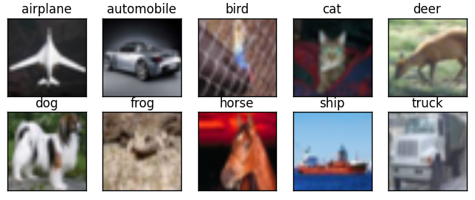
10개의 분류가진 32x32크기의 컬러이미지
분류 당 6000장
Training에 50000장
Test에 10000장

Slide 7


One Hot Encoding of Target Vector
Data Generator

Slide 8
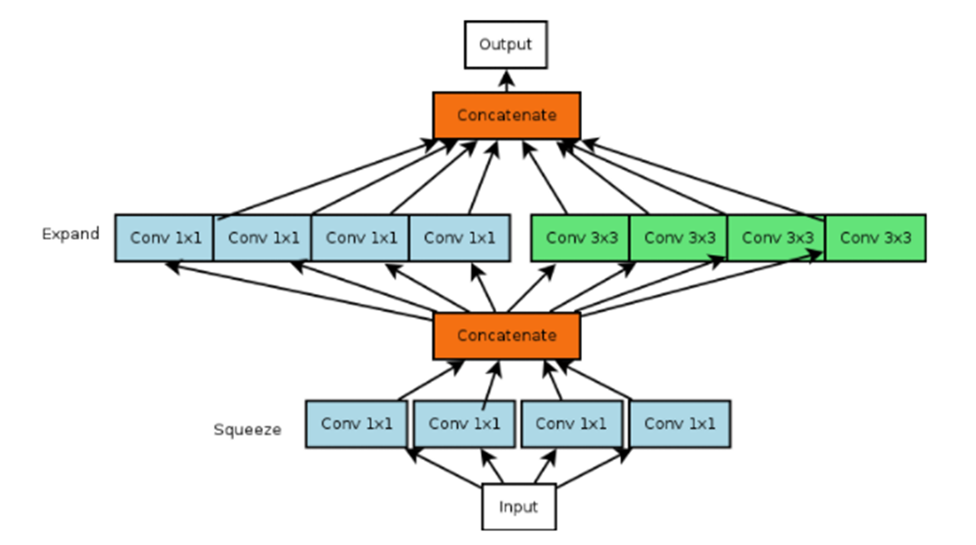
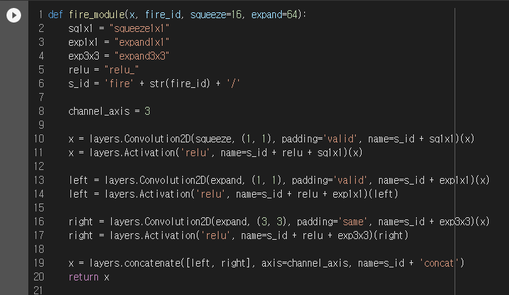
Implementation of Fire Module

Slide 9
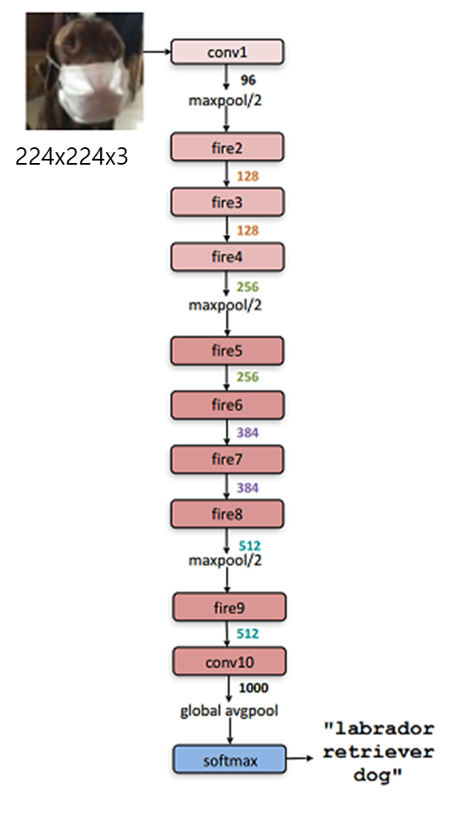
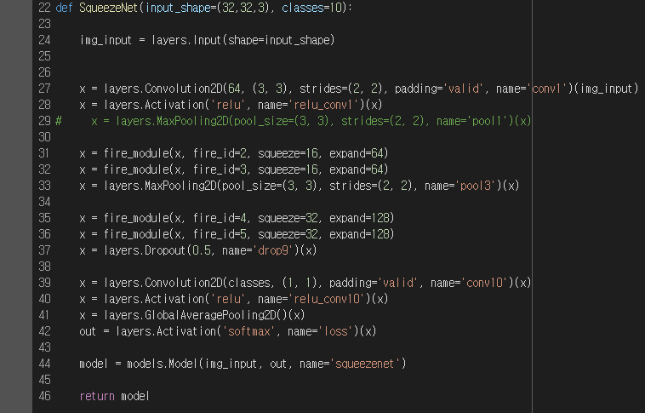
${base}_{e}$=128, ${incr}_{e}$=128, ${pct}_{3x3}=0.5$, SR = 0.125

Slide 10
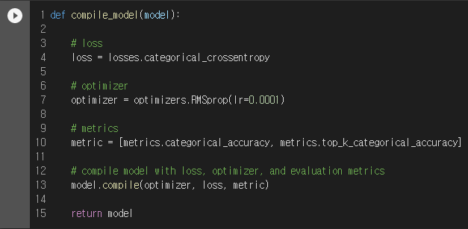
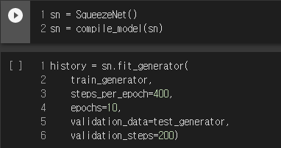
Compile Model
Train Model on Cifar10

Slide 11
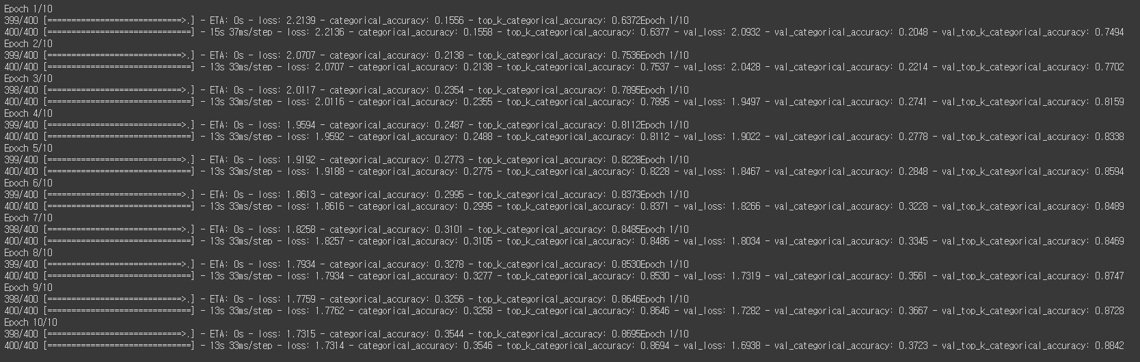

Slide 12
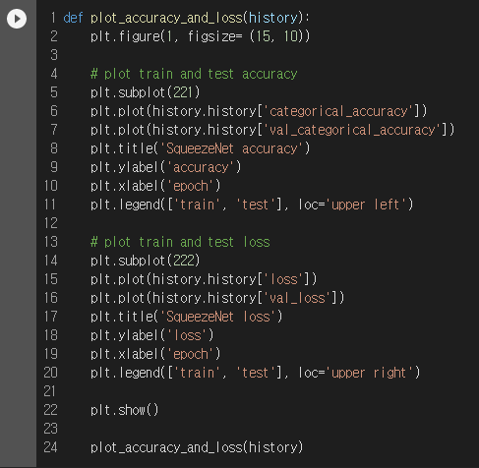
Plot Accuracy and Loss Over Time

Slide 13
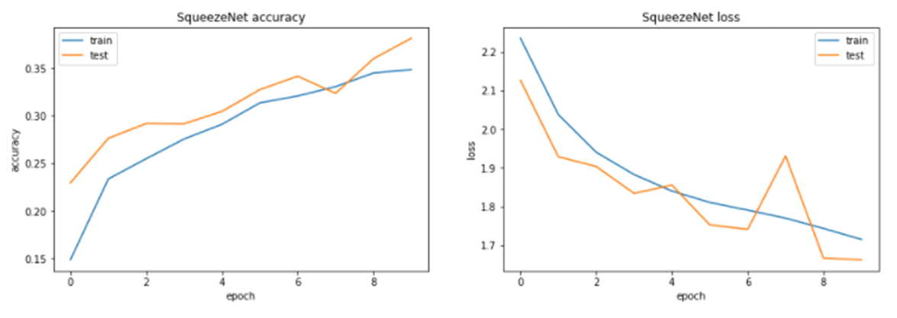

Slide 14
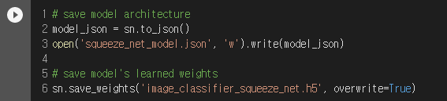
Save Model Configuration and Weights

