Slide 1
GoogleNet(Inception)
Result
발표자 : 182605 이윤수

Slide 2
Index
Simple Convnet MNIST
Inception MNIST
Simple Convnet CIFAR
Inception CIFAR

Slide 3
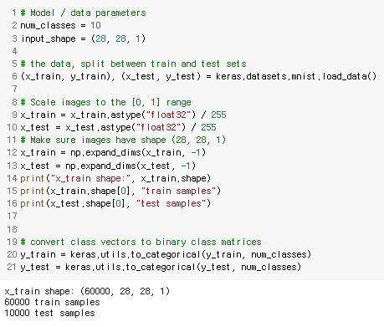
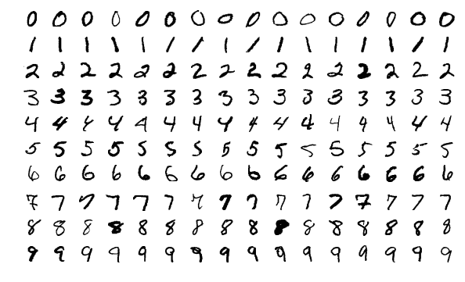
Simple Convnet MNIST

Slide 4
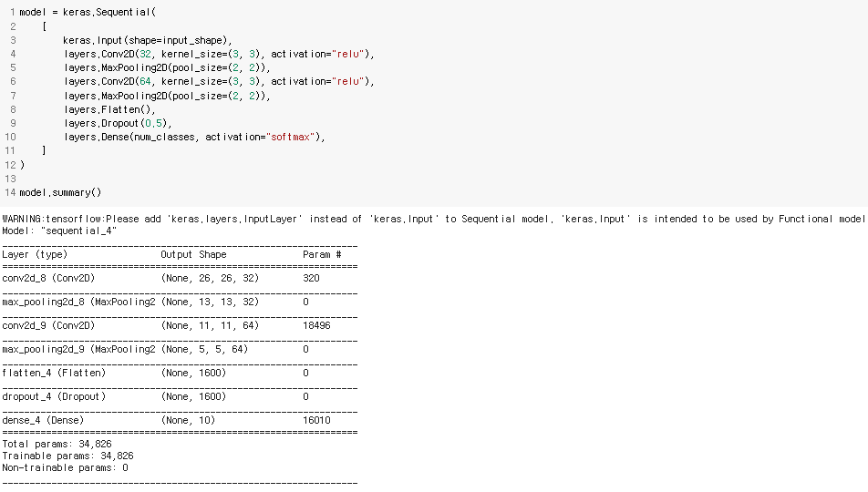
Simple Convnet MNIST

Slide 5
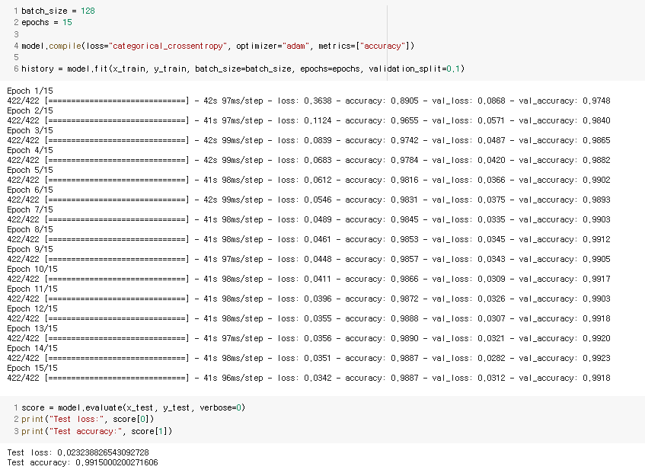
Simple Convnet MNIST

Slide 6
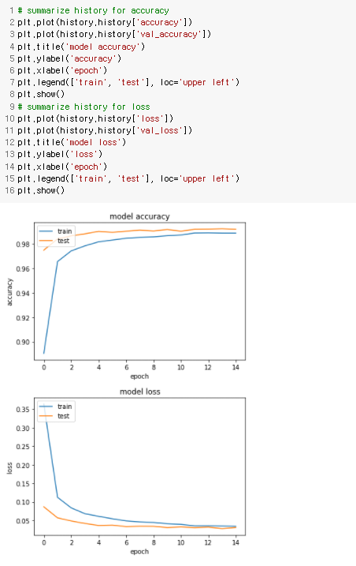
Simple Convnet MNIST

Slide 7
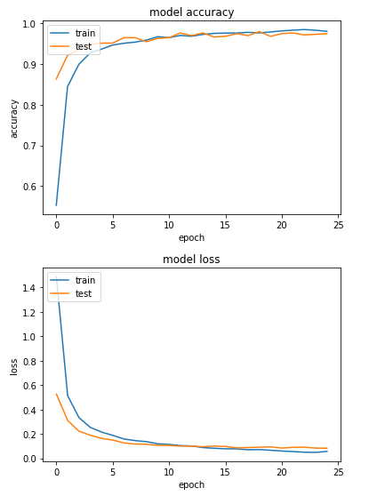
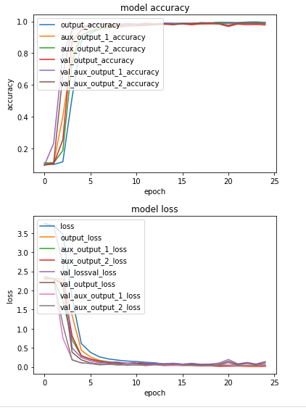
Inception MNIST

Slide 8
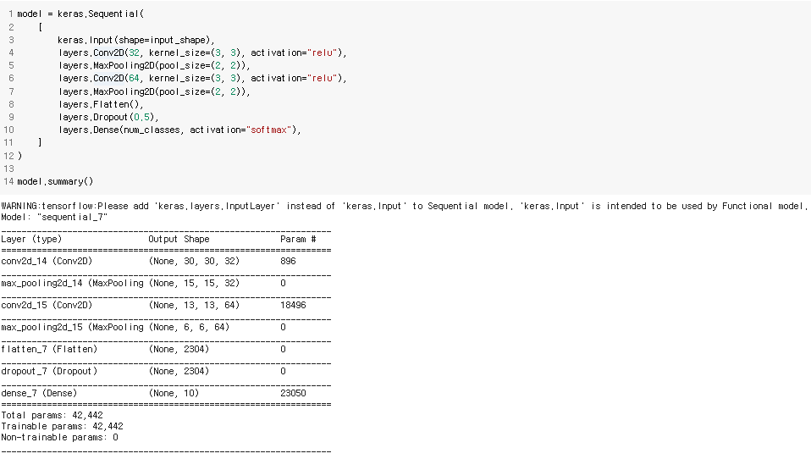
Simple Convnet CIFAR

Slide 9
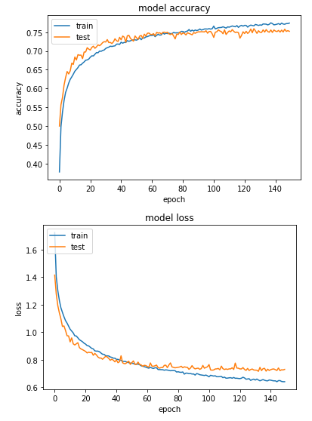
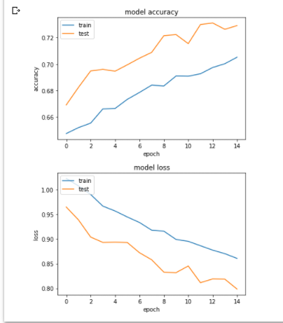
Simple Convnet CIFAR

Slide 10
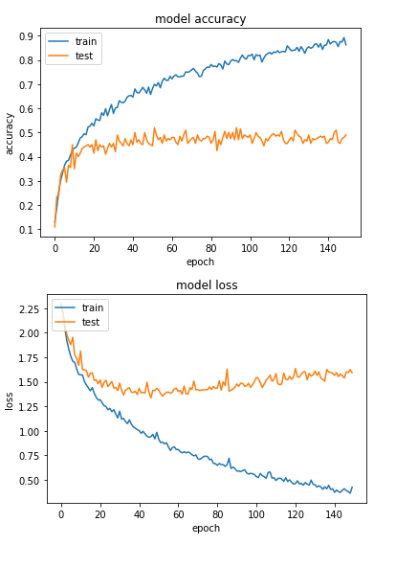
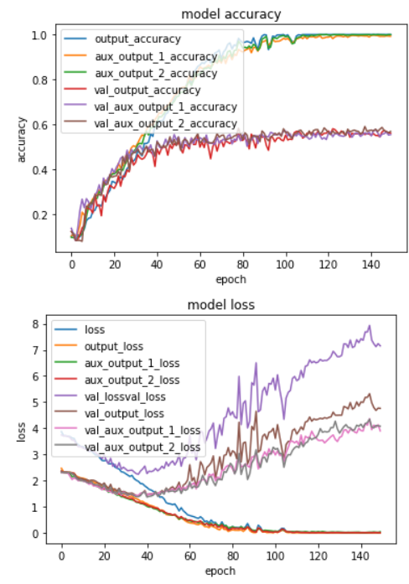
Inception CIFAR
2000, 500

Slide 11
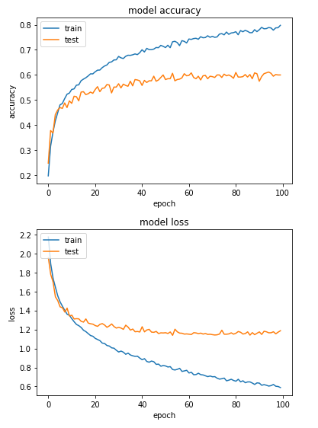
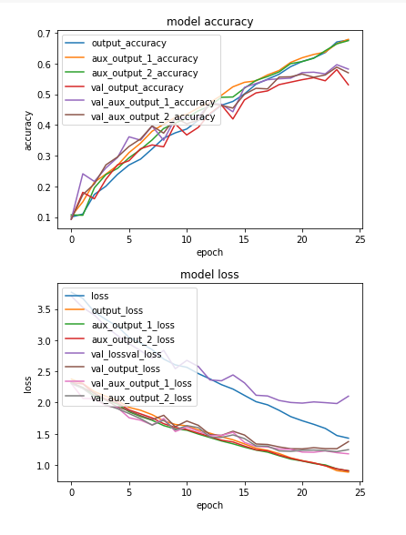
Inception CIFAR
6000, 2000

