Slide 1
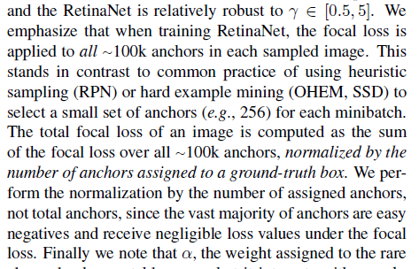
Loss function의 존재
https://keras.io/examples/vision/retinanet/

Slide 2
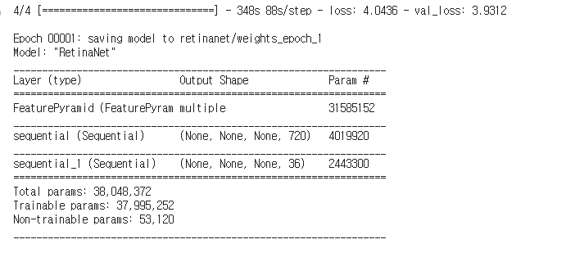

Slide 3
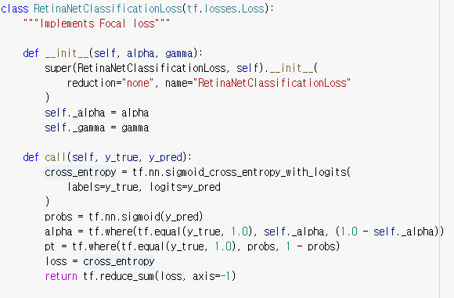

Slide 4
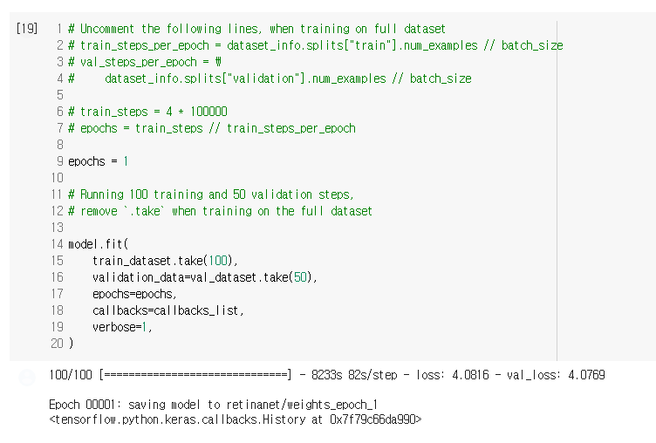
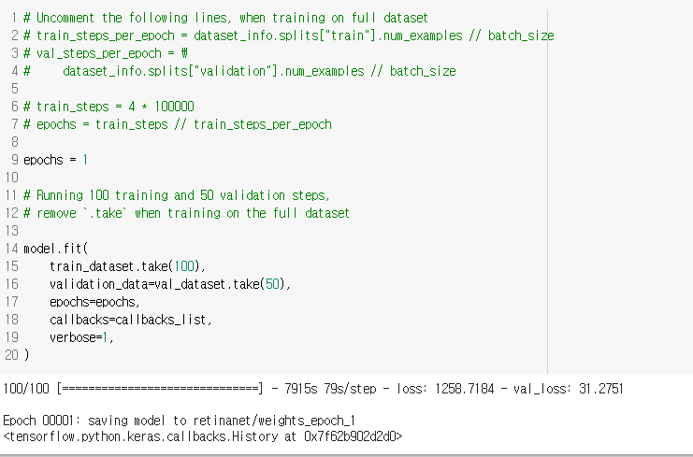

Slide 5
RetinaMask
(Learning to predict masks improves state-of-the-art sing-shot detection for free)
발표자 : 182605 이윤수

Slide 6
Index
Introduction
Related Work
Model
Experiment

Slide 7
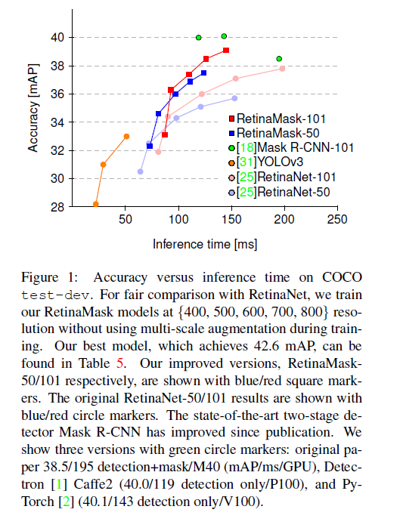
Introduction
Our modifications to training result in detectors with better accuracy at the same computational cost
RetinaNet -> RetinaMask
Today, two-stage detectors significantly beat single stage detectors on the speed-vs-accuracy trade-off.
-> adaption on lower-power embedded devices the cost sometimes exacerbated

Slide 8
Introduction
Three new techniques that improve training :
Adding a novel instance mask prediction head to the single-shot RetinaNet detector during training.
A new self-adjusting loss function that improves robustness during training.
Including more of the positive examples in training, even those with low overlap

Slide 9
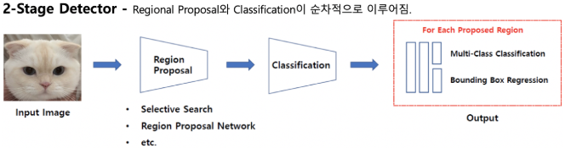
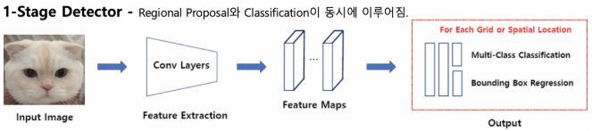
Related Work

Slide 10
Related Work
Techniques for Improving Detectors
Cleaner training data often helps achieve fast convergence and higher final accuracy (ex : NMS(non-maximum suppression))
Certain model modifications add context information to predictions
Additional training information is beneficial for detectors

Slide 11
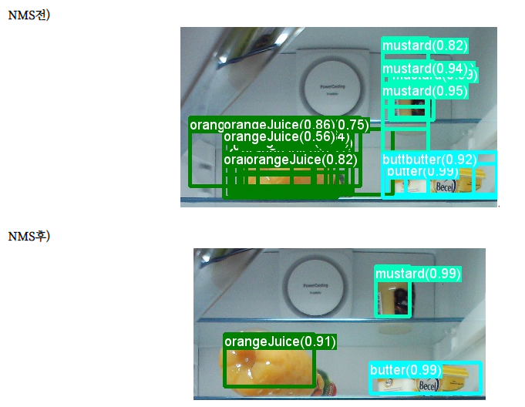
Related Work

Slide 12
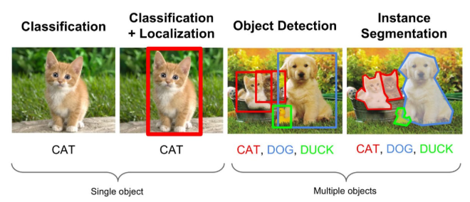
Related Work

Slide 13
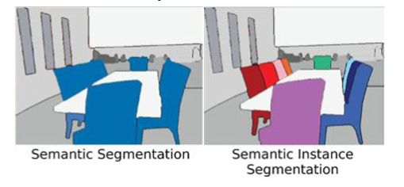
Related Work

Slide 14
Model
Best matching policy
Modified bounding box regression loss
Add the mask prediction module on top of RetinaNet

Slide 15
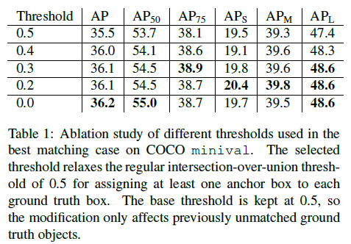

Model
Best matching policy
There exists an exceptional case for which the assignment can be improved
(ex : some of the gt-objects’ aspect ratios are outliers with one side much longer than the other)
No anchor box can be matched
For each of these ground truth boxes we propose to find its best matching anchor box, relaxing the overlapping IOU threshold
-> Using best matching anchor with any nonzero overlap gives the best accuracy

Slide 16
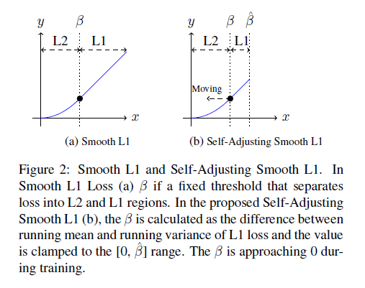

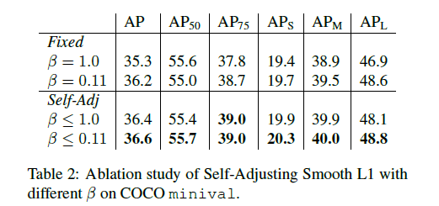
Model
Self-Adjusting Smooth L1 Loss
B splits the positive axis range into two parts :

Slide 17
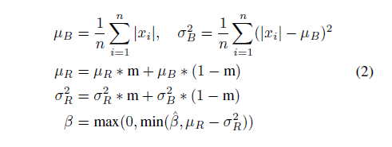
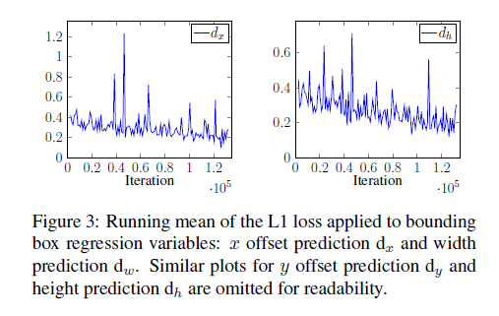
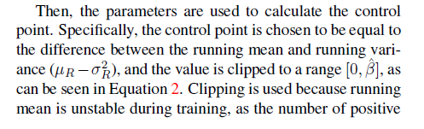
Model
Self-Adjusting Smooth L1 Loss
Inside the loss function, the running mean and variance of the absolute loss are recorded. We use the running minibatch mean and variance with momentum=0.9 to update these two parameters.

Slide 18

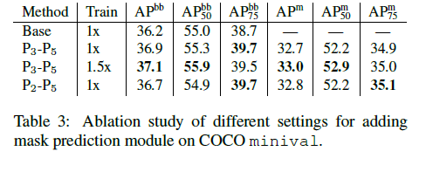
Model
Mask Prediction Module
After running RetinaNet for bounding box predictions, extract the top N scored predictions.
Then, distribute these mask proposals to sample features from the appropriate layer of the FPN according to Equation 3 proposed in FPN
We use the following equation to determine which feature map, Pk to sample from for predicting the instance mask:
K0 = 4; w, h = width, height of detection;
If the size is smaller than 224^2 assigned to feature layer P3
Between 224^2 ~ 448^2 assigned to layer P4
Larger than 448^2 assigned to layer p5
In our ablation study, we analyze the impact of using more feature layers for mask proposals assignment, showing that this does not give any performance boost

Slide 19
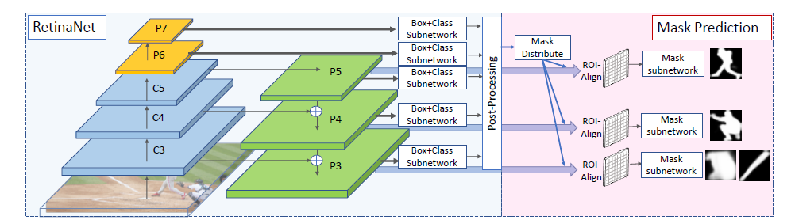
Model
Mask Prediction Module
The ROI-Align operation is performed at the assigned feature layers, yielding 14*14 resolution features, which are fed into 4 consequent convolution layers(3*3) and a single transposed convolutional layer (2*2) + prediction conv(1*1) layer

Slide 20
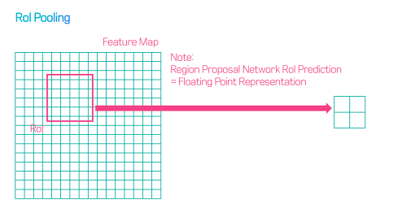
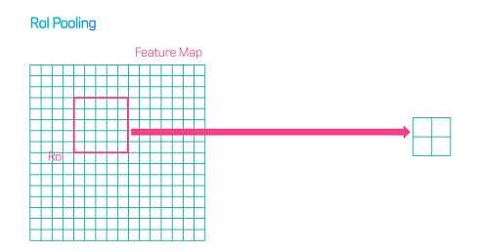
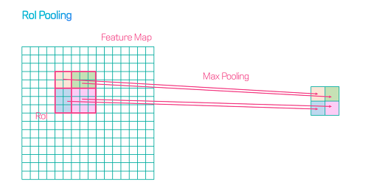
Model

Slide 21
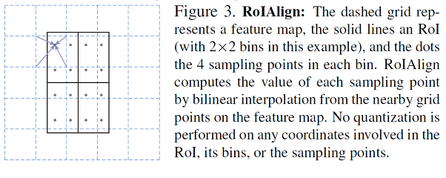
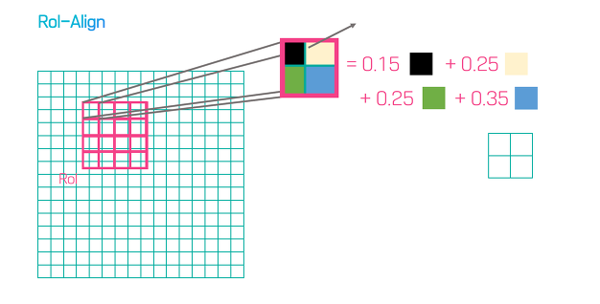
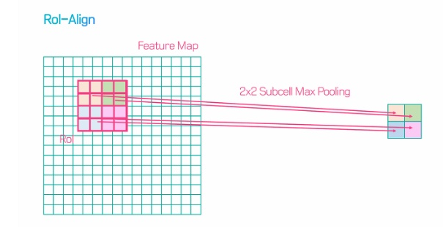
Model

Slide 22
Model
For each image during training, we also run suppression and top-100 selection of the predicted boxes (the same processing as single-shot detectors apply during inference).
First, during the bounding box inference we use a confidence threshold of 0.05 to filter out predictions with low confidence.
Second, we select the top 1000 scoring boxes from each prediction layer.
Third, we apply non-maximum suppression (nms) with threshold 0.4 for each class separately.
Finally, the top-100 scoring predictions are selected for each image

Slide 23
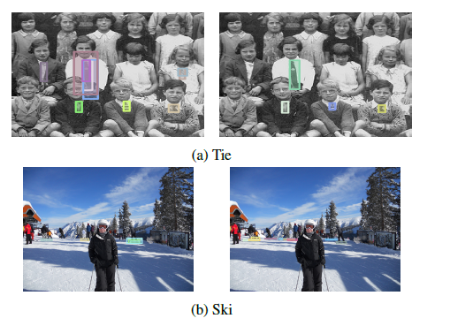
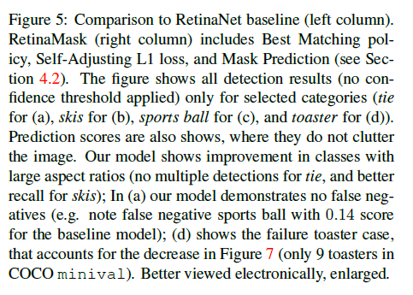
Experiment

Slide 24
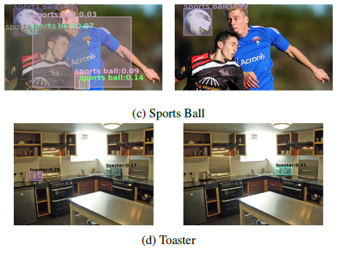
Experiment

Slide 25
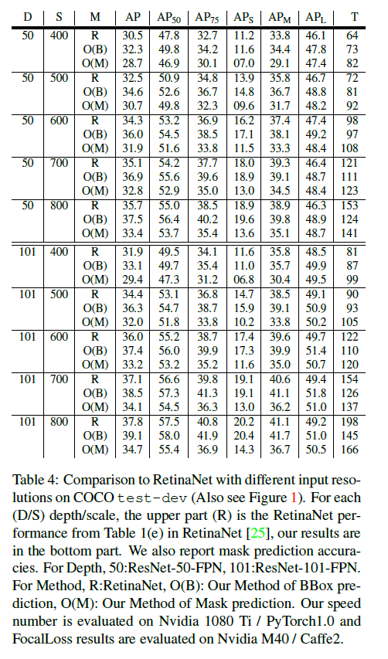
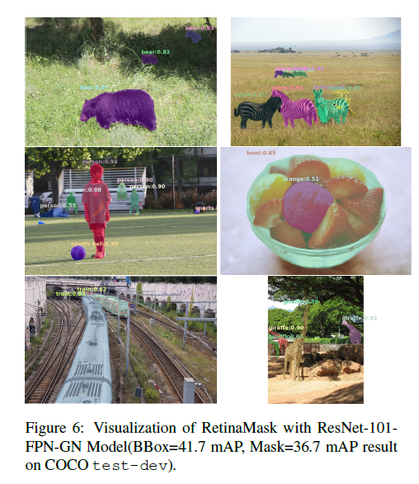
Experiment

Slide 26
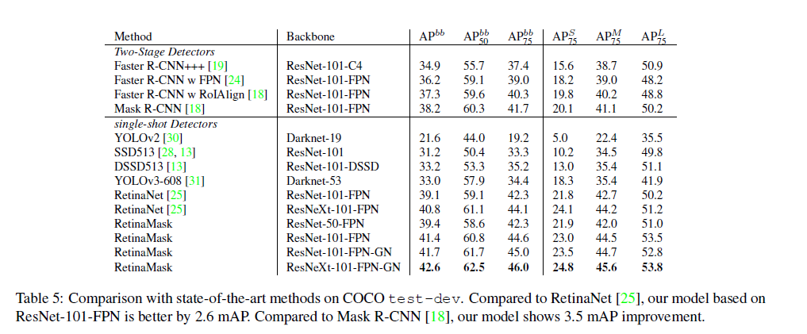
Experiment

Slide 27
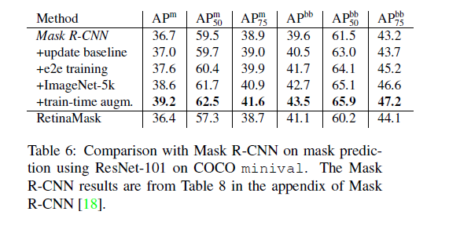
Experiment

