Slide 1
HRNet
(Deep High-Resolution Representation Learning for Visual Recognition)
발표자 : 182605 이윤수

Slide 2
Index
Introduction
Related Work
HighResolution Networks
Result

Slide 3
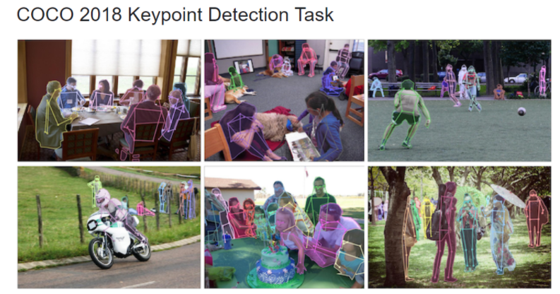
Introduction

Slide 4
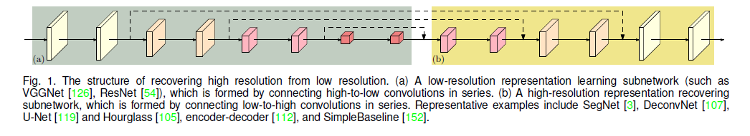
Introduction
Gradually reduce the spatial size of the feature maps
-> connect the convolutions from high resolution to low resolution in series
-> lead to a low-resolution representation
: High-resolution representations are need for position-sensitive tasks ex) semantic segmentation, human pose estimation, object detection

Slide 5
Introduction
We present a novel architecture, namely High-Resolution Net (HRNet), which is able to maintain high-resolution representations through the whole process.
High-to-low resolution convolution streams in parallel rather than in series.
We repeat Multi-resolution fusions to boost the high-resolution representations with the help of the low-resolution representations.

Slide 6
Related Work
Learning low-resolution representations
Recovering high-resolution representations
Maintaining high-resolution representations
Multi-scale fusion
: multi-resolution images into multiple networks and aggregate the output response maps

Slide 7
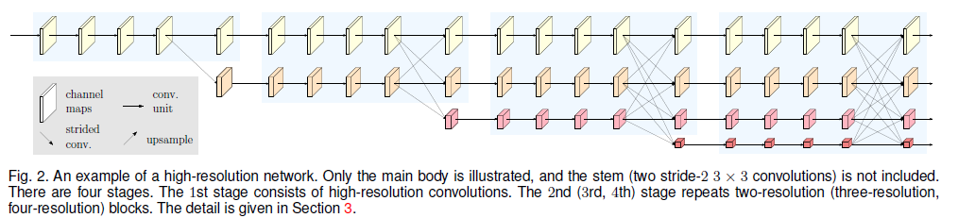
High-resolution networks
We input the image into a stem, which consists of two stride-2 3*3 convolutions decreasing the resolution to ¼, and subsequently the main body that outputs the representation with the same resolution ¼

Slide 8
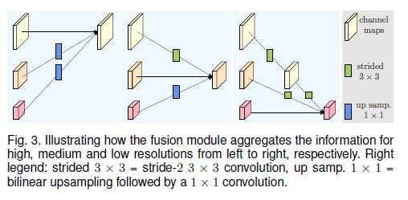
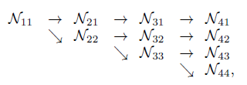
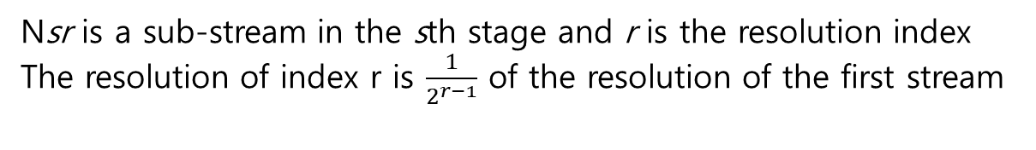
High-resolution networks
Nsr is a sub-stream in the sth stage and r is the resolution index
The resolution of index r is $\frac{1}{2^{r−1}}$ of the resolution of the first stream

Slide 9
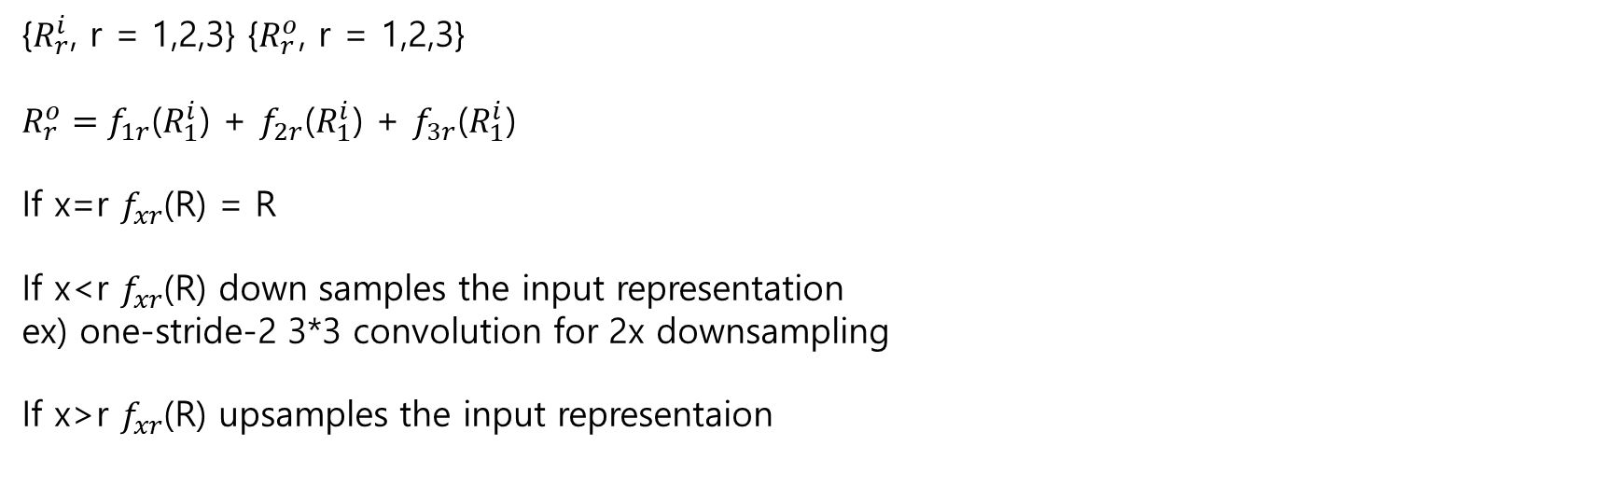
High-resolution networks
{$R_{r}^{i}$, r = 1,2,3} {$R_{r}^{o}$, r = 1,2,3}
$R_{r}^{o}=f_{1r}$($R_{1}^{i}$) + $f_{2r}$($R_{1}^{i}$) + $f_{3r}$($R_{1}^{i}$)
If x=r $f_{xr}$(R) = R
If x<r $f_{xr}$(R) down samples the input representation ex) one-stride-2 3*3 convolution for 2x downsampling
If x>r $f_{xr}$(R) upsamples the input representaion

Slide 10
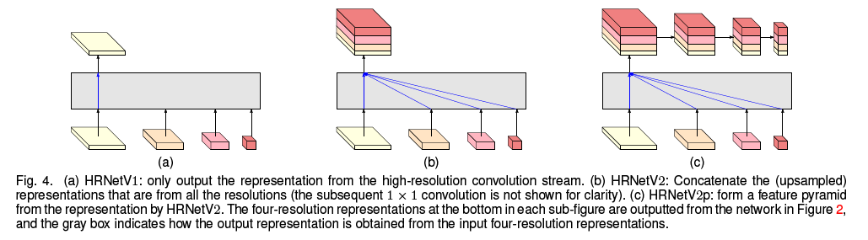
High-resolution networks
HRNetV1 : only from the high-resolution stream -> human pose estimation
HRNetV2 : rescale the low-resolution representations and concatenate -> semantic segmentation
HRNetV2p : down sample HRNetV2 -> object detection

Slide 11

Result
We empirically observe that the performance is almost the same for HRNetV1 and HRNetV2, and thus we choose HRNetV1 as its computation complexity is a little lower.
Dataset : COCO dataset 200,000 images, 250,000 person instances labeled with 17 key-points
Evaluation metric :
d is the Euclidean distance between detectded keypoint and corresponding ground truth,
u is visibility flag of the ground truth,
s is the object scale,
k is a per-keypoint constant

Slide 12
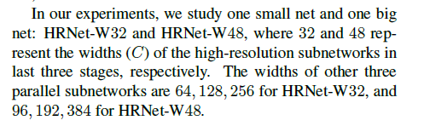
Result
Training :
Extend the human detection box 4:3 and crop the box from the image, which is resized to a fixed size, 256x192 or 384x288
Data augmentation (random rotation, random scale, flipping)
Adam optimizer
210epoch 4 V100 GPU 60(80)hours HRNet-W32(HRNet-W48)

Slide 13
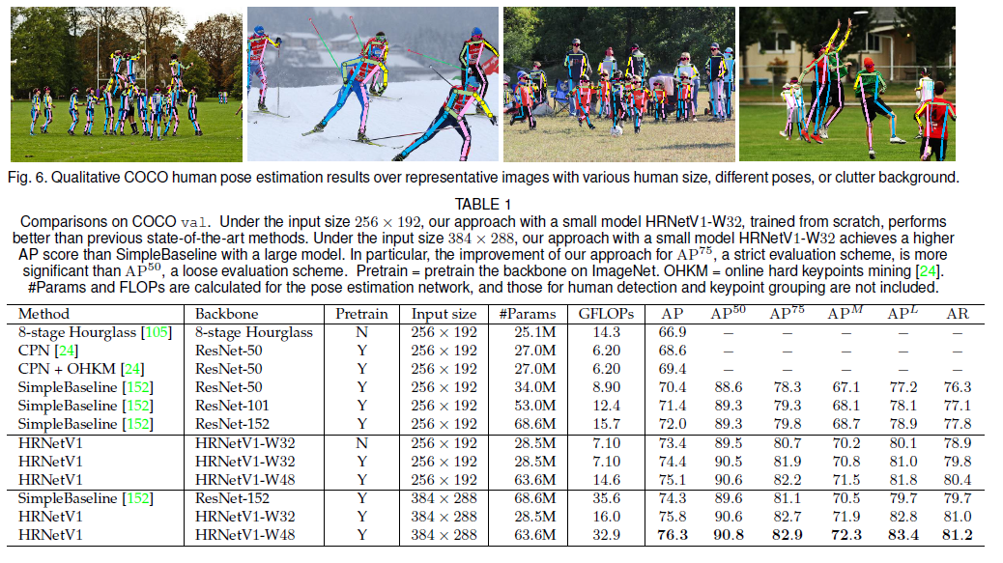
Result

Slide 14
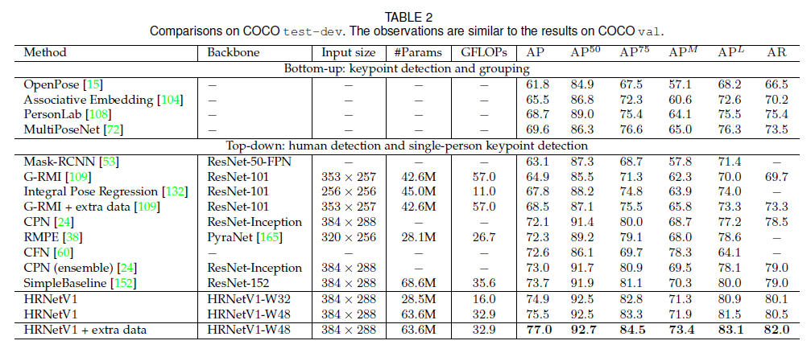
Result

Slide 15
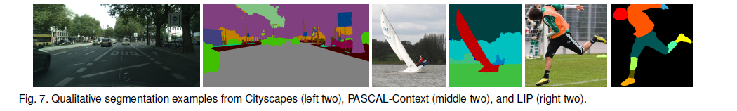
Result
We feed the input image to the HRNetV2 and then pass the resulting 15C-dimensional representation at each position to a linear classifier with the softmax loss to predict the segmentation maps.
The segmentation maps are upsampled to the input size by bilinear upsampling for both training and testing

Slide 16
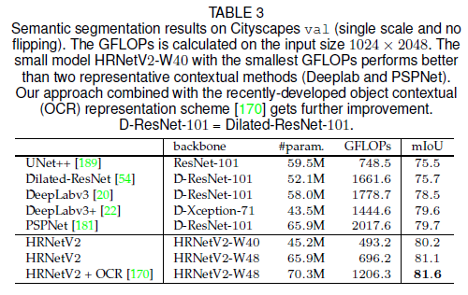
Result

Slide 17
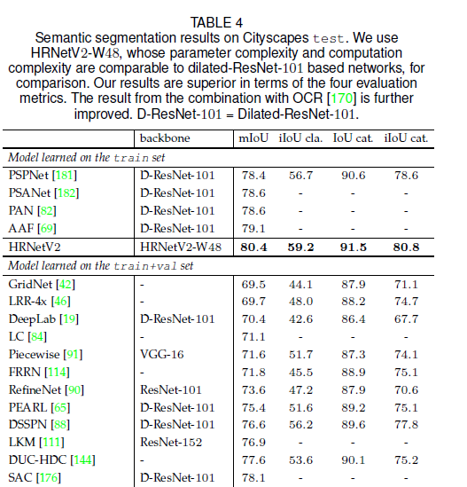
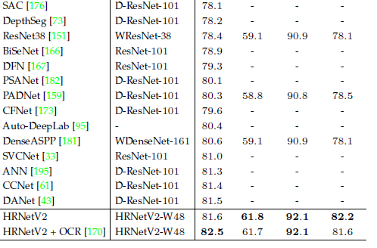
Result

Slide 18
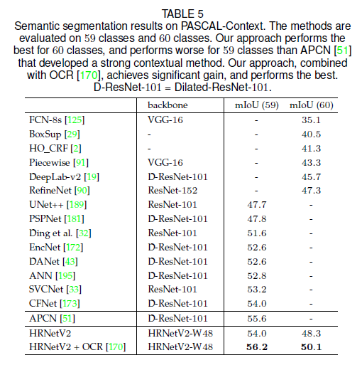
Result

Slide 19
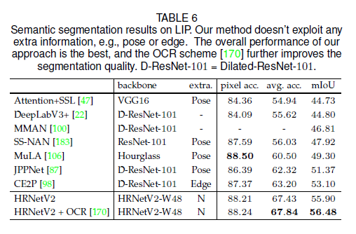
Result

Slide 20
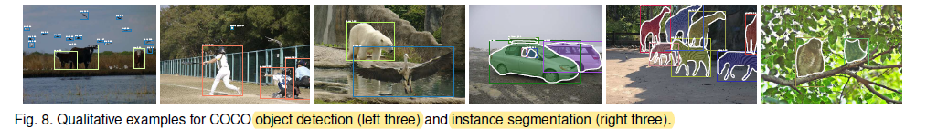
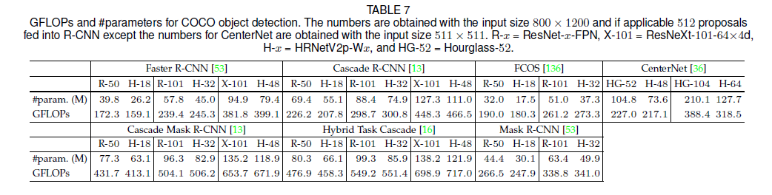
Result

Slide 21
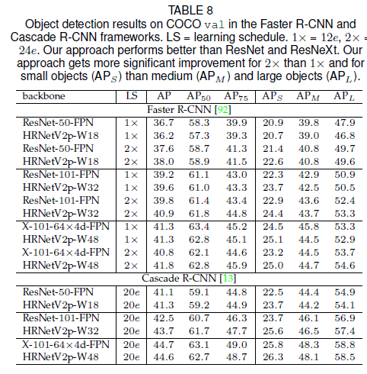
Result

Slide 22
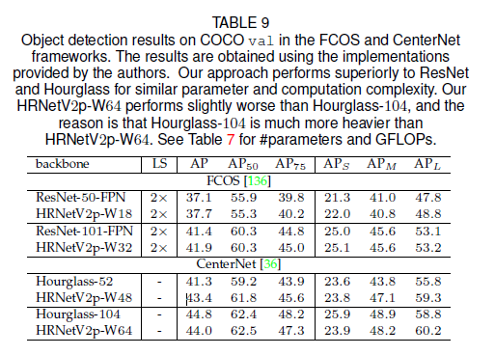
Result

Slide 23
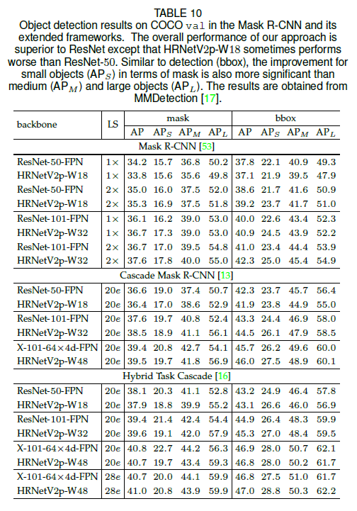
Result

Slide 24
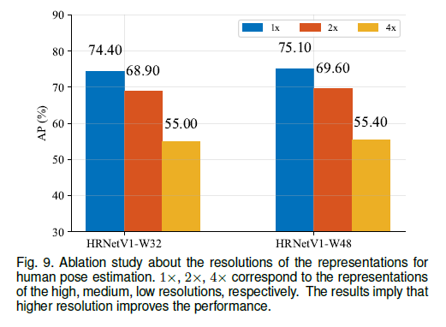
Result

Slide 25
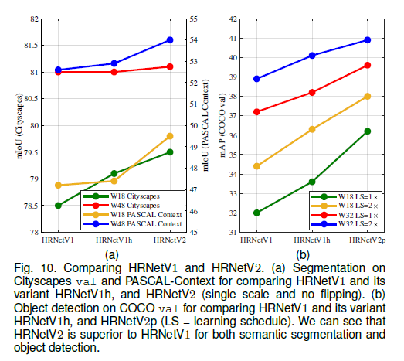
Result

Slide 26
Q & A

