Slide 1
HRNet - Code
발표자 : 182605 이윤수

Slide 2
Index
Code Explanation

Slide 3
Code Explanation
HRNet
Conventional UNet
ResNet Based UNet

Slide 4
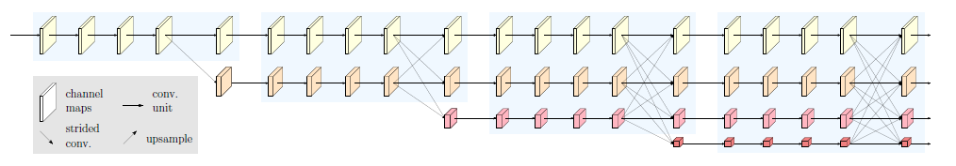
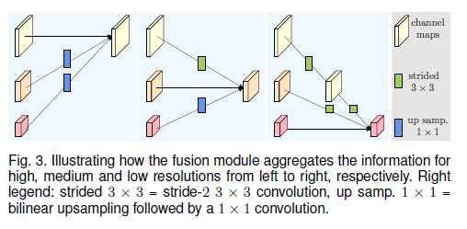
Code Explanation
HRNet

Slide 5
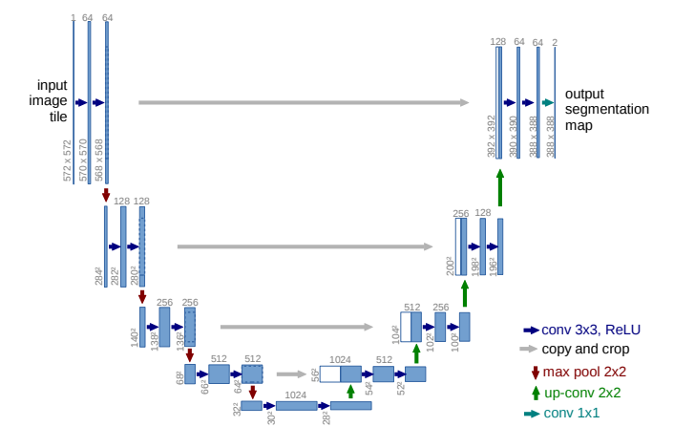
Code Explanation
Conventional UNet

Slide 6
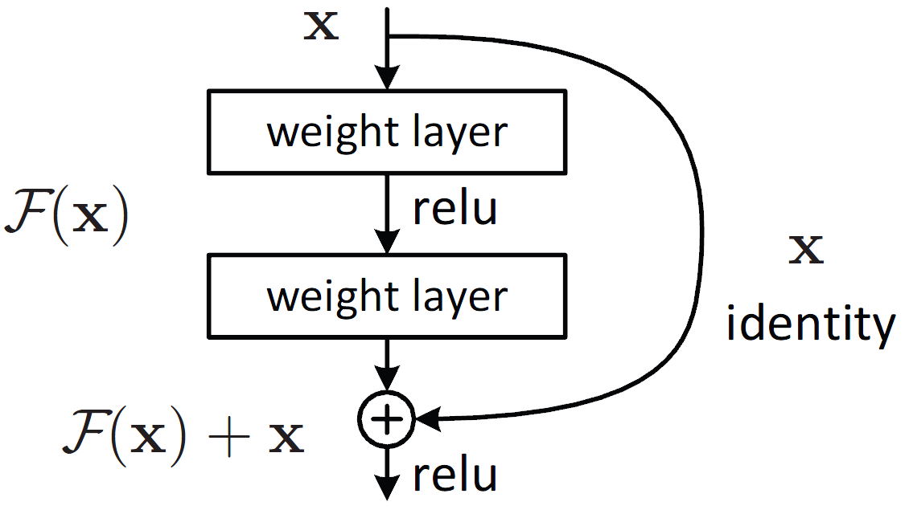
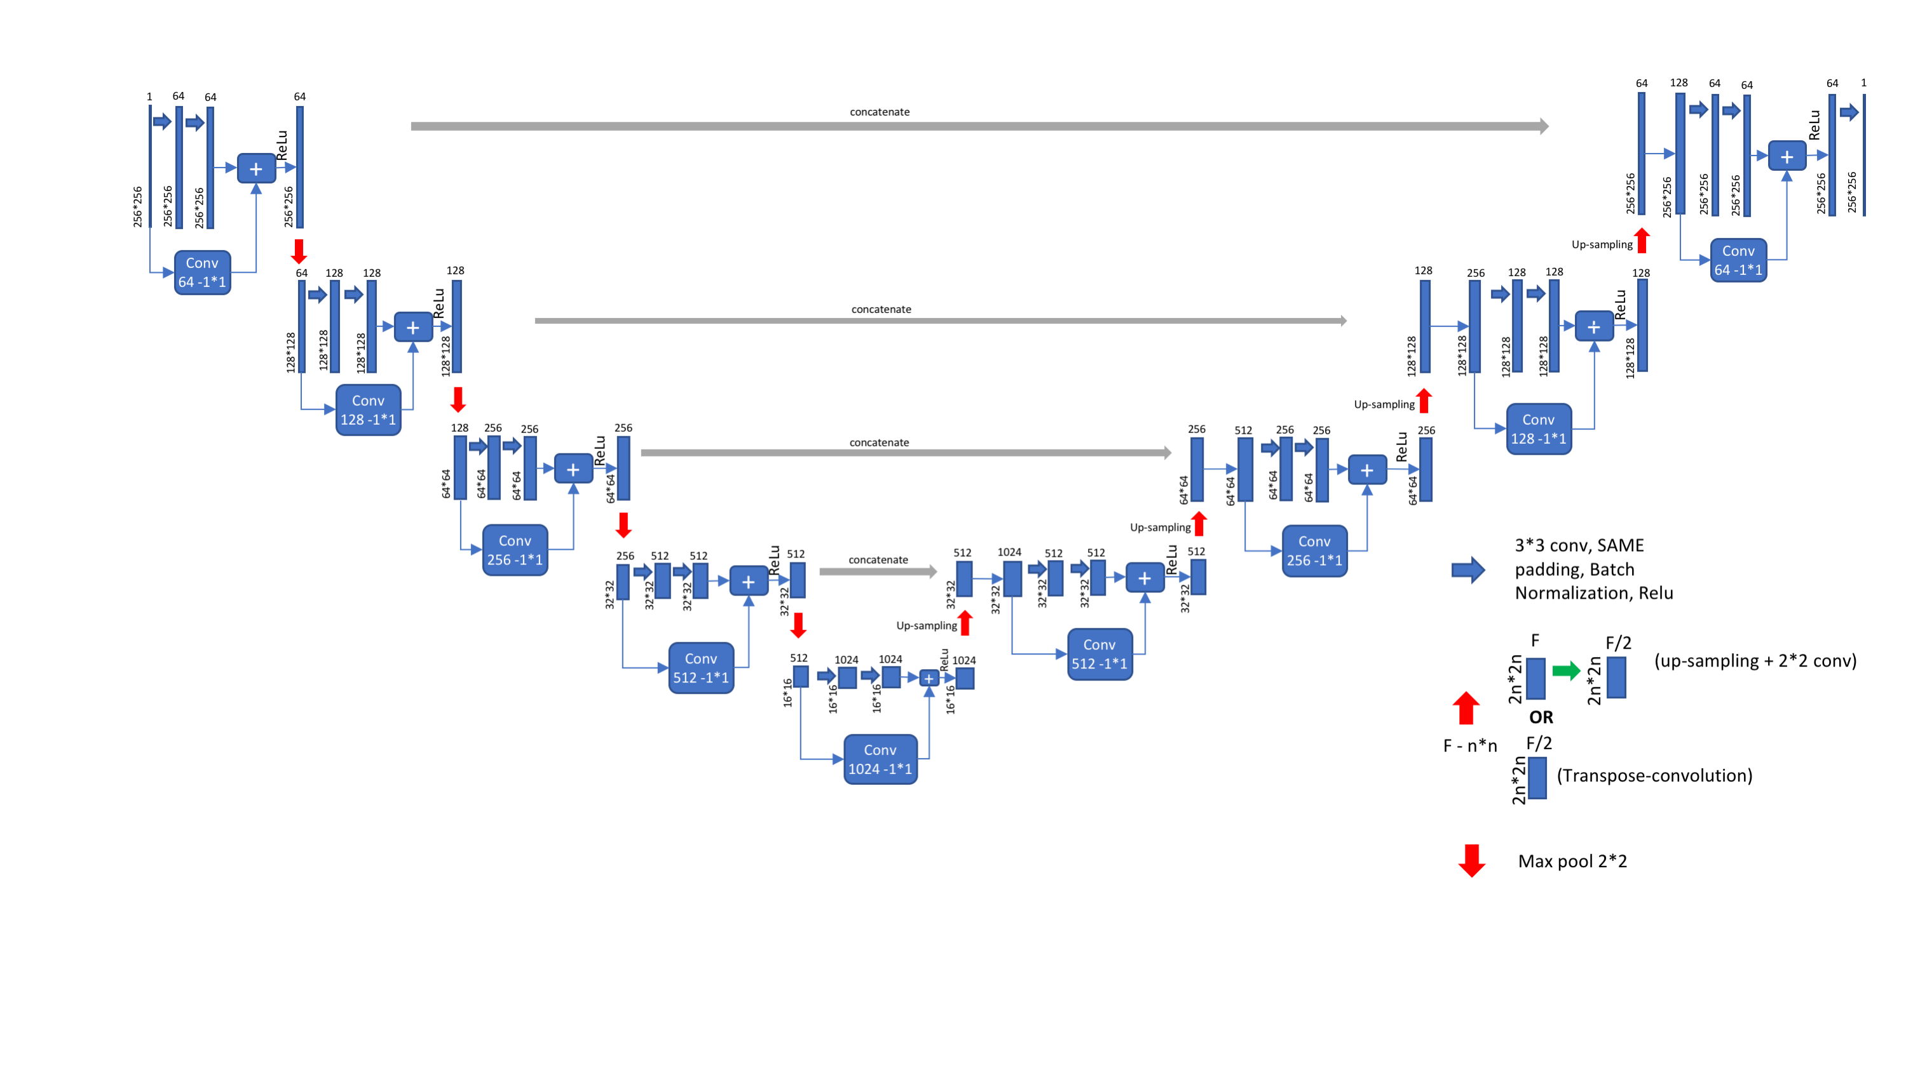
Code Explanation
ResNet Based UNet

Slide 7
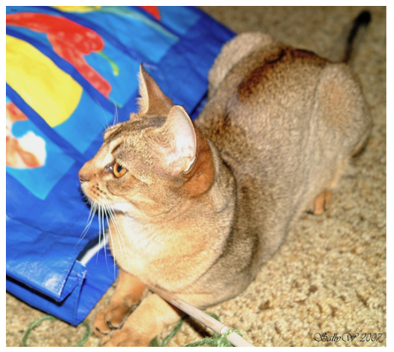

Code Explanation
https://keras.io/examples/vision/oxford_pets_image_segmentation/
Image segmentation with a U-Net-like architecture

Slide 8
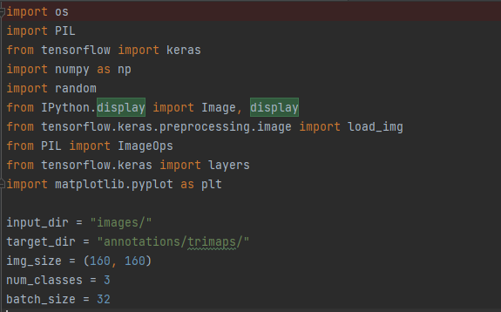
Code Explanation

Slide 9
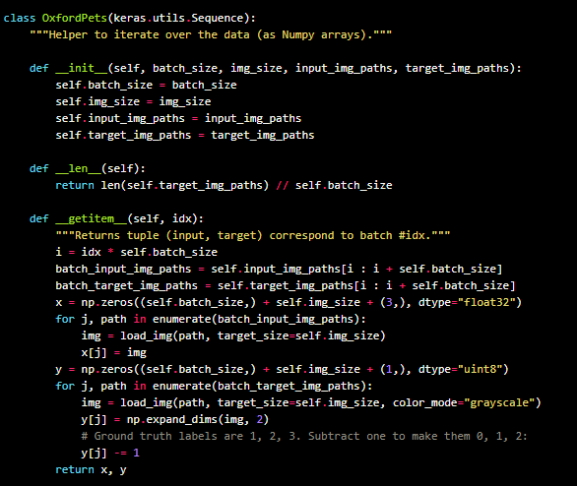
Code Explanation

Slide 10
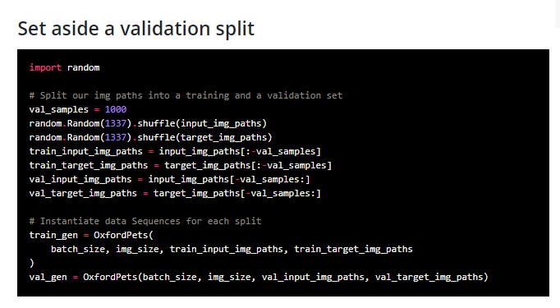
Code Explanation

Slide 11
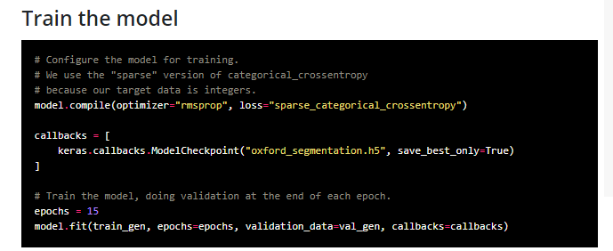
Code Explanation

Slide 12
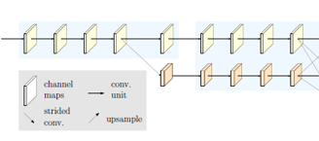
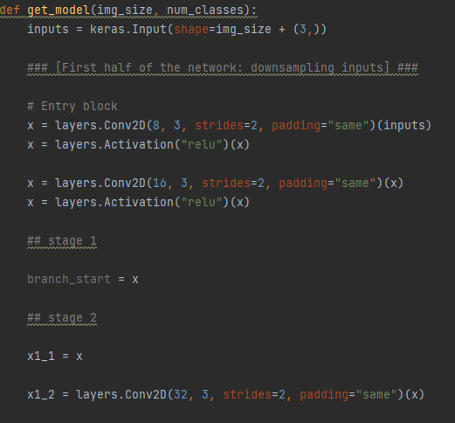
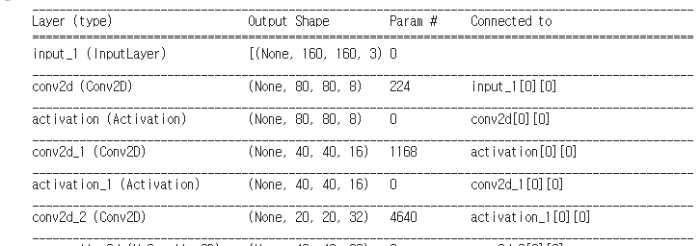
Code Explanation
HRNet

Slide 13

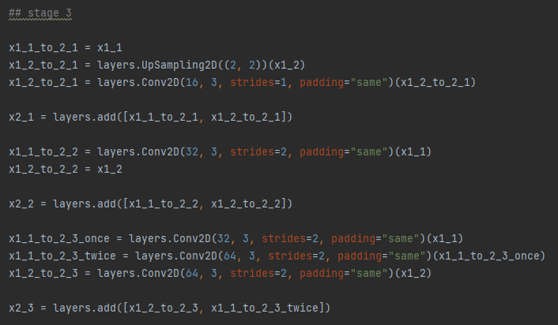
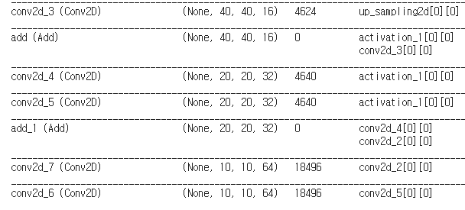
Code Explanation
HRNet

Slide 14
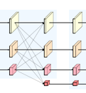
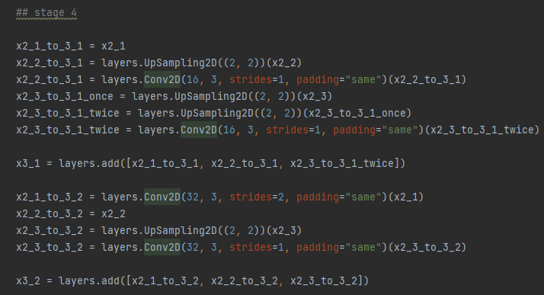
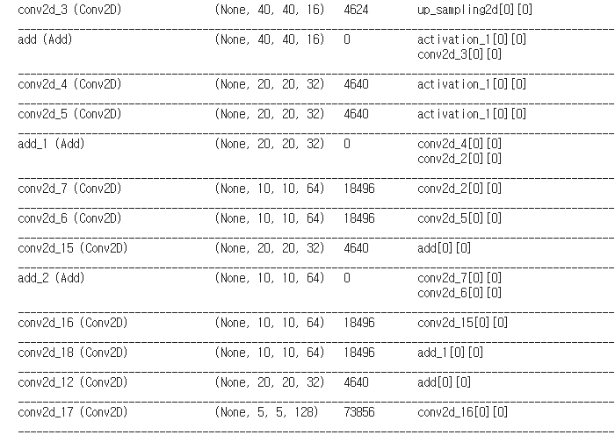
Code Explanation
HRNet

Slide 15
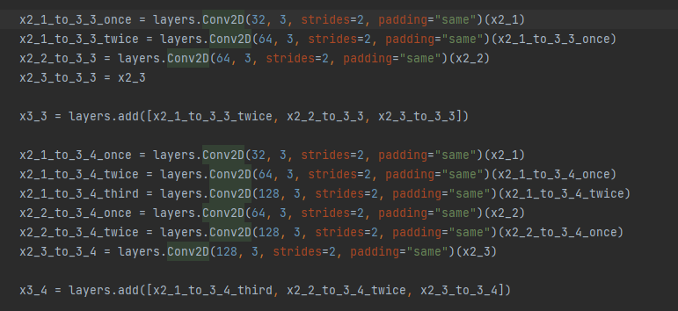
Code Explanation
HRNet

Slide 16
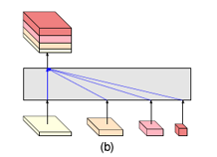
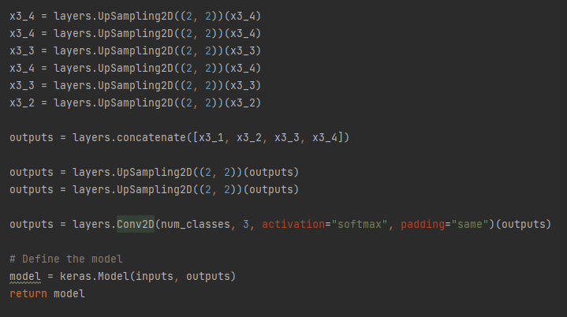
Code Explanation
HRNet

Slide 17


Code Explanation
HRNet_Result

Slide 18



Code Explanation
HRNet_Result

Slide 19
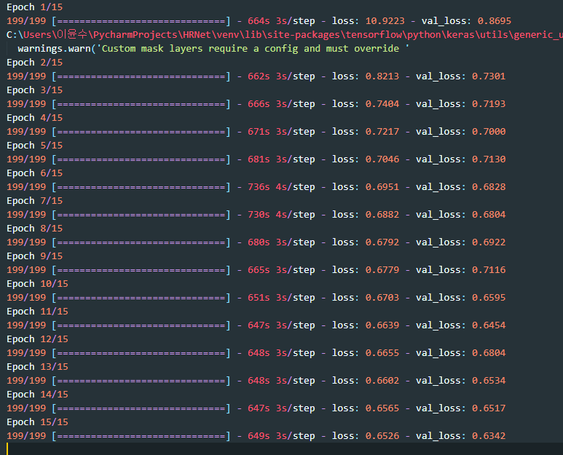
Code Explanation
HRNet_Result

Slide 20
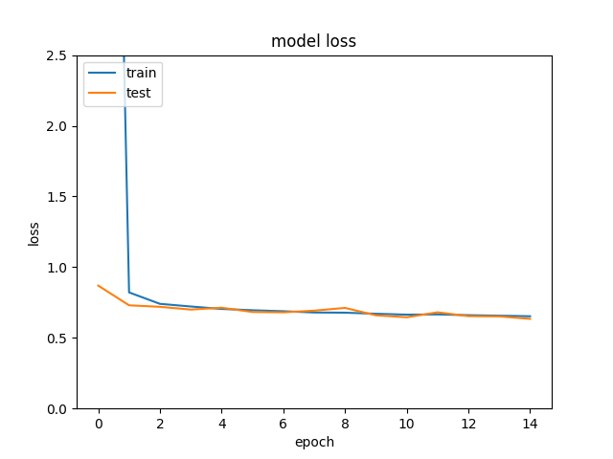
Code Explanation
HRNet_Result

Slide 21
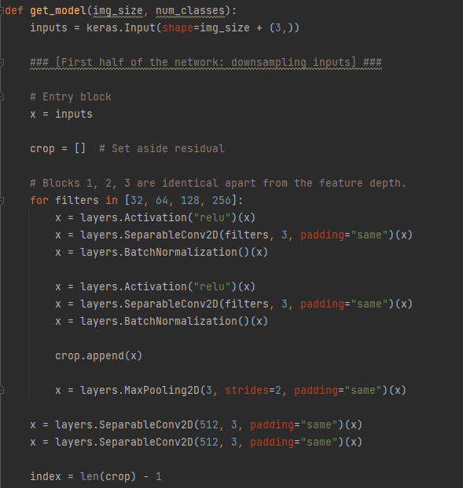
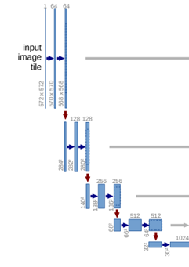
Code Explanation
Conventional UNet

Slide 22
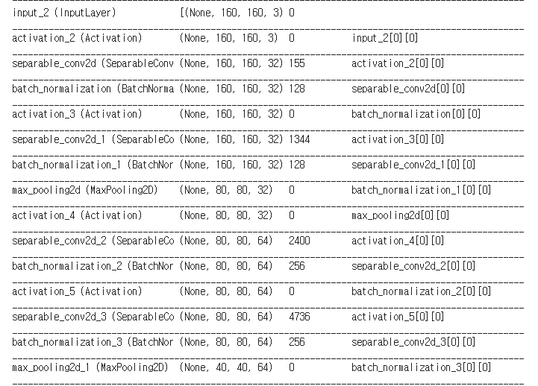
Code Explanation
Conventional UNet

Slide 23
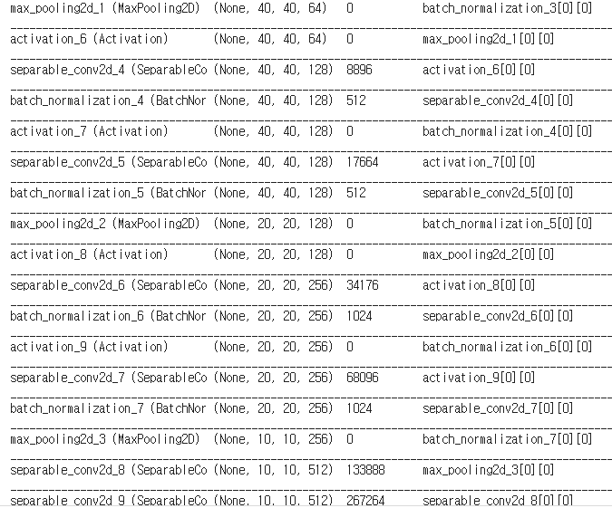
Code Explanation
Conventional UNet

Slide 24
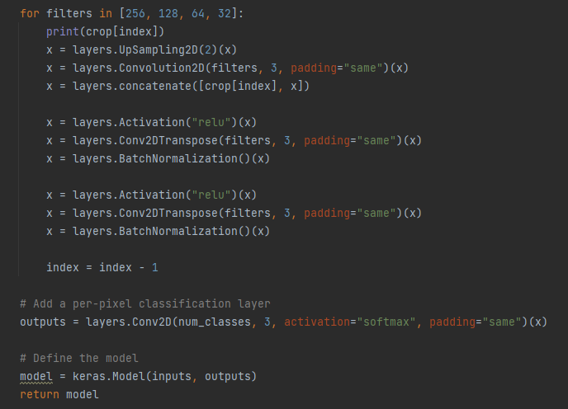
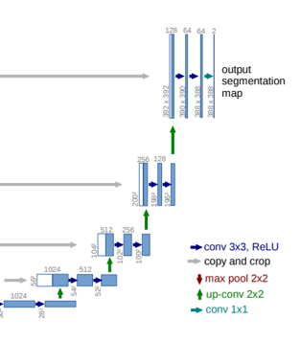
Code Explanation
Conventional UNet

Slide 25
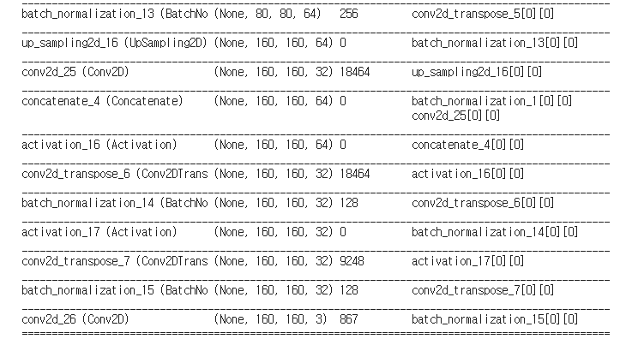
Code Explanation
Conventional UNet

Slide 26
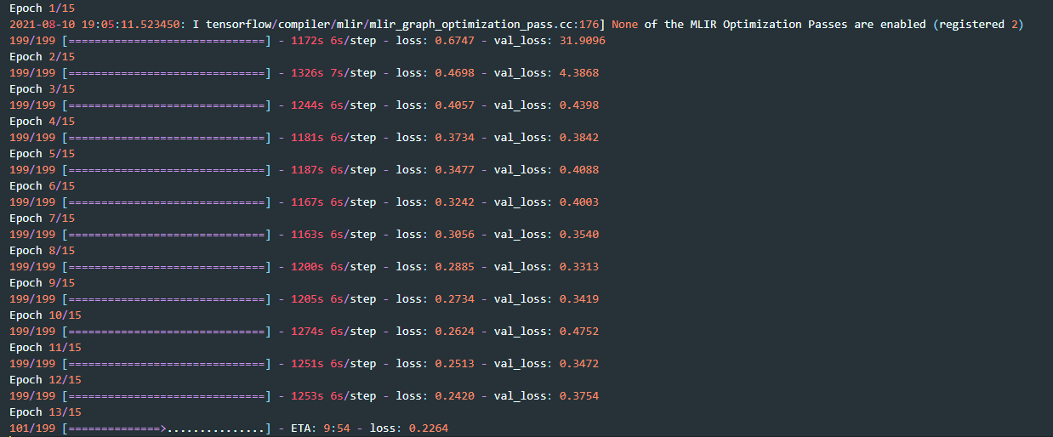
Code Explanation
Conventional UNet

Slide 27
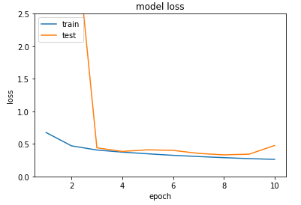
Code Explanation
Conventional UNet

Slide 28
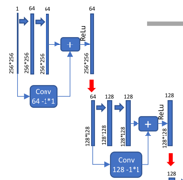
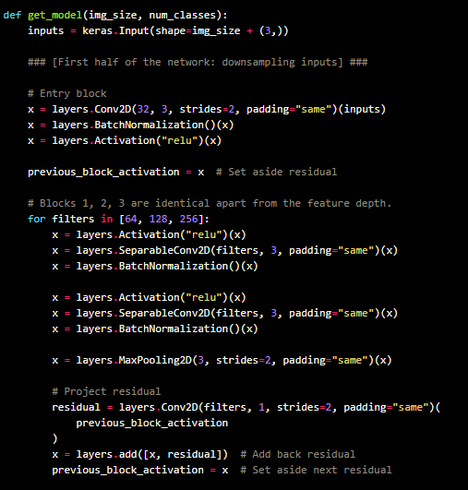
Code Explanation
ResNet Based UNet

Slide 29
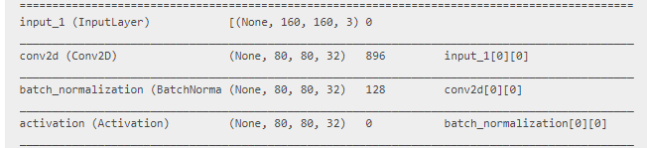
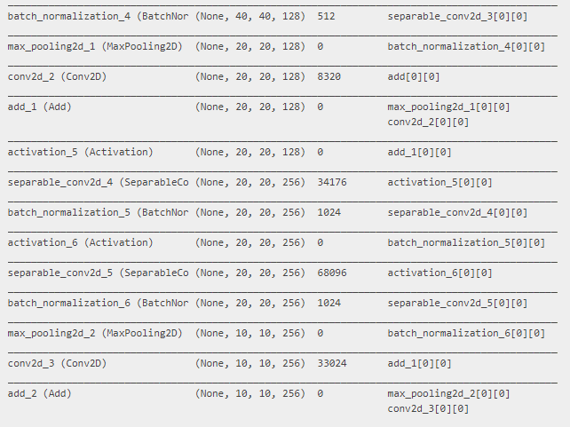
Code Explanation
ResNet Based UNet

Slide 30
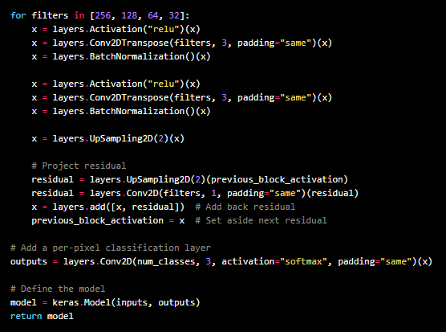
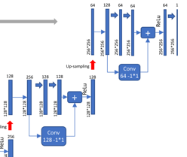
Code Explanation
ResNet Based UNet

Slide 31
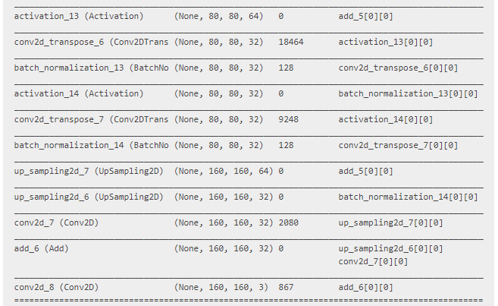
Code Explanation
ResNet Based UNet

Slide 32
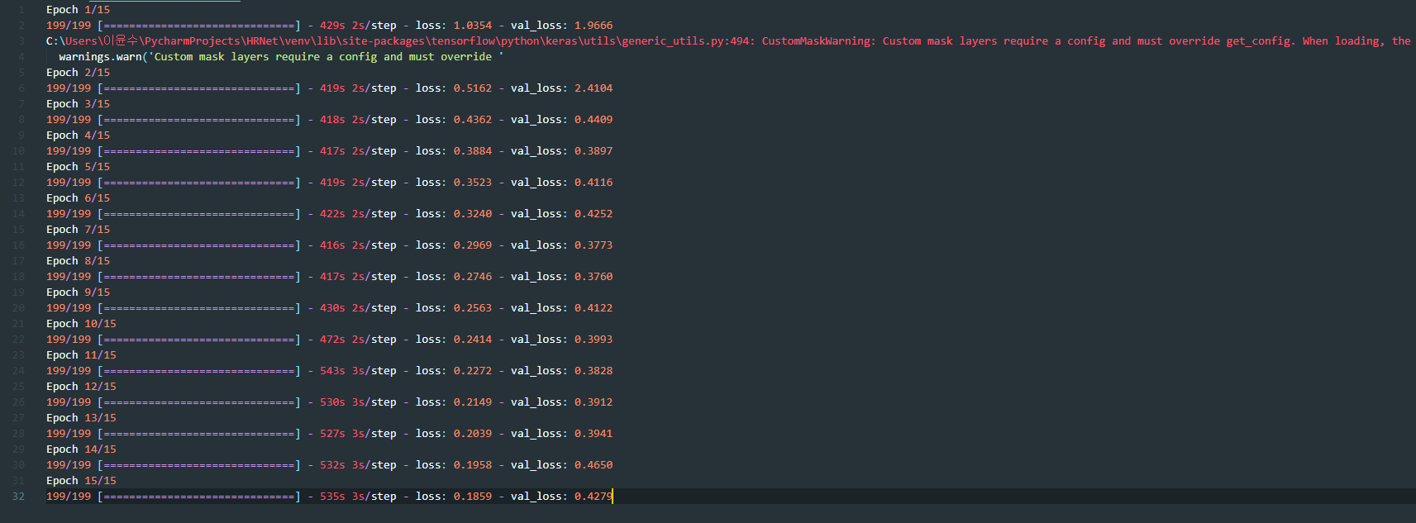
Code Explanation
ResNet Based UNet

Slide 33
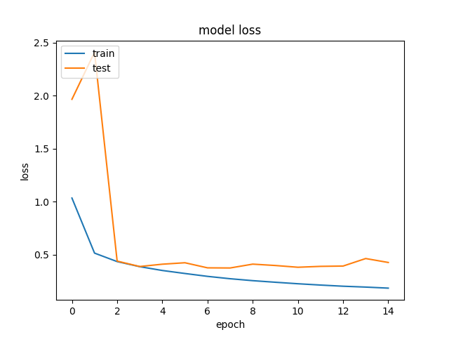
Code Explanation
ResNet Based UNet

Slide 34
Code Explanation
ResNet Based UNet

Slide 35
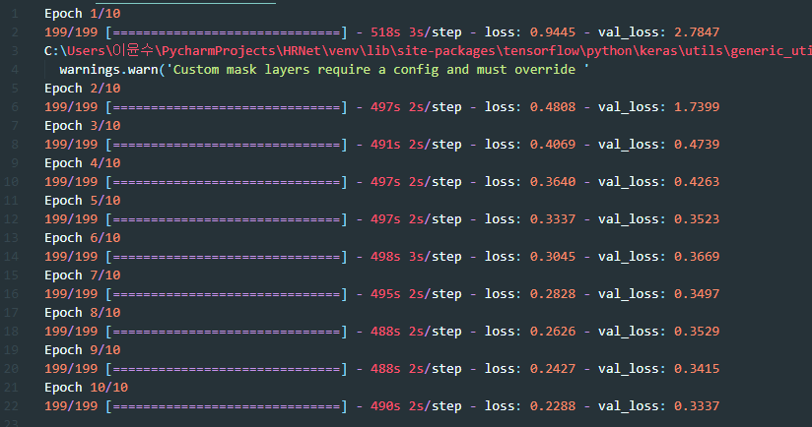
Code Explanation
ResNet Based UNet

Slide 36
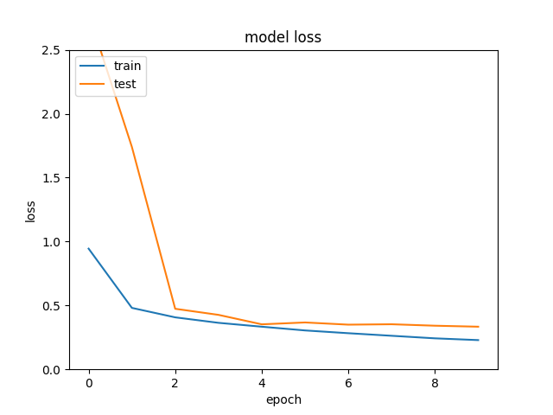
Code Explanation
ResNet Based UNet

Slide 37
Code Explanation
ResNet Based Unet - Site
ResNet Based UNet

Slide 38
Code Explanation
HRNet
Conventional UNet
ResNet Based UNet

Slide 39
Q & A

