Slide 1
HRNet - Code
발표자 : 182605 이윤수

Slide 2
Index
Code Explanation

Slide 3
Code Explanation
HRNet
Conventional UNet
ResNet Based Unet
ESPCN

Slide 4
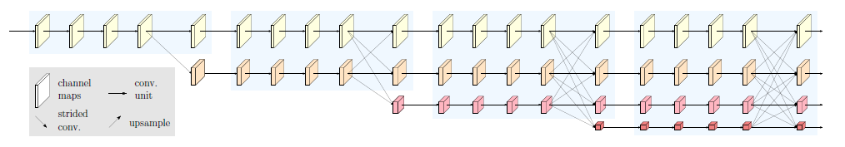
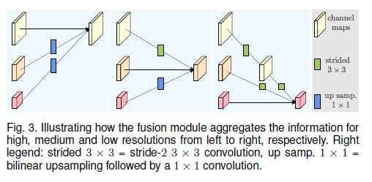
Code Explanation
HRNet

Slide 5
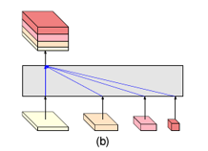
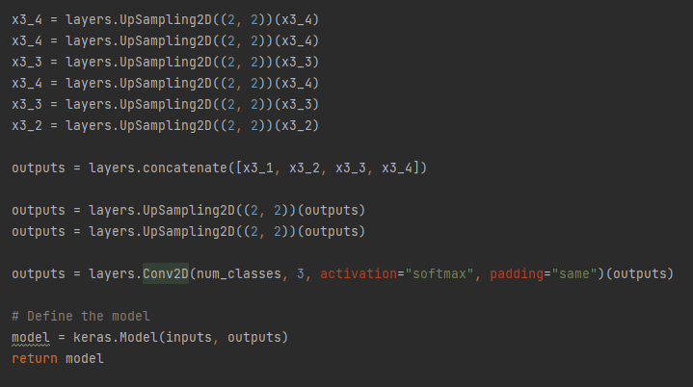
Code Explanation
HRNet

Slide 6
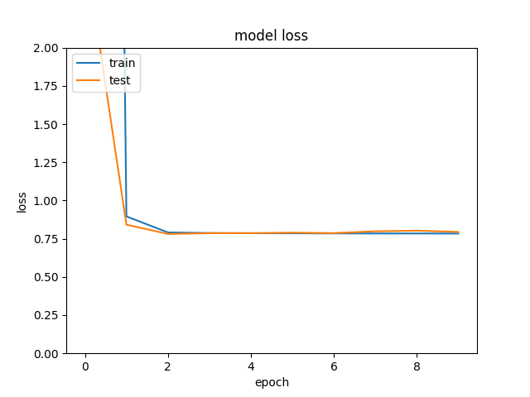
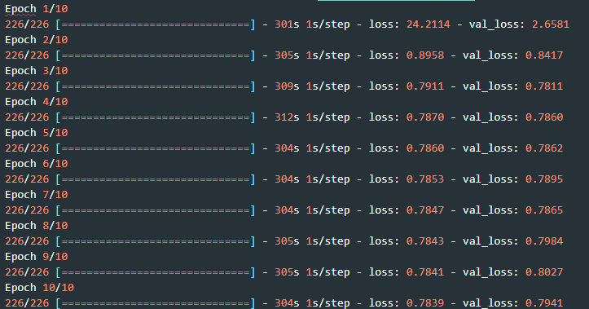
Code Explanation
HRNet
7000 -> 1000

Slide 7
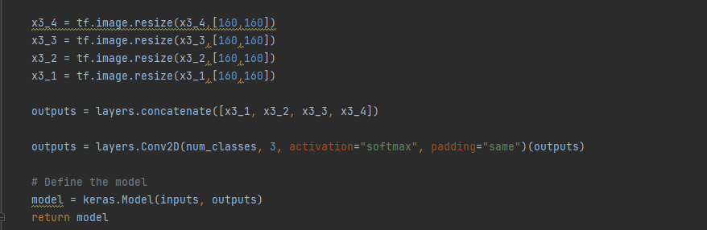
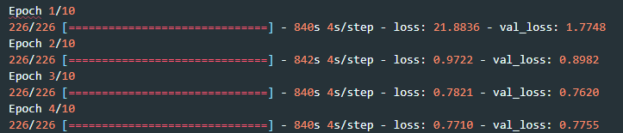
Code Explanation
HRNet

Slide 8
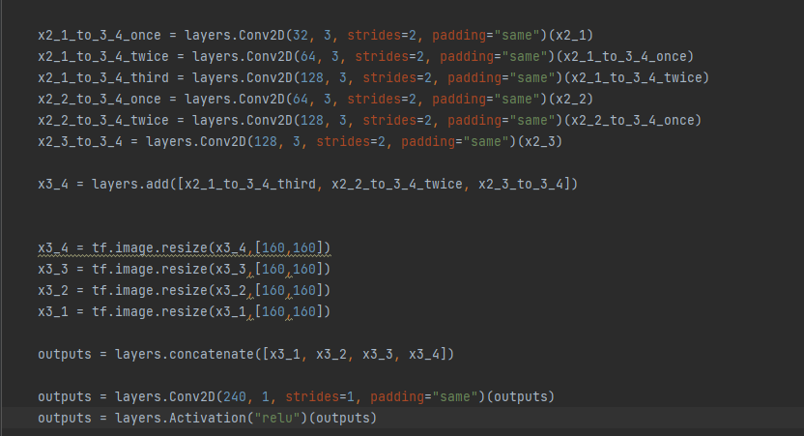
Code Explanation
HRNet

Slide 9
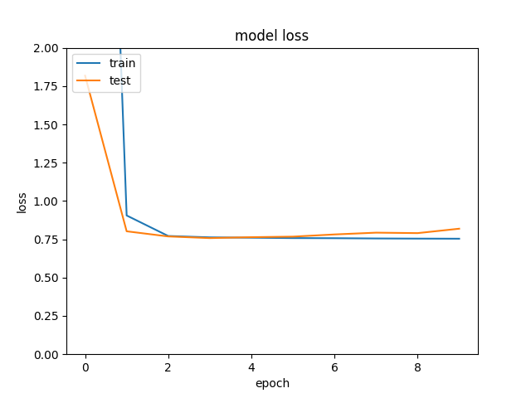
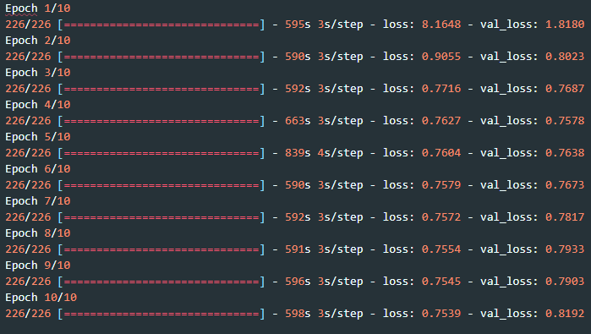
Code Explanation
HRNet

Slide 10
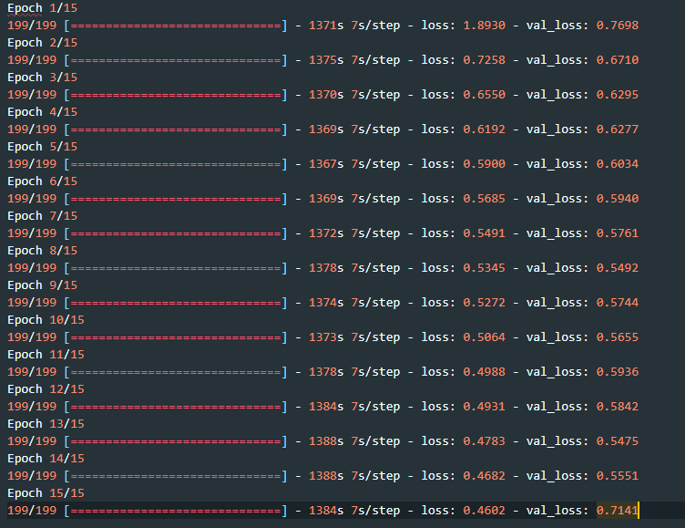
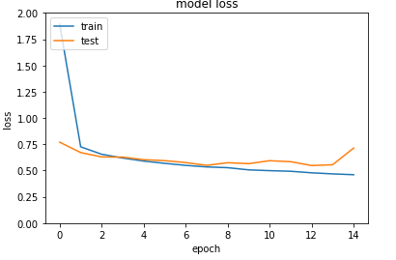
Code Explanation
HRNet

Slide 11
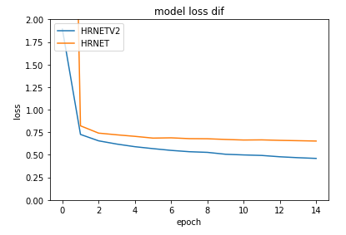
Code Explanation
HRNet

Slide 12
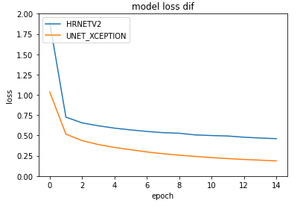
Code Explanation
HRNet

Slide 13
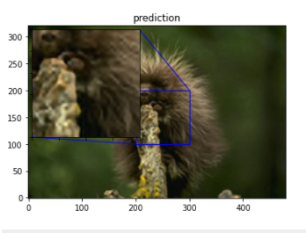
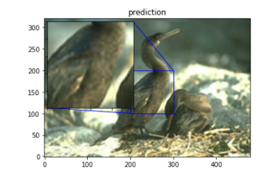
Code Explanation
ESPCN_HRNET
https://keras.io/examples/vision/super_resolution_sub_pixel/

Slide 14
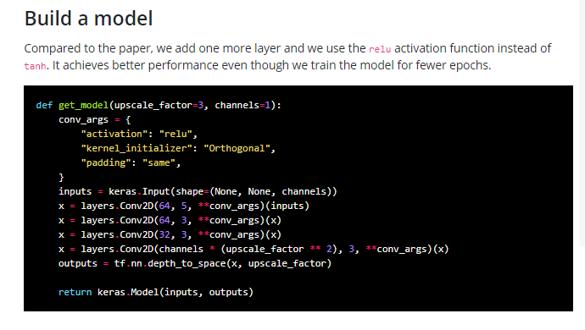
Code Explanation
ESPCN_HRNET

Slide 15
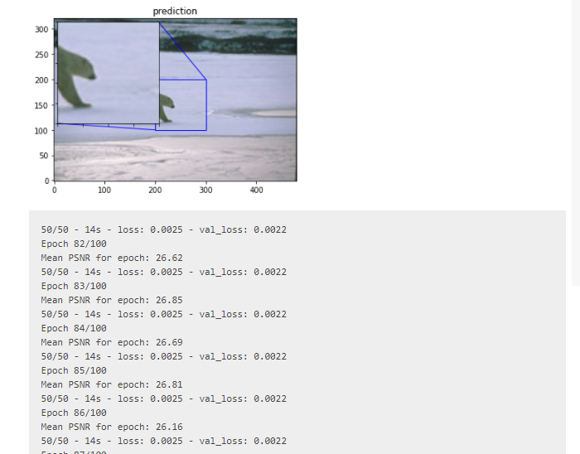
Code Explanation

Slide 16
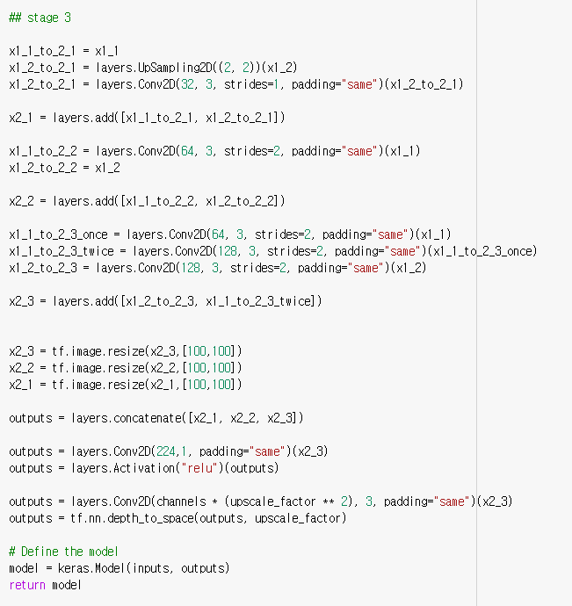
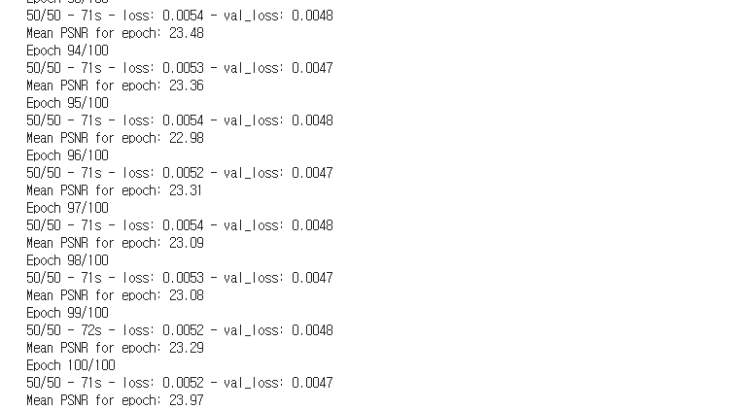
Code Explanation

Slide 17
Code Explanation

Slide 18
Code Explanation
오류 원인 : 크기가 홀수인(107*107) 사진이 stride=2 convolution을 가한후 다시 upsampling을 했을때 input size변화
107*107 -> 53*53 -> 106*106 107*107 + 106*106
시도
-입력 이미지 크기 조절 : 사진이 깨짐 -사진크기가 홀수 일 때 padding : 구현력 부족

Slide 19
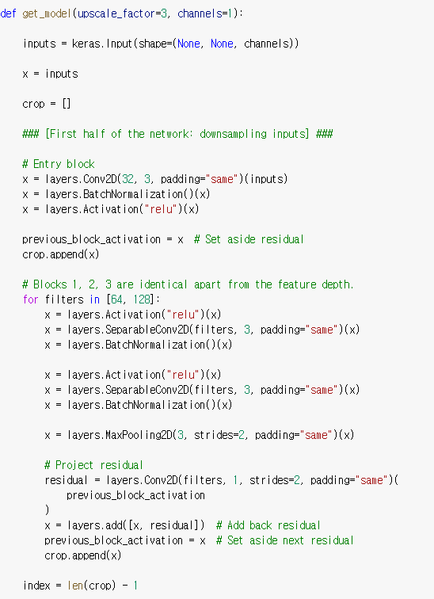
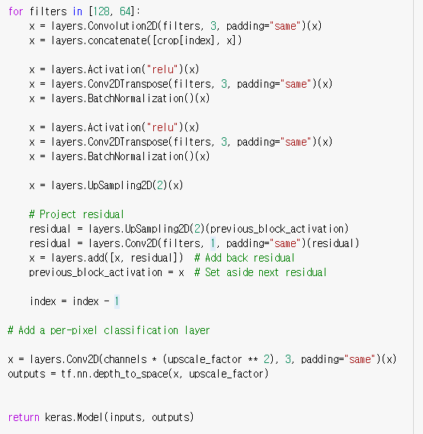
Code Explanation

Slide 20
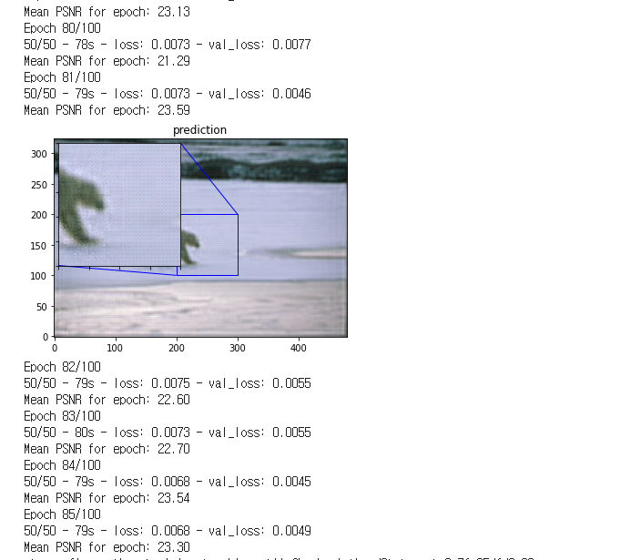
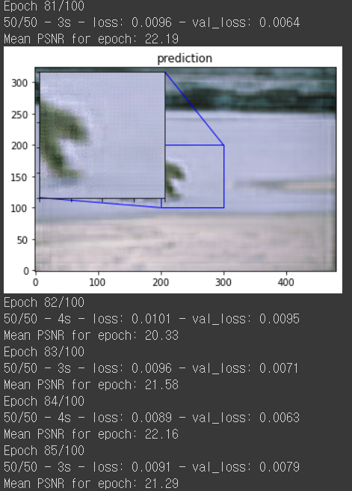
Code Explanation

Slide 21
Q & A

