Slide 1
DenseNet (Densely Connected Convolutional Networks)
발표자 : 182605 이윤수

Slide 2
Introduction
Experiment
Discussion

Slide 3
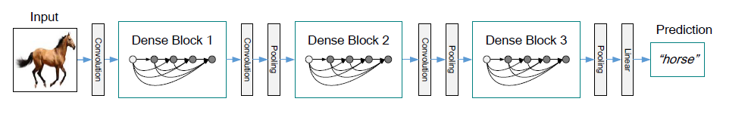
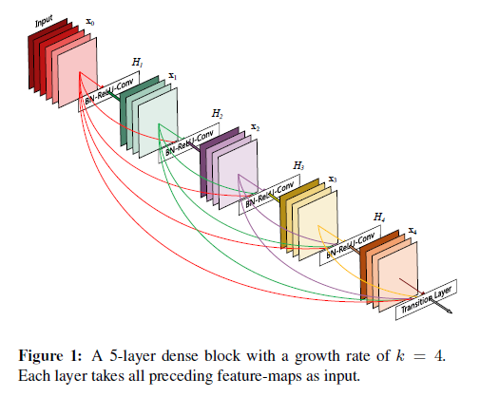
Experiment

Slide 4
Experiment
CIFAR
SVHN
ImageNet

Slide 5
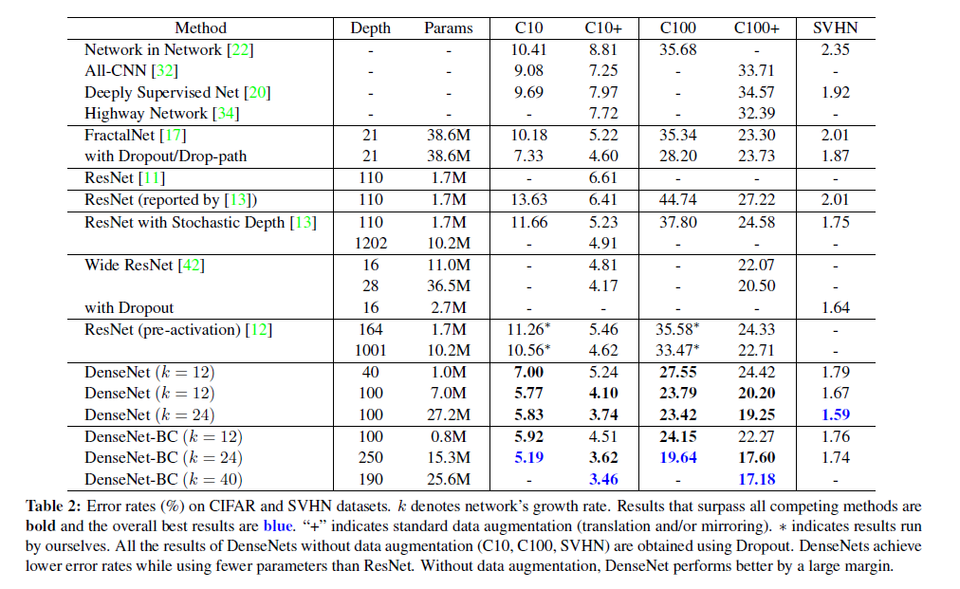
Experiment

Slide 6
Q & A

