Slide 1
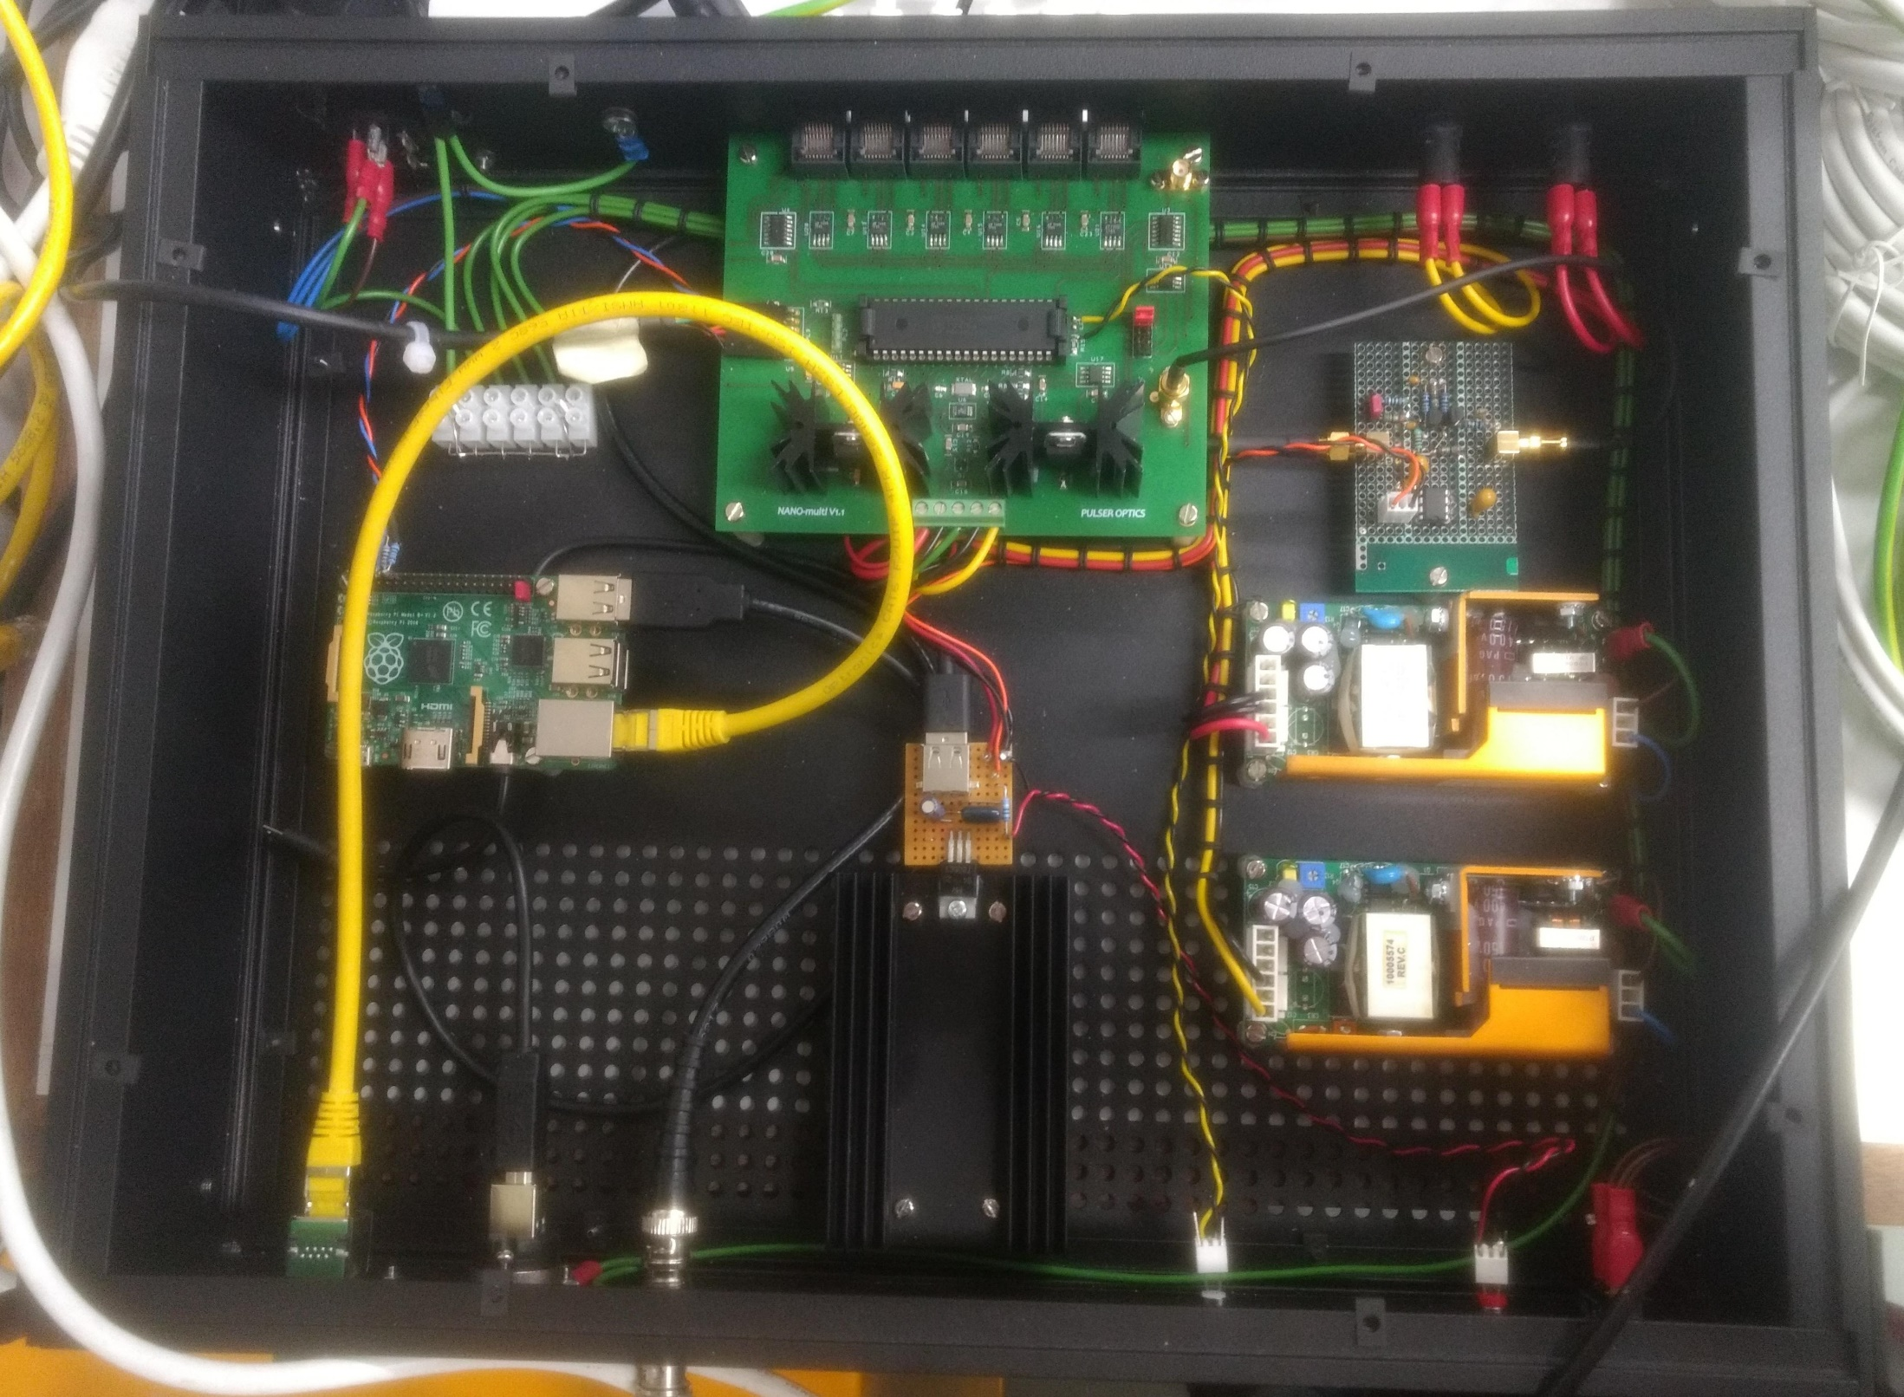
Connectors for branches 1-6
mains fuse
LV fuse (analogue)
LV fuse
(digital)
Main (PIC) controller
Trigger pulse shaping for trigger compatible with flash ADC
5 V (from 9 V supply) for raspberry pi)
9 V LV power supply (digital electronics)
raspberry pi
28 V LV power supply
(LED driver)
Ethernet connection
Trigger out

