Slide 1
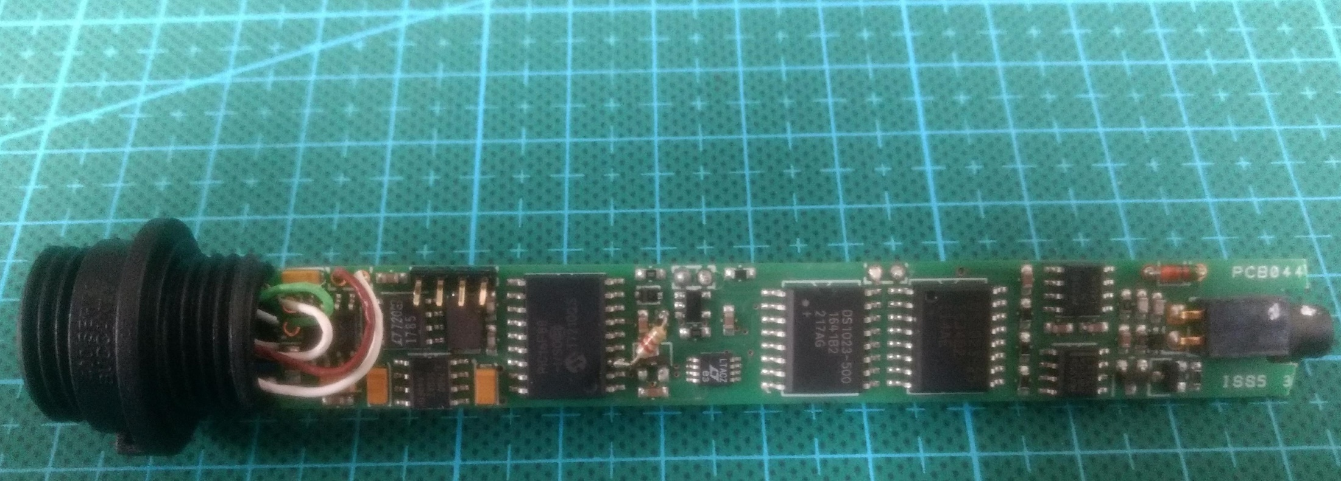
(note white markers
indicating
orientation)
LED
Note: fragile
connection
to buccaneer
connector
Connector
for
programming
PIC
chip

