Slide 1
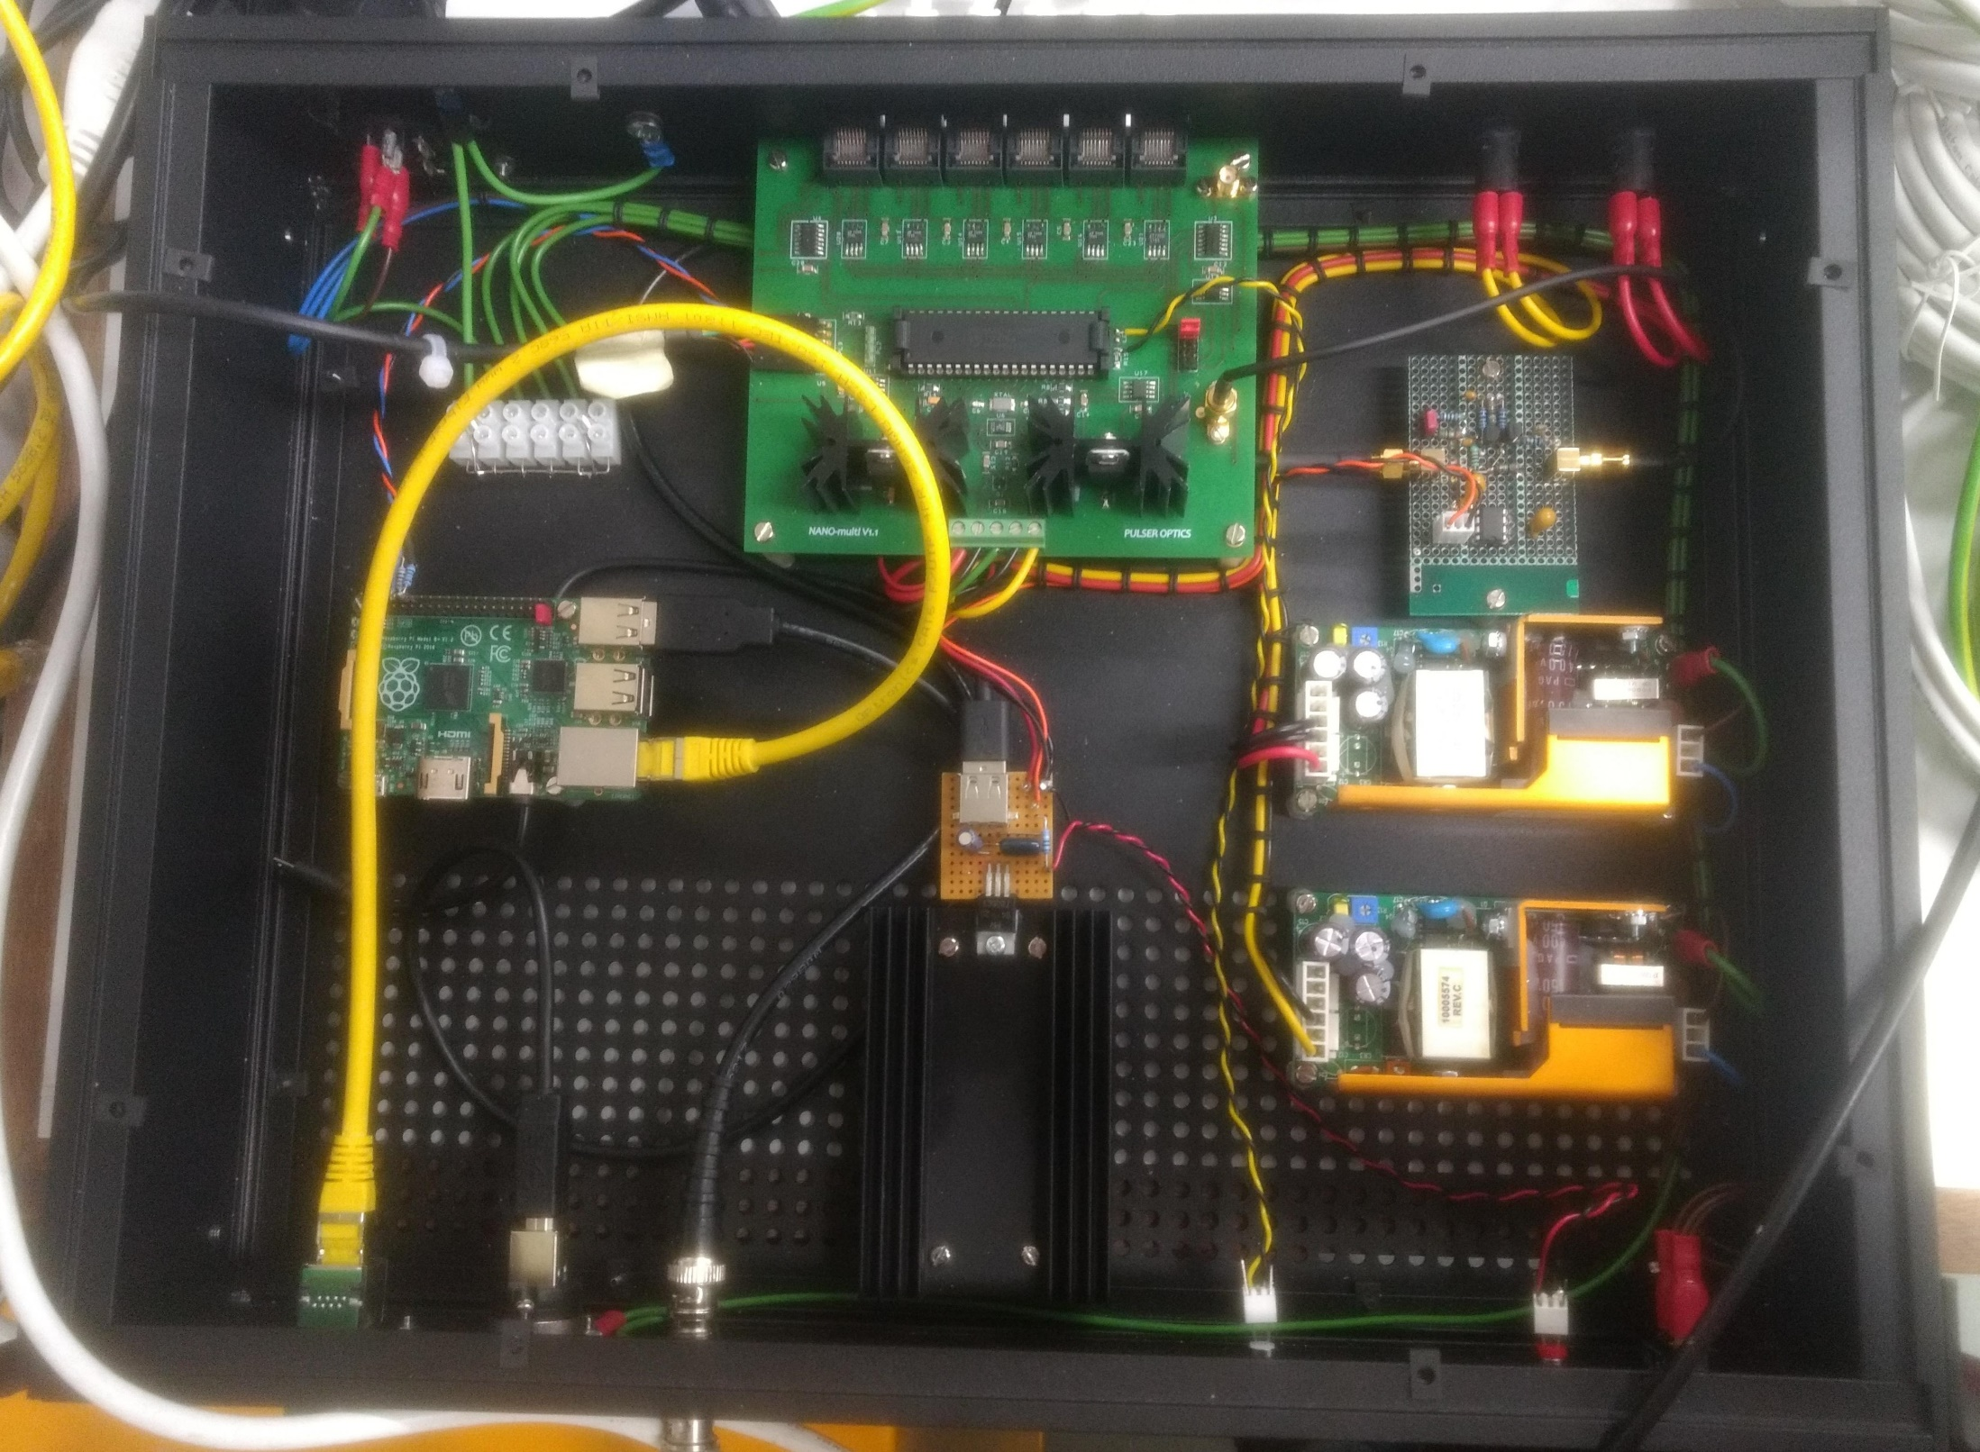
mains fuse
LV fuse
LV fuse
Main (PIC) controller
Trigger pulse shaping
raspberry pi
LV power supply
LV power supply
Ethernet connection
Trigger out

