Slide 1
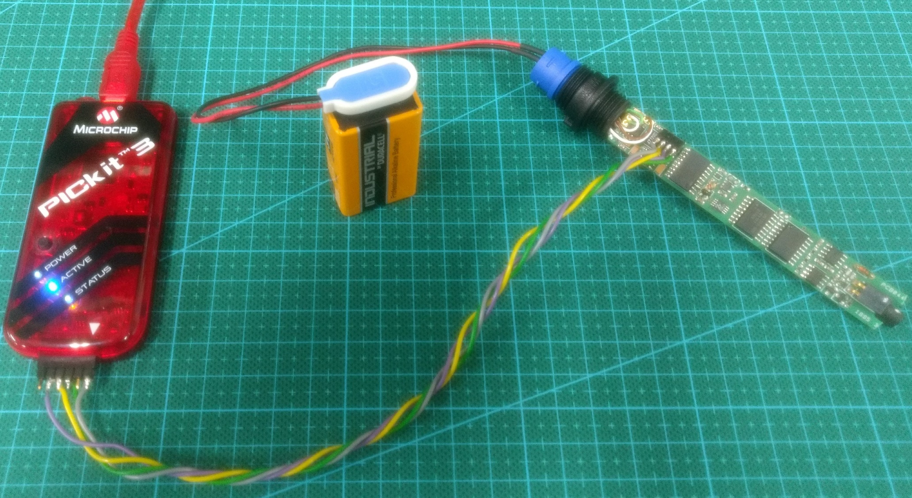
to PC
nanopulser head
9 V battery to supply power to the digital part
custom connector cable
programming interface connector

