Slide 1

Time-Series Visualization of Search Volume Trends for Three Major Infectious Diseases
지도교수: 김성찬 교수님
학생: 강서진
2026. 6. 16.

Slide 2
Outline
Definition
COVID-19
Influenza
Norovirus

Slide 3
1. Keyword Definition
COVID-19
Naver DataLab
  코로나, 코로나바이러스, 코로나19, 코비드, 코비드19, covid, covid19, covid-19, sars-cov-2
Google Trends
  COVID-19
Influenza
Naver DataLab
  독감, 인플루엔자, influenza
Google Trends
  Influenza
Norovirus
Naver DataLab
  노로바이러스, norovirus
Google Trends
  Norovirus

Slide 4

1. Period Definition & Others
Period
Reference Paper
  Week 37, 2025 ~ Week 10, 2026 $→$ Sep. 8, 2025 ~ Mar. 8, 2026
Naver DataLab
  Sep. 1, 2025 ~ Mar. 8, 2026 $→$ Sep. 8, 2025 ~ Mar. 8, 2026 $→$ Week 37, 2025 ~ Week 10, 2026
Google Trends
  Sep. 7, 2025 ~ Mar. 7, 2026 $→$ Week 37, 2025 ~ Week 10, 2026
Others
Trend Location of Google Trends
  South Korea

Slide 5
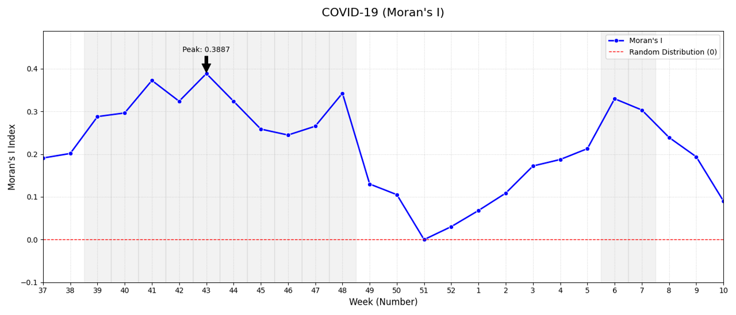
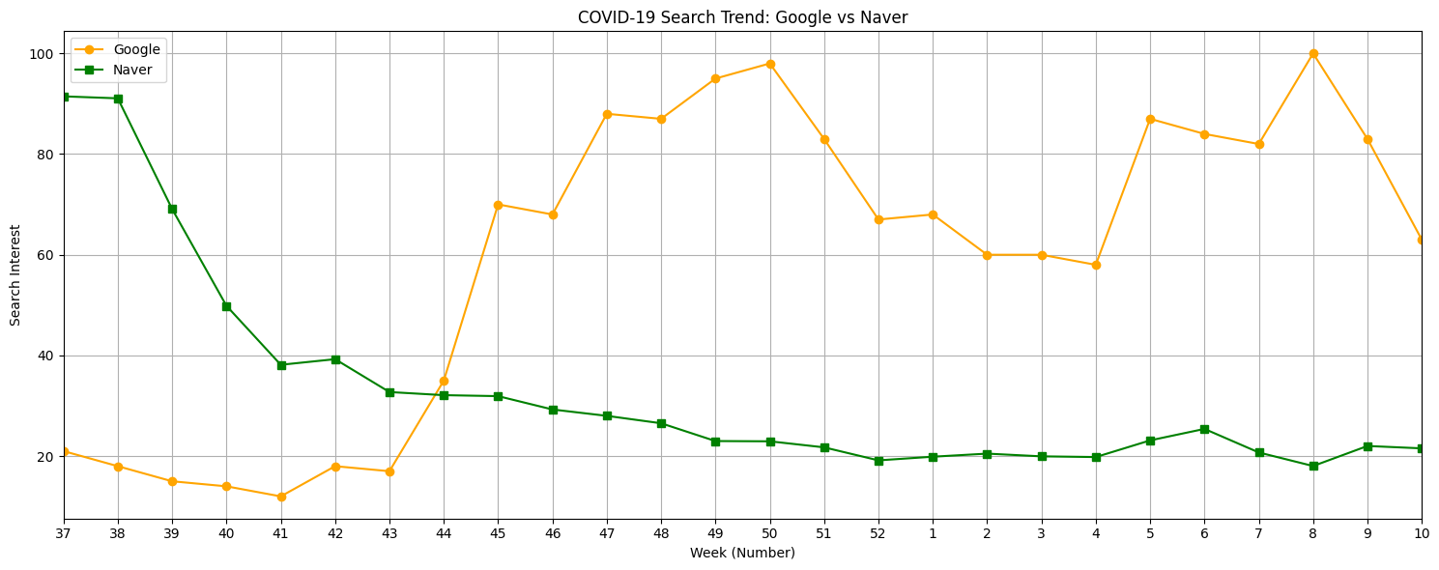
2. COVID-19
Figure 2: Moran’s I analysis results for (a) COVID-19.
COVID-19 Search Trend: Google vs Naver.

Slide 6
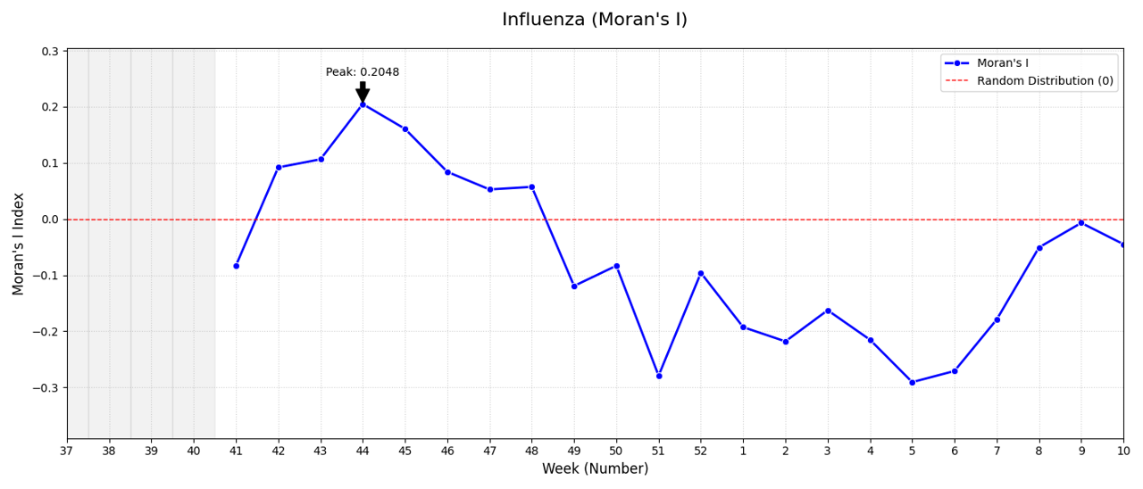
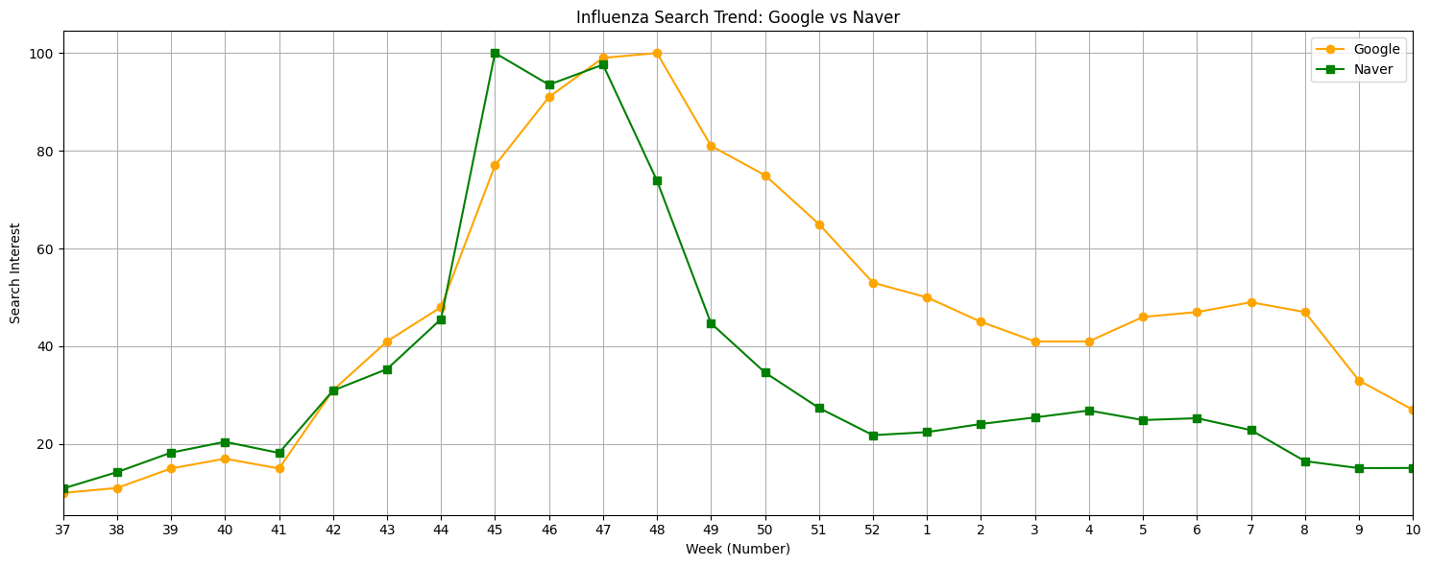
3. Influenza
Figure 2: Moran’s I analysis results for (b) Influenza.
Influenza Search Trend: Google vs Naver.

Slide 7
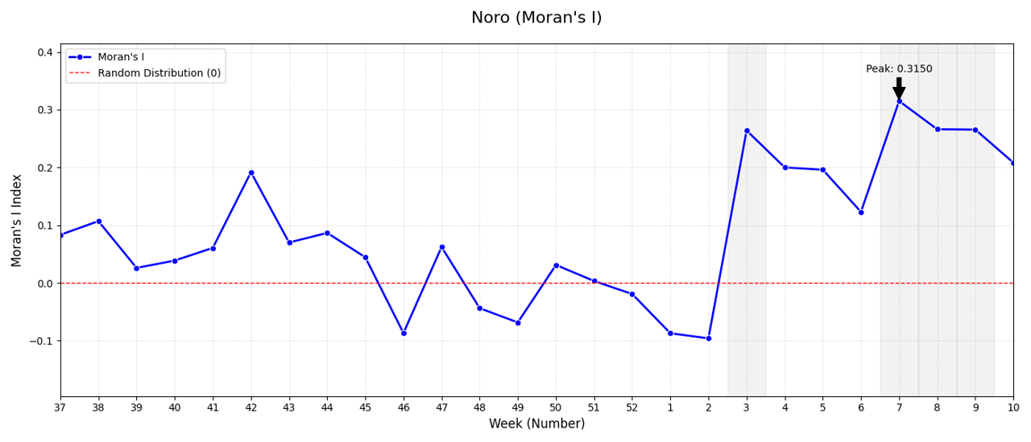
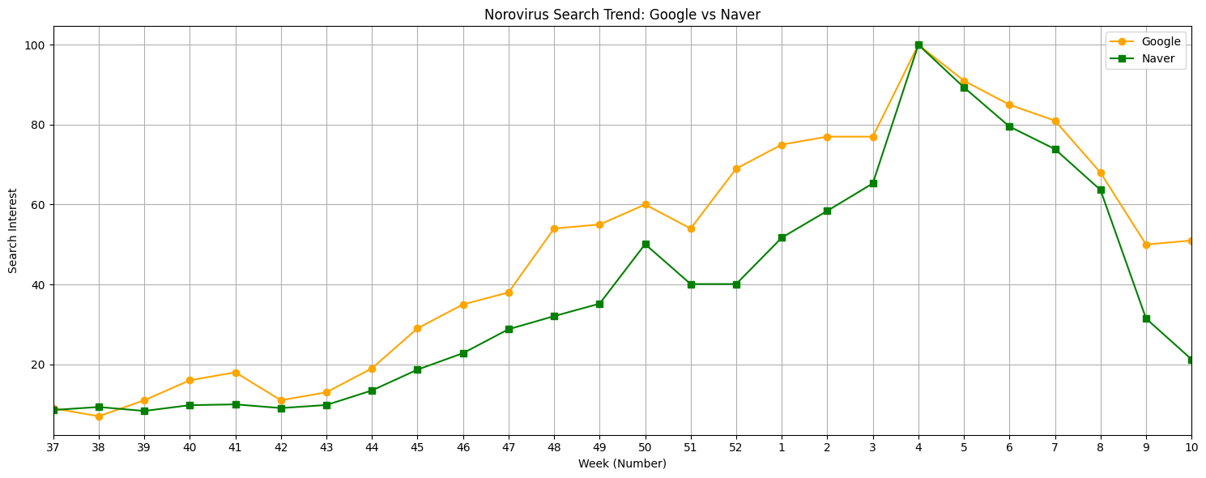
4. Norovirus
Figure 2: Moran’s I analysis results for (c) Norovirus.
Norovirus Search Trend: Google vs Naver.

