Slide 1


Utilizing Internet Search Trends and Wastewater Surveillance to Identify
Infectious Disease Outbreaks in Communities
Paper Review
${\text{Alessandro Zulli}}^{\text{∥}}$, ${\text{Zoe Zhang}}^{\text{∥}}$, Madelena Ruedaflores, Jordan Sahly, Darryl Angel, Karthik Rohatgi, Waleed Malik, Ritche Hao, James Shepherd, and Jordan Peccia*
Advisor: Seongchan Kim
Presenter: Seo-Jin Kang
2026. 8. 5.

Slide 2
Outline
Introduction
Related Works
Method
Experimental Results
Conclusion

Slide 3
Introduction

Slide 4
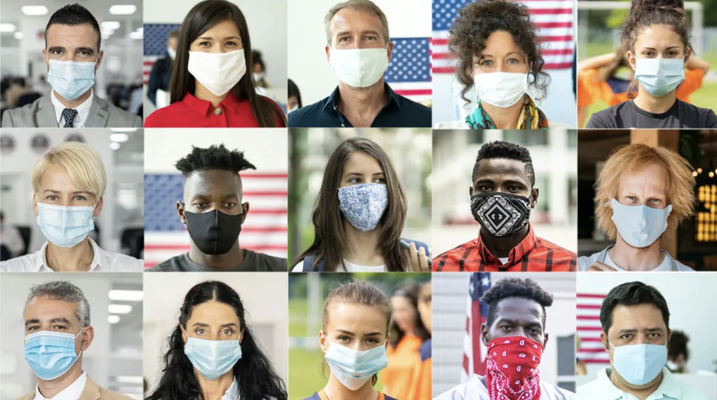
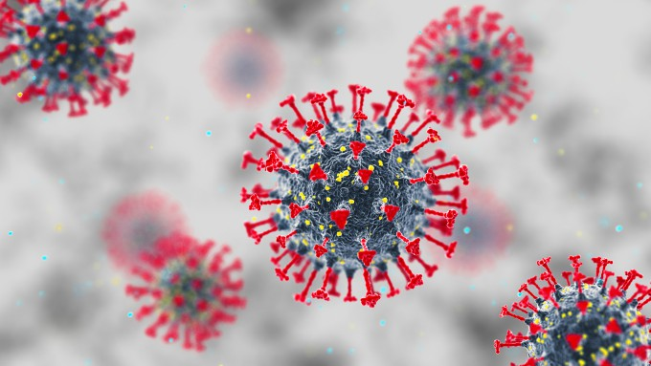
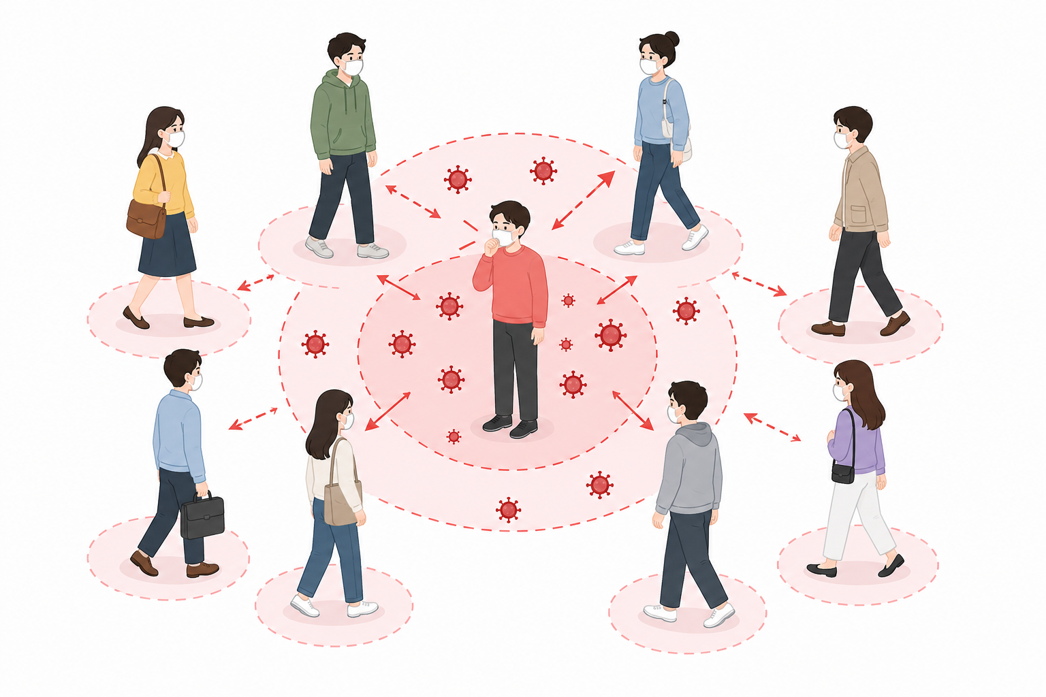
Increased Risk of Viral Infection During Outbreaks
The risk of viral infection is strongly associated with
the proportion of infected individuals in the community.

Slide 5
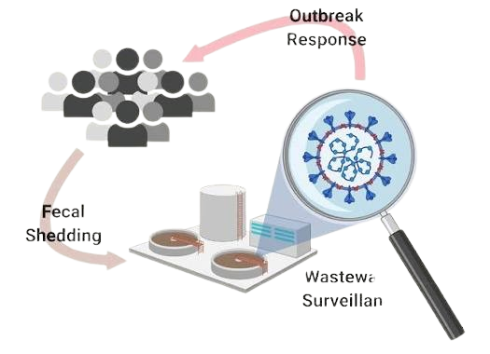

Challenges: Existing Infectious Disease Surveillance
Robust clinical testing infrastructure.
Cutting-edge Wastewater-based Epidemiology.
Faster than clinical.

Slide 6
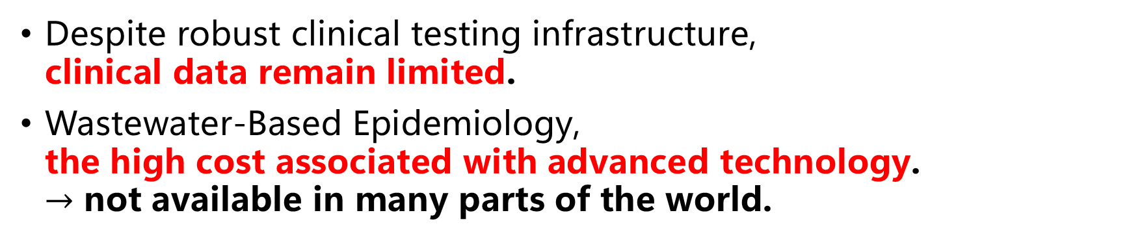
Challenges: Existing Infectious Disease Surveillance
Despite robust clinical testing infrastructure,
clinical data remain limited.
Wastewater-Based Epidemiology,
the high cost associated with advanced technology.
$→$ not available in many parts of the world.

Slide 7
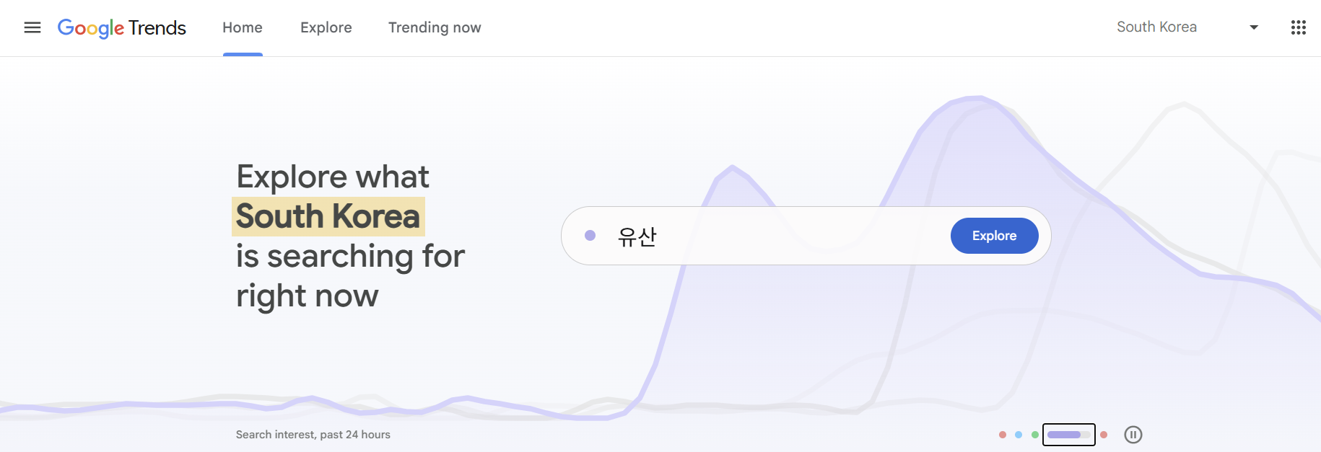
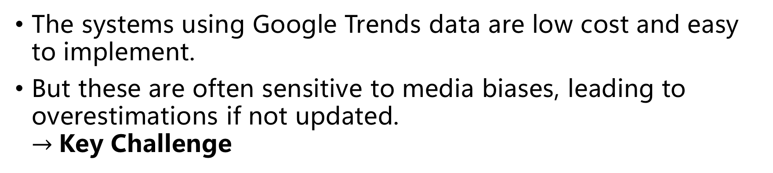
Solution: Using Google Trends data
The systems using Google Trends data are low cost and easy to implement.
But these are often sensitive to media biases, leading to overestimations if not updated.
$→$Key Challenge

Slide 8
Related Works

Slide 9


Previous Works
Between search terms and total numbers of influenza.
significant correlations
Similar studies have been performed for RSV, norovirus, and mpox that use Google Trends and other social media trends.

Slide 10
Previous Works
Between search terms and total numbers of influenza.
significant correlations
Similar studies have been performed for RSV, norovirus, and mpox that use Google Trends and other social media trends.
No prior studies have used wastewater as a predictor and validation signal.

Slide 11


Why Wastewater?
Provides unbiased real-time signals
Quickly detects deviations and recalibrates predictive models.
Highly effective against poorly reported diseases (e.g., norovirus).

Slide 12
Method

Slide 13
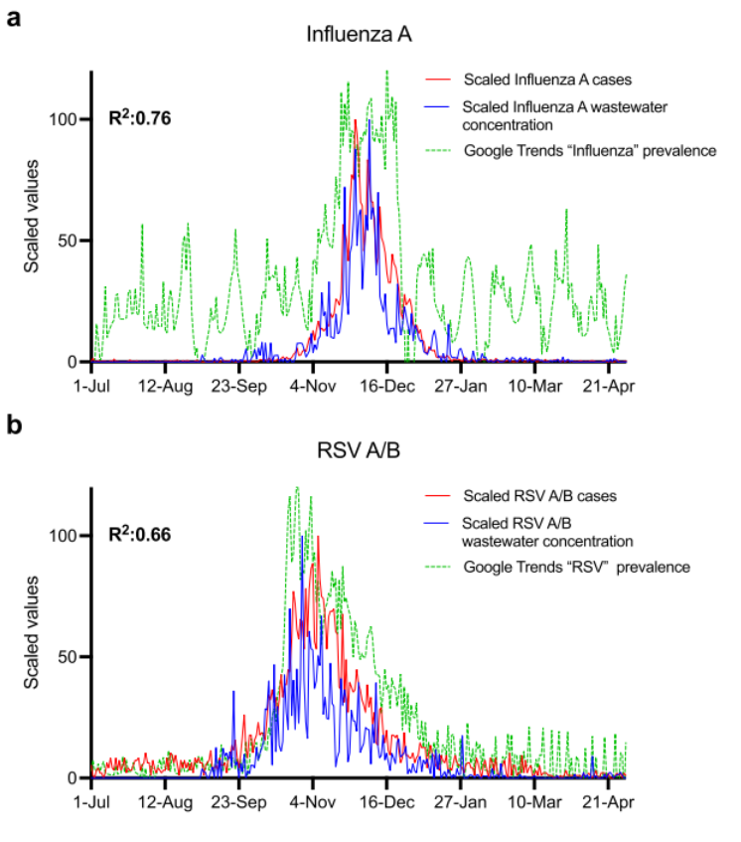
Data Normalization: Min-Max, 0~100
Diseases
  Influenza A, RSV A/B, Norovirus, Mpox.
Three Types of Data
  Wastewater Concentrations, Clinical Cases, Google Trends.

Slide 14
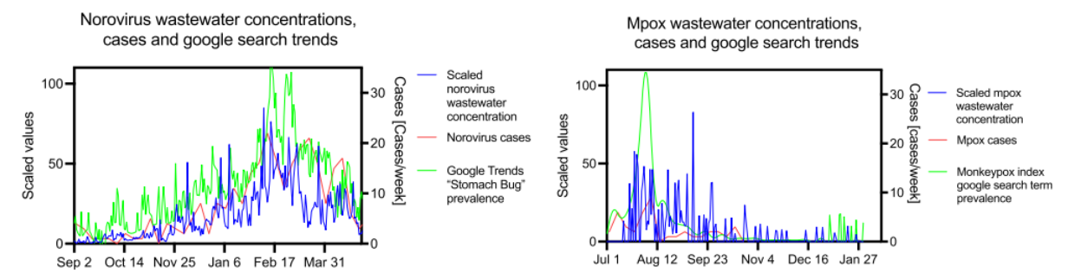
Data Normalization: Min-Max, 0~100
Diseases
  Influenza A, RSV A/B, Norovirus, Mpox.
Three Types of Data
  Wastewater Concentrations, Clinical Cases, Google Trends.

Slide 15
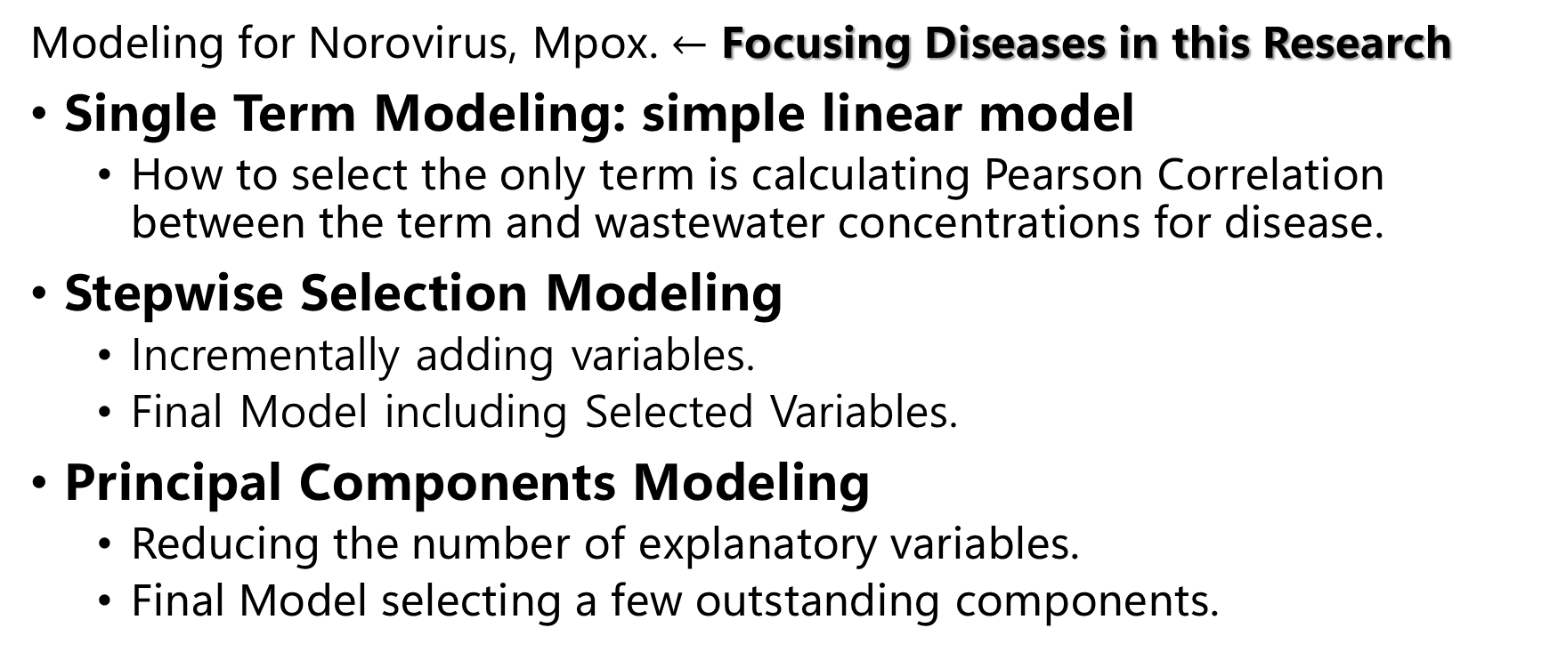
Three Types of Modeling for Norovirus, Mpox
Modeling for Norovirus, Mpox. $←$ Focusing Diseases in this Research
Single Term Modeling: simple linear model
  How to select the only term is calculating Pearson Correlation between the term and wastewater concentrations for disease.
Stepwise Selection Modeling
  Incrementally adding variables.
  Final Model including Selected Variables.
Principal Components Modeling
  Reducing the number of explanatory variables.
  Final Model selecting a few outstanding components.

Slide 16
Experimental Results

Slide 17
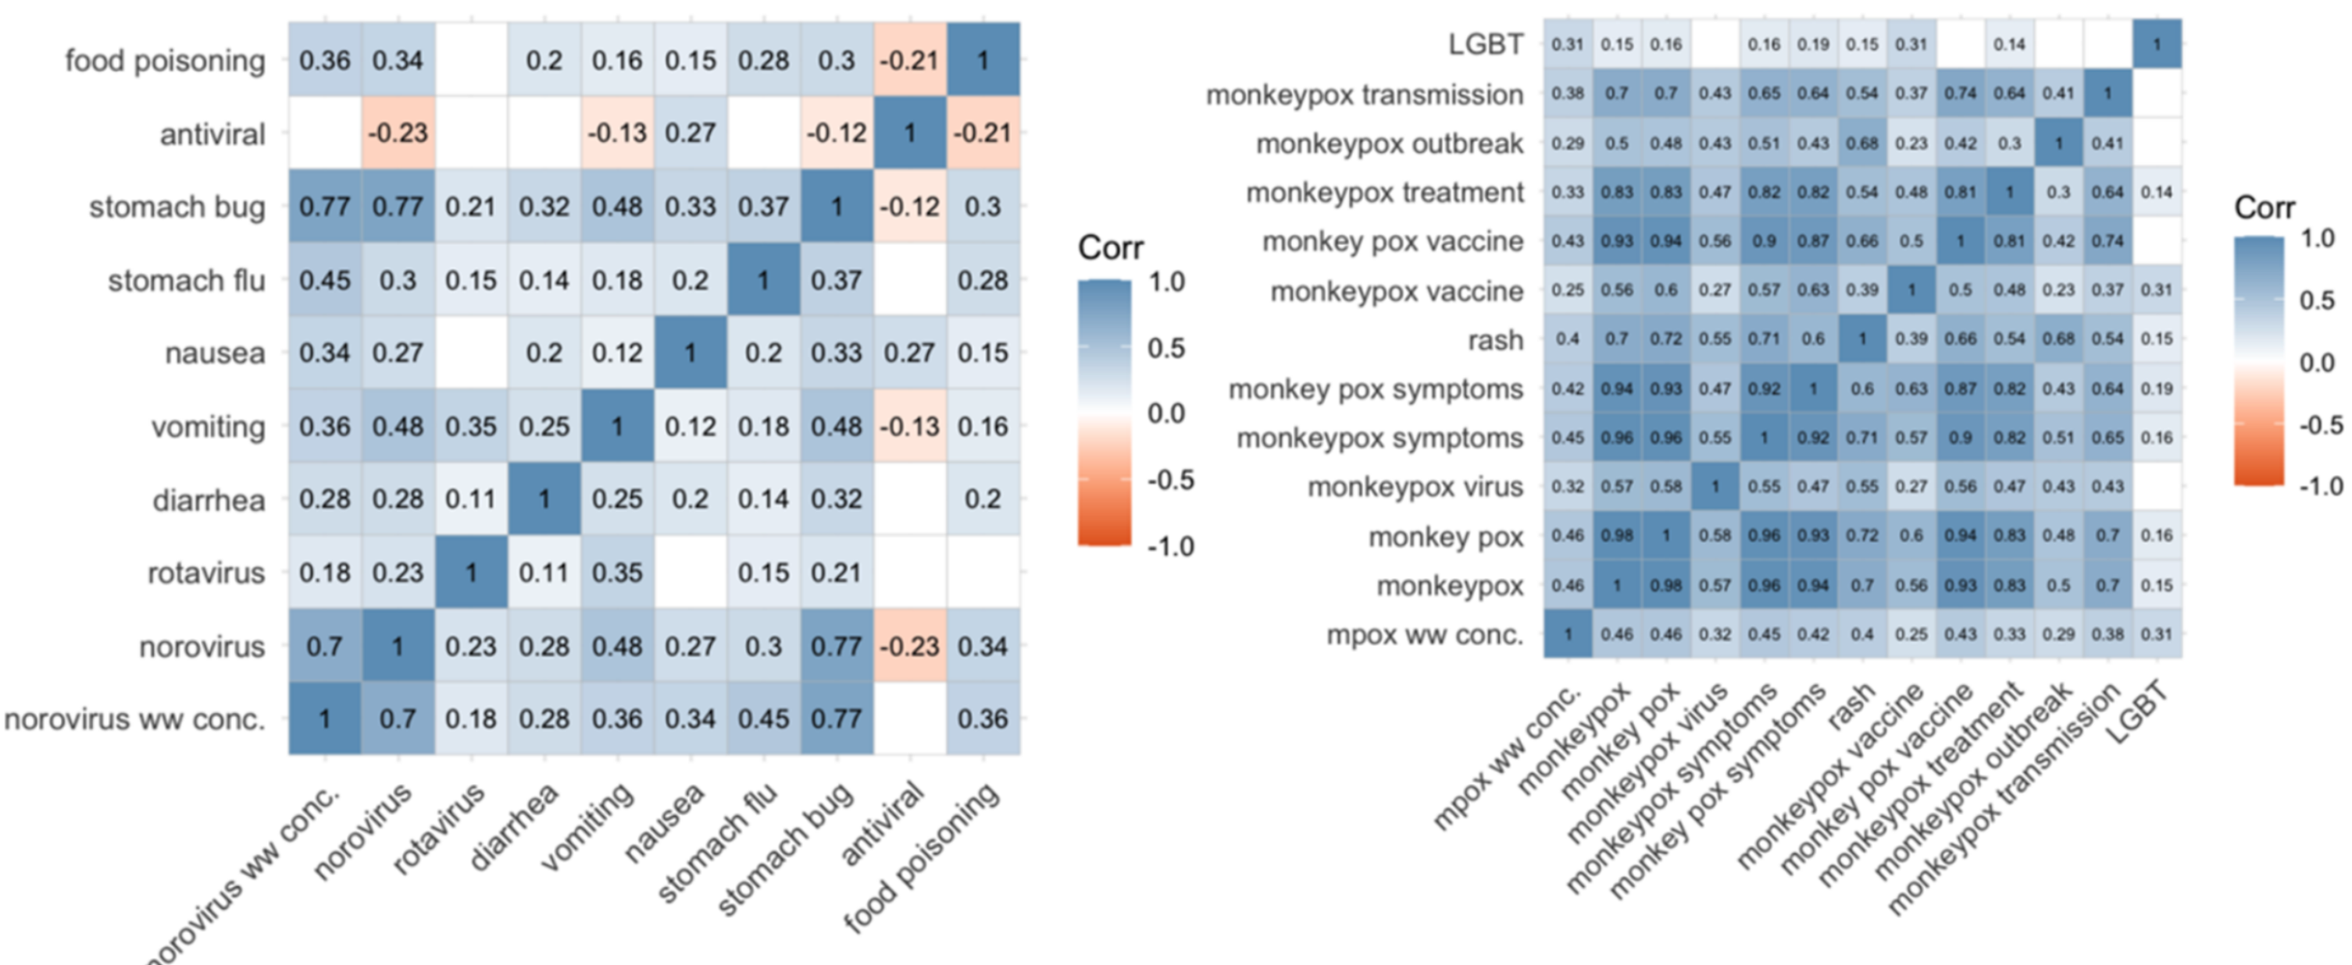
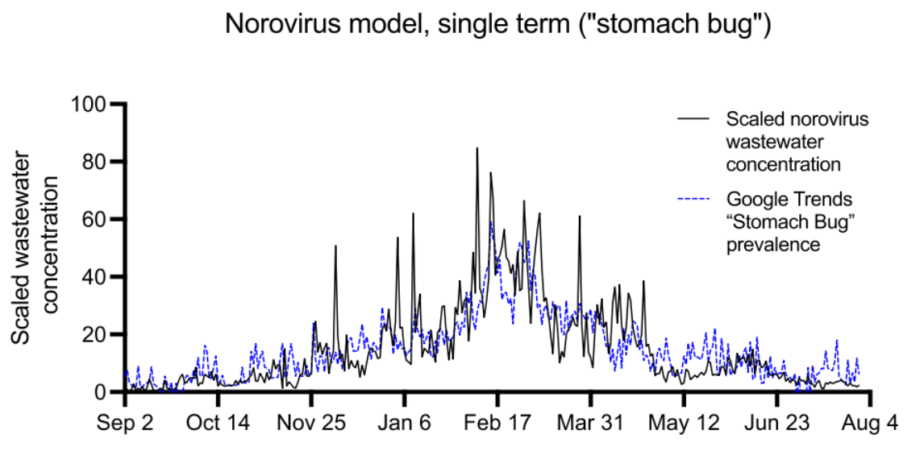

Single Term Modeling
Norovirus
Mpox
Pearson Correlation
  Norovirus: stomach bug.
  Mpox: didn’t show
  any single dominant term.
Single Term Model
  Shows the results of this modeling.
  The predicted concentrations
  closely matching observed values.
  $R^{2}$: 0.59, $p$ < 0.001

Slide 18
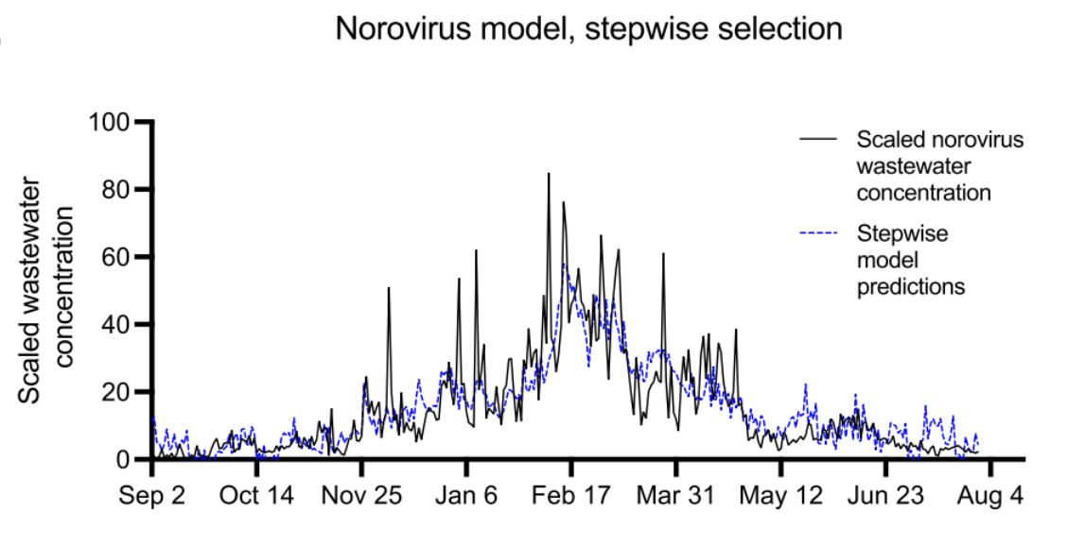
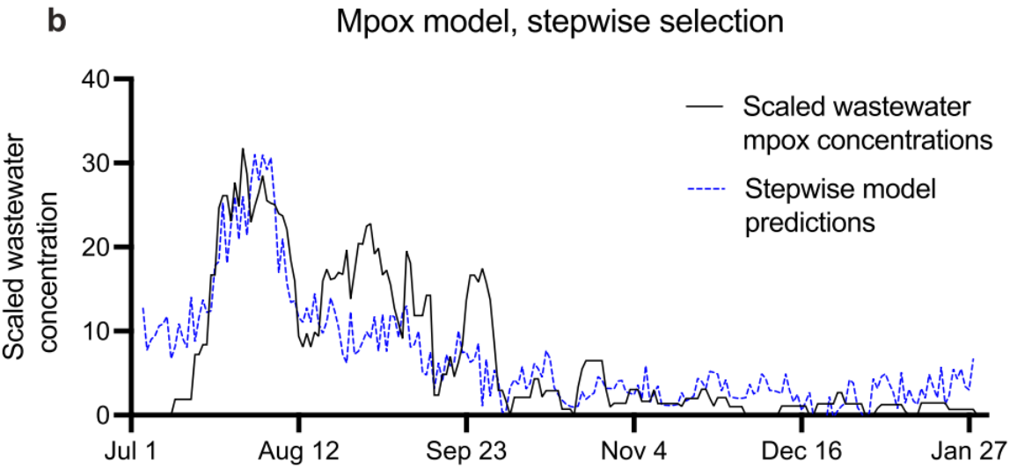
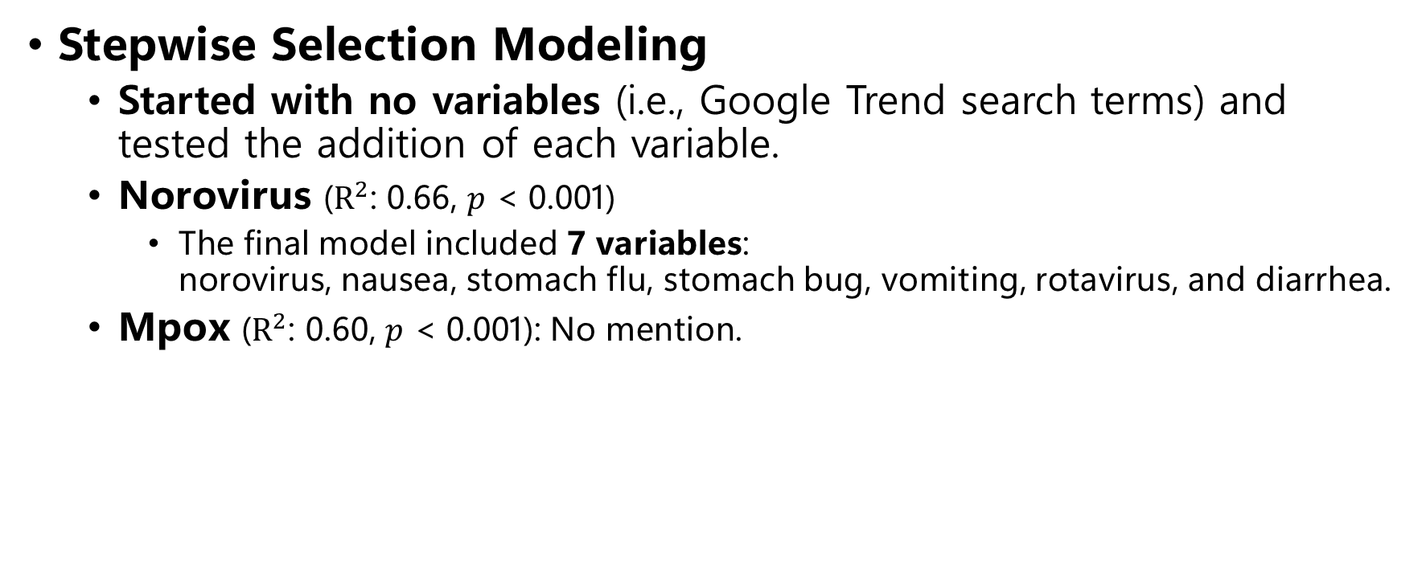
Stepwise Selection Modeling
Stepwise Selection Modeling
  Started with no variables (i.e., Google Trend search terms) and tested the addition of each variable.
  Norovirus ($R^{2}$: 0.66, $p$ < 0.001)
    The final model included 7 variables:
    norovirus, nausea, stomach flu, stomach bug, vomiting, rotavirus, and diarrhea.
  Mpox ($R^{2}$: 0.60, $p$ < 0.001): No mention.

Slide 19
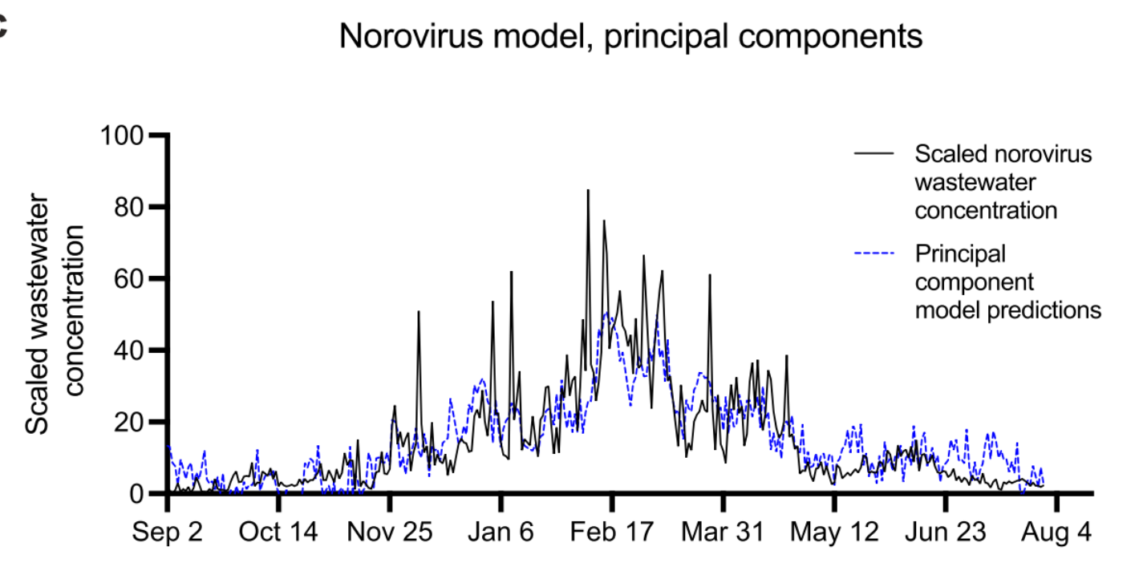
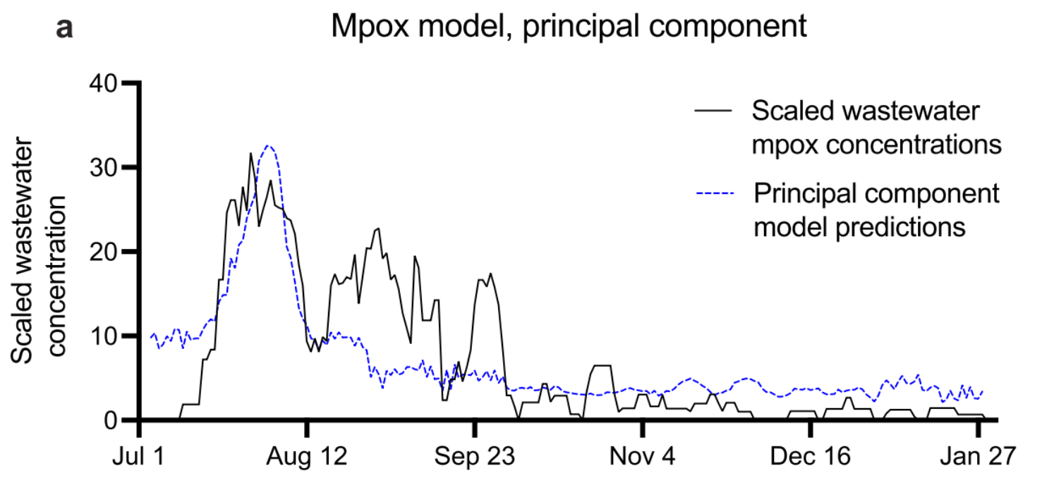
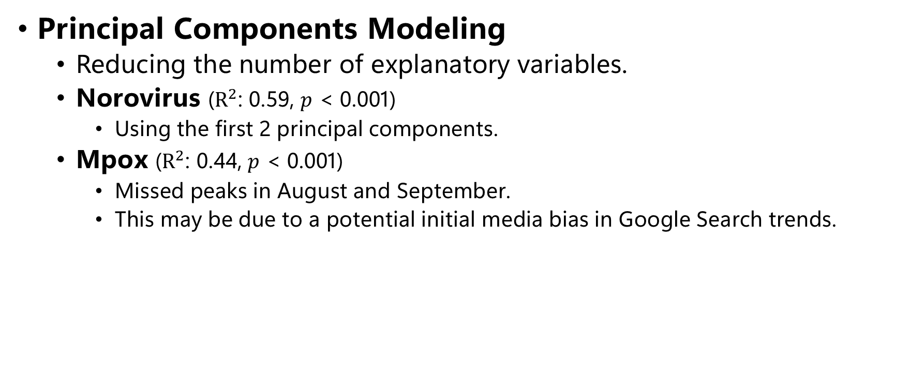
Principal Components Modeling
Principal Components Modeling
  Reducing the number of explanatory variables.
  Norovirus ($R^{2}$: 0.59, $p$ < 0.001)
    Using the first 2 principal components.
  Mpox ($R^{2}$: 0.44, $p$ < 0.001)
    Missed peaks in August and September.
    This may be due to a potential initial media bias in Google Search trends.

Slide 20
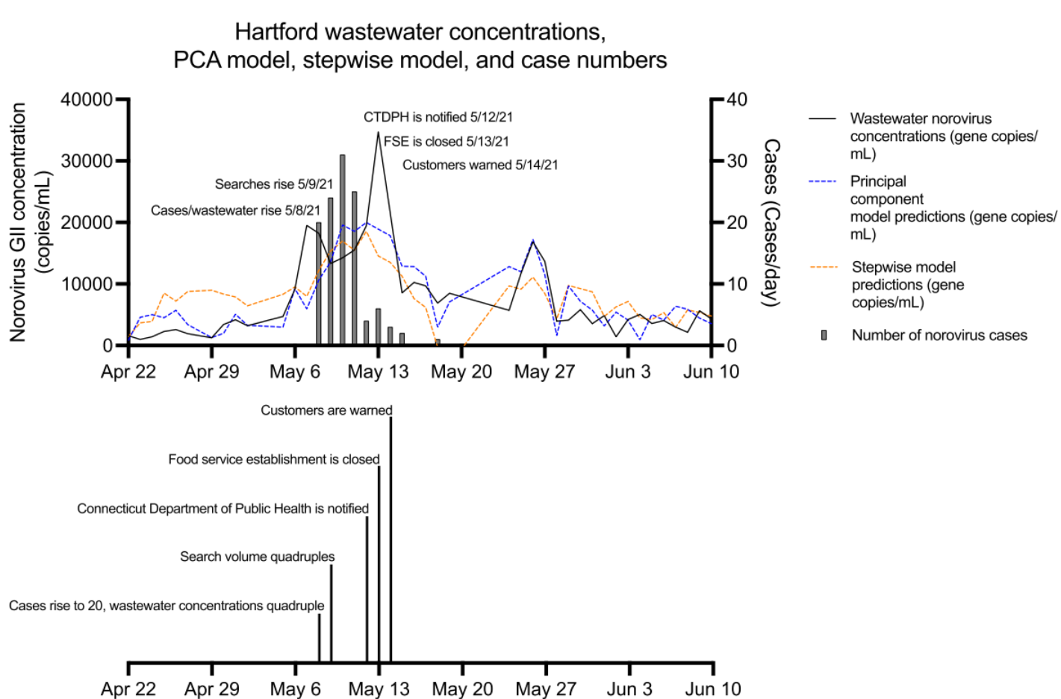
Application: Prior Foodborne Outbreak of Norovirus GII
PC Model & SS Model identify this acute outbreak event.
  Mainly based on the
  “stomach bug”.

Slide 21
Conclusion

Slide 22
Conclusion
Benefits of Google Trends Model
  Provides faster notification than clinical case data.
  Enables early nonpharmaceutical interventions to prevent disease spread.
Future Challenge
  Needs further validation and refinement for diseases with limited clinical surveillance.
Role of Wastewater Surveillance
  Addresses the validation gap through environmental surveillance.
  Validates predictive models even without expansive clinical testing.

Slide 23
Reference
Image
  https://www.sciencenews.org/article/double-mask-fit-reduce-coronavirus-exposure-covid-19-pandemic
  https://www.dongascience.com/ko/news/76408
  https://www.antidote.me/blog/curious-about-clinical-studies-heres-what-you-can-expect-as-a-participant
  https://pubs.acs.org/esthag/article-abstract/54/13/7754/1416684/Wastewater-Based-Epidemiology-Global-Collaborative?redirectedFrom=fulltext
  https://www.magnific.com/kr/free-photos-vectors/%ED%95%98%EC%88%98-%EC%B2%98%EB%A6%AC%EC%9E%A5
  https://staedean.com/data/blog/signs-bad-data-quality-data-governance
Utilizing Internet Search Trends and Wastewater Surveillance to Identify Infectious Disease Outbreaks in Communities

Slide 24
Thank You.

Slide 25
발표 코멘트
감염병별 키워드는 매우 복잡하다. (선정)
그래프 잘 보이게, Ahead 시간 순서 조정.
데이터 정규화 후 결과 재추출.

Slide 26
논문 제출 리스트업
CONFERENCE
WSDM 2027
https://wsdm-conference.org/2027/index.html
Aug. 17, 2026, Abstract Deadline
IEEE BigData 2026
https://bigdataieee.org/BigData2026/important-dates/
Aug. 21, 2026, Full Paper
SC 2026
https://sc26.supercomputing.org/all-dates-deadlines/
JOUNRAL
JMIR
https://www.jmir.org/

