Slide 1

Mining Spatiotemporal Diffusion Patterns of
Multi-Pathogens from Wastewater:
A Multi-Scalar Spatial Autocorrelation Study
Seongchan Kim*, Hyojin Kim, Haeng-gon Lee, Insung Ahn*
지도교수: 김성찬 교수님
학생: 강서진
2026. 6. 13.

Slide 2
Outline
Introduction
Method
Experimental Result
Conclusion and Future Work

Slide 3
1. Introduction

Slide 4
Background
Wastewater-Based Epidemiology (WBE)
A crucial tool for monitoring community infection levels.
Viral concentrations in wastewater provide a non-invasive reflection of infection levels at the aggregate population level.
Three Major Pathogens
COVID-19 (SARS-CoV-2)
  A novel respiratory infectious disease that caused a global pandemic.
Influenza
  A typical seasonal respiratory illness.
Norovirus
  A representative waterborne and foodborne pathogen transmitted via the fecal-oral route.

Slide 5
Limitation of Existing Studies
Limitation of Existing Studies
Analyzing the occurrence trends of single pathogens within specific metropolitan or industrial areas.
Comparing a limited set of viruses during specific peak seasons.
Research Objective
Identifying systemic differences in regional correlation by integrating weekly surveillance data for multiple pathogens across all 17 provinces in South Korea.
Significance
Understanding the degree of epidemic synchronization within the Korean peninsula is essential for the efficient allocation of national quarantine resources and the development of tailored response strategies for local governments.

Slide 6
2. Method

Slide 7
Method & Contribution
Method
Leveraging a comprehensive nationwide dataset
Two-fold
  Macro-level Epidemic Synchronization Analysis to evaluate the temporal alignment of outbreaks across the country.
  Micro-level Spatial Autocorrelation Analysis to elucidate the geographical diffusion mechanisms unique to each pathogen.
Contribution
Through this multi-scalar approach, this study validates how wastewater surveillance effectively reflects the complex spatiotemporal dynamics of diverse infectious diseases, providing a robust empirical basis for pathogen-specific public health interventions.

Slide 8
Macro-level Epidemic Synchronization Analysis (1/2)
Pearson Correlation
This measures the linear relationship between viral loads across 17 provinces, identifying whether surges occur as simultaneous national phenomena or independent regional fluctuations, irrespective of geographical distance.
Data (1/2)
Data for this study were obtained from the 2026 Week 10 Weekly Report of the KOWAS Project.
The dataset includes surveillance materials reported by environmental research institutes in 17 provinces in Korea from Week 37, 2025 to Week 10, 2026.
Considering the variations in laboratory equipment and wastewater treatment plant (WWTP) environments across regions, weekly viral concentration data were extracted from 3-week moving average graphs.

Slide 9
Macro-level Epidemic Synchronization Analysis (2/2)
Data (2/2)
To ensure precision and minimize manual transcription errors, we employed Advanced Optical Character Recognition (OCR) powered by a multimodal large language model (Google Gemini), which allowed for consistent digitization of the graphical data.
To mitigate data asymmetry, a log-scale transformation was performed.
After Data Preprocessing
Pearson correlation analysis was conducted to analyze the associations in viral concentrations between regions.
This statistical approach is effective for filtering out noise caused by environmental factors—such as equipment deviation, inflow fluctuations, and recovery rate variances—to derive meaningful spatiotemporal patterns.

Slide 10

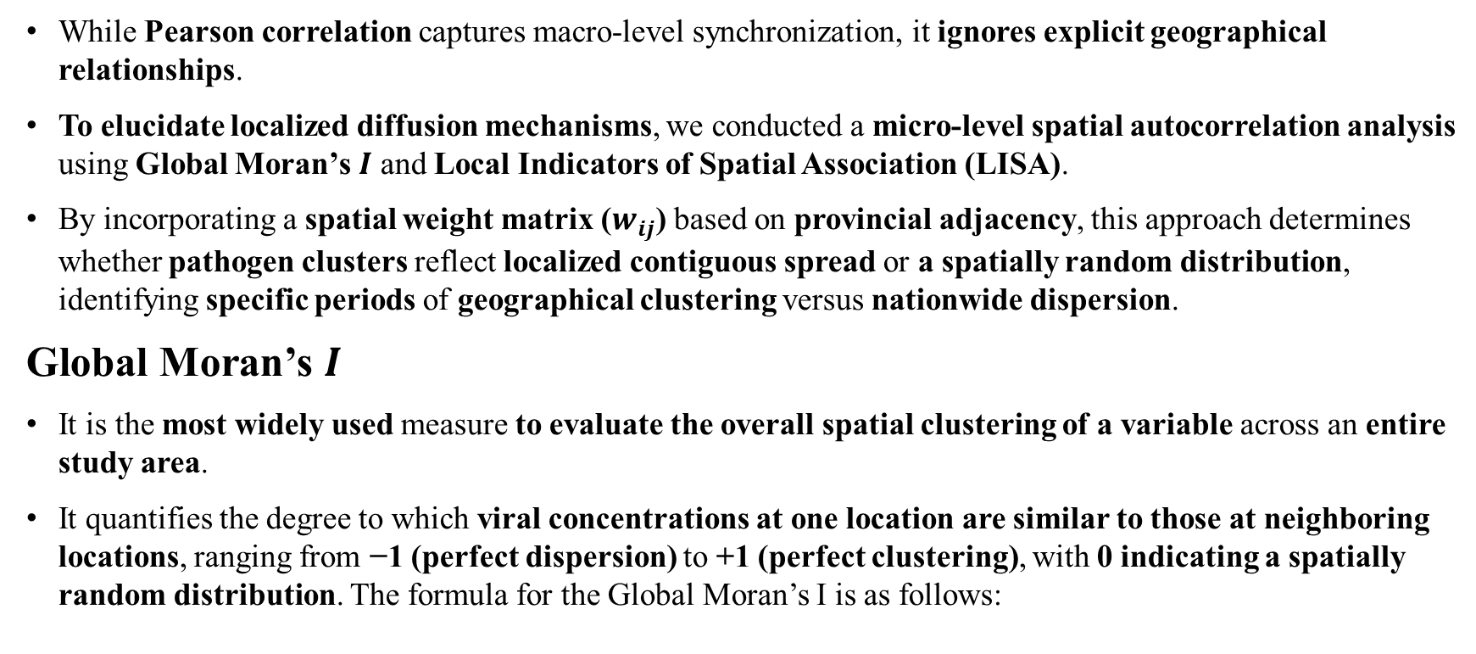
Micro-level Spatial Autocorrelation Analysis (1/2)
While Pearson correlation captures macro-level synchronization, it ignores explicit geographical relationships.
To elucidate localized diffusion mechanisms, we conducted a micro-level spatial autocorrelation analysis using Global Moran’s $I$ and Local Indicators of Spatial Association (LISA).
By incorporating a spatial weight matrix ($w_{ij}$) based on provincial adjacency, this approach determines whether pathogen clusters reflect localized contiguous spread or a spatially random distribution, identifying specific periods of geographical clustering versus nationwide dispersion.
Global Moran’s $I$
It is the most widely used measure to evaluate the overall spatial clustering of a variable across an entire study area.
It quantifies the degree to which viral concentrations at one location are similar to those at neighboring locations, ranging from −1 (perfect dispersion) to +1 (perfect clustering), with 0 indicating a spatially random distribution. The formula for the Global Moran’s I is as follows:
$$I=\frac{\sum_{i=1}^{n}{\sum_{j=1}^{n}{w_{ij}\left(𝓍_{i}−\overline{𝓍}\right)\left(𝓍_{j}−\overline{𝓍}\right)}}}{\sum_{i=1}^{n}{{\left(𝓍_{i}−\overline{𝓍}\right)}^{2}}}$$

Slide 11
Micro-level Spatial Autocorrelation Analysis (2/2)
The analysis utilized the same dataset described in Macro-level analysis.
To represent the geographical relationships between regions, we constructed a spatial adjacency matrix based on the boundary borders of the 17 provinces in South Korea.
  binary contiguity matrix, 1 or 0.
Local Indicators of Spatial Association (LISA)
To further pinpoint specific regional clusters of infection.
LISA allows for the identification of local spatial clusters and outliers by categorizing regions into four distinct quadrants:
  High-High (HH) / Hotspots: These regions represent epidemic centers where both the local area and its neighboring regions exhibit high viral concentrations.
  Low-Low (LL) / Coldspots: These clusters consist of “clean” areas where both the local and surrounding regions maintain low concentration levels.
  High-Low (HL) & Low-High (LH) / Spatial Outliers: These areas represent “atypical” regions where the local concentration is significantly different from that of its neighbors, highlighting localized anomalies in the diffusion pattern.

Slide 12
3. Experimental Result

Slide 13
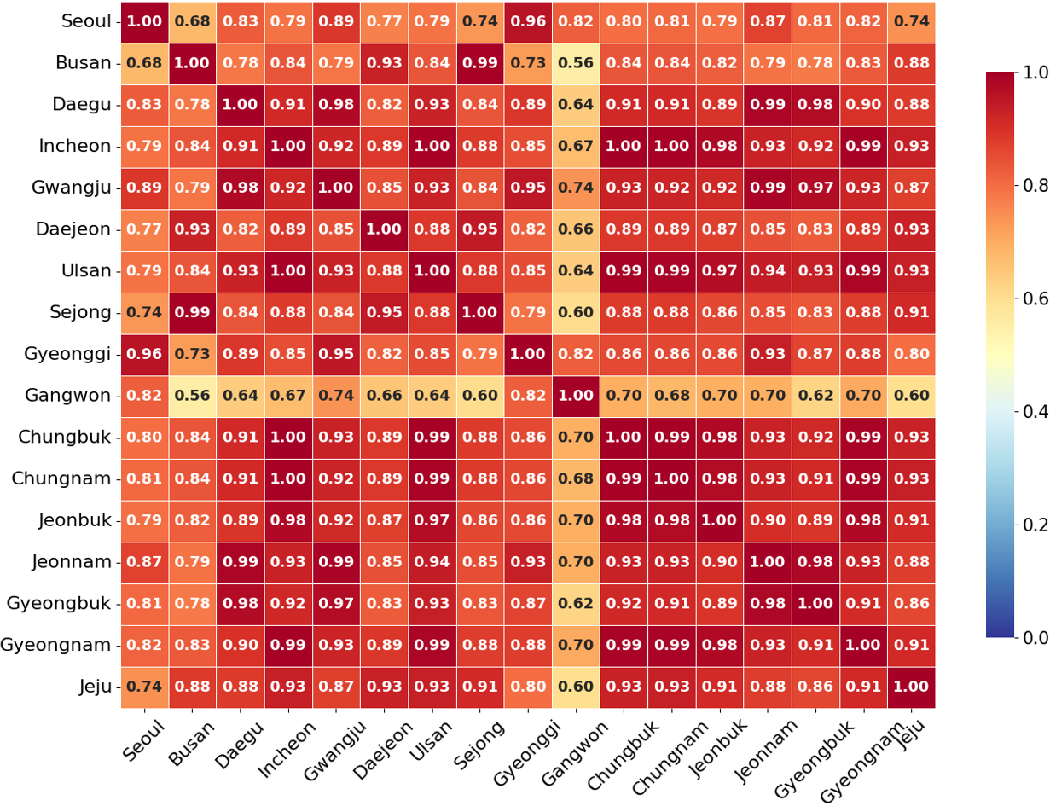
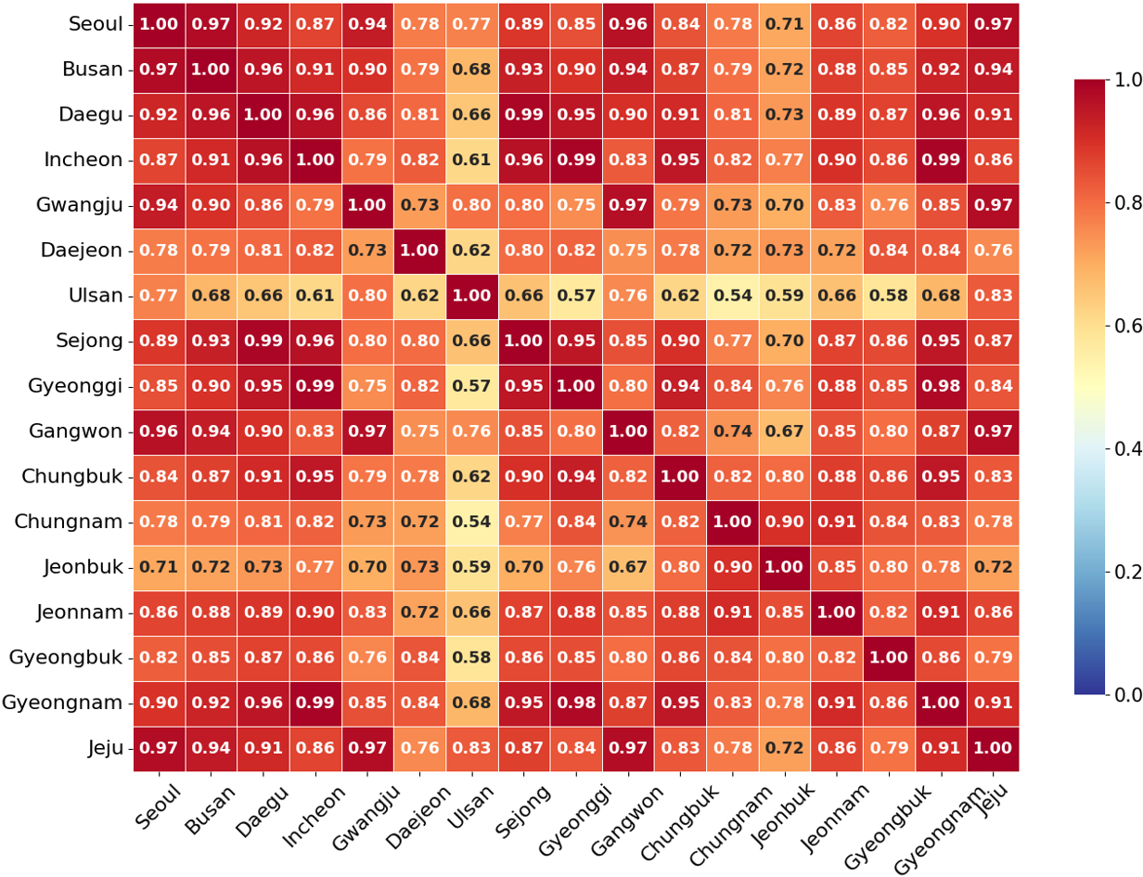
Macro-level Epidemic Synchronization Analysis (1/3)
Macro-regional Outbreaks of Norovirus and Influenza
Norovirus and Influenza showed high positive correlations across the 17 provinces, with average correlation coefficients of 0.829 and 0.865, respectively (𝑝 < 0.01 for all regional pairs).
Norovirus concentrations surged simultaneously across all regions starting from Week 50, coinciding with a sharp drop in temperature.
Influenza also formed uniform waves nationwide during the winter season (Week 52 – Week 5).
This suggests that the outbreaks of these two pathogens are governed more by seasonal factors and nationwide environmental changes than by geographical distance.
Figure 1: Regional Pearson correlation heatmaps of nationwide
wastewater-based virus concentrations: (b) Influenza, and (c) Norovirus.

Slide 14
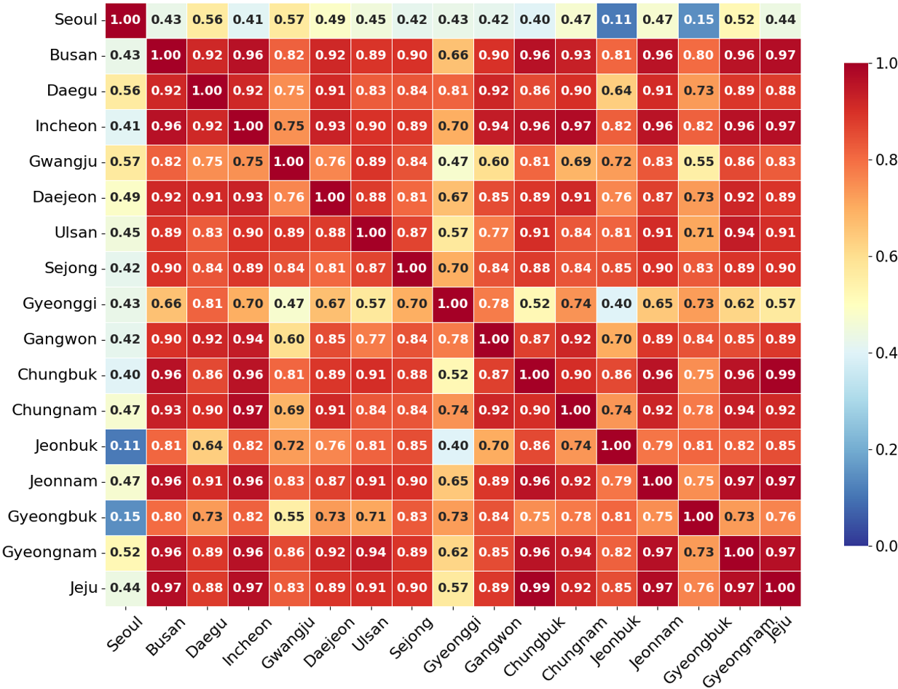
Macro-level Epidemic Synchronization Analysis (2/3)
Regional Independence of COVID-19
In contrast, the regional correlation for COVID-19 was relatively low(avg. 0.782) and inconsistently distributed.
While most regions showed correlation levels between 0.6 and 0.7 (𝑝 < 0.05), Seoul recorded the lowest synchronization level, with correlation coefficients ranging from 0.11 (with Jeonbuk) to 0.56 (with Daegu) (𝑝 ≥ 0.05).
This indicates that COVID-19 trends in Seoul followed a distinct trajectory, likely driven by high population density, unique mobility patterns, or localized quarantine policies.
Figure 1: Regional Pearson correlation heatmaps of nationwide
wastewater-based virus concentrations: (a) COVID-19.

Slide 15
Macro-level Epidemic Synchronization Analysis (3/3)
Time-series Analysis
COVID-19 reached its first peak in the autumn (Weeks 37–40) before gradually declining.
Conversely, Norovirus and Influenza remained at nearundetectable levels during autumn but increased explosively after Week 50, demonstrating complementary epidemic cycles.
This discrepancy in outbreak timing proves that multi-pathogen integrated monitoring via wastewater is effective in establishing a year-round, gapless infectious disease surveillance system.

Slide 16
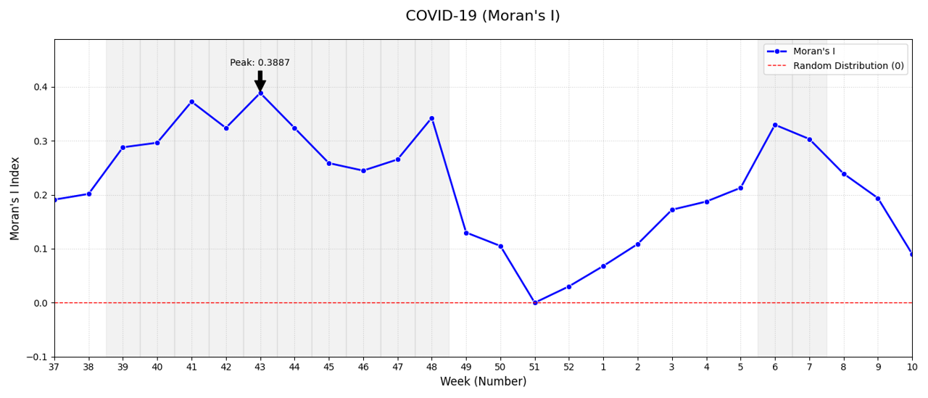
Micro-level Spatial Autocorrelation Analysis Covid19 (1/2)
Spatiotemporal Clustering of Viral Loads for Covid19
Spatial autocorrelation analysis yielded a mean Moran’s I of 0.2180, indicating a consistent pattern of geographical clustering.
Regional Clustering (Weeks 39–48)
  Strong positive autocorrelation was observed, peaking at 0.3887 in Week 43 (𝑍 > 1.96, 𝑝 < 0.05).
  This phase confirms that viral transmission was initially localized and heavily influenced by geographical proximity.
Figure 2: Moran’s I analysis results for (a) COVID-19.

Slide 17
Micro-level Spatial Autocorrelation Analysis Covid19 (2/2)
Spatial Homogenization (Week 49–Week 2)
  Moran’s I sharply declined, reaching near-zero in Week 51 (−0.0001, 𝑝 > 0.05).
  The loss of statistical significance suggests a transition to a random spatial distribution, reflecting a nationwide outbreak that neutralized localized clusters.
Re-clustering (Weeks 6–7)
  The index rebounded above 0.3, indicating the emergence of secondary regional hotspots following the national peak.
In summary, the viral spread transitioned from concentrated regional clusters to random national distribution, before reverting to secondary re-clustering, demonstrating a clear “concentration-dispersion-reconcentration” cycle.
Figure 2: Moran’s I analysis results for (a) COVID-19.

Slide 18
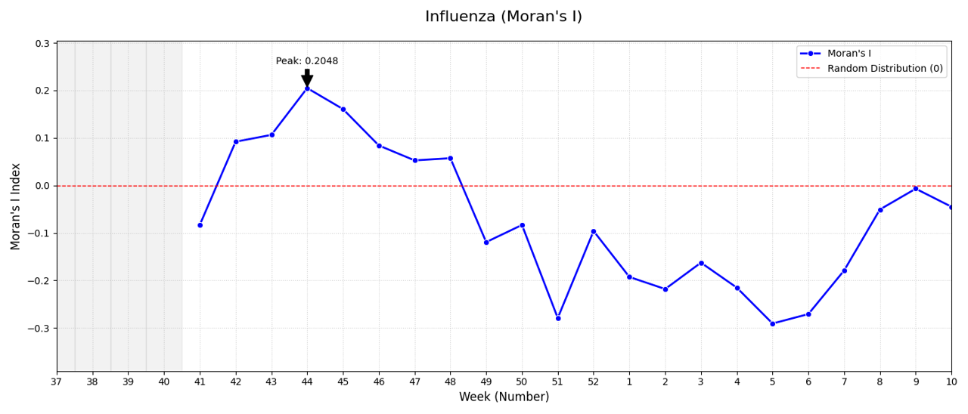
Micro-level Spatial Autocorrelation Analysis Influenza (1/2)
Spatial Autocorrelation Analysis of Influenza
The spatial analysis of Influenza concentrations in wastewater revealed a distinct lack of consistent geographical clustering compared to other pathogens.
The mean Moran’s I for the study period was −0.0698, with a near-zero mean Z-score (0.0102), indicating a predominantly random spatial distribution.
Initial Weak Correlation (Weeks 42–48)
  During the early stage of the outbreak, Moran’s I fluctuated between 0.05 and 0.20, peaking at 0.2048 in Week 44.
  However, these values remained statistically non-significant (𝑝 > 0.05), suggesting only a marginal and unreliable tendency toward localized clustering.
Figure 2: Moran’s I analysis results for (b) Influenza.

Slide 19
Micro-level Spatial Autocorrelation Analysis Influenza (2/2)
Spatial Dispersion and Randomness (Week 49–Week 10)
  From Week 49 onwards, the index frequently shifted into negative values, reaching its minimum at −0.2906 in Week 5.
  This negative autocorrelation indicates a spatial dispersion pattern, where high-concentration areas were often adjacent to low-concentration areas, resembling a checkerboard distribution rather than regional clusters.
Overall, the high 𝑝-values and fluctuating Moran’s I suggest that Influenza transmission did not follow a stepwise geographical expansion model.
Instead, the results point to a simultaneous nationwide occurrence where viral prevalence was driven by factors independent of geographical proximity, leading to a loss of discernible spatial structure.
Figure 2: Moran’s I analysis results for (b) Influenza.

Slide 20
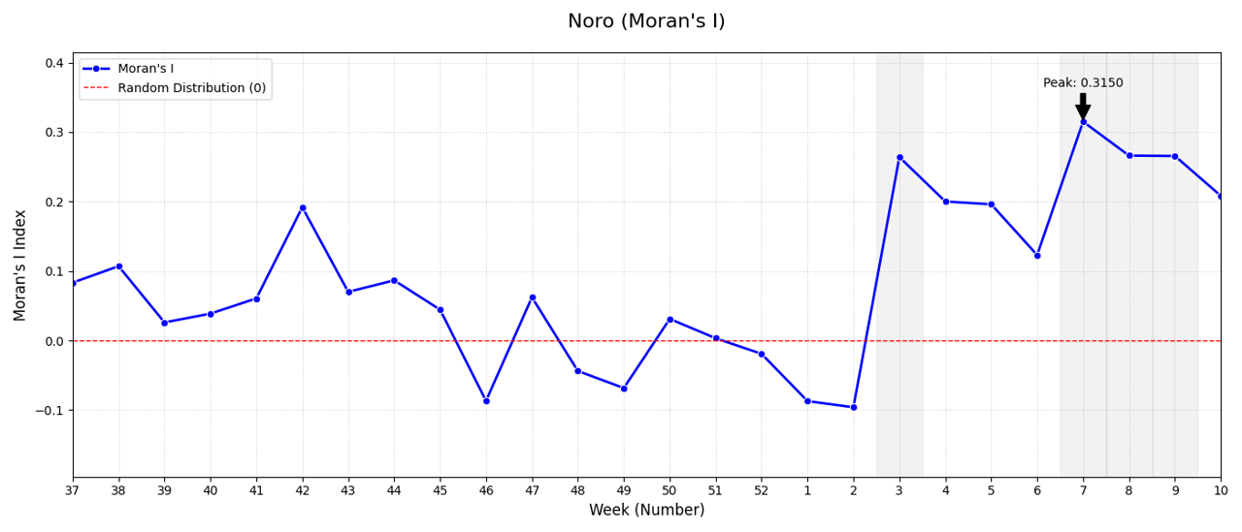
Micro-level Spatial Autocorrelation Analysis Norovirus (1/2)
Spatial Autocorrelation Analysis of Norovirus
The spatial analysis of Norovirus yielded an average Moran’s I of 0.0863, characterized by a distinct transition from a random distribution to a structured spatial clustering over time.
Random Distribution Phase (Week 37–Week 2)
  For the majority of the early and middle periods, Moran’s I fluctuated between −0.096 and 0.191.
  High 𝑝-values (𝑝 > 0.05) and low Z-scores during this interval indicate that viral prevalence was sporadically distributed without significant dependence on geographical proximity.
Figure 2: Moran’s I analysis results for (c) Norovirus.

Slide 21
Micro-level Spatial Autocorrelation Analysis Norovirus (2/2)
Delayed Clustering Phase (Week 3–Week 10)
  A sharp shift toward spatial clustering was observed starting from Week 3 (𝐼 = 0.2640, 𝑝 < 0.05).
  The autocorrelation peaked in Week 7, with Moran’s I reaching 0.3150 and a Z-score of 2.1327.
  This significant trend suggests that as the seasonal outbreak intensified, viral transmission became highly localized, forming strong regional clusters.
In summary, Norovirus exhibited a unique “delayed clustering” pattern, where initial widespread sporadic cases eventually consolidated into significant geographical hotspots during the peak of the outbreak.
Figure 2: Moran’s I analysis results for (c) Norovirus.

Slide 22
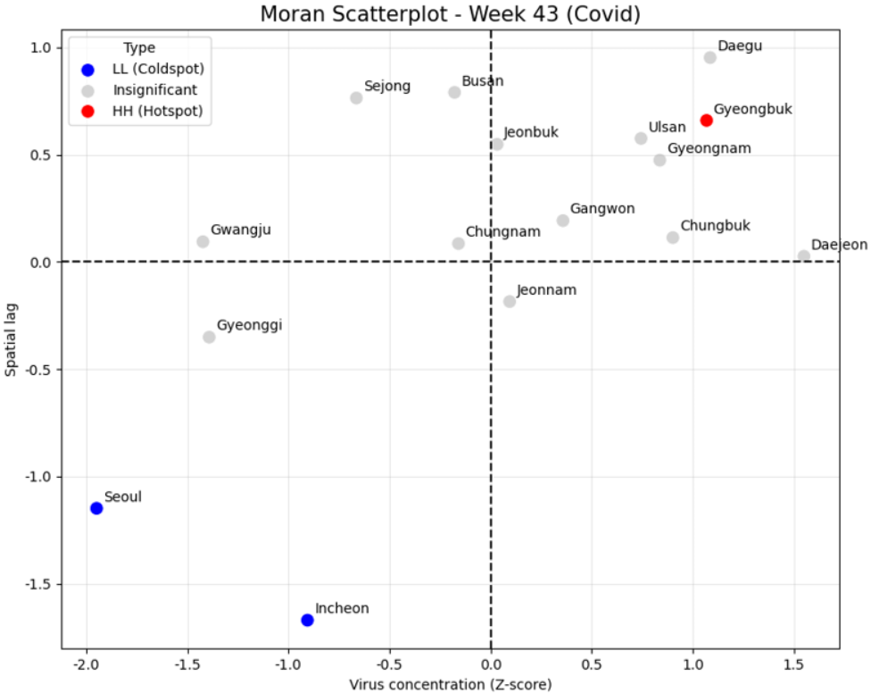
Micro-level Spatial Autocorrelation Analysis LISA Analysis of SARS-CoV-2 (1/2)
LISA Analysis of SARS-CoV-2: Spatiotemporal Cluster Dynamics
Figure 3 presents the Local Moran Scatterplots for SARS-CoV-2 at a representative time point, Week 43 (the initial clustering peak), which corresponds to the initial phase of the full concentration–dispersion–reconcentration cycle identified in the global Moran’s I analysis.
During the initial phase of the outbreak, Gyeongbuk emerged as the sole statistically significant HH hotspot (𝑝 < 0.05), indicating that both the province itself and its neighboring regions exhibited elevated viral concentrations.
(a) Week 43 (Initial Clustering)
Figure 3: Local Moran Scatterplots for SARS-CoV-2 at three
representative time points. The x-axis represents the standardized
viral concentration (Z-score) of each province, and
the y-axis represents the spatial lag (weighted average of
neighboring provinces). Cluster types are denoted as follows:
HH (High-High, Hotspot; red), LL (Low-Low, Coldspot;
blue), LH (Low-High, Divergent; light blue), and Insignificant
(grey).

Slide 23
Micro-level Spatial Autocorrelation Analysis LISA Analysis of SARS-CoV-2 (2/2)
This finding confirms that the early outbreak was geographically concentrated in the southeastern region of Korea.
Concurrently, Seoul and Incheon were identified as LL cold spots, reflecting suppressed viral loads in both the metropolitan core and its surrounding areas.
The spatial juxtaposition of a southeastern hotspot and a metropolitan cold spot highlights the regionally bifurcated nature of the early epidemic, in which the capital region remained largely insulated from the initial wave.
(a) Week 43 (Initial Clustering)
Figure 3: Local Moran Scatterplots for SARS-CoV-2 at three
representative time points. The x-axis represents the standardized
viral concentration (Z-score) of each province, and
the y-axis represents the spatial lag (weighted average of
neighboring provinces). Cluster types are denoted as follows:
HH (High-High, Hotspot; red), LL (Low-Low, Coldspot;
blue), LH (Low-High, Divergent; light blue), and Insignificant
(grey).

Slide 24
4. Conclusion and Future Work

Slide 25
Conclusion
This study demonstrated that Wastewater-Based Epidemiology (WBE) coupled with spatial autocorrelation tracking can effectively differentiate the spatiotemporal transmission dynamics of major pathogens.
While Influenza and Norovirus exhibited strong nationwide temporal synchronization driven by seasonal climate shifts rather than geographic proximity, SARS-CoV-2 followed a highly localized “concentration-dispersion-reconcentration” spatial cycle.
Notably, the distinct, non-synchronized trajectory of the Seoul metropolitan area highlights the importance of localized transmission variables such as population density and mobility.

Slide 26
Future Work
These empirical findings highlight the necessity of differentiated public health responses: implementing uniform nationwide protocols for seasonal climate-driven viruses alongside localized precision monitoring for autonomous pathogens.
This dual-track strategy aligns closely with a recently launched Korean government R&D project, “AI-based Early Warning System for Infectious Diseases Using Wastewater,” which mandates the automated detection of over 35 pathogens at more than 100 domestic wastewater treatment plants.
By integrating these multi-pathogen datasets, the project seeks to construct high-performance predictive engines and a comprehensive platform for monitoring and forecasting high-risk infectious diseases.
To support this objective, future research will focus on expanding the temporal observation window and incorporating non-aggregated raw concentration data to maximize real-time early warning capabilities.

Slide 27
Reference
Kyeong-Nam Kim, Jae-Seon Choi, Yeon-Su Lee, Dae-Gyo Kim, Jun-Young Park, Young-Min Kim, and Young-Sun Choi. 2024. A Study on COVID-19 Surveillance Using Wastewater-Based Epidemiology in Ulsan Area. Journal of Food Hygiene and Safety 39, 3 (2024), 260–265.
Lan Hee Kim, Viktorija Mikolaityte, and Sungpyo Kim. 2023. Establishment of wastewater-based SARS-CoV-2 monitoring system over two years: Case studies in South Korea. Journal of Environmental Chemical Engineering 11 (2023), 110034. Issue 3.
Young-Taek Kim, Kwang-Sik Lee, Ho-Seop Lee, et al. 2024. Development of a wastewater based infectious disease surveillance research system in South Korea. Scientific Reports 14, 1 (2024), 24544.
Korea Disease Control and Prevention Agency. 2026. KOWAS (KOrea Wastewater Surveillance) Project. https://kowas.re.kr/ National wastewater-based infectious disease surveillance portal.
Korea Disease Control and Prevention Agency (KDCA). 2026. Weekly Wastewater Surveillance Report (Week 10, 2026). Weekly Report. KOWAS (KOrea Wastewater Surveillance). https://bit.ly/3L8Y1zW Accessed: 2026-05-12.
Yago Lorenzo-Toja et al. 2022. Wastewater-based epidemiology for communitylevel surveillance of SARS-CoV-2 and other respiratory viruses. Science of The Total Environment 806 (2022), 150675.
Amy Xiao et al. 2022. Comparison of SARS-CoV-2 and Influenza viral titers in wastewater during a winter surge. Water Research 210 (2022), 117977.

