Slide 1

I Have to Get the Hell Out of NYC
The Search for Affordable Homes, Elsewhere…
February 1, 2018

Slide 2
“The Search” is an exercise to clean and aggregate several large datasets from Zillow housing data using Python to rank housing property value growth around the United States
Kaggle and Zillow provided 50+ datasets across many housing metrics, including many of their proprietary metrics (i.e. housing value index, custom zip/area/metro codes, and then aggregated listing values)
My goal was to practice aggregating these siloed datasets to better my skills in data cleaning/management

Slide 3
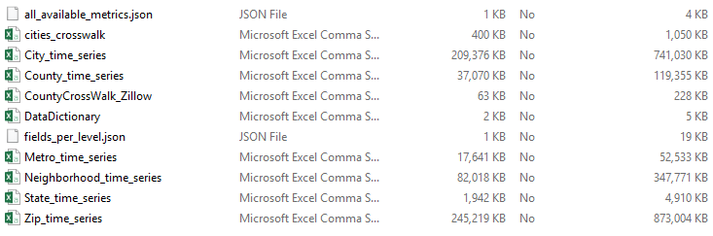
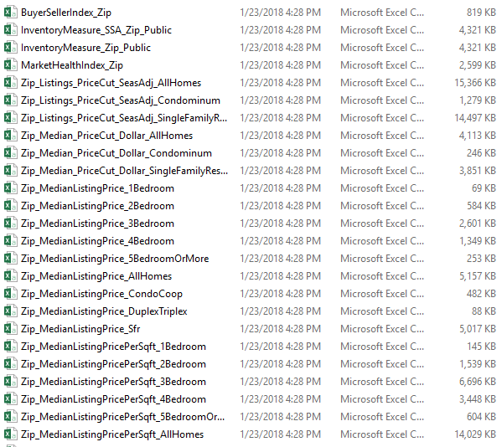
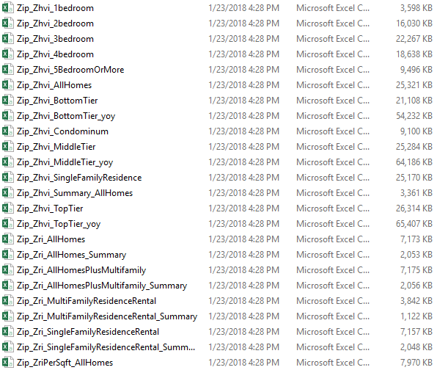
Surveying Zillow Data
First steps were surveying the Zillow data and identifying fields that could be joined (i.e. zip codes, city names) and finding population data by zip code

Slide 4
Surveying Zillow Data
This led to finding more Kaggle data based on the 2000 and 2010 census, as other population data by zip code was significantly incomplete
Zillow data also had similar problems:
Of the entire dataset from 1996 through 2017, significant data only existed from 2006 and onwards
In addition, many of their metrics (and ones I originally planned on using) were sporadic across zip codes
In addition, given the Great Recession, and aiming to calculate current trends in housing values, only data from 2010 through 2016 was used

Slide 5
Housing Insights
Top Line YoY increase & Total L6Y
Date | MedianListingPrice_2Bedroom | MedianListingPrice_3Bedroom | MedianListingPrice_4Bedroom | MedianListingPrice_5BedroomOrMore
12/31/2010 | $ 201,472 | $ 212,773 | $ 339,059 | $ 703,278
12/31/2011 | $ 193,431 | $ 199,538 | $ 324,341 | $ 683,497
12/31/2012 | $ 188,461 | $ 198,577 | $ 329,437 | $ 688,880
12/31/2013 | $ 203,179 | $ 215,691 | $ 360,764 | $ 736,915
12/31/2014 | $ 219,902 | $ 237,948 | $ 383,292 | $ 741,547
12/31/2015 | $ 246,054 | $ 259,613 | $ 416,841 | $ 804,841
12/31/2016 | $ 272,465 | $ 280,149 | $ 447,712 | $ 917,753
Total % Change | 35% | 32% | 32% | 30%

Slide 6
Housing Insights
The largest YoY winners across increased housing value could be considered the hedonistic cities, as well as the generally thought of retirement centers of the USA.
2 Bedroom | YoY Avg. L6Y
Denver, CO | 39.1%
Honolulu, HI | 21.6%
Naples, FL | 20.9%
Punta Gorda, FL | 19.4%
Boynton Beach, FL | 18.2%
Miami Beach, FL | 16.2%
Bellingham, WA | 15.1%
Fort Lauderdale, FL | 14.9%
Los Angeles, CA | 14.4%
Coconut Creek, FL | 13.9%
Nashville, TN | 13.8%
Greeley, CO | 12.9%
Chicago, IL | 12.5%
Atlanta, GA | 12.2%
Henderson, NV | 11.4%
3 Bedroom | YoY Avg. L6Y
Las Vegas, NV | 119.8%
Nashville, TN | 52.5%
Vancouver, WA | 37.5%
Denver, CO | 36.4%
Fort Worth, TX | 31.8%
Colorado Springs, CO | 29.8%
Charlotte, NC | 29.7%
Indianapolis, IN | 27.0%
Fredericksburg, VA | 26.8%
Dallas, TX | 25.0%
Port Saint Lucie, FL | 24.9%
Knoxville, TN | 23.3%
Jupiter, FL | 23.3%
Henderson, NV | 22.9%
Asheville, NC | 21.2%

Slide 7
Housing Insights
4 & 5 bedroom median list prices should be taken with a grain of salt. It is not listed in the Zillow methodology how many houses in a certain region are needed to create a median price.
4 Bedroom | YoY Avg. L6Y
Las Vegas, NV | 61.4%
Marietta, GA | 29.6%
Plano, TX | 25.8%
Charlotte, NC | 25.6%
Colorado Springs, CO | 25.0%
Fredericksburg, VA | 24.1%
Reno, NV | 22.0%
McKinney, TX | 21.2%
Henderson, NV | 21.0%
Dallas, TX | 20.0%
Fort Worth, TX | 19.9%
Coral Springs, FL | 19.8%
Atlanta, GA | 18.9%
Bothell, WA | 17.2%
Port Saint Lucie, FL | 16.5%
5 Bedroom | YoY Avg. L6Y
New York, NY | 41.0%
Frisco, TX | 18.5%
Las Vegas, NV | 16.3%
Kissimmee, FL | 12.1%
Coral Springs, FL | 12.0%
Saint George, UT | 10.8%
Buford, GA | 10.7%
Marietta, GA | 10.2%
North Las Vegas, NV | 10.2%
Colorado Springs, CO | 9.7%
Apopka, FL | 9.0%
McKinney, TX | 8.7%
Greeley, CO | 8.5%
Roswell, GA | 7.1%
Suwanee, GA | 7.0%

Slide 8
Reflecting on Results & Conclusions
Given the data difficulties (and my beginner Python data cleaning capabilities), the rankings for 2-3 bedroom houses are intuitive.
Both 2 and 3 bedroom homes that rank the highest YoY increase are in areas of baby-boomer retirees or popular among 30-year old destinations
Despite the lack the of stats here due to data cleaning issues, increased population is seemingly indicative of increased YoY home values
City | Population Change | City | Population Change
Frisco, TX | 169,866 | Suwanee, GA | 88,119
McKinney, TX | 120,291 | Tampa, FL | 86,232
Las Vegas, NV | 116,397 | Charlotte, NC | 86,076
Longmont, CO | 114,285 | Mansfield, TX | 86,058
Port Saint Lucie, FL | 107,367 | Chula Vista, CA | 84,273
Aurora, CO | 100,395 | Canton, GA | 82,353
Henderson, NV | 97,575 | Fort Worth, TX | 82,242
Pembroke Pines, FL | 96,576 | Waxhaw, NC | 82,095
Cedar Park, TX | 92,547 | Wylie, TX | 81,876
Albuquerque, NM | 89,343 | Pasco, WA | 81,858

Slide 9
Project Approach
This was more of an exercise in data cleaning and management for datasets over 1M rows
Initially, I imagined the Zillow datasets (in at least one of the 50+ available ones) would have trended other metrics, such as population, average household income, complete median/mean sets of “sold” prices by size of house, etc.
In addition, I never would have guessed how siloed and different the field values could be, such as 3 different types of zip codes, proprietary regional naming, and multiple city names and keys--without a seemingly actual primary key.
Ultimately, all this data led to analysis paralysis—a state of being overwhelmed and frustrated with a heap of messy data, you reduce your original project scope to something much more descriptive and simple.

Slide 10

Next Steps
Identifying state rankings in terms of “most physically active states”, “states by most sunshine OR temperate weather”, “business friendly states”, etc. could yield more macro trends in this data
Additionally, reviewing specific historical data fields to some of these hot real estates cities may identify predictive/nascent traits that could be used for long-term real estate investments

