Slide 1

Market Basket, Frequent Itemsets, Association Rules, Apriori, Other Algorithms
Group 5
Pratik Kontamwar
Girish Kulkarni
Sumedh Joglekar
Nishita Kalyanpur
Kartik Mistry
Mukul Khilnani
Harshitha KV
Wali Hassan Khan
Samuel Buahin

Slide 2
Market Basket Analysis

Slide 3
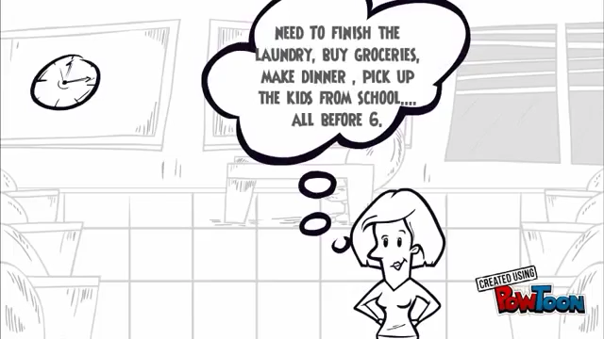

Slide 4
What is Market Basket Analysis?
Market Basket Analysis is a modelling technique based upon the theory that if you buy a certain group of items, you are more (or less) likely to buy another group of items.
It works by looking for combinations of items that occur together frequently in transactions.

Slide 5
Market Basket Analysis
Many-to-many relationship between different objects
The relationship is between items(itemset) and baskets (transactions)
Example:
Rule: {pencil, paper} => {rubber}.
Support: the percentage of transactions that contain all of the items in an itemset (e.g., pencil, paper and rubber).
Confidence: the probability that a transaction that contains the items on the left hand side of the rule (in our example, pencil and paper) also contains the item on the right hand side (a rubber).

Slide 6
Questions
The things that customers actually purchase are known as:
Items
Transactions
Support
Confidence

Slide 7
Benefits of Market Basket Analysis
Store Layout: Organize or set up your store according to market basket analysis in order to increase revenue. The products are placed near each other so that the customer notice and take a decision to buy them.
Marketing Messages: Market basket analysis increase the efficiency of marketing messages, With the help of market business analysis data, you can give relevant suggestions to your customer.
Recommendation Engines : Market basket analysis is the base for creating recommendation engines. A recommendation engine is a software that analyzes identifies and recommends content to users in which they are interested.

Slide 8
Applications
Cross Selling: Cross-selling is basically a sales technique in which seller suggests some related product to a customer after he buys a product. Market basket analysis helps the retailer to know the consumer behavior and then go for cross-selling.
Product Placement: It refers to placing the complimentary (pen and paper)and substitute goods (tea and coffee) together so that the customer addresses the goods and will buy both the goods together, which increases the probability of purchase.
Customer Behavior: Market basket analysis helps to understand customer behavior. It understands the customer behavior under different conditions.

Slide 9
What are frequent sets?
A frequent itemset is an itemset whose support is greater than some predefined user-specified threshold support.
Association Mining searches for frequent items in the data-set.
In frequent mining usually the interesting associations and correlations between item sets in transactional and relational databases are found.
Frequent Mining shows which items appear together in a transaction or relation.

Slide 10
Why is frequent itemset mining needed?
Frequent mining is generation of association rules from a Transactional Dataset.
If there are 2 items A and B purchased frequently then its good to put them together in stores or provide some discount offer on one item on purchase of other item. This can result in higher sales.
For example it is likely to find that if a customer buys Milk and bread he/she also buys Butter. So the association rule is [‘milk]^[‘bread’]=>[‘butter’].
So seller can suggest the customer to buy butter if he/she buys Milk and Bread.

Slide 11

Question
What entity qualifies an item set to be a frequent item set?

Slide 12
Find Frequent Itemsets - Apriori
The Apriori property:
Any subset of a frequent itemset must be frequent.
Example: if (beer, bread, milk} is frequent, so is {beer, bread}, i.e., every transaction having {beer, bread, milk} also contains {beer, bread}.
Apriori Pruning principle: If there is any itemset which is infrequent, its superset should not be generated/tested!
Example: if {(beer, bread, milk)} is infrequent, so is {beer, bread, milk, cheese}.
Breadth First Search:
Initially, scan DB once to get frequent 1-element itemset.
Then scan DB again to get 2-element itemsets, and so on.
For each iteration k:
Generate length (k) candidates from length (k-1) frequent itemsets. It has two steps:
Join step: Merge pairs (f1, f2) of frequent (k-1)-element itemsets into k– element candidate itemsets Ck if all elements in f1 and f2 are the same except the last element.
Prune step: Remove those candidates in Ck that cannot be frequent.
Scan DB and remove the infrequent candidates
Terminate when no set can be generated

Slide 13
Support and Confidence
Support is calculate by Support of (A=>B) = [AB]/N,
Support is an indication the how frequently the items appear in the database
Confidence is calculated by Confidence of (A=>B) = [AB]/[A]
Confidence indicates the number of times the if/then statements have been found to be true.
Itemset – A collection of one or more items
Example: {Milk, Bread, Diaper} – 3-itemset. An itemset that contains 3 items.
Frequent Itemset – An itemset whose support is greater than or equal to a threshold

Slide 14

Support and Confidence (Contd.)
Support = p(A∩B) = $\frac{Number of transactions containing both A and B}{Total Number of Transactions}$
Confidence = p(B|A) =$\frac{\text{p}\text{(}\text{A}\text{∩}\text{B}\text{)}}{p(A)}$ = $\frac{Number of transactions containing A \& B}{Total Number of Transactions containing A}$

Slide 15
Fun Facts
Rules often preferred having High Support or High Confidence or both.
For Meeting the Strong Rules for given data Support and Confidence should meet the threshold value

Slide 16
Question
Among mentioned below what all can be the applications of frequent itemset algorithm?
Plagiarism
Biomarkers
Ecommerce Market
All of the above

Slide 17
APRIORI ALGORITHM
Apriori Is an algortihm for frequent item set mining and association rule learning over transactional databases.
It proceeds by identifying the frequent individual items in the database and extending them to larger and larger item sets as long as those item sets appear sufficiently often in the database.
The frequent item sets determined by Apriori can be used to determine association rules which highlight general trends in the database: this has applications in domains such as market basket analysis.

Slide 18
Algorithm
We have to build a candidate list for K itemset and extract a frequent list of k-elements using support count using support count
After that we use the frequent list of k itemsets in the determining the candidate and the frequent list of k+1 itemsets
We use pruning to do that
We repeat until we have an empty candidate or frequent support of k itemsets
Then return the list of k-1 itemsets

Slide 19
Question
Assume that the largest frequent itemset is of size k.
How many passes does the apriori algorithm need in worst case?
A. k − 1
B. k
C. k + 1
D. k 2
E. 2k
F. 2 k − 1

Slide 20
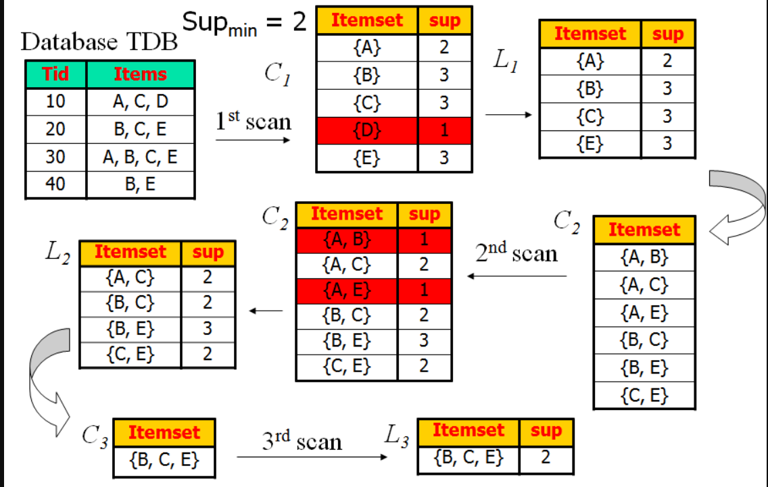
Example:

Slide 21
Pros and Cons:
1.Apriori is an easy-to-implement and easy-to-understand algorithm.
2.It can be used on large itemsets.
3. It can be easily parallelized
1.Computationally expensive.
2.Calculating support requires entire database scan.
3. Assumes transaction database is memory resident.

Slide 22
Question
The Apriori algorithm is used for the following data mining task -
A. Classification
B. Clustering
C. Association

Slide 23
ASSOCIATION RULE
Association Rule is a way to find patterns or relation in data by using features which are correlated and occur together.
Useful for analysing and predicting Customer behavior
If/then statements that help uncover relationships between unrelated data in a set of data.
Discovered by Rakesh Agrawal, Tomasz Imielinski and Arun Swami.
Examples:
If a customer buys bread he/she is likely to buy butter
Buys{bread} => buys {butter}

Slide 24
Association Rule
Parts of Association rule:
Using the bread and butter example:
Bread => Butter [10%, 50%]
Bread -> Ancedent
Butter -> Consequent
10% -> Support
50% -> Confidence

Slide 25
Association Rule
Using the supermarket example
Total transactions : 100
Bread -> 10
10/100 * 100 = 10% => Support
In 10 transactions, butter = 5 transactions
5/10 = 50% => Confidence

Slide 26
Association Rule
Types of Association Rules:
Single Dimensional Rule
Bread => Butter : (Buy)
Multi Dimensional Rule
Occupation(I.T), Age(>22) => buys (laptop) : (Occupation, age, buy). Dimensions are not repeated
Hybrid Association Rule
Time(5:00pm), buys (tea) => buys (biscuits) : (Occupation, buy. buy)

Slide 27
Applications
Market basket analysis (Promotional Pricing and product placement)
Web usage analysis
Intrusion detection
Bioinformatics
Continuous production

Slide 28
Question
Name the types of Association Rules

Slide 29
Other Algorithm
SON Algorithm: Repeatedly read small subsets of the baskets into main memory and run an in memory algorithm to find all frequent itemsets
The first pass of the SON Algorithm performs the Simple algorithm on subsets that compose partitions of the dataset.
The second pass counts the output from the first pass and determines if an itemset is frequent across all subsets.

Slide 30
Question
Example of Regression problem:
What does the first pass of SON Algorithm do?

Slide 31
Other Algorithm
FP Growth Algorithm: An efficient and scalable method for mining the complete set of frequent patterns by pattern fragment growth, using an extended prefix-tree structure for storing compressed and crucial information about frequent patterns named frequent pattern tree (FP Tree).
Advantages:
Only 2 passes over data-set than repeated database scan apriori
Much faster than apriori algorithm
Disadvantages:
FP-Tree may not fit in memory
FP-Tree is expensive to build

Slide 32
Question
How do we find all frequent patterns from the FP-Tree?

