Slide 1
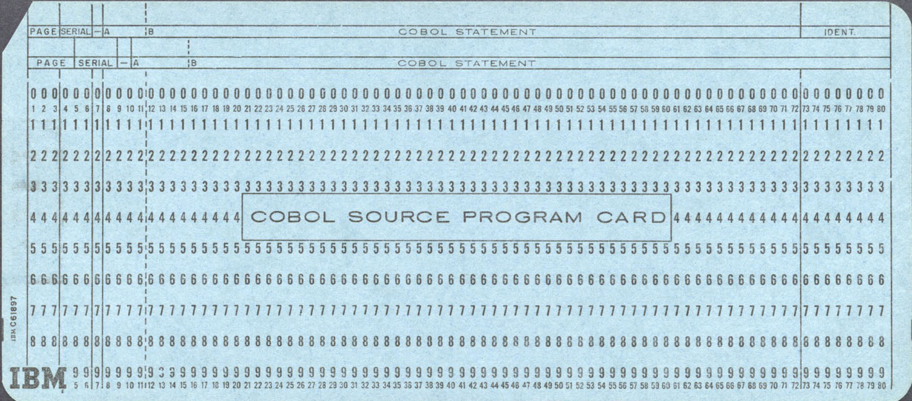

COBOL Bubble Sort
Common Business Oriented Language
Compiled
Statically Typed
Created in 1959 as part of a DoD effort to create a portable data processing language
800,000,000,000
Lines of COBOL code still in use
Notes:
COBOL stands for Common Business Oriented Language, and it is a compiled, statically typed, procedural language that was created in 1959 as part of a Department of Defense effort to create a portable language for data processing.
Even though it’s a 64 year old language, the latest research suggests that there are over 800 Billion lines of COBOL in use.
800 billion is two lines of code everyday since the earth started spinning which should scare you.
So while some call it a dead language the truth is it’s a hard to kill language

Slide 2
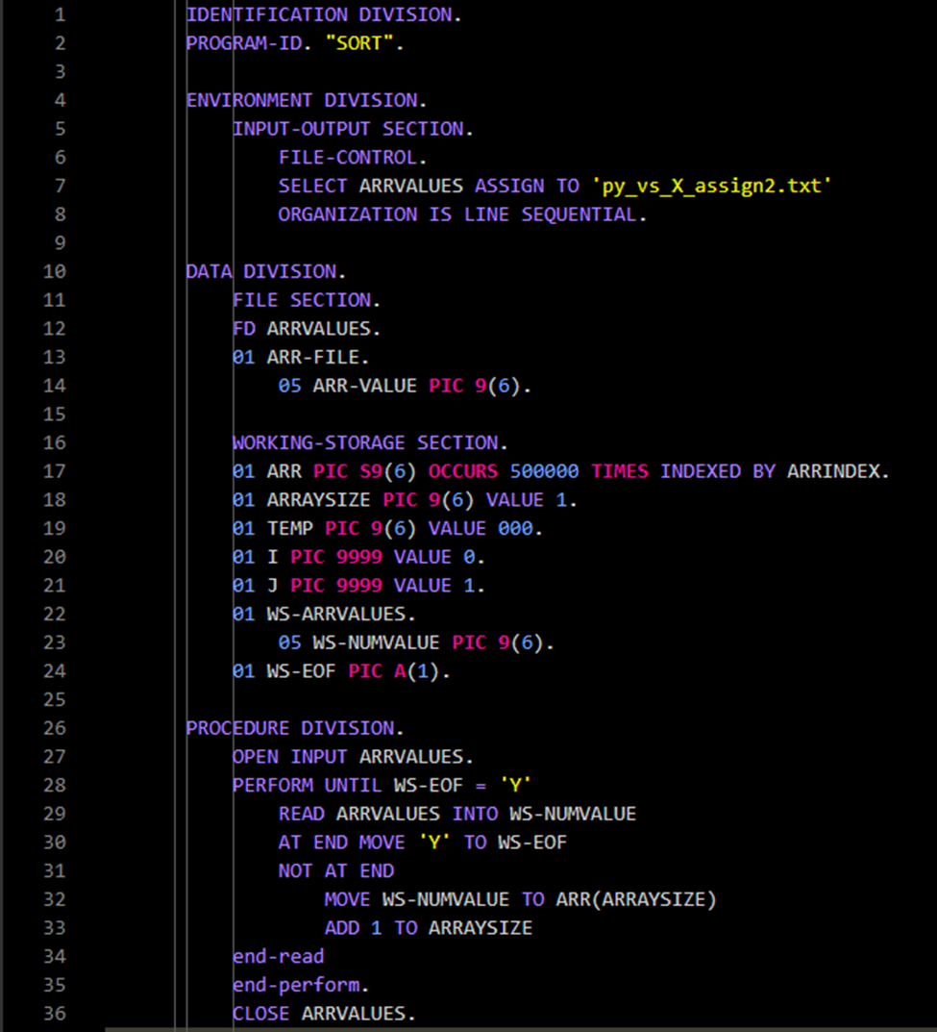
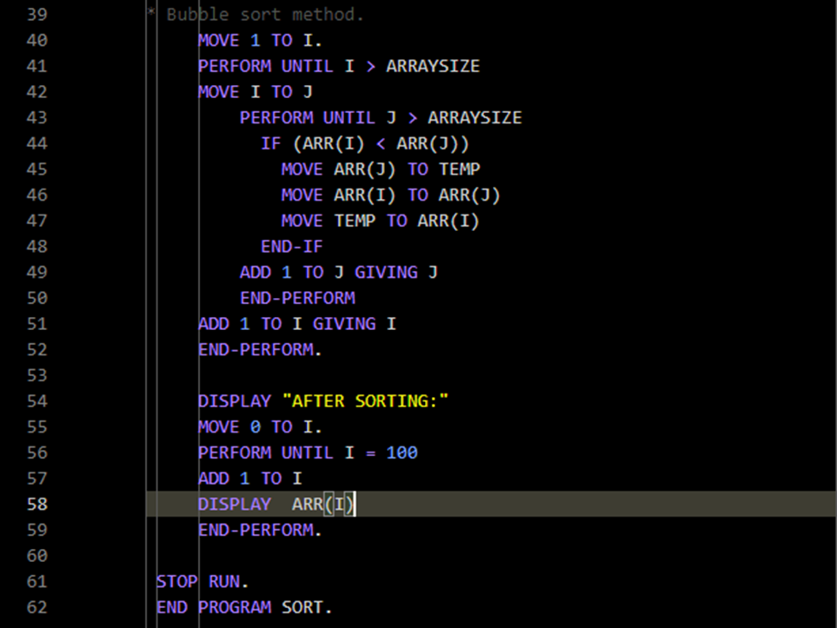
COBOL programs are divided into four divisions, Identification, Environment, Data, and the Procedure Division.
Notes:
Here’s my code. COBOL code is formatted with columns this is a carryover from when they were on punch cards.
There are four divisions including the data division where you declare every single variable and the procedure division where the magic happens
COBOL does not have arrays they have tables. The key word “PIC” you see in pink stands for picture clause and 9 indicates it will be a numeric value consisting of digits zero thru 9.
COBOL does not allow for dynamically sized indexed tables so on line 17 I cheated and set the value to 500,000.
I saved an arraysize variable for the bubble sort, so that it treats the value of array size as the last index, that way we don’t try to sort the unsortable.

Slide 3

RESULTS
Sorting an array of size n = 500,000…
Python Runtime: 4 Hours
COBOL Runtime: At least twice that
Preferred Language for future projects: C#
Notes:
To keep it fair I ran this within my Windows Subsytem for Linux environment. That was a huge mistake. It took Python nearly 4 hours, and the COBOL implementation is still running and eating up my cpu even though I started it literally two days ago. I probably used several trees worth of electricity to sort this array with half a million numbers.
In the future, my preferred language would be C#, like an adult.

