Slide 1

Linux + SCOM + OMS =
Stefan Roth | itnetX
Cloud Architect
Microsoft Most Valuable Professional (MVP)
Stefan Johner | itnetX
Cloud Architect

Slide 2
30 SAC (30 Seconds Audience Check)
Who is using SCOM & Unix/Linux monitoring?
Who is using OMS & Unix/Linux agent?
Who is using OMS in production?
Who does not know either SCOM or OMS?
  This is a level 300 session
  Slide / Demo ratio 2.83 : 1
Who is already bored ☺?

Slide 3



Blogger
http://stefanroth.net
http://hellshell.com
Co-Author
Twitter
@stefanroth_net
@hellshell_com

Slide 4

Blogger
https://blog.jhnr.ch
Twitter
@JohnerStefan

Slide 5
Agenda
SCOM X-Plat Overview
SCOM 2016 What’s New
OMS X-Plat Overview
Demo, Demo, Demo

Slide 6

Once upon a Time…
Linux is not in the public domain. Linux is a cancer that attaches itself in an intellectual property sense to everything it touches. That's the way that the license works
Linux is a cancer that attaches itself in an intellectual property sense to everything it touches.
I'd rather use Windows and Internet Explorer in Hell than I'd use Linux and Mozilla Firefox in Heaven!

Slide 7



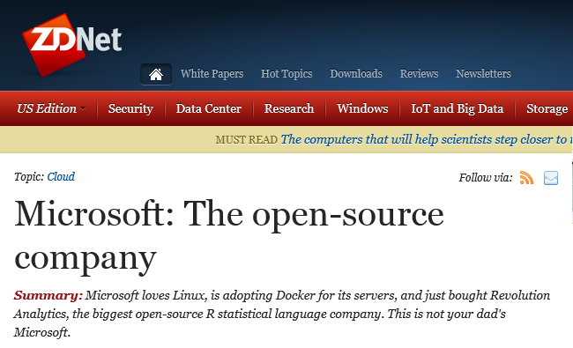
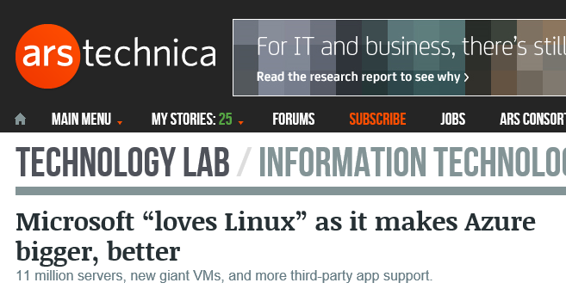
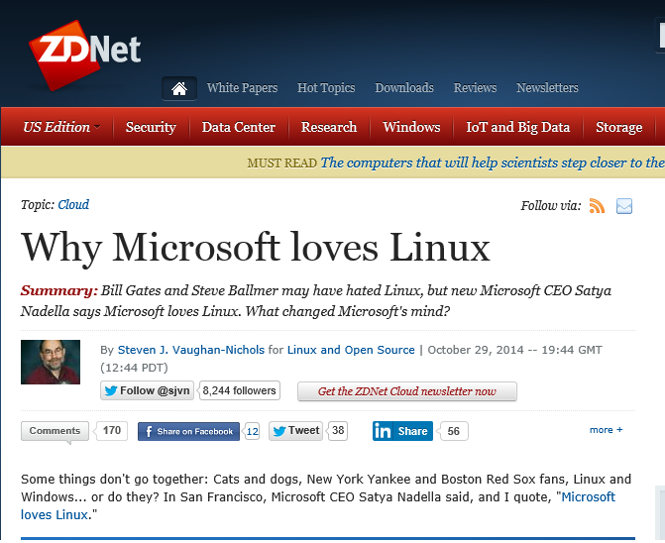
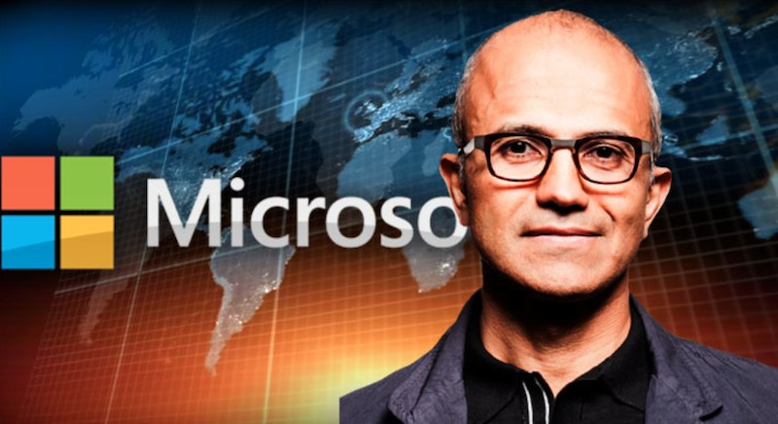
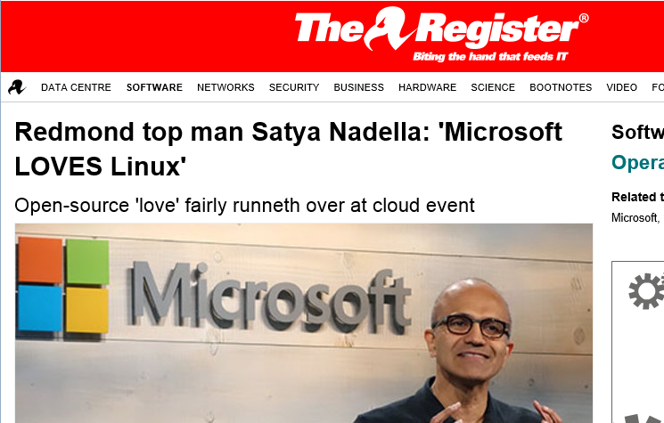
A Miracle Happened…

Slide 8
Linux in System Center: increasing momentum
2008
2009
2010
2011
2012
2013
2014
2015
Linux/UNIX In OpsMgr
JEE in OpsMgr
Linux/UNIX in ConfigMgr
Linux Endpoint Protection in ConfigMgr
Linux in VMM
Linux in DPM
Initial development
Shipping
Apache and MySQL in OpsMgr
Preview
Preview

Slide 9
Architectural Overview
Managed Windows Computer
MOMChannel
SDK
OpsMgr agent
for Windows
Config (MPs)
Config
Service
Events, Data, State
Health Service
MP
MP
MP
Health
Service
WinRM
library
OpsMgr agent
for Linux/UNIX
(OpenPegasus CIM
Server + providers)
HTTPS transport
HTTPS transport
WS-Man protocol
(OMI CIM Server
+ providers)
ssh client
library
ssh connection
sshd
Agent Maintenance Actions
OpsMgr Management Server
Managed Linux/UNIX Computer

Slide 10













Built-In Monitoring
Custom LogFile Monitoring
Monitor any logfile
Specify regular expression to match against
Process Monitoring
Monitor by name any service, daemon or process
Distinguish duplicate names with regex filter on process arguments
Specify minimum and maximum counts
Command line rules and monitors
Run any shell command line to determine health or performance
Target computer or group
Target computer or group
Target computer or group
JEE AppServer
Basic
Application server instances
Basic discovery of apps, ports etc.
Deep (Bean Spy)
Applications deployed in the application server.
Garbage collections per second.
Time spent in garbage collection.
JVM memory usage and capacity.
Number of class loaded in the JVM.
Number of active threads.
More using MBeans (JMX)
Health and performance monitoring in Microsoft’s Linux/UNIX management packs
CPU
Memory
Disk
Network
Processes
Logfiles

Slide 11
Apache Monitoring Architecture
Apache HTTP Server
OMI Server
(CIM Server)
WS-Man
Step 1: Import MP
Step 2: Deploy SCOM agent*
Step 3: Run SCOM task to deploy mod_cimprov Apache module **
* Automatically deploys OMI module
**UNIX/Linux Privileged Account Run As Profile
Shared memory
mod_cimprov
Apache_HTTPD*
Providers
mod_php
SCX_OperatingSystem
mod_ssl
SCX_FileSystem
mod_alias
SCX_UnixProcess
Linux
Computer
Apache Web Server
OpsMgr Linux Agent

Slide 12
Demo
Apache Monitoring

Slide 13
MySQL Monitoring Architecture
OMI Server
(CIM Server)
Authentication
File defines credentials
WS-Man
MySQL Server
Step 1: Import MP
Step 2: Deploy SCOM agent*
Step 3: Configure MySQL user
Step 3: Run SCOM task “Set Default MySQL Credentials”**
* Automatically deploys OMI module
**UNIX/Linux Privileged Account Run As Profile
MySQL_Server*
Providers
MySQL Client
Database
Database
SCX_OperatingSystem
SCX_FileSystem
SCX_UnixProcess
Linux
Computer
MySQL Server
OpsMgr Linux Agent

Slide 14
Demo
MySQL Monitoring

Slide 15
Demo
Overview SCOM 2016 Features

Slide 16
OMS
Agent for Linux

Slide 17
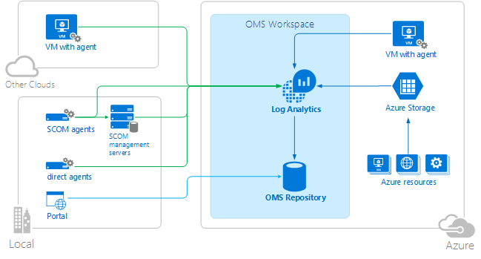
Big Picture
Sources:
https://azure.microsoft.com/en-us/documentation/articles/log-analytics-overview/
https://azure.microsoft.com/en-us/documentation/articles/log-analytics-security/

Slide 18








Architectural Overview
omsagent (FluentD)
syslog
Upload Data (https)
Nagios
OMI Server (CIM Server)
Providers
Zabbix
Operating System
Apache
Docker
MySQL / MariaDB
Containers
Pull Config (https)
collectd
omsconfig
PowerShell DSC

Slide 19






OMS CollectD
collectd is a Unix daemon that collects, transfers and stores performance data of computers and network equipment.
«read plug-ins» collect data
«write plug-ins» send data over the network to a remote instance of the daemon
Linux Server
write_http
omsagent
List of available plugins: https://collectd.org/wiki/index.php/Table_of_Plugins

Slide 20
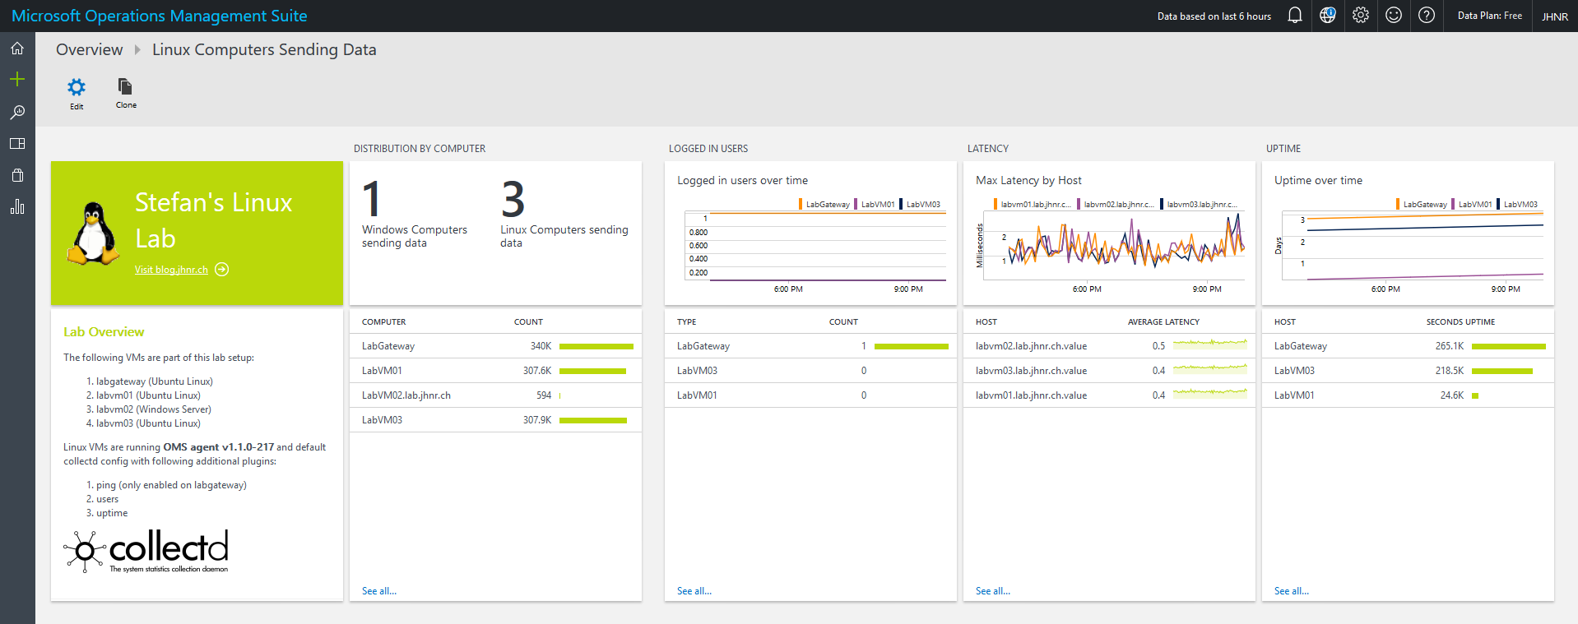
Custom Dashboard

Slide 21
Demo:
OMS Agent for Linux and CollectD Metrics

Slide 22
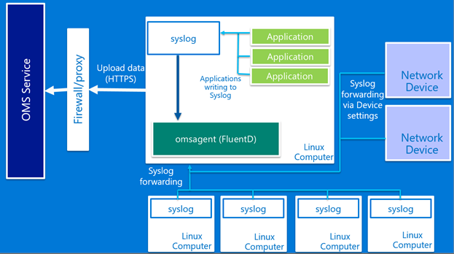
OMS Syslog
Either rsyslog or syslog-ng are required to collect syslog messages.
  sysklog is not supported
Use OMS portal for centralized facility and severity management
Default all managed agents get OMS configuration. Selective disable:
  OMS_MetaConfigHelper.py –disable
> 500 messages/seconds (daemon => agent) needs change to TCP protocol
Routing syslog messages directly to OMS agent possible (passing by syslog daemon)

Slide 23
Demo:
Syslog

Slide 24
Additional Resources
OMS Agent for Linux Documentation
https://github.com/Microsoft/OMS-Agent-for-Linux/blob/master/docs/OMS-Agent-for-Linux.md#install-the-oms-agent-for-linux
Troubleshooting Guide:
https://github.com/Microsoft/OMS-Agent-for-Linux/blob/master/docs/Troubleshooting.md
Bring your custom collectd metrics into the OMS Log Analytics platform
https://blogs.technet.microsoft.com/msoms/2016/07/14/bring-your-custom-collectd-metrics-into-the-oms-log-analytics-platform/
Syslog collection in Operations Management Suite
https://blogs.technet.microsoft.com/msoms/2016/05/12/syslog-collection-in-operations-management-suite/
Enable Log Analytics in MS OMS on Azure virtual machines
https://blogs.technet.microsoft.com/msoms/2016/02/09/1474/
Bring your Custom JSON data to Log Analytics (OMS) with Twitter Data Example
https://blogs.technet.microsoft.com/msoms/2016/07/21/bring-your-custom-json-data-to-log-analytics-oms-with-twitter-data-example/
Inside the Microsoft Operations Management Suite [e-book]
https://gallery.technet.microsoft.com/Inside-the-Operations-2928e342

Slide 25
Upcoming OMS Sessions
Wednesday, August 24 • 15:15 - 16:15
Automation in a modern world
Thursday, August 25 • 14:00 - 15:00
Lessons learned from Microsoft Premier Support - Implementing OMS
Thursday, August 25 • 16:15 - 16:45
Ask-the-Experts: Focus 'OMS'
Thursday, August 25 • 16:45 - 17:45
Using your OM skills to hack OMS
Friday, August 26 • 10:45 - 11:45
Rocket science OMS and German Cloud? Must compliance be complex?
Friday, August 26 • 14:00 - 15:00
How to Manage your Azure RemoteApp environment with OMS

Slide 26

















Thank you!
We need your feedback!
  Please rate this session
  Use the “Happy-Or-Not” devices at the exit
Thanks to all our conference sponsors!

