Slide 1
Case Study 1
Stephen Johnson
2/26/2019

Slide 2
Number of Breweries by State
State | count |  | State | count
CO | 47 |  | MD | 7
CA | 39 |  | OK | 6
MI | 32 |  | IA | 5
OR | 29 |  | ID | 5
TX | 28 |  | LA | 5
PA | 25 |  | NE | 5
MA | 23 |  | RI | 5
WA | 23 |  | HI | 4
IN | 22 |  | KY | 4
WI | 20 |  | NM | 4
NC | 19 |  | SC | 4
IL | 18 |  | UT | 4
NY | 16 |  | WY | 4
VA | 16 |  | AL | 3
FL | 15 |  | KS | 3
OH | 15 |  | NH | 3
MN | 12 |  | NJ | 3
AZ | 11 |  | TN | 3
VT | 10 |  | AR | 2
ME | 9 |  | DE | 2
MO | 9 |  | MS | 2
MT | 9 |  | NV | 2
CT | 8 |  | DC | 1
AK | 7 |  | ND | 1
GA | 7 |  | SD | 1
Top 5:
CO | 47
CA | 39
MI | 32
OR | 29
TX | 28
Bottom 5:
MS | 2
NV | 2
DC | 1
ND | 1
SD | 1

Slide 3
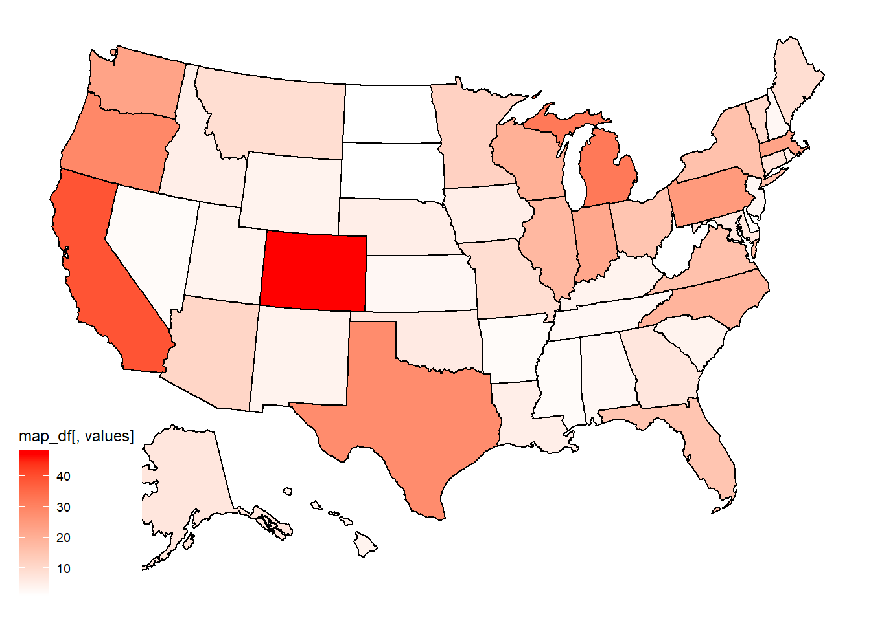
Number of Breweries by State
OR
29
MI
32
Top 5:
CO | 47
CA | 39
MI | 32
OR | 29
TX | 28
CA
39
CO
47
TX
28

Slide 4
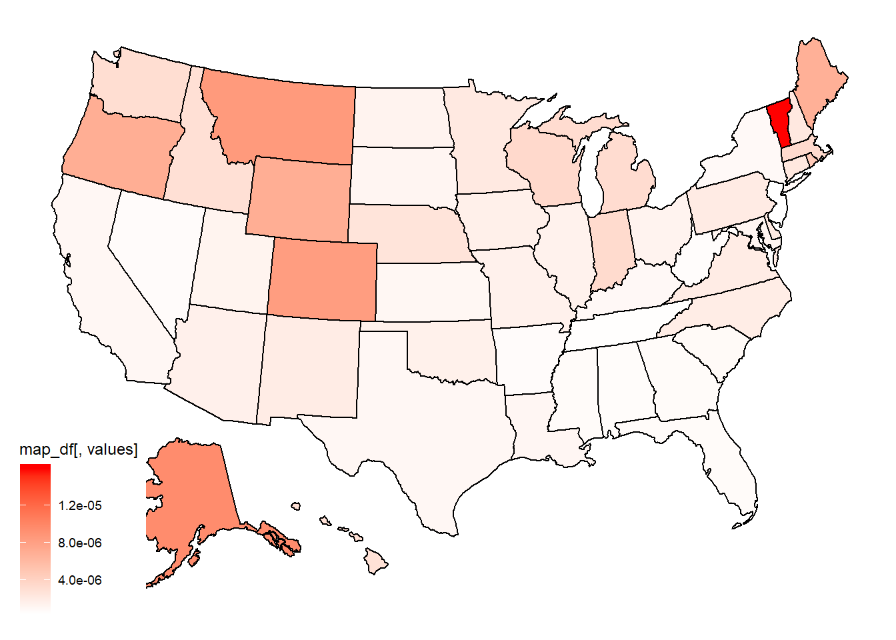
Number of Breweries per Capita by State
Top 5:
VT | 10
AK | 9
MT | 8
CO | 8
WY | 7

Slide 5
Brewery/Beer Data
Brewery_id | Brewery | City | State | Beer | Beer_ID | ABV | IBU | Style | Ounces
1 | NorthGate Brewing | Minneapolis | MN | Get Together | 2692 | 0.045 | 50 | American IPA | 16
1 | NorthGate Brewing | Minneapolis | MN | Maggie’s Leap | 2691 | 0.049 | 26 | Milk / Sweet Stout | 16
1 | NorthGate Brewing | Minneapolis | MN | Wall’s End | 2690 | 0.048 | 19 | English Brown Ale | 16
1 | NorthGate Brewing | Minneapolis | MN | Pumpion | 2689 | 0.060 | 38 | Pumpkin Ale | 16
1 | NorthGate Brewing | Minneapolis | MN | Stronghold | 2688 | 0.060 | 25 | American Porter | 16
1 | NorthGate Brewing | Minneapolis | MN | Parapet ESB | 2687 | 0.056 | 47 | Extra Special / Strong Bitter (ESB) | 16

Slide 6
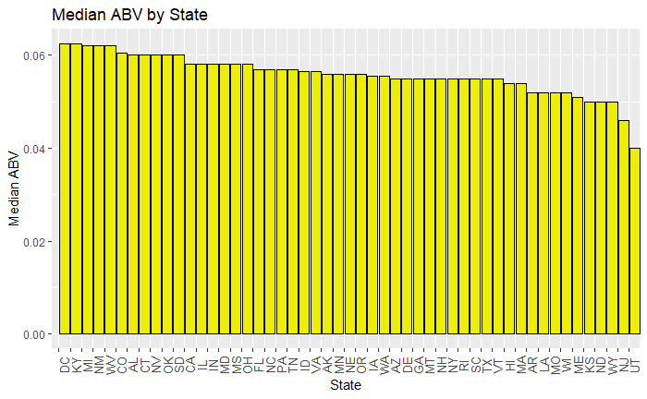
Alcohol by Volume (ABV) in the U.S.
Top 5:
DC | 0.0625
KY | 0.0625
MI | 0.0620
NM | 0.0620
WV | 0.0620

Slide 7
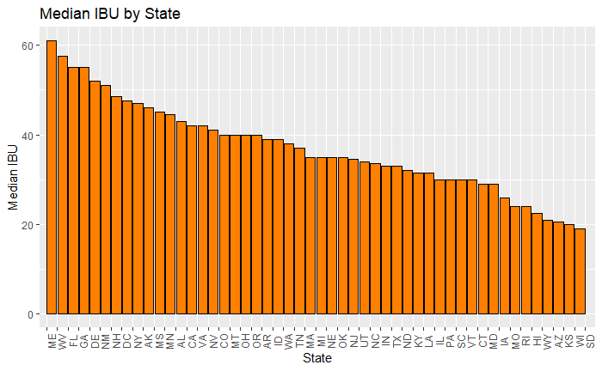
International Bitterness Units (IBU) in the U.S.
Top 5:
ME | 61.0
WV | 57.5
FL | 55.0
GA | 55.0
DE | 52.0

Slide 8
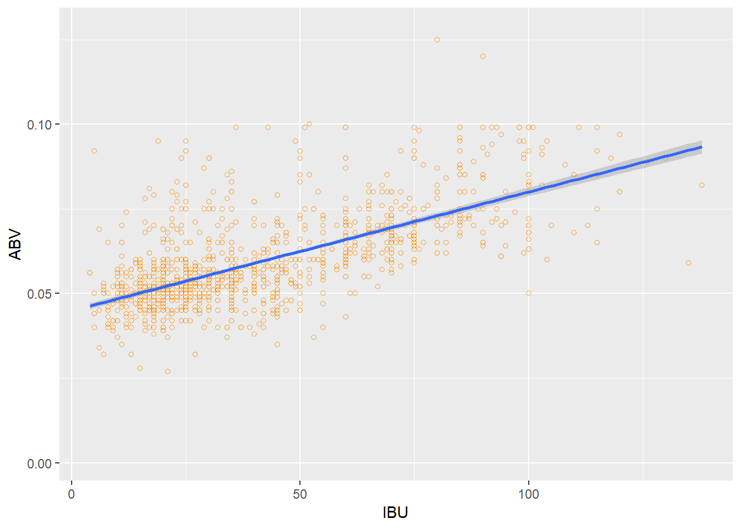
ABV vs. IBU appears to be correlated
Higher alcohol = higher bitterness…

