Slide 1
Case Study 1 – Beer Data: Opportunity analysis for Brewery
Stephen Johnson
2/26/2019

Slide 2
What states should we consider for the next brewery?
The number of breweries in the U.S. per state provides insight into service areas and where there could be opportunities to better serve consumers of beer
The types of beer (ABV and IBU) by state can help us determine what we should be serving in those regions

Slide 3
Number of Breweries by State
State | count |  | State | count
CO | 47 |  | MD | 7
CA | 39 |  | OK | 6
MI | 32 |  | IA | 5
OR | 29 |  | ID | 5
TX | 28 |  | LA | 5
PA | 25 |  | NE | 5
MA | 23 |  | RI | 5
WA | 23 |  | HI | 4
IN | 22 |  | KY | 4
WI | 20 |  | NM | 4
NC | 19 |  | SC | 4
IL | 18 |  | UT | 4
NY | 16 |  | WY | 4
VA | 16 |  | AL | 3
FL | 15 |  | KS | 3
OH | 15 |  | NH | 3
MN | 12 |  | NJ | 3
AZ | 11 |  | TN | 3
VT | 10 |  | AR | 2
ME | 9 |  | DE | 2
MO | 9 |  | MS | 2
MT | 9 |  | NV | 2
CT | 8 |  | DC | 1
AK | 7 |  | ND | 1
GA | 7 |  | SD | 1
West Coast is strongly represented along with the Mountain region state of Colorado
Texas, North Carolina, Virginia and Florida representing the South
Michigan, Indiana, Wisconsin, Illinois, Ohio and Minnesota provide solid representation for the Midwest
Pennsylvania, Massachusetts, New York and Vermont in the Northeast

Slide 4
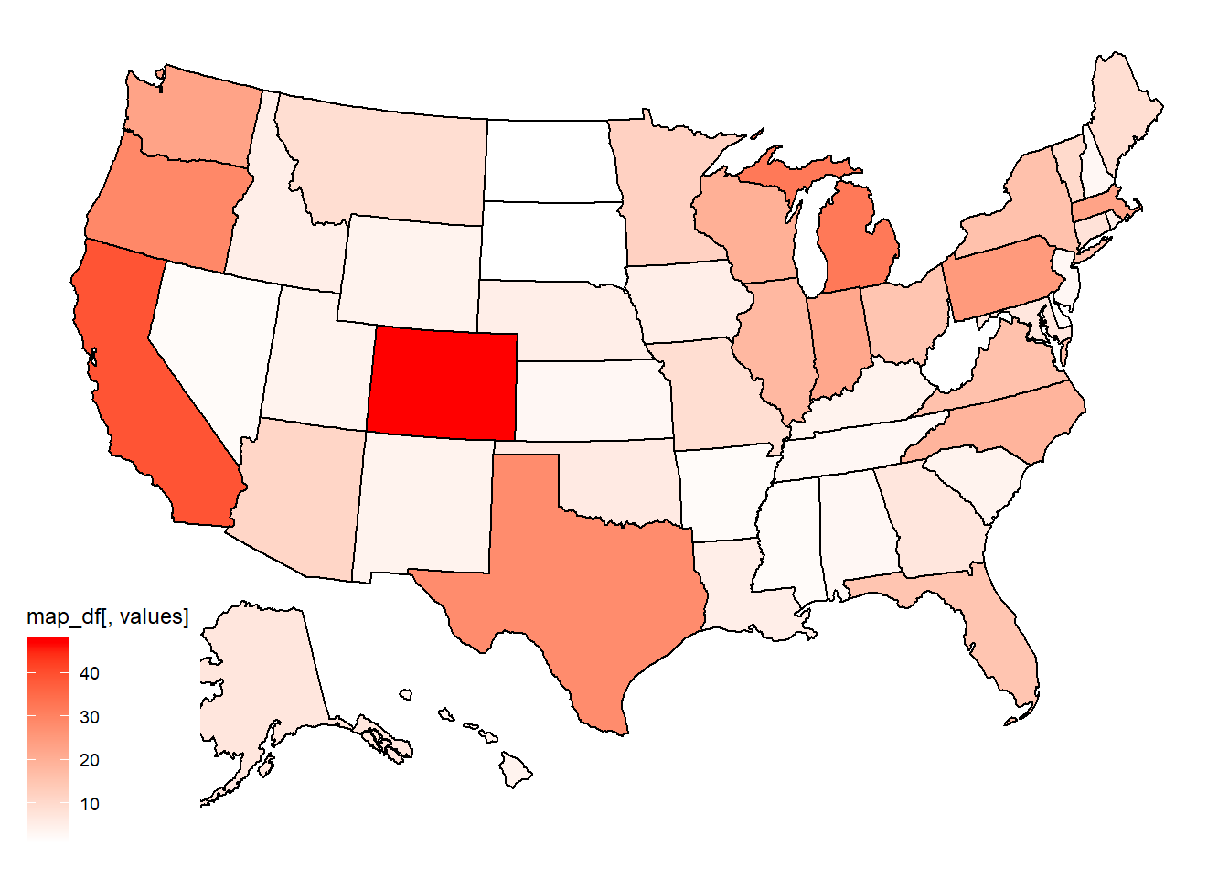
Number of Breweries by State
Midwest
Northeast
Top 5 States:
CO | 47
CA | 39
MI | 32
OR | 29
TX | 28
Western/Mountain
South

Slide 5
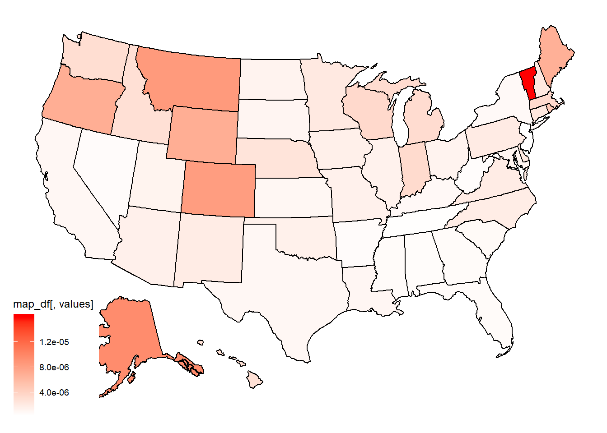
Number of Breweries per Capita by State Opportunity in Midwest and south?
Midwest
Northeast
Top 5 States:
VT | 10
AK | 9
MT | 8
CO | 8
WY | 7
Western/Mountain
South

Slide 6
Brewery/Beer Data
Brewery_id | Brewery | City | State | Beer | Beer_ID | ABV | IBU | Style | Ounces
1 | NorthGate Brewing | Minneapolis | MN | Get Together | 2692 | 0.045 | 50 | American IPA | 16
1 | NorthGate Brewing | Minneapolis | MN | Maggie’s Leap | 2691 | 0.049 | 26 | Milk / Sweet Stout | 16
1 | NorthGate Brewing | Minneapolis | MN | Wall’s End | 2690 | 0.048 | 19 | English Brown Ale | 16
1 | NorthGate Brewing | Minneapolis | MN | Pumpion | 2689 | 0.060 | 38 | Pumpkin Ale | 16
1 | NorthGate Brewing | Minneapolis | MN | Stronghold | 2688 | 0.060 | 25 | American Porter | 16
1 | NorthGate Brewing | Minneapolis | MN | Parapet ESB | 2687 | 0.056 | 47 | Extra Special / Strong Bitter (ESB) | 16

Slide 7
SUMMARY ABV and ibu in the U.S. statistics provide insight into range
ABV | IBU | Style | Ounces | Brewery | City | State
Min. :0.00100 | Min. : 4.00 | American IPA : 424 | Min. : 8.40 | Brewery Vivant : 62 | Grand Rapids: 66 | CO : 265
1st Qu.:0.05000 | 1st Qu.: 21.00 | American Pale Ale (APA) : 245 | 1st Qu.:12.00 | Oskar Blues Brewery : 46 | Portland : 64 | CA : 183
Median :0.05600 | Median : 35.00 | American Amber / Red Ale : 133 | Median :12.00 | Sun King Brewing Company : 38 | Chicago : 55 | MI : 162
Mean :0.05977 | Mean : 42.71 | American Blonde Ale : 108 | Mean :13.59 | Cigar City Brewing Company: 25 | Indianapolis: 43 | IN : 139
3rd Qu.:0.06700 | 3rd Qu.: 64.00 | American Double / Imperial IPA: 105 | 3rd Qu.:16.00 | Sixpoint Craft Ales : 24 | San Diego : 42 | TX : 130
Max. :0.12800 | Max. :138.00 | American Pale Wheat Ale : 97 | Max. :32.00 | Hopworks Urban Brewery : 23 | Boulder : 41 | OR : 125
NA’s :62 | NA’s :1005 | (Other) :1298 | NA | (Other) :2192 | (Other) :2099 | (Other):1406

Slide 8
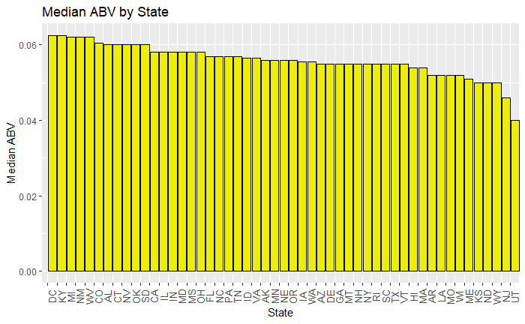
Alcohol by Volume (ABV) in the U.S.
Top 5:
DC | 0.0625
KY | 0.0625
MI | 0.0620
NM | 0.0620
WV | 0.0620

Slide 9
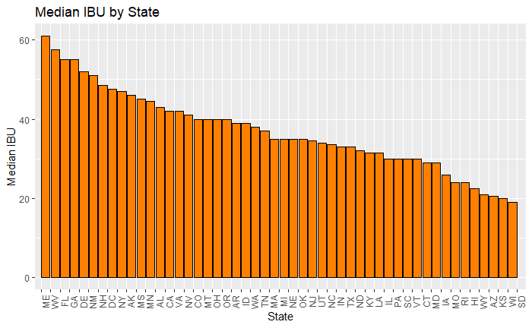
International Bitterness Units (IBU) in the U.S.
Top 5:
ME | 61.0
WV | 57.5
FL | 55.0
GA | 55.0
DE | 52.0

Slide 10
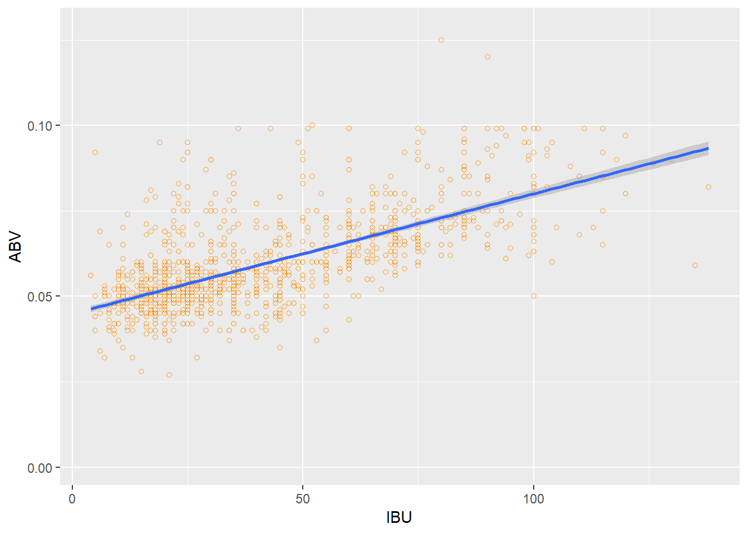
ABV vs. IBU appears to be correlated
Higher alcohol = higher bitterness…
Consider both within each state to determine what beer types should be offered
Refer to red arrows by state in previous 2 slides

Slide 11
Conclusion
Southern and Midwestern regions are identified as prime opportunities for the next brewery. States with higher brewery counts (not per capita) should be primary targets.
Next Steps for Deep Dive Analysis:
Breweries by State vs. ABV and IBU
Benchmarking
Opportunity Analysis

