Slide 1


Identifying Causal Drivers of Stock Price Movements in the UK Market An Empirical Study Using Macroeconomic and Technical Indicators
Sherin Johny
23050521 MSc Data Science
15th July 2025
GitHUb_Link

Slide 2
Introduction & Motivation
Why do stock prices move?
Importance for investors, policymakers, and risk managers.
The UK market: globally significant, sensitive to macroeconomic shifts.
Recent UK market events: [e.g., Brexit, COVID-19, interest rate changes]
Why understanding causality matters now more than ever

Slide 3
Research Objectives
Identify causal (not just correlated) drivers of UK stock prices.
Integrate macroeconomic and technical indicators.
Evaluate predictive power and limitations.

Slide 4
Literature Comparison
Study | Methods Used | Models Used | Metrics Reported | Conclusions | What’s New in My Project
Bessler & Yang (2003) | Granger causality, VAR | No ML | p-values, F-statistics | Global market linkages, not feature selection or prediction | Causal feature selection for UK stocks, ML prediction
Runge et al. (2019) | PCMCI (nonlinear, high-dimensional causality) | PCMCI | Precision, Recall (causal discovery) PCMCI outperforms Granger in causal detection; no prediction metrics | PCMCI outperforms Granger in complex data, finds hidden drivers | Could extend to PCMCI; focus on predictive modeling
Wang & Wang (2022) | Granger, PCMCI, DoWhy, ML integration | Causal + ML ( RF, XGB, NN ) | Accuracy, F1, AUC (Accuracy/F1: 0.55–0.65; modest gains from causal features) | Causal feature selection improves interpretability, sometimes accuracy | Full ML pipeline, UK focus, direct causal vs. predictive comp.
Zhang & Wang (2020) | Granger causality for feature selection | RF, SVM, LR, KNN, DT | Accuracy, F1, Precision, Recall. (RF/SVM (causal): Accuracy/F1 ~0.63–0.64; others ~0.57–0.60) | Causal features help interpretability, sometimes accuracy (China market) | More models, more features, UK market, comprehensive eval

Slide 5
Data Collection & Sources
Stock Data: 5 FTSE 100 tickers (AZN.L, BP.L, GSK.L, HSBA.L, VOD.L)
Macroeconomic: GBP/USD, Bank Rate, Unemployment, CPI
Timeframe: 2015–2025
Dataset: 12,894 records, 89 features

Slide 6
Data Preprocessing &
Feature Engineering
Merged datasets on date and ticker.
Engineered technical indicators: RSI, MACD, SMA, EMA, Bollinger Bands, ATR, etc.
Created lag features for causal inference.
Removed rows with missing data.

Slide 7
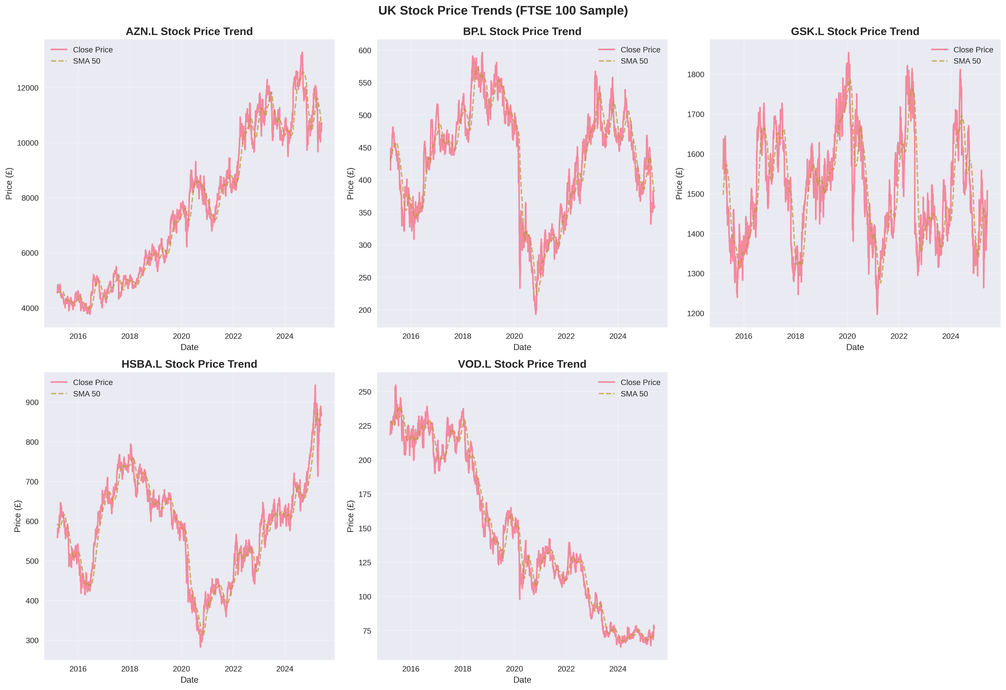
Exploratory Data Analysis
Stock price trends

Slide 8
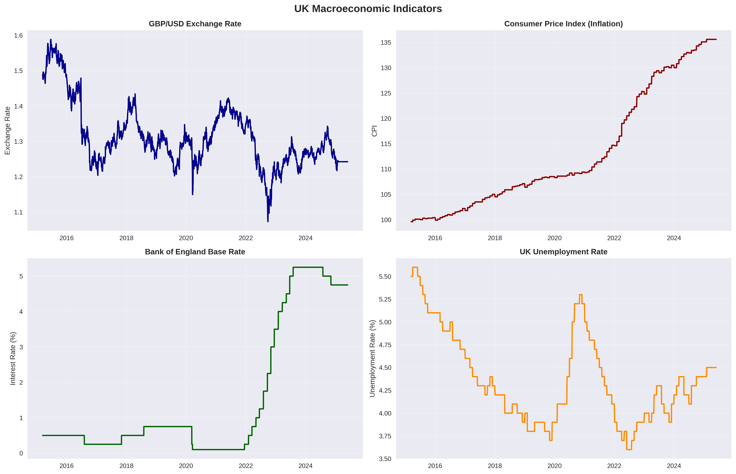
Macroeconomic Tends

Slide 9
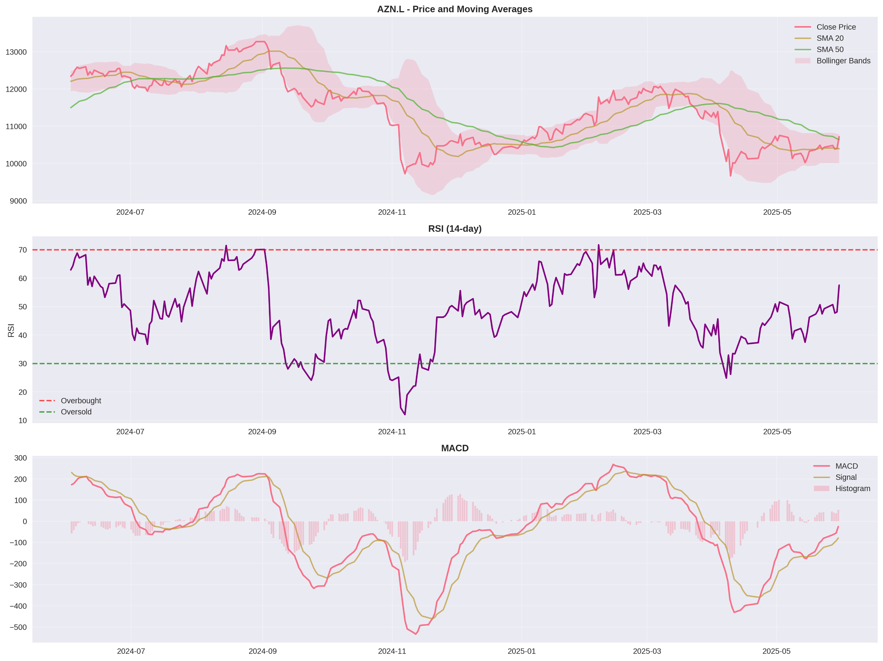
Technical Indicators

Slide 10
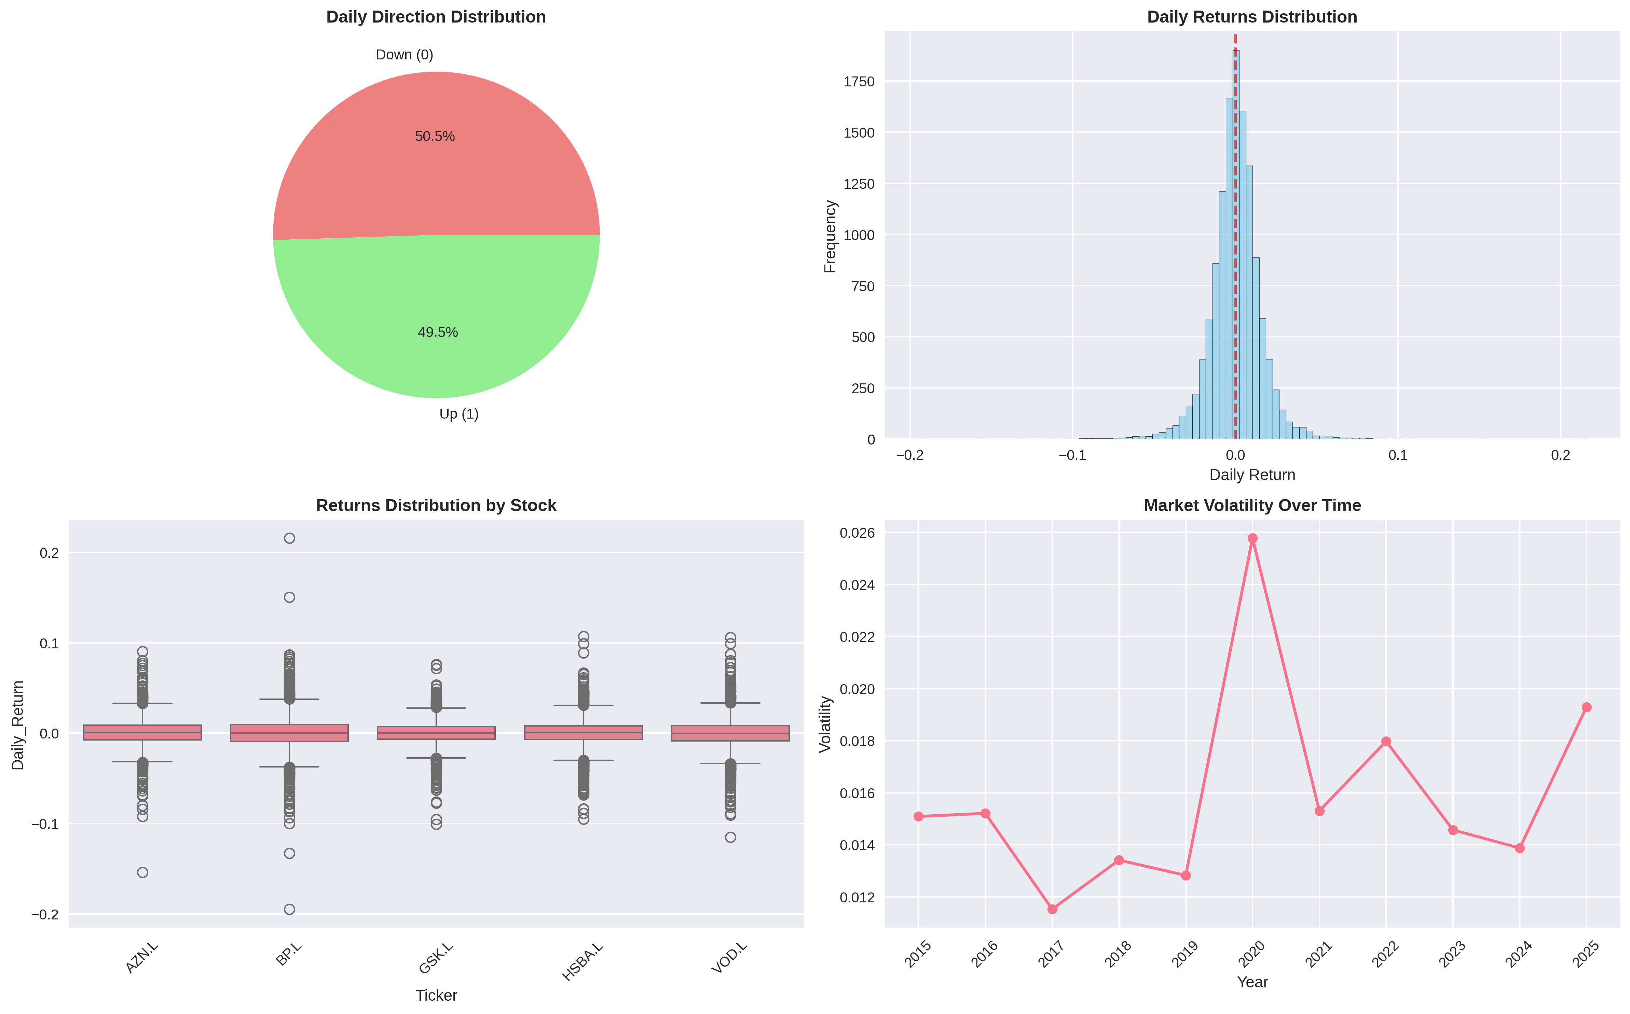
Target analysis: balanced up/down days

Slide 11
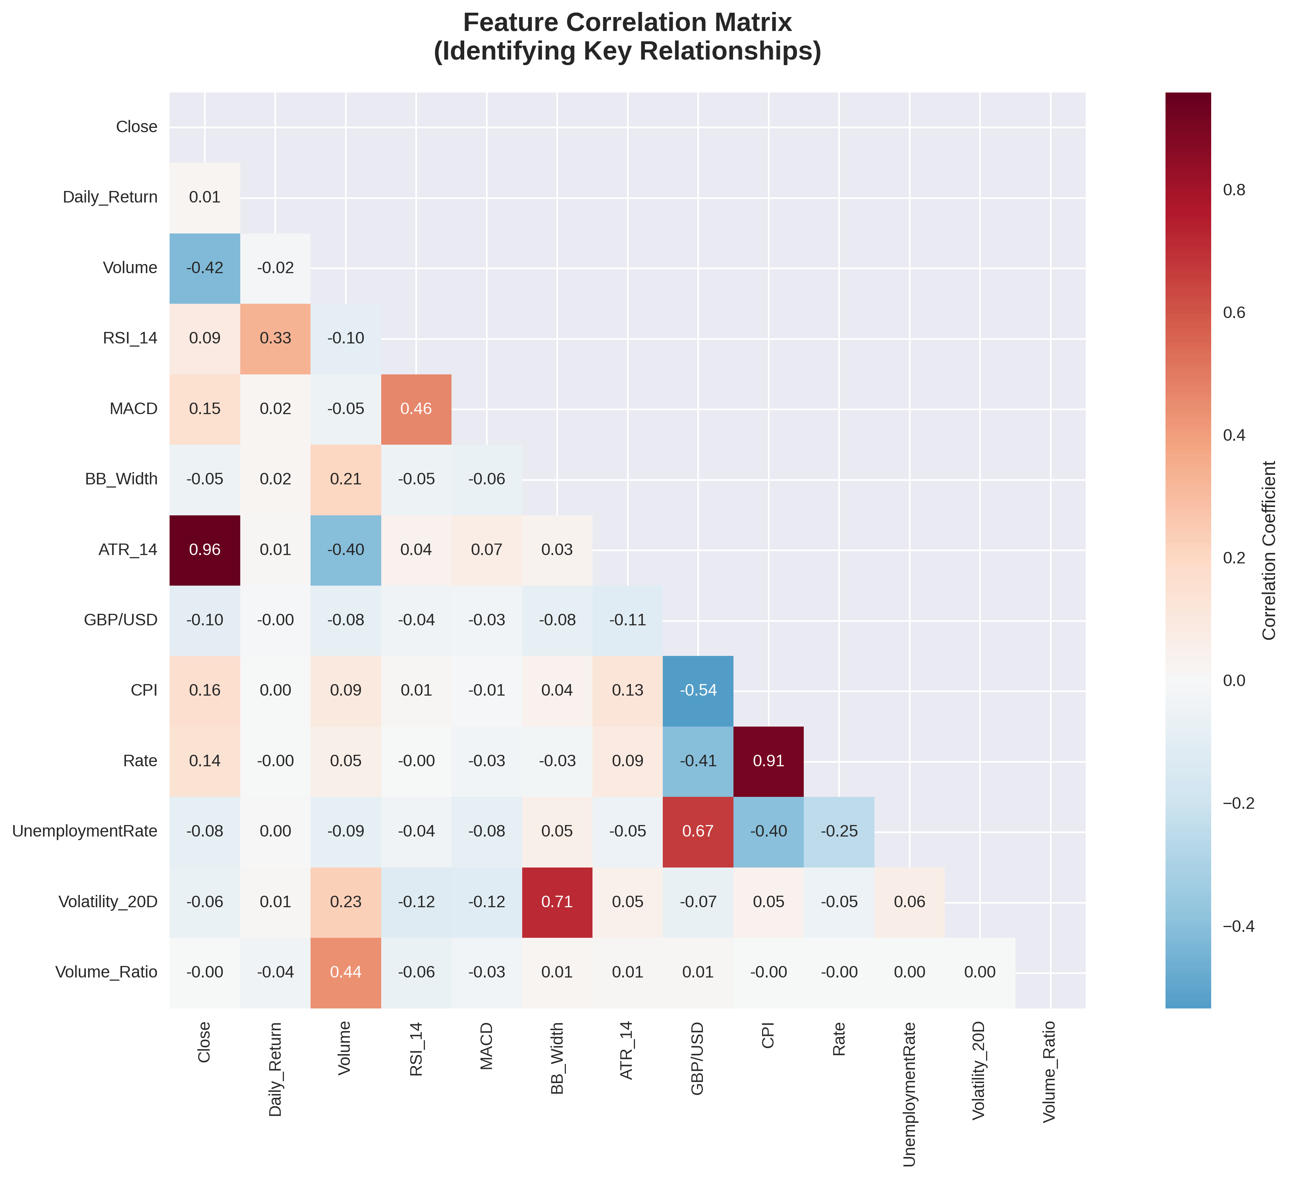
Correlation matrix

Slide 12
Causal Inference
Methodology
Stationarity Check
Why causal inference?
Correlation ≠ causation.
Method: Granger Causality Analysis.
Stationary Features
Granger Causality Test
Features with Lowest p values < Significance Threshold
No
Yes
No Causal effect
Causal Features

Slide 13
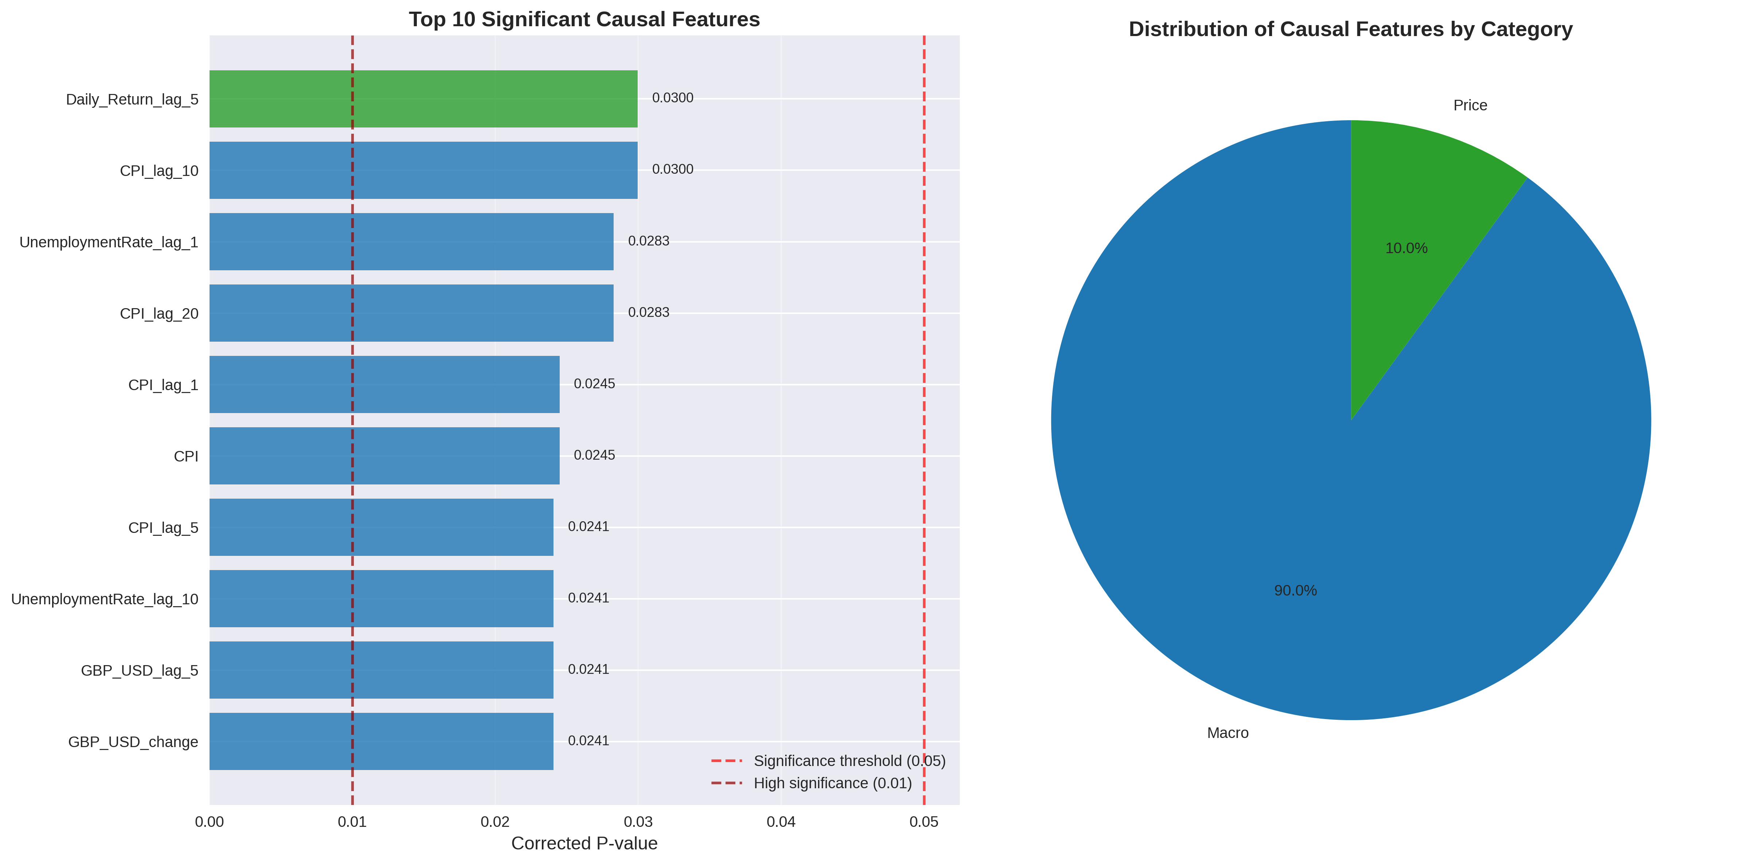
Significant Causal Features

Slide 14
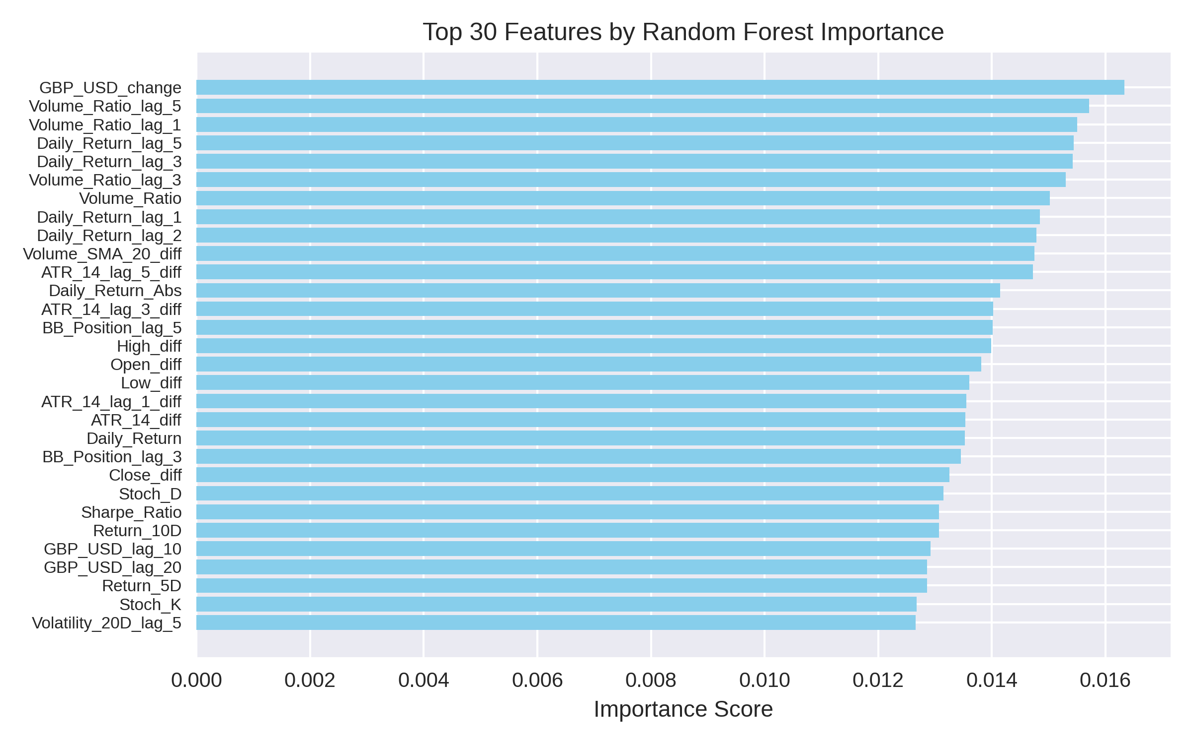
Traditional Feature Selection
Feature selection:
Random Forest importance

Slide 15
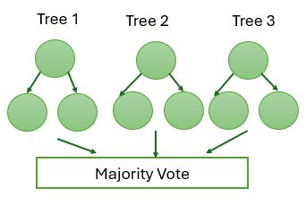
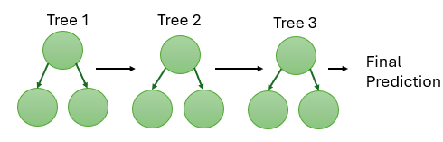
Model Architecture Overview
Random Forest
Model Architectures
Random Forest: Ensemble of decision trees (bagging, majority vote)
XGBoost: Sequential boosting, each tree corrects previous errors (level-wise growth)
LightGBM: Boosting with leaf-wise tree growth and histogram-based splits
XGBoost/Light GBM
Sequence Boosting

Slide 16
Why These Models?
Why Random Forest, XGBoost, and LightGBM?
Handle non-linear relationships and high-dimensional data
Robust to outliers and noise (common in financial time series)
Provide feature importance for interpretability
Proven performance in financial applications.

Slide 17
Key Hyperparameters & Their Roles
Model | Hyperparameter | What It Controls / Why Tuned
Random Forest | n_estimators | Number of trees (stability, variance)
 | max_depth | Tree complexity (overfitting control)
 | min_samples_split | Minimum samples to split (prevents overfit)
 | max_features | Features per split (diversity, decorrelation)
XGBoost | n_estimators | Number of boosting rounds
 | max_depth | Tree complexity
 | learning_rate | Step size/shrinkage (overfitting control)
 | subsample | Data fraction per tree (randomness)
LightGBM | n_estimators | Number of boosting rounds
 | max_depth | Tree complexity
 | learning_rate | Step size/shrinkage
 | subsample | Data fraction per tree
 | num_leaves | Max leaves per tree (complexity control)

Slide 18
Hyperparameter tuning
Model | Default Hyperparameter values | Hyperparameter Values after Tuning | Model | Default Hyperparameter values | Hyperparameter Values after Tuning
Random Forest Selected_features | n_estimators: [100, 200] max_depth: [10, 15, None] min_samples_split: [10, 20] max_features: [0.3, 0.5, 'sqrt'] | n_estimators: 100 max_depth: None min_samples_split: 20 max_features: 0.3 | Random Forest Causal_features | n_estimators: [100, 200] max_depth: [10, 15, None] min_samples_split: [10, 20] max_features: [0.3, 0.5, 'sqrt'] | n_estimators: 100, max_depth: 10 min_samples_split: 10 max_features: sqrt
XGBoost Selected_Features | n_estimators: [100 200] max_depth: [3 6] learning_rate: [0.01 0.1] subsample: [0.8 1.0] | n_estimators: 100 max_depth: 3 learning_rate: 0.01 subsample: 0.8 | XGBoost Causal_Features | n_estimators: [100 200] max_depth: [3 6] learning_rate: [0.01 0.1] subsample: [0.8 1.0] | n_estimators: 100 max_depth: 3 learning_rate: 0.01 subsample: 0.8
Light GBM Selected_Features | n_estimators: [100 200] max_depth: [3 6] learning_rate: [0.01 0.1] subsample: [0.8 1.0] num_leaves: [31 50] | n_estimators: 100 max_depth: 3 learning_rate: 0.01 subsample: 0.8 num_leaves: 31 | Light GBM Causal_Features | n_estimators: [100 200] max_depth: [3 6] learning_rate: [0.01 0.1] subsample: [0.8 1.0] num_leaves: [31 50] | n_estimators: 100 max_depth: 3 learning_rate: 0.01 subsample: 0.8 num_leaves: 31

Slide 19
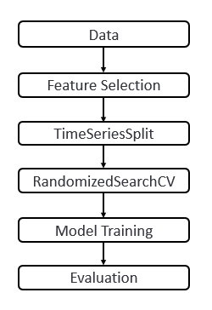
Training & Evaluation Workflow
Model Training & Evaluation Workflow
Data preprocessing & feature engineering
Feature selection (Random Forest or Granger causality)
TimeSeriesSplit for train/validation/test (preserves time order)
Hyperparameter tuning (RandomizedSearchCV)
Model training on training set
Evaluation on test set (Accuracy, F1, Sharpe, Confusion Matrix)

Slide 20
Model Modifications & Customizations
Used TimeSeriesSplit for all cross-validation to respect temporal order
Used RandomizedSearchCV for efficient hyperparameter tuning
Evaluated models with multiple metrics (Accuracy, F1, Sharpe Ratio)

Slide 21
Prediction Results & Model Evaluation
Dataset | Model | #Features | Test Acc | Test F1 | Sharpe
selected_features | LightGBM | 30 | 0.5031 | 0.6449 | -0.3583
causal_features | LightGBM | 10 | 0.4988 | 0.6220 | -0.3093
selected_features | XGBoost | 30 | 0.4957 | 0.6340 | -0.6423
causal_features | XGBoost | 10 | 0.5027 | 0.6225 | -0.3646
selected_features | RandomForest | 30 | 0.5361 | 0.5150 | -1.1481
causal_features | RandomForest | 10 | 0.5943 | 0.6237 | 0.0182

Slide 22
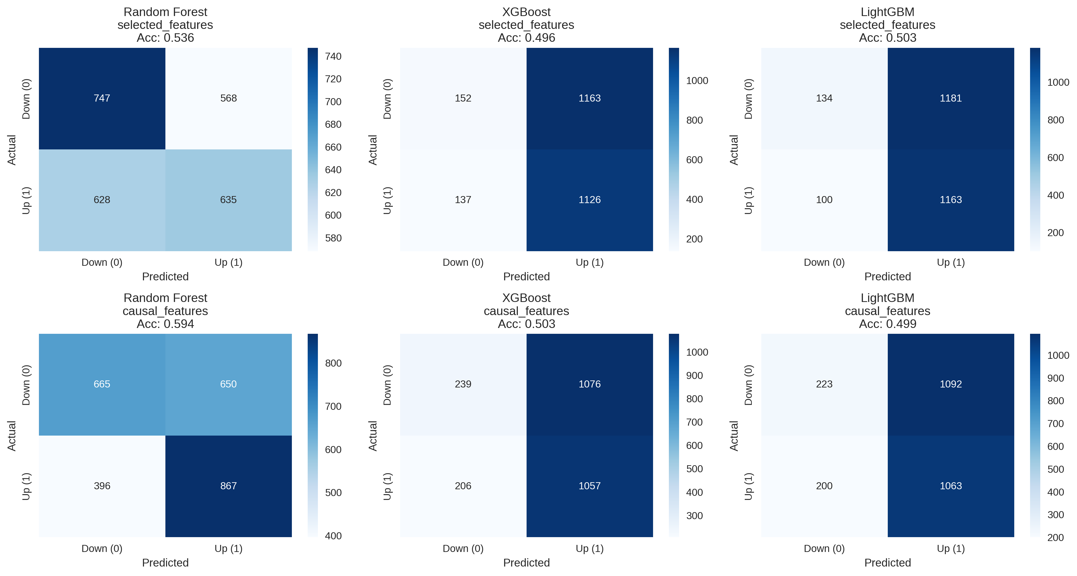
Confusion Matrices

Slide 23
Analysis, Limitations, and Future Work
Analysis:
Models perform only slightly better than random guessing
Lagged returns and macro lags most predictive
Causal features offer interpretability, but not a major boost in accuracy
Limitations:
UK market is highly efficient; hard to outperform random
Macroeconomic data is low-frequency vs. daily stock data
Technical indicators may not capture all market dynamics
Models may not handle non-stationarity or regime changes
No alternative data (news, sentiment, etc.)
Future Work:
Incorporate alternative data (news, sentiment, Google Trends)
Try deep learning and regime-switching models
Use advanced causal inference (PCMCI, DoWhy)

Slide 24
Conclusion
Key causal drivers identified, but predictive power limited.
Highlights the complexity of financial markets.
Causal analysis is valuable for understanding, but prediction remains challenging.
Thank you! Questions?

