Slide 1
Post Traumatic Stress Disorder

Slide 2
Motivation
Post Traumatic Stress Disorder (PTSD) – psychiatric and somatic disorder that affects individuals exposed to trauma.
Why metabolomics? Previous studies - High co-morbidity between metabolic disorders and PTSD Indicate systemic pathology associated with PTSD might be identified by metabolomic analysis of blood.
Metabolic disorders
cardiovascular disease
obesity
Autoimmune disease
diabetes

Slide 3
Roadmap
Metabolic disorders
Univariate approach
Biological Pathways driven approach
Subsequent mapping of significant metabolites to biological pathways
Significant differences of individual metabolite levels between cases and controls.
Significant differences of pathway expression levels between cases and controls
Identifying which specific metabolites in these pathways are significantly different
Comparison between metabolites obtained from the two methods
Comparison between pathways obtained from the two methods
Notes:
– suggestive of underlying neuroendocrine and metabolic changes in PTSD as a result of traumatic experience.
Underlying alterations in sympathetic nervous system activity, neuroendocrine systems, and metabolism associated with PTSD similar to those present in traditional metabolic disorders (such as diabetes)

Slide 4
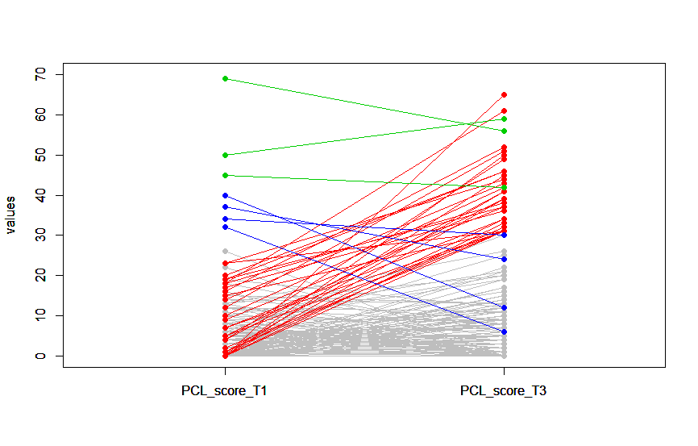
Overview of the Dataset
Classification of subjects into +PTSD and -PTSD according to PCL scores
T1 = pre-deployment
T3 = At least 6 months post deployment
PCL scores
 | Number of Subjects
T1<31 and T3<31 (grey) | 268
T1<31 and T3>=31 (red) | 30
T1>=31 and T3<31 (blue) | 4
T1>=31 and T3>=31 (green) | 3
T1
T3
Pre deployment
At least 6 months post deployment
Grey lines indicate the subjects which remained controls throughout the period of study
Red lines indicate the subjects which transitioned from controls to cases after exposure to trauma
Green lines indicate the subjects which remained as cases for the period of study
Blue lines indicate the subjects which went from cases to controls after exposure to trauma (probably outliers)
Notes:
PCL score
Describe colours

Slide 5
Methods : Univariate Analysis
Clinical
T1
Metabolomic
Clinical
T1/T3
Clinical
Longitudinal analysis between T1 and T3
Cross-sectional case-control analysis at T1 and T3
Metabolomic
Metabolomic
T3
 | PCL | T1
Cases | >=31 at T3, <31 at T1 | 21
Controls | PCL==0 at T1 and T3 | 91
 | PCL<31 at T1 and T3 | 251
Total subjects |  | 276
 | PCL | T1 | T3
Cases | >=31 | 10 | 71
Controls | PCL==0 | 234 | 147
 | PCL<31 | 400 | 394
Total subjects |  | 410 | 465
To reduce the effects of noise, controls were taken to be subjects which had a PCL score of 0 instead of PCL<31
Subjects with mild (score>=8)/moderate/severe TBI status were excluded from analysis. This metric was decided based on
the Mellon et al. (2019) study

Slide 6
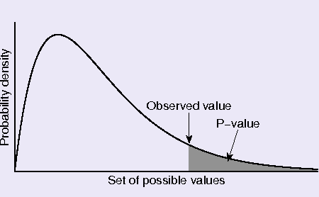
Methods : Univariate Analysis
Normalisation of Data
Log Normalisation
Median Normalisation
Finding the significant metabolites using Mann Whitney U test
Feeding the significant metabolites into online software (Metaboanalyst) to get the significant pathways.
Normalization of data was required because there were some metabolites which were in the range of 0-1 while some went up to an expression level of 500.
Median normalization was done as this is less sensitive to outliers as compared to mean normalization.
Longitudinal analysis
Metabolanalyst finds significant pathways based on a one-tailed Fisher’s Exact Test. It looks for over-representation i.e. at the right end of the distribution. Pathways with p<=0.05 were considered as significant;
 | T1 | T3
Upregulated | 12
Downregulated | 97
Cross-sectional case-control analysis
 | T1 | T3
Upregulated | 118 | 99
Downregulated | 12 | 31
Notes:
in a test for over-representation of pathways in the sample, the p-value is the probability of randomly having k or more metabolites from the total metabolites in n total draws.

Slide 7
Results : Univariate Analysis
T3 (Cross-sectional case-control) | T1 (Longitudinal) | T3 (Longitudinal)
Caffeine metabolism | Glycerophospholipid metabolism | Glycerophospholipid metabolism
Sphingolipid metabolism | Tryptophan metabolism | Citrate cycle (TCA cycle)
Glycerophospholipid metabolism |  | Alanine, aspartate and glutamate metabolism
Cyanoamino acid metabolism |  | Arginine and proline metabolism
Primary bile acid biosynthesis |  | Phenylalanine metabolism
 |  | Arachidonic acid metabolism
Cases : 71
Controls : 147
Latent cases : 21
Controls : 251
Cases : 21
Controls : 251
Surprisingly, the caffeine metabolism comes up as the most significant pathway in our analysis.
T1
T3
T1
T3
Controls
Cases
Controls
Cases
Controls
Controls
Controls
Controls
Notes:
Corrected for TBI

Slide 8
Comparisons with previous literature
Mellon, S.H., et al., Metabolomic analysis of male combat veterans with post traumatic stress disorder. PLoS One, 2019.
Metabolite Name | Cases |  | Controls |  | p-value from Mann Whitey test | Time Point
 | Mean | SD | Mean | SD
Lactate | 1.257802 | 0.4497928 | 1.092341 | 0.3620565 | 0.00307451 | T3
Hypoxanthine | 1.294777 | 0.7773993 | 1.093846 | 0.9965483 | 0.00719221 | T3
Citrate | 0.9977141 | 0.1621915 | 1.053727 | 0.161398 | 0.00762962 | T3
5-oxoproline | 1.095276 | 0.2501406 | 1.019315 | 0.2239857 | 0.01391371 | T3
Pyruvate | 1.164861 | 0.3155773 | 1.079913 | 0.2466914 | 0.04568103 | T3
Arginine | 1.020292 | 0.3720054 | 1.074703 | 0.2981304 | 0.04756322 | T3
Comparison of metabolites obtained from cross-sectional case-control analysis.
The directionality of regulation is conserved
(Red highlight = upregulated
Green highlight = downregulated)
Mellon, S.H., et al., Metabolism, Metabolomics, and Inflammation in Posttraumatic Stress Disorder. Biol Psychiatry, 2018.
Glycerophospholipid signaling pathway
Comes up as significant pathway in current study

Slide 9
Motivation: Pathway Driven Approach
Do a few significantly different metabolites in a pathway imply significance of the whole pathway?
What about the cases when many metabolites in a pathway are different between the two study groups however not enough to show up as significant.
Can many such differences add up to give a significant pathway?
Does analyzing pathway as a whole give more biologically significant results?
KEGG
18,567
metabolites
367
pathways
Ft. Campbell
367
metabolites
65
pathways
Significant Pathways

Slide 10
Methods: Pathway Driven Approach
Each pathway consists of >1 metabolites. So a single descriptor for each pathway was obtained based on the below procedures
Corresponding to the result for each procedure, significant pathways were selected using two techniques
The final result was corrected for multiple hypothesis and goodness of each method was assessed
Correlated metabolites were found within each significant pathway
Condition-Responsive Genes (CORGs)
LASSO Regression
Correlation coefficients
(BH correction)
Principle Component Analysis
Pathway Activity
Mann Whitney Test
COMBINER

Slide 11
Results : Pathway Driven Approach
Caffeine metabolism | Nicotinate and nicotinamide metabolism
Glycine, serine and threonine metabolism | D-Arginine and D-ornithine metabolism
Phenylalanine metabolism | Fatty acid biosynthesis
Alanine, aspartate and glutamate metabolism | Glutathione metabolism
Sphingolipid metabolism | Lysine degradation
Arginine and proline metabolism | Pentose phosphate pathway
Taurine and hypotaurine metabolism | Lysine biosynthesis
Cysteine and methionine metabolism | Thiamine metabolism
Pantothenate and CoA biosynthesis | Ubiquinone and other terpenoid-quinone biosynthesis
Citrate cycle (TCA cycle) | Glycolysis or Gluconeogenesis
Pyrimidine metabolism | Pyruvate metabolism
Glycerophospholipid metabolism | Tryptophan metabolism
Primary bile acid biosynthesis | Amino sugar and nucleotide sugar metabolism
Glyoxylate and dicarboxylate metabolism

