Slide 1
BCI 이해하기

Slide 2
Java Class Format
Byte Code Instrumentation
ClassFile {
u4 magic;
u2 minor_version;
u2 major_version;
u2 constant_pool_count;
cp_info constant_pool[constant_pool_count-1];
u2 access_flags;
u2 this_class;
u2 super_class;
u2 interfaces_count;
u2 interfaces[interfaces_count];
u2 fields_count;
field_info fields[fields_count];
u2 methods_count;
method_info methods[methods_count];
u2 attributes_count;
attribute_info attributes[attributes_count];
}
http://docs.oracle.com/javase/specs/jvms/se7/html/jvms-4.html

Slide 3
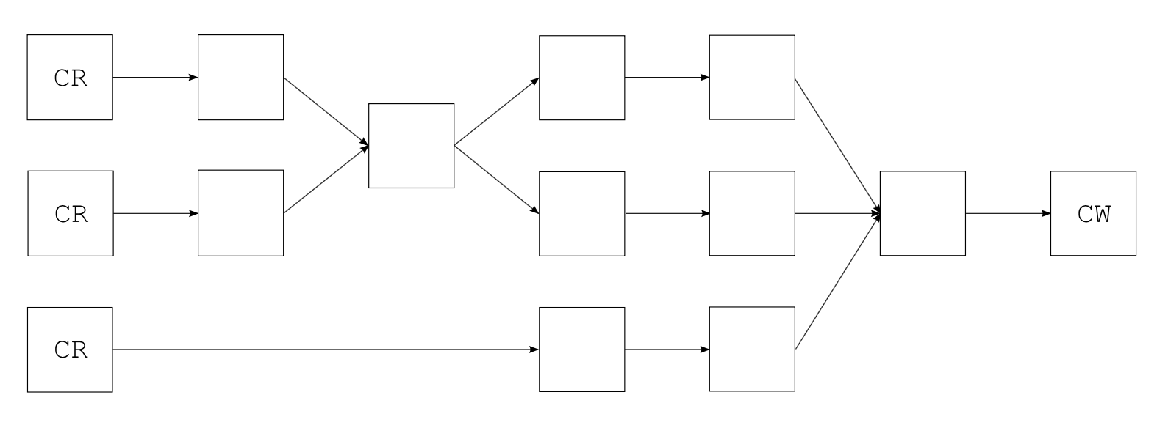
BCI Library - ASM
Byte Code Instrumentation
http://asm.ow2.org/index.html
ClassReader cr = new ClassReader(classBytes);
cr.accept(new ClassVisitor(Opcodes.ASM4) {
public void visit(int version, int access, String name,
String signature, String superName, String[] interfaces) {
print(version, access, name, signature, superName, interfaces);
}
}, 0);
https://github.com/scouter-project/scouter/blob/master/scouter.agent/src/scouter/agent/asm/HttpServiceASM.java

Slide 4
Class Hooking
Byte Code Instrumentation
-agentlib:<libname>[=<options>]
<libname> 고유 에이전트 라이브러리를 로드합니다(예: -agentlib:hprof).
-agentlib:jdwp=help 및 -agentlib:hprof=help도 참조하십시오.
-javaagent:<jarpath>[=<options>]
Java 프로그래밍 언어 에이전트를 로드합니다. java.lang.instrument를 참조하십시오..
AppClassLoader
javaagent
ClassFileTransformer
Class
a.class
java.lang
ClassLoader
Native JVM

Slide 5
BCI 유형
서비스 추적
Http Service 시작점 지정
Custom Service 시작점 지정
기타
외부 API 호출(HTTP) 응답시간 측정
TCP Socket 연결 로깅
메소드 추적
파라미터/리턴 로깅
예외 로깅
응답시간 측정
파라미터 로깅
JDBC 추적
SQL 로깅 및 성능 측정
Connection Pool get/return 로깅
Fetch Row Count 로깅

Slide 6
Hello World – 대상 클래스
public class HelloWorld {
public static void main(String[] args) {
System.out.println("Hello World");
}
public static void start() {
System.out.println("STRT");
}
public static void end() {
System.out.println("END");
}
}
https://github.com/skyworker/scouter-study/tree/master/helloworld.asm/src

Slide 7
HelloWorld- PrintClass
public class S1PrintClass {
private static final String TMP_HELLO_WORLD_CLASS = "/tmp/HelloWorld.class";
public static void main(String[] args) throws IOException {
ClassReader cr = new ClassReader(load());
cr.accept(new ClassVisitor(Opcodes.ASM4) {
public void visit(int version, int access, String name, String signature, String superName,
String[] interfaces) {
System.out.println("Name= " + name);
System.out.println("superName= " + superName);
}
}, 0);
}
private static byte[] load() throws IOException {
File f = new File(TMP_HELLO_WORLD_CLASS);
FileInputStream r = new FileInputStream(f);
byte[] buff = new byte[(int) f.length()];
r.read(buff);
r.close();
return buff;
}
}

Slide 8
HelloWorld - PrintMethod
class S2MyClassVisitor extends ClassVisitor implements Opcodes {
public S2MyClassVisitor(ClassVisitor cv) {
super(ASM4, cv);
}
public void visit(int version, int access, String name, String signature, String superName,
String[] interfaces) {
System.out.println(name + " extends " + superName);
}
@Override
public MethodVisitor visitMethod(int access, String name, String desc, String signature, String[] exceptions) {
MethodVisitor mv = super.visitMethod(access, name, desc, signature, exceptions);
System.out.println("\t" + name + desc);
return mv;
}
}

Slide 9
HelloWorld – Hook Method(1/2)
class S3MyClassVisitor extends ClassVisitor implements Opcodes {
public S3MyClassVisitor(ClassVisitor cv) {
super(ASM4, cv);
}
public void visit(int version, int access, String name, String signature, String superName, String[] interfaces) {
System.out.println(name + " to HelloWorld1");
cv.visit(version, access, "HelloWorld1", signature, ⬅ CLASS RENAME
superName, interfaces);
}
@Override
public MethodVisitor visitMethod(int access, String name, String desc, String signature, String[] exceptions) {
MethodVisitor mv = super.visitMethod(access, name, desc, signature, exceptions);
System.out.println("\t" + name + desc);
if (name.equals("main")) {
return new S3MyMethodVisitor(access, desc, mv);
} else {
return mv;
}
}
}

Slide 10
HelloWorld – Hook Method(2/2)
class S3MyMethodVisitor extends LocalVariablesSorter implements Opcodes {
private final static String CLASSNAME = "HelloWorld";
private final static String START_METHOD = "start";
private static final String START_SIGNATURE = "()V";
private final static String END_METHOD = "end";
private static final String END_SIGNATURE = "()V";
public S3MyMethodVisitor(int access, String desc, MethodVisitor mv) {
super(ASM4, access, desc, mv);
}
@Override
public void visitCode() {
mv.visitMethodInsn(Opcodes.INVOKESTATIC, CLASSNAME, START_METHOD, START_SIGNATURE, false); ⬅ HOOK START
mv.visitCode();
}
@Override
public void visitInsn(int opcode) {
if ((opcode >= IRETURN && opcode <= RETURN)) {
mv.visitMethodInsn(Opcodes.INVOKESTATIC, CLASSNAME, END_METHOD, END_SIGNATURE, false); ⬅ HOOK END
}
mv.visitInsn(opcode);
}
}

