Slide 1

Locus 1
Locus 2
Locus …
Locus …
Locus 2,000
A
T
Allele 1
Allele 2

Slide 2
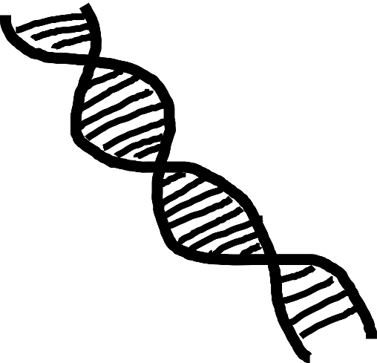


Population size ↓
Inbreeding ↑ Genetic drift ↑
Genetic Diversity ↓

Slide 3
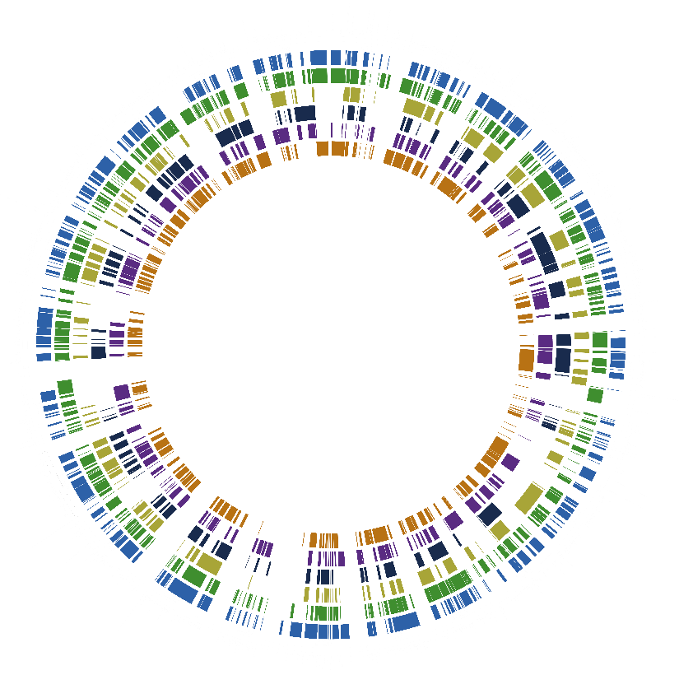

Slide 4


Oil Spill
Genetic Diversity
Mutations
Gene expression
Methylation patterns
(Epigenetics)
Population-level effects

Slide 5
Selection
Genetic Diversity
Genetic Drift
Gene flow
patterns of genetic diversity
within-group & between-group

