Slide 1
JSON Information System Validation
Progress Report
Ste Jones
(Liverpool University, GridPP)
July 2019

Slide 2
Contents
Introduction
Where I keep the work
Levels of validation
Standards
Technology
The Compute Schema
Limitations
The RI Parser
Workflow
Further work
Wrap up

Slide 3
Introduction
We are striving to change the BDII
One idea is to use JSON, a common structured file format (like XML)
Only well formed JSON conforming to a proper schema is useful
It’s impossible to write complex JSON by hand
Hence we’ll need tools to automatically validate the JSON in the system

Slide 4
Where I keep the work
The work is here:
  https://github.com/sjones-hep-ph-liv-ac-uk/json_info_system
You can download like this:
  git clone https://github.com/sjones-hep-ph-liv-ac-uk/json_info_system
There are two versions, v1.2 and v1.5, which correspond ~ to versions of this manual schema definition:
  https://docs.google.com/document/d/1t9Hs25B0X7ruhRs4IbdAZ1qDEpBKg2RXBFL9kIesGC0

Slide 5
Levels of validation
JSON must be well formed. It has to comply with the grammar of a JSON file. This is not specific to any application. It’s not so easy to get the grammar correct by hand.
And JSON must comply with a schema. The schema shows the structure of the document as it relates to a specific application. Schemas can be manual (documented) or automated (using a tool). Automated is better.
It’s impossible to write well-formed, schema-complaint JSON by hand, hence we’ll need tools.

Slide 6
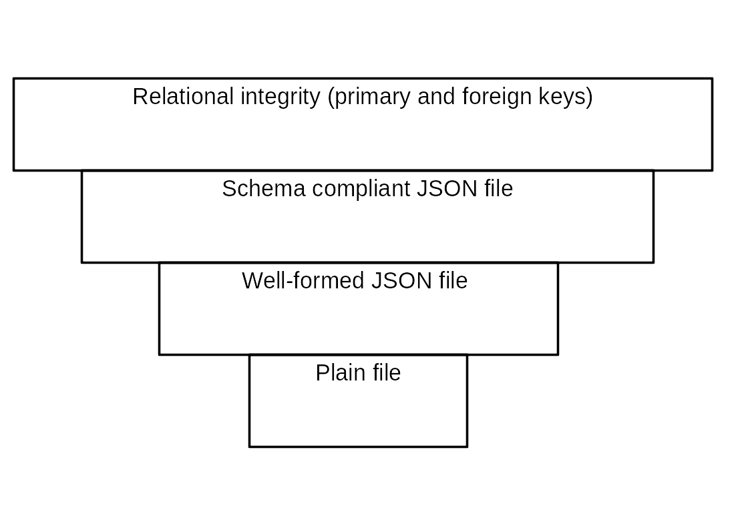
Levels of validation

Slide 7
Technology
There is a standard for JSON Schema.
https://json-schema.org/
The newest is draft 7.
There are many tools that ingest a JSON document and its schema and show if the former complies with the latter.
I’m using a specific tool called “jsonschema”
https://pypi.org/project/jsonschema/

Slide 8
Technology
The jsonschema tool takes a JSON document and its schema.
  jsonschema -i liv.json ../crr/schema.json
It complains if the JSON document is not well formed.
If it is well formed, it compares the JSON document to the schema and complains if it does not conform.
It’s the “strong and silent type”. If all is well, it says nothing.

Slide 9
The Schema
Obviously, this needs a schema file. I have written one, in the github:
  json_info_system/v1.5/crr/schema.json
A section of schema looks like this:
"computingresources": {
"type": "object",
"patternProperties": {
"^.*$": {
"type": "object",
"required": ["site", "type", "jobmanager", "jobmanager_version", "status", "number_logical_cpus", "capacity_hs06", "os", "max_walltime_minutes", "max_memory_gb", "assigned_vos", "publication_time"],
"properties": {
"site": { "type": "string", "pattern": "^(.*)$" },
"type": { "type": "string", "enum": ["batch", "vacuum"] } ,
"jobmanager": { "type": "string", "enum": ["condor", "torque","VAC","uk.ac.gridpp.vcycle","sge","slurm","lsf"] } ,
"jobmanager_version": { "type": "string" },
"status": { "type": "string", "enum": ["development","pre-production","testing","production" ] } ,
"number_logical_cpus": { "type": "number" },
"capacity_hs06": { "type": "number" },

Slide 10
Limitations
The JSON Schema technology is pretty good at constraining structure of the documents.
The fields are typed; structures nested well; everything that must be there must be there; anything that must not be there must not be there; field values can be constrained to an enum list or a regex pattern, etc.
Unfortunately, there are limitations. Uniqueness is a problem; and relational integrity is another, related problem.

Slide 11
Limitations
Uniqueness: You can have two entities at the same level with the same name. Problem: identity is lost; one will be overwritten.
Relational Integrity: Shares in the accesspoints section relate to names in the shares section. Similar with VOs in the resource section versus VOs in the shares section.
And there is no way to impose these things in JSON Schema, leading to a loss of relational integrity.

Slide 12
The RI Parser
But we solve all this with a “SAX style” (i.e. event driven) parser.
Once the JSON file is known to be well formed and to comply with an application schema, it is possible to meaningfully parse the file.
So I’ve written a python tool to parse a computingresources JSON, and impose the relational integrity required.
Hence, with the schema and the RI parser taken together, we can keep ~ complete control over the JSON documents, and reject poor ones.

Slide 13
Workflow
Create a JSON document.
Validate/edit cycle until it passes schema check.
Parse/edit until is passes the relational integrity check.
End result: reliable JSON.
Obviously if JSON production is done by a computer, then the workflow can be used to test that the tools are good.

Slide 14
Further steps
Converge on manual schema document(s).
Update JSON Schema and RI parser to match.
Schema and RI parser for storage aspects.
Goal to adopt JSON Schemas and RI parsers as change control element, since they are far less ambiguous than a written document, and written documents tend to drift off.
Maintain, adopt, promote and document JSONSchema/RIParser workflow on an ongoing basis. There will be new requirements.

Slide 15
Wrap up
Cheers, end, comments and insults equally welcome, nothing is written in stone ….

