Slide 1
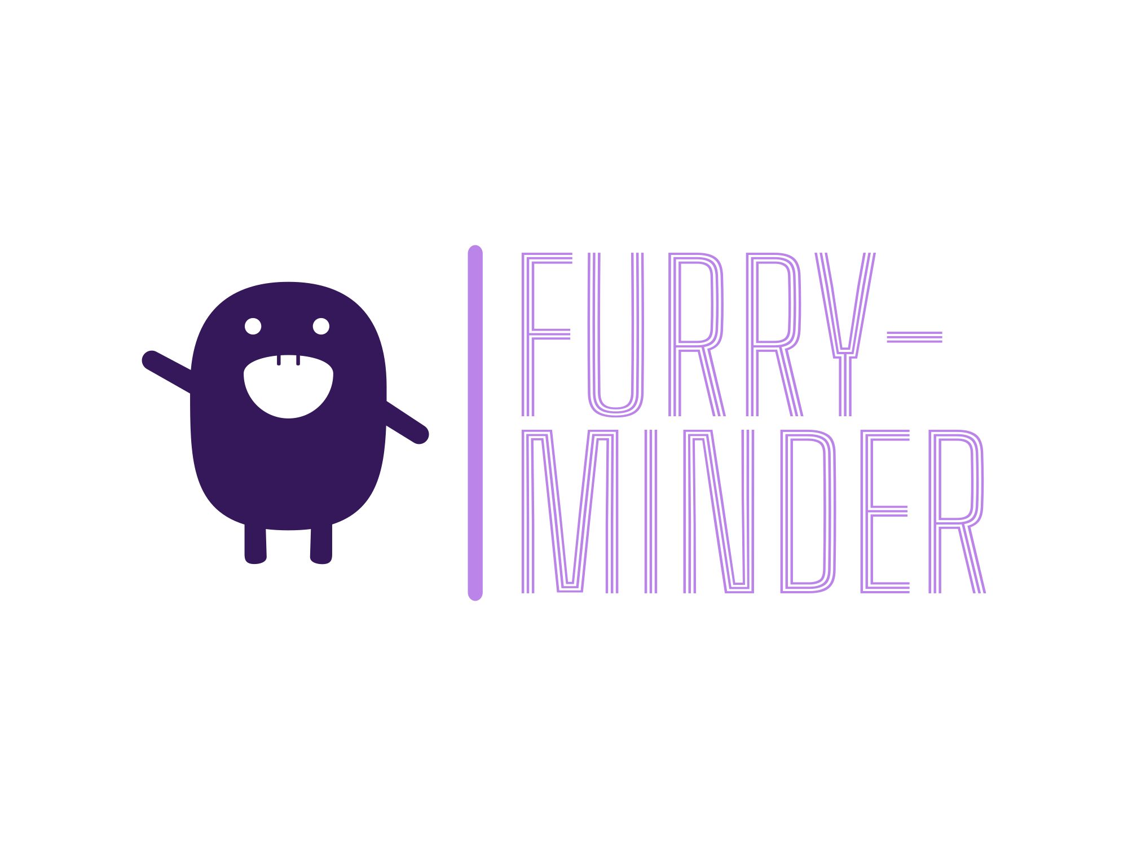

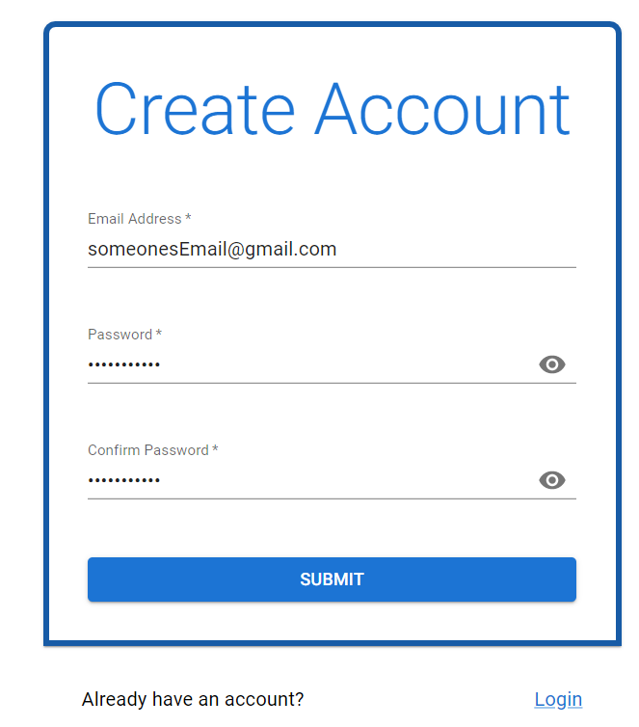
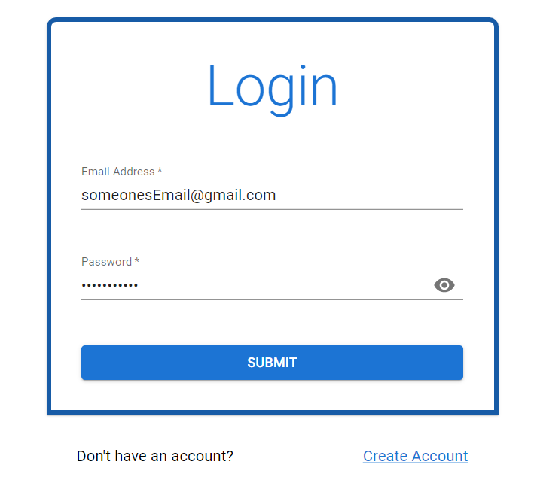
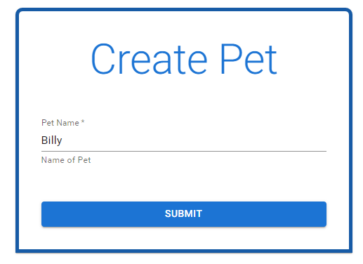
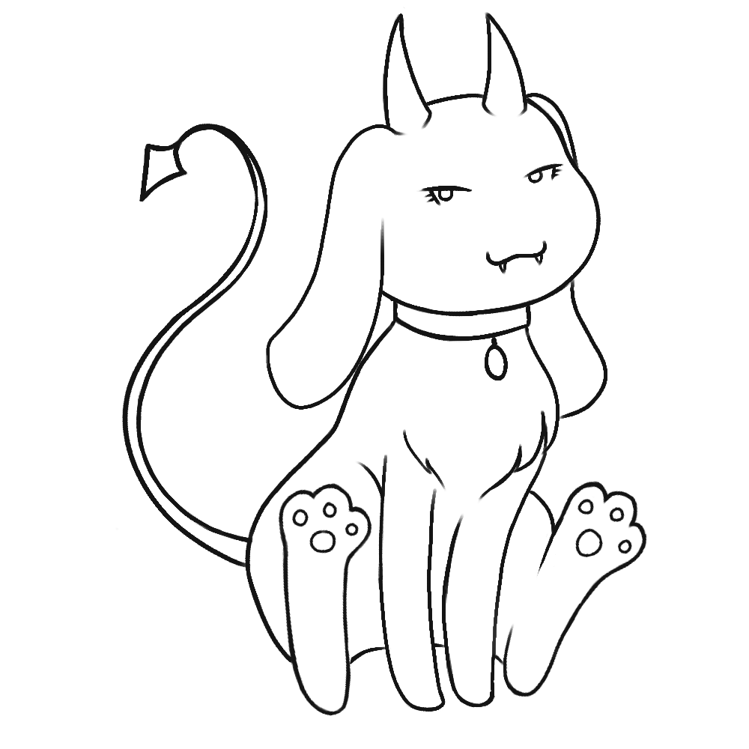
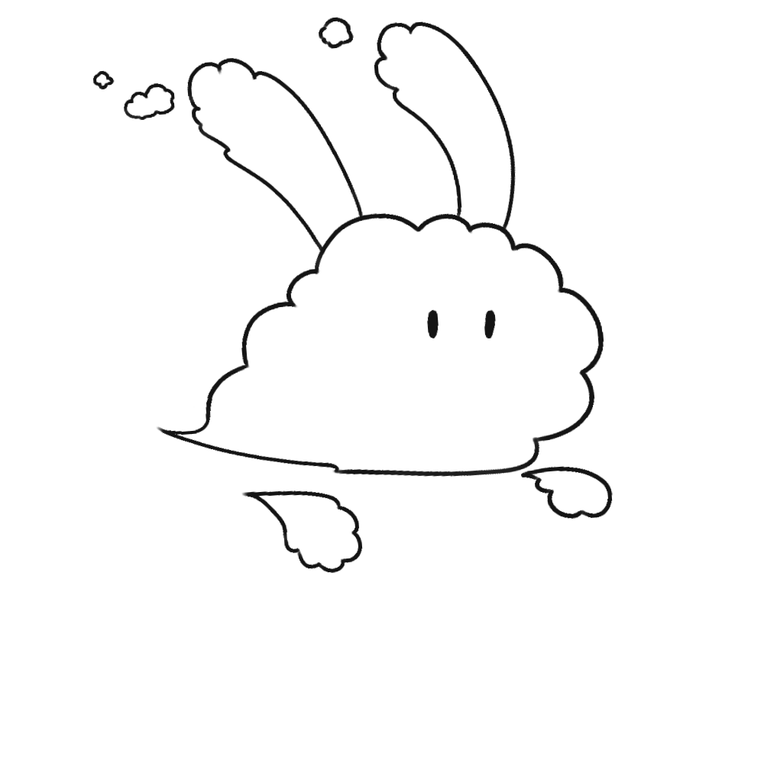

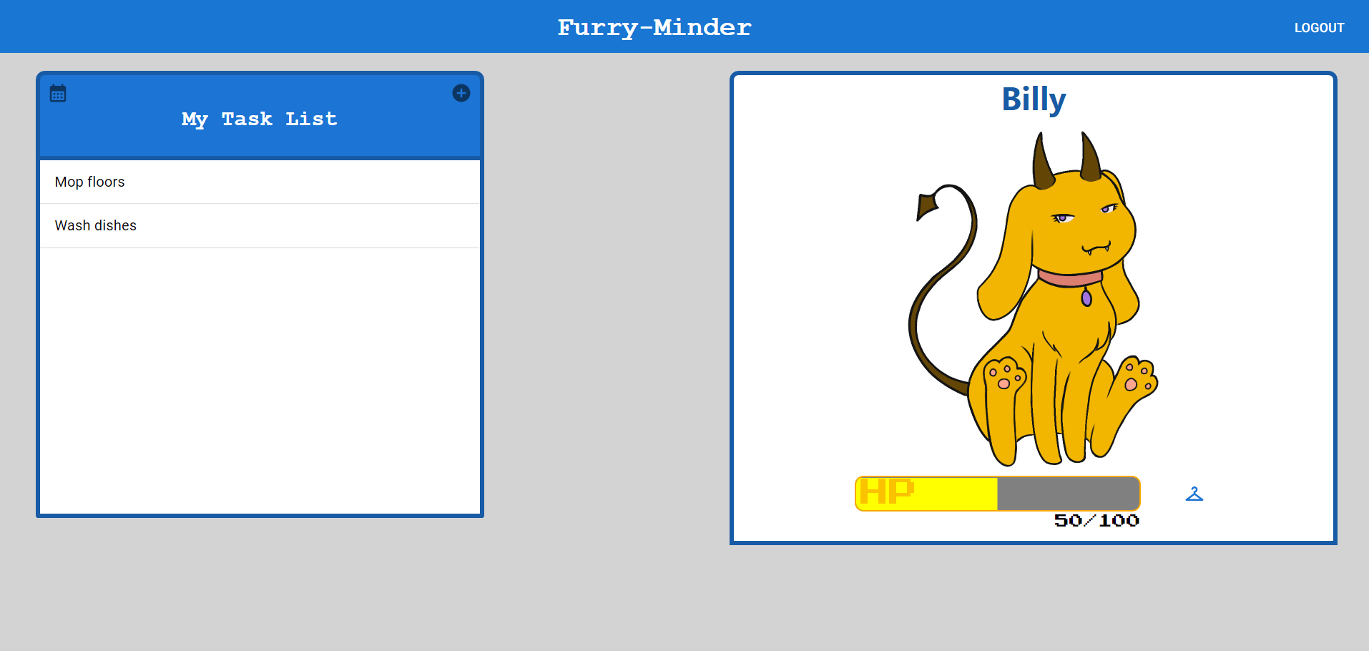
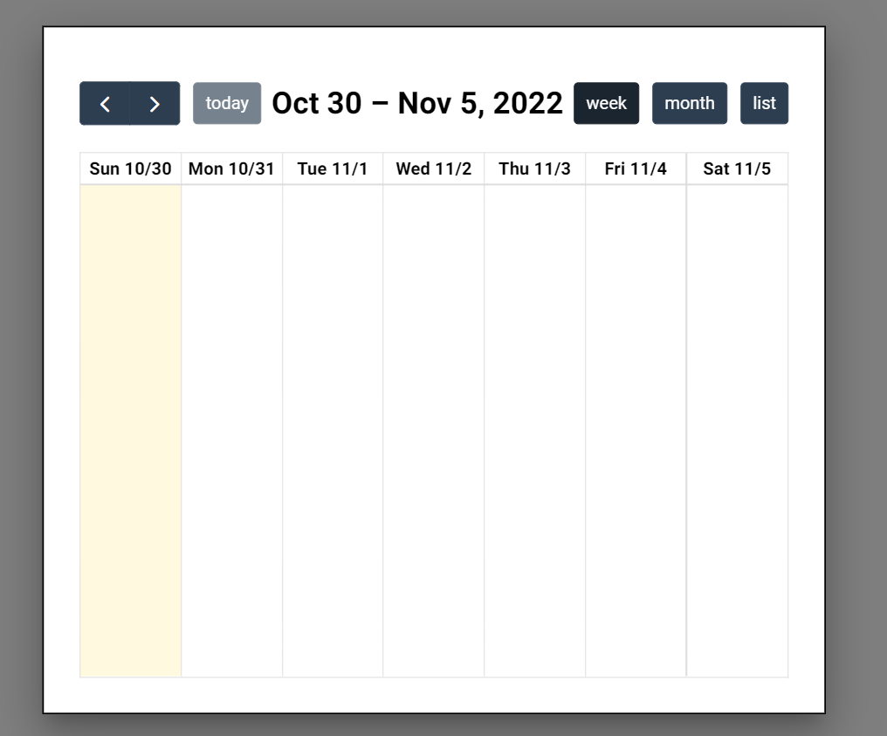
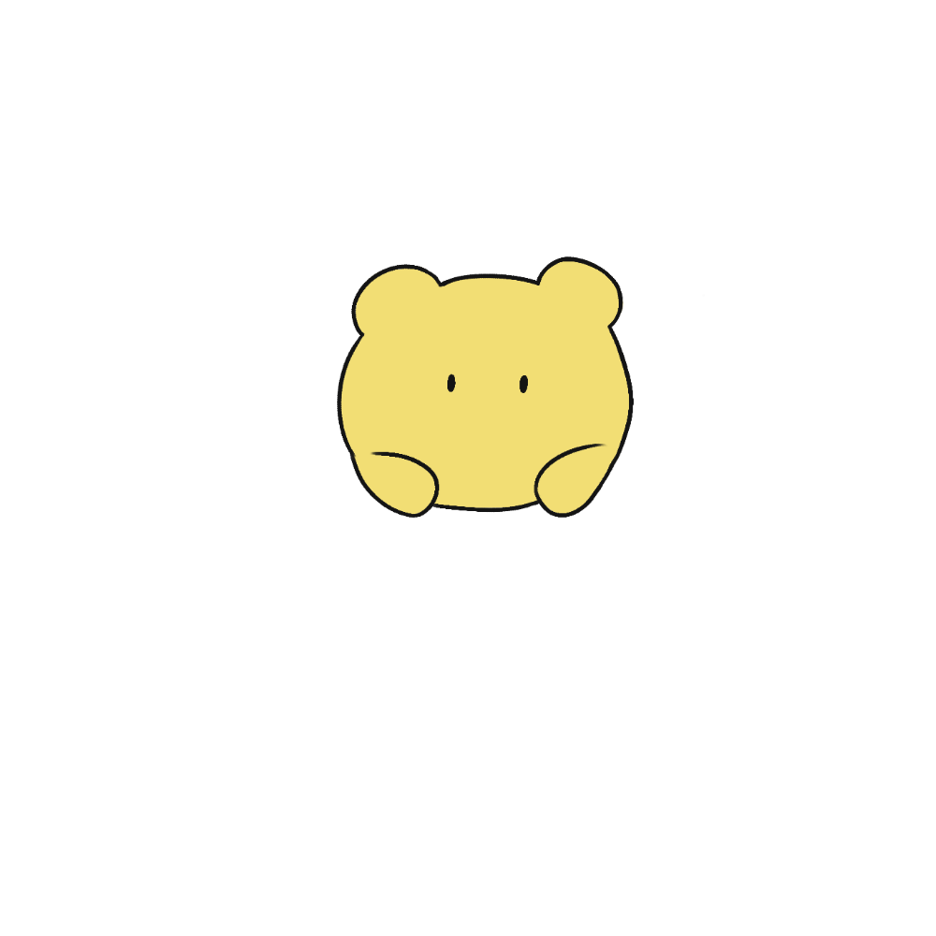
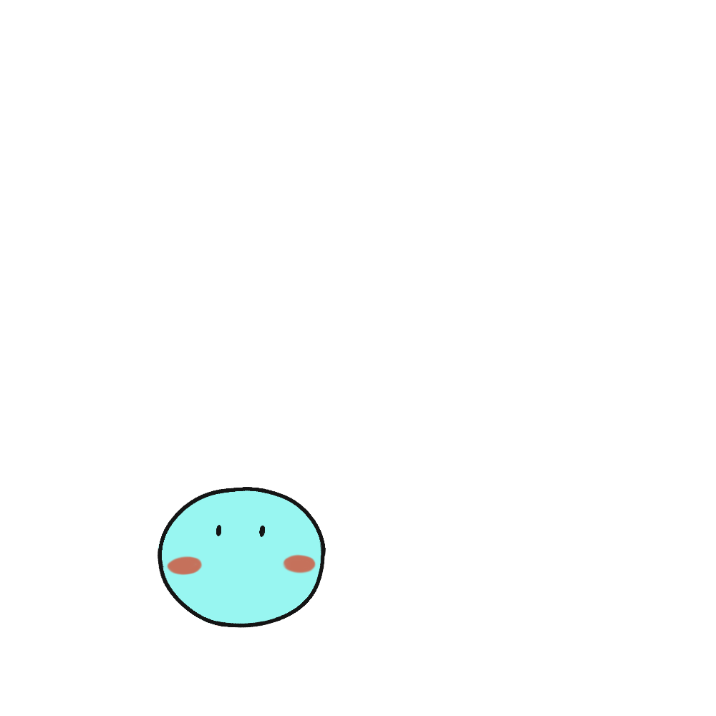
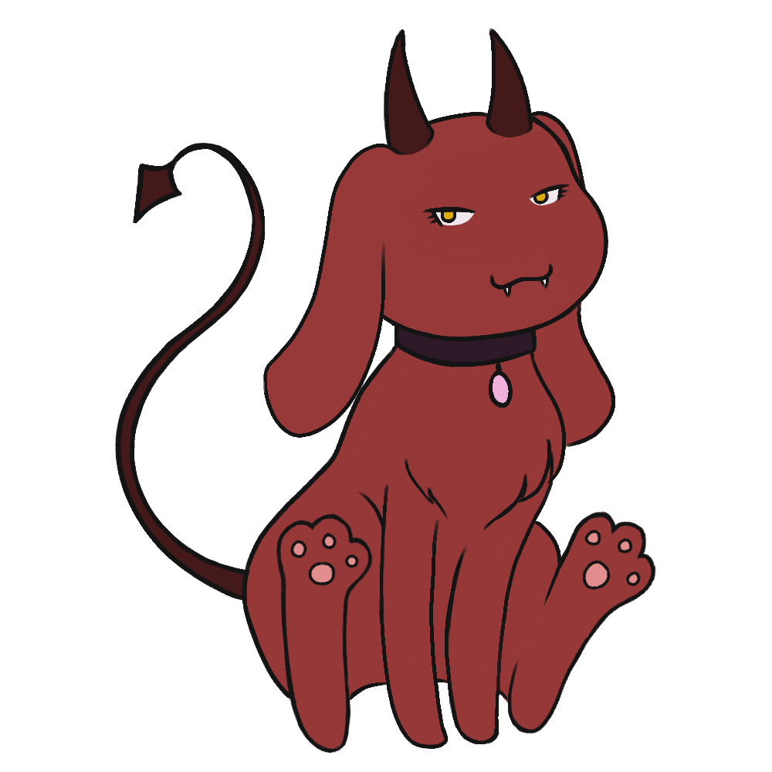
Furry-Minder
Sarah Jorissen, Laura Lopez, Jonathon Hoffman
Dept. Of Computer Science and Information Technology
Introduction
Technology
Future Work
Each day of our lives, we are faced with filling up our day with tasks that we don’t want to accomplish. We constantly have to force ourselves to do them or get something out of it to get the job done. Due to natural human nature, we need the incentive to feel accomplished after completing our tasks. To assist in this constant issue, Furry-Minder provides a solution. The pet helps incentivize the user to stay productive and on task by tying the pet's care to a to-do list. If tasks are finished on time, the pet will be fed & cared for and continue to grow. However, neglecting your tasks also means neglecting your pet, eventually leading to its death and starting all over again.
Furry-Minder’s team decided to develop the application for Google Chrome. The team developed the application using Windows and Ubuntu operating systems, but was mainly developed using Windows. We decided on using WebStorm IDE for development because it was a quality JavaScript IDE that works on multiple operating systems and helped simplify and streamline many necessary tasks. Plus it was free to use! Since the application is a web-based application, the languages that were used throughout development was HTML, CSS, and JavaScript. We decided to use React because it helped streamline the creation of our project and it came with various useful built-in features. For the database we decided to use Firebase’s real-time database. For the calendar component of the project, we decided on using the FullCalendar API due to its flexible implementation. For communication we created a discord server for the lifetime of the project, where we would discuss the development and what aspects of the project we were working on. Finally, in order to maintain some form of version control we used GitHub.
The plans for future development of Furry-Minder would mostly include functionalities revolving around the user’s experience while using the application. These include, but are not limited to: allowing different forms of notifications for upcoming tasks due and pet status, developing a browser extension that allows the application to appear over other windows of the users work environment, email notification system for user’s push notifications, an setting that allows the user to choose between a light and dark mode, allow the user to manipulate the UI positioning of their application, a score system to record pet’s lifespans, including a way for the user to interact with their pet to regain health.
Figure 3: Users who are not already signed in will have the option to log in or create an account (above). When creating a new account, the user will also name their newly-created pet (below).
Background
Furry-Minder’s creation was inspired by the popular 90’s toy, Tamagotchi. Similar to Tamagotchi pets, Furry-Minder’s purpose is to incentivize its users to complete their desired tasks on time while concurrently having an interactive pet to guide them along the way. Furry-Minder provides user stimulus as their pet will be deteriorated as they fail to complete tasks. If tasks are neglected for too long, the pet will also be neglected, leading to its death. The user will then have to be assigned a new baby pet to start over again. On the flip side, as users complete their tasks, their pet will be given health in which allows them to grow. All pets will begin as a baby pet and progress to an adult. Further incentive to complete tasks include the unlocking of items to customize their pet as well as pet color changes to maximize user motivation of use.
Furry-Minder ideally targets users that are predominantly procrastinators and need an extra reward, or in some cases punishment, to get the job done.
Furry-Minder is also for those that are nostalgic about the once popular and raving Tamagotchi. This may include animal lovers who cannot stand to let a pet suffer, even if it may be electronic. However, Furry-Minder is set apart from typical reminder or calendar systems and Tamagotchi due to its mix of innovative stimulus and practicality. The truth of the matter is: there has been nothing that compares to the combined functionality of Furry-Minder out in the real world, until now.
Design
Furry-Minder is a single-page web-based application that uses modals for most of its functionalities and Firebase for the backend database.
Homepage: Displays the task list for the current date as well as the user’s pet. If not logged in, the user will be prompted to do so or make an account.
Signup/Login: Allows a user to create an account that will keep track of their pet and tasks.
Task List Component: Displays the tasks for the day.
Add/Edit Tasks: Users can create new tasks or update existing ones.
Calendar Component: Consists of the users tasks and buttons that traverse the calendar, that display different views such as week, month, and a list view.
Figure 5: Examples of some of the adult pets that will be used during Furry-Minder.
Figure 1: The main page view for a user that’s already logged in.
References
React - https://reactjs.org/
Firebase - https://firebase.google.com/
FullCalendar - https://fullcalendar.io/
WebStorm IDE -
https://www.jetbrains.com/webstorm/
Node.JS - https://nodejs.org/en/
Acknowledgements
We would like to thank Dr. Karen Meisch for her support of students in the College of Science, Technology, Engineering & Mathematics, and Dr. Leong Lee for his support of students in the Department of Computer Science and Information Technology.
Figure 2: This is the initial view the user will see when opening the calendar modal.
Figure 4: Examples of each of the three different life stages of a pet: “child”, “teen”, and “adult.”

