Slide 1
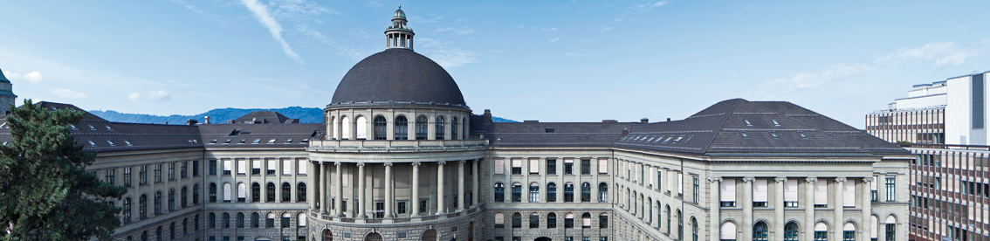
The Careful Driver Model
Shin Watanabe & Jorit Schmelzle

Slide 2

Overview
Motivation
Description of the model
Analyzing methods
Results
Outlook

Slide 3
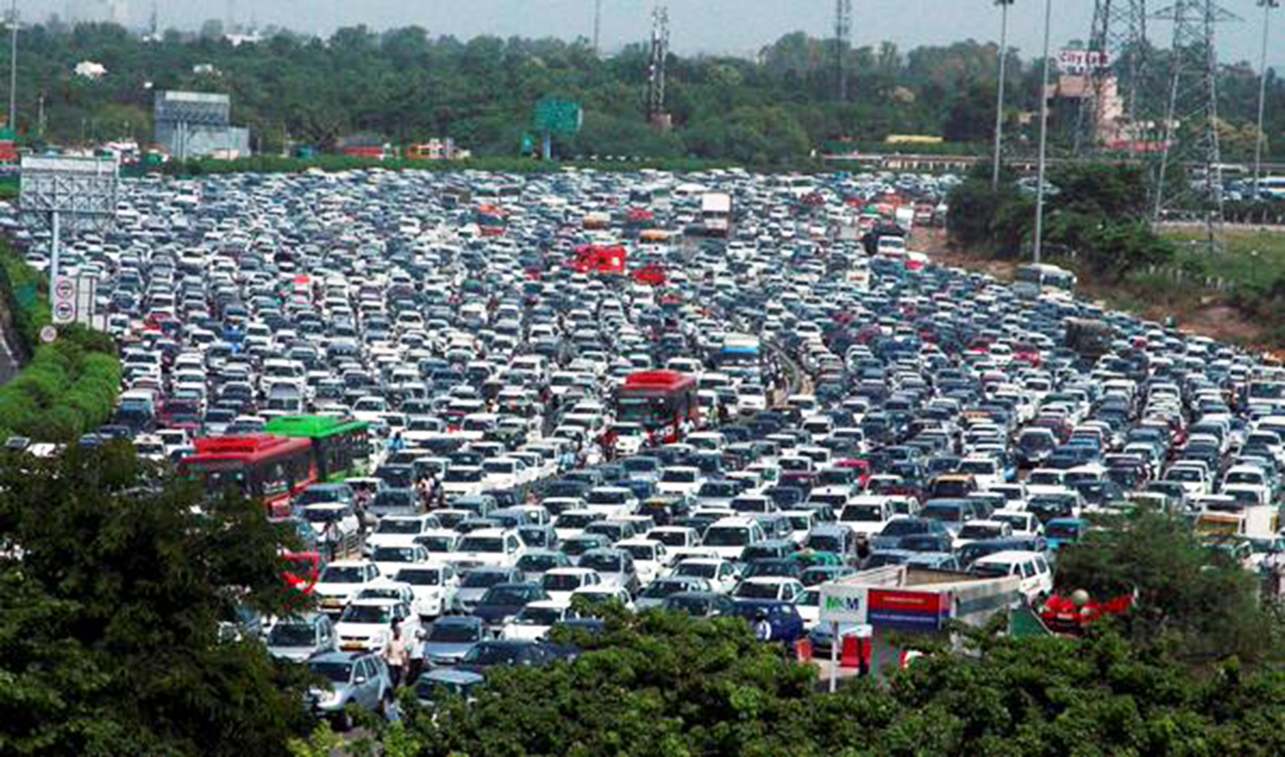
Why modelling traffic jams with CA?
Economical point of view (reduce CO2 emission)
Proved to model traffic accurately
Lots of different approaches by different countries made us curious
Important because densely populated areas need optimization of flow without
new roads
“Easy” to implement for such a complex system
[7] independent.co.uk

Slide 4
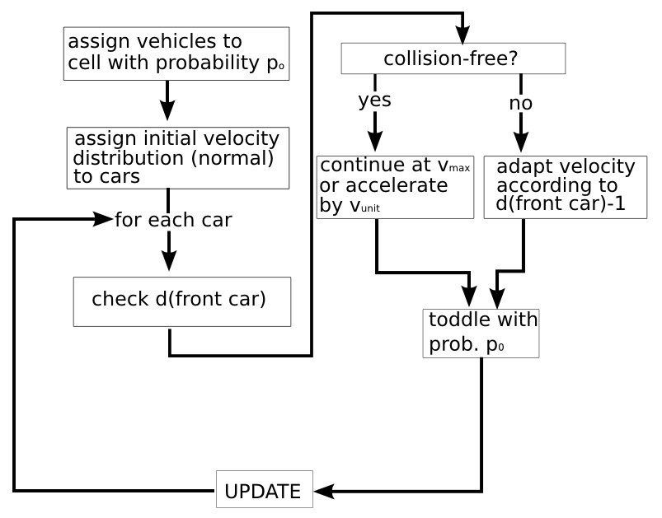
The original Nagel Schreckenberg Model
Cellular automaton
Cell represents a space of (vunit * 1 s) m
Acceleration and deceleration are modeled in velocity units (eg. vunit = 7.5 m/s)

Slide 5
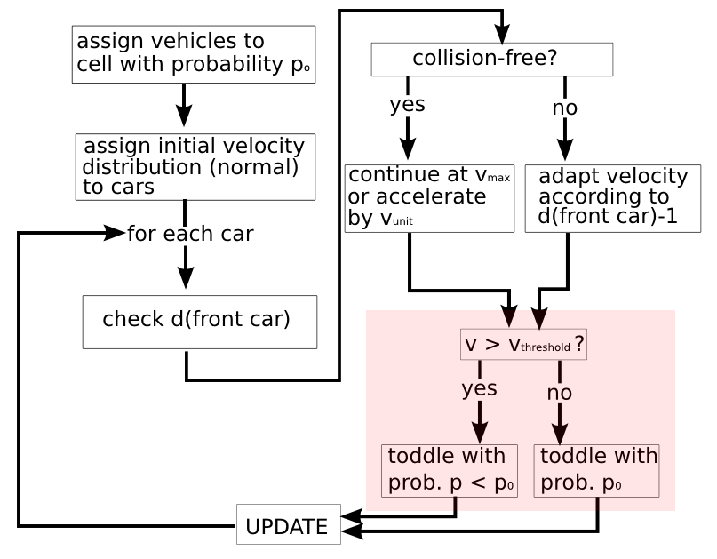
The Velocity Dependent Randomization Model

Slide 6
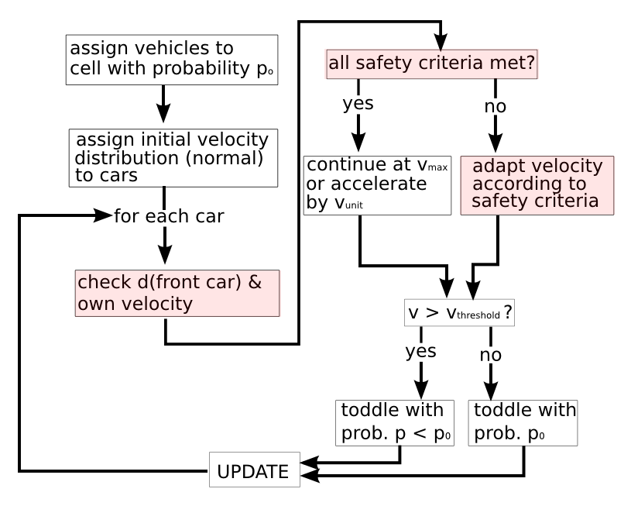
How does the Careful Driver Model work?
Upgraded Velocity dependent randomization model
Toddling depending on the velocity
No physically impossible braking maneuvers
Safety distance (as time delta) adapted to someone's own velocity

Slide 7
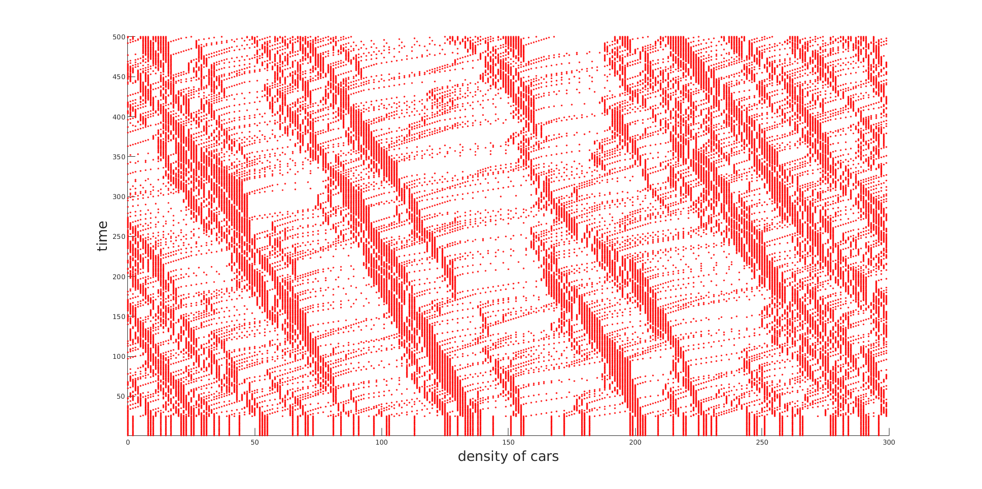
How to analyze a traffic model
Space-time diagram
of a typical simulation

Slide 8
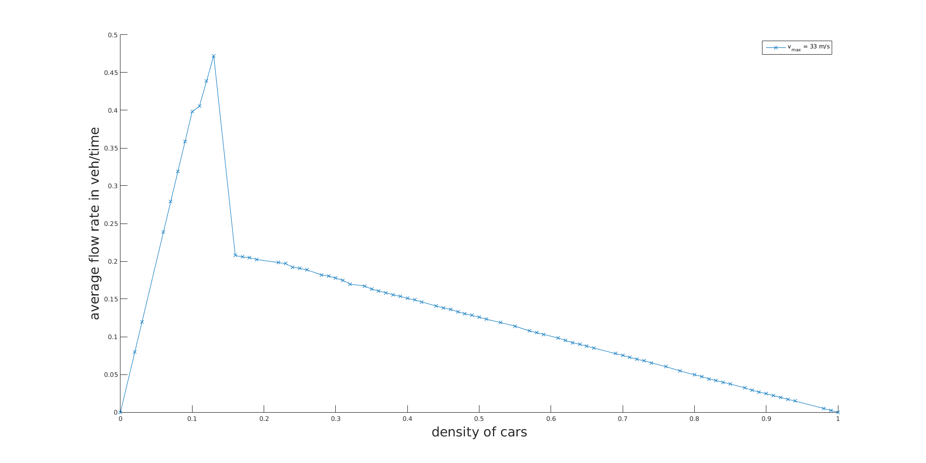

The fundamental diagram
Fundamental diagram of the VDR model over 10.000 iterations per occupation probability

Slide 9
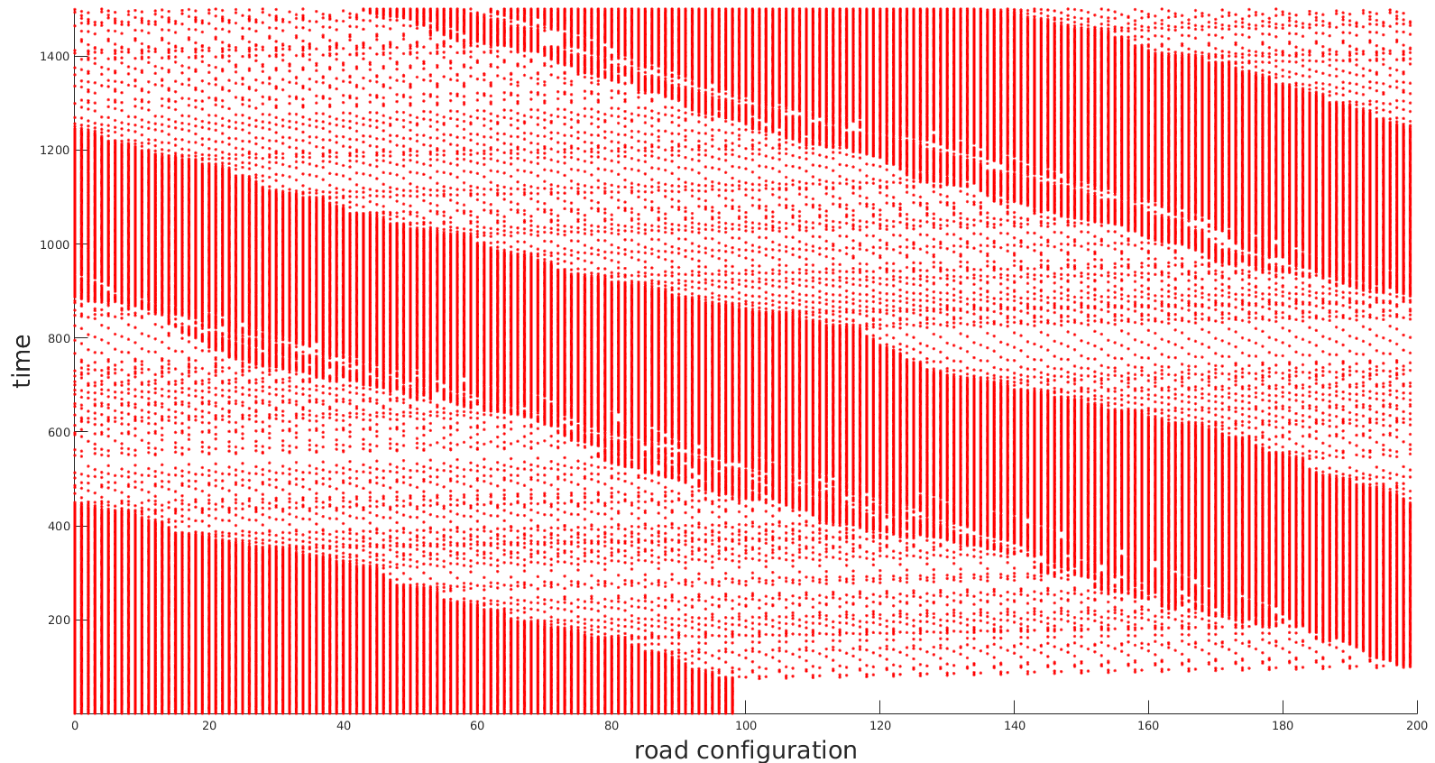
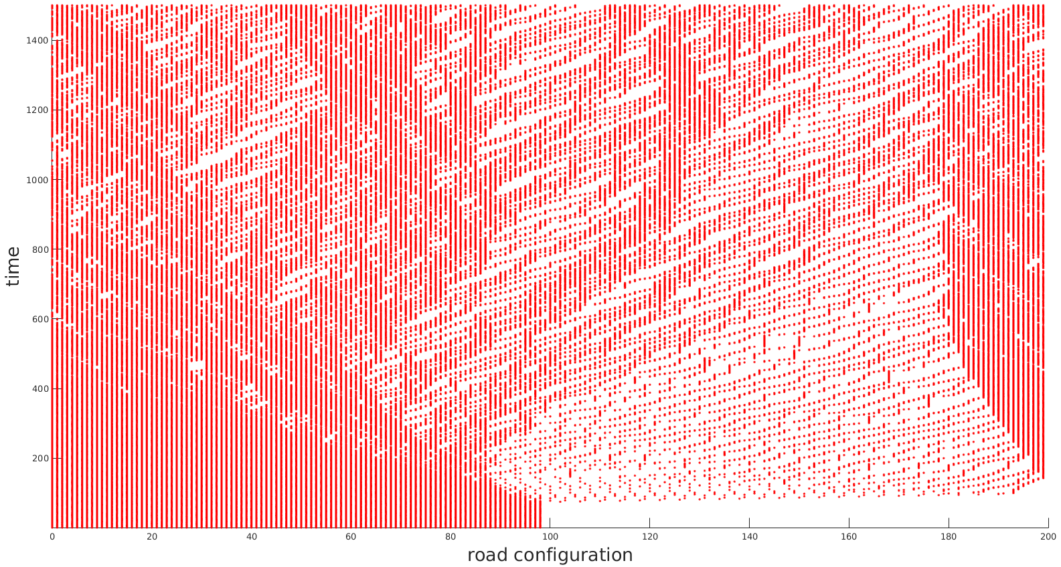
Does our Careful Driver Model produce different Results?
ST-diagram of the Basic VDR model with inhomogeneous initial distribution of vehicles
ST-diagram of the Careful Driver Model with inhomogeneous initial distribution of vehicles

Slide 10
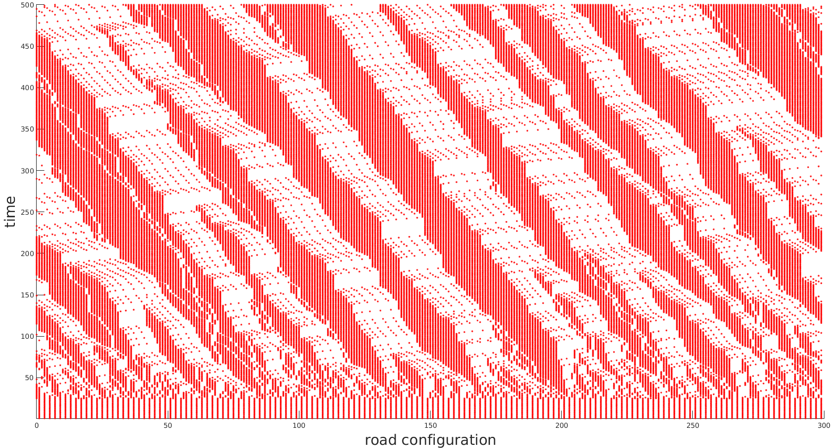
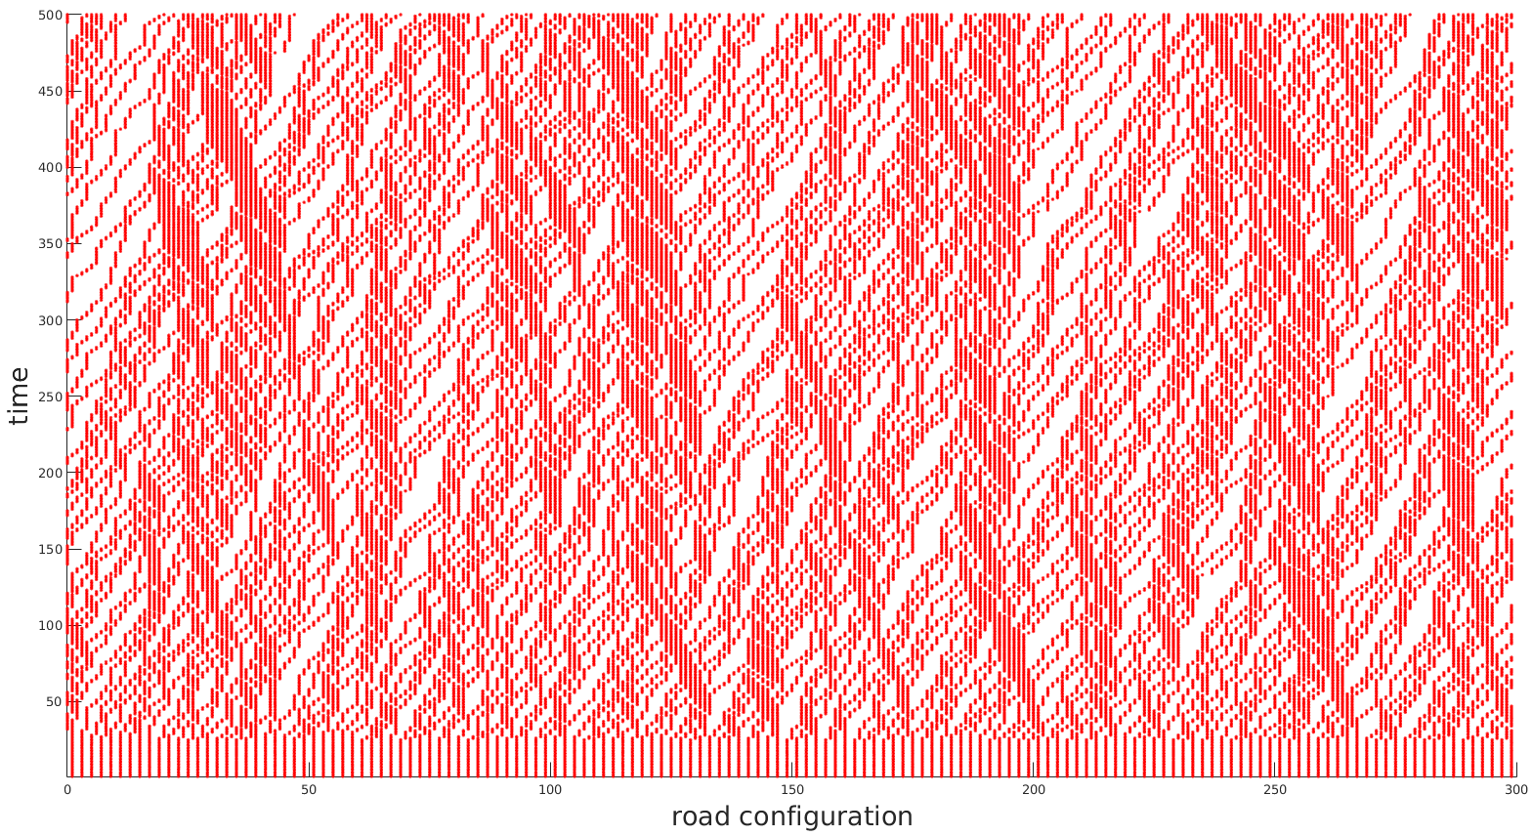
Does our Careful Driver Model produce different Results?
ST-diagram of the Basic VDR model with homogeneous initial distribution of vehicles
ST-diagram of the Careful Driver Model with homogeneous initial distribution of vehicles

Slide 11
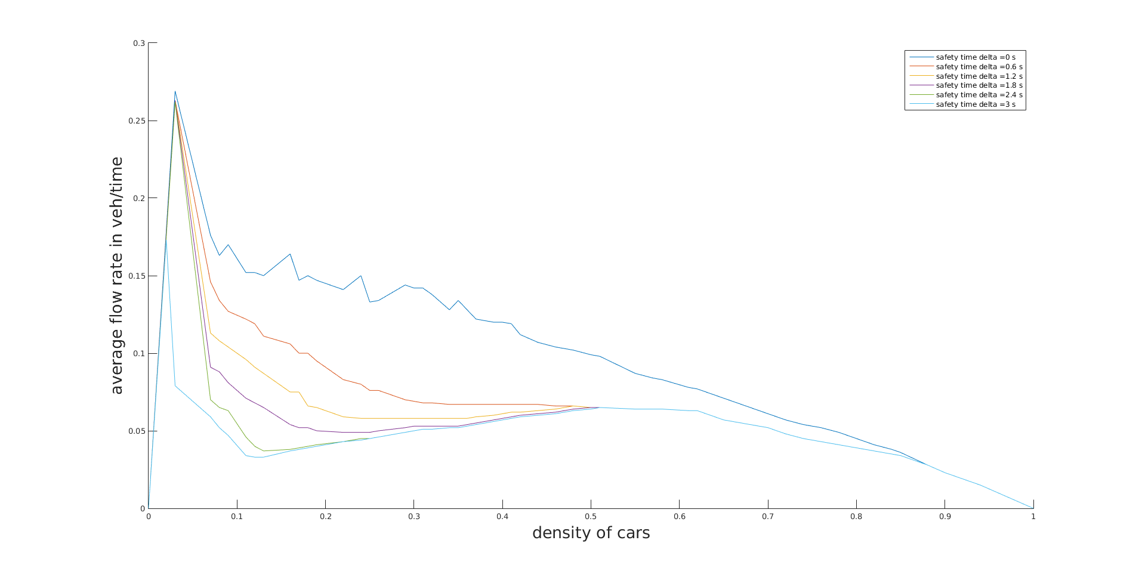
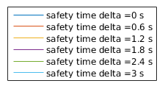
Flowrate influenced by the safety distance
Fundamental diagram of the CD Model with
different safety time deltas.

Slide 12
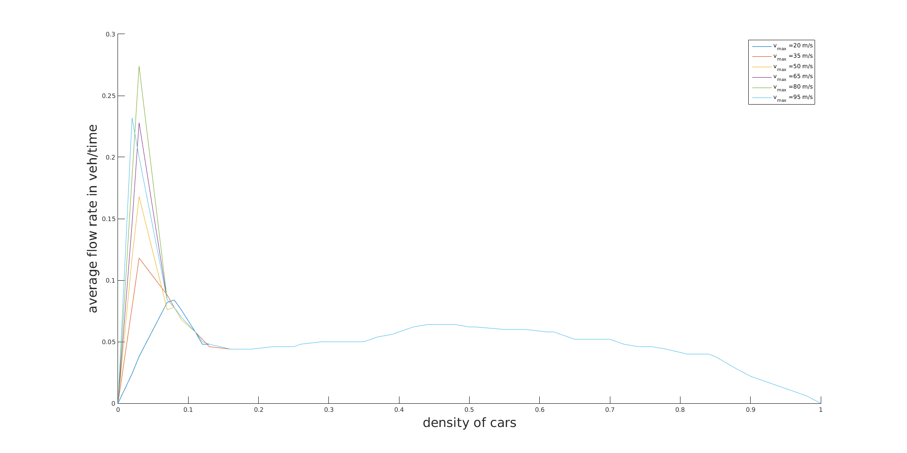
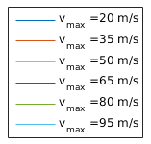
How do speed limits affect our model?
Fundamental diagram of the CD Model for different max. velocities

Slide 13
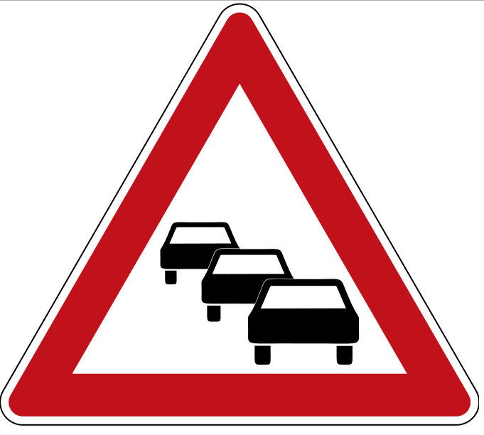
Outlook & Summary
Compare model to recorded data
Calculate real economical benefit (CO2 emission)
Expand model to consider own velocity AND predict positions of other traffic participants for the next time step
Examine how accurately drivers would respect the rules of our CDM
Make studies if a steady flow increases attention of drivers

Slide 14
References
[1] K.Nagel and M. Schreckenberg. A cellular automaton model for freeway traffic
J. Phys. I France, 2221-2229 (1992)
[2] Barlovic, Robert, et al. Metastable states in cellular automata for traffic flow
The European Physical Journal B - Condensed Matter and Complex Systems
5.3 (1998): 793-800.
[3] Schneider, Johannes, and Ebersbach. Anticipatory Drivers in the Nagel-
Schreckenberg Model International Journal of Modern Physics C 13.01 (2002):
107-113.
[4] T. Held and S. Bittihn. Cellular automata for traffic simulation - Nagel-
Schreckenberg model (2011)
[5] W. Knospe, L. Santen, A. Schadschneider and M. Schreckenberg. Towards a
realistic microscopic description of highway traffic Journal of Physics A: Math-
ematical and General (2000)
[6] Paul Wright. Investigating Traffic Flow in The Nagel-Schreckenberg Model
(2013)
[7] http://static.independent.co.uk/s3fs-public/thumbnails/image/2015/09/10/11/traffic-jam-india.jpg

Slide 15


