Slide 1
BOBO The Color Sorting Robotic Arm
~Shruti Joshi
~Nitish Garg

Slide 2
OBJECTIVE
The subject will pick up the colored object from a specified position on the platform , bring it up to the webcam for classification of the color of the object and on the basis of the decided category , it will place the object in the container , specified for a particular color !

Slide 3
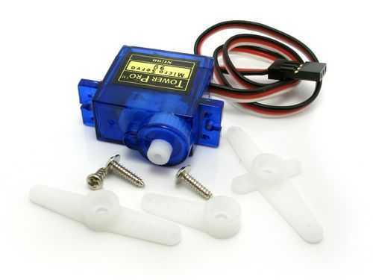
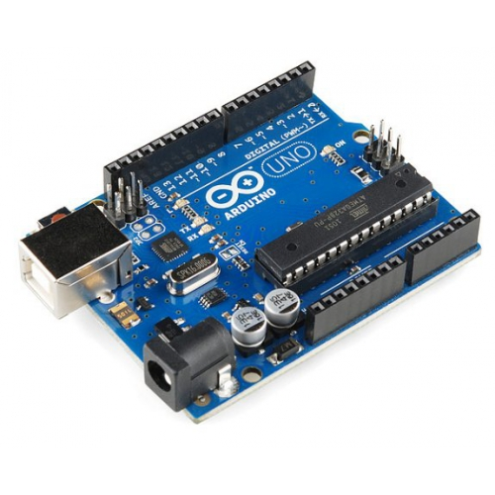
MAJOR COMPONENTS OF THE ARM
TOWER PRO SG90 MINI SERVO MOTOR
Servo motor is a type of motors whose output shaft can be moved to a specific angular position by sending it a coded signal. The servo motor will maintain the position of the shaft as long as you keep applying the coded signal.
ARDUINO UNO
The Arduino Uno is a microcontroller board based on the ATmega328 (datasheet). It has 14 digital input/output pins (of which 6 can be used as PWM outputs), 6 analog inputs, a 16 MHz ceramic resonator, a USB connection, a power jack, an ICSP header, and a reset button.

Slide 4
PROCEDURE OF ONE CYCLE MOVEMENT
Set the Arm into the Initial Position .
Get to the Pickup Point .
Pick up the object .
Proceed towards the Webcam with the object in hold .
Color Classification using Image Processing in MATLAB .
Proceed towards the specific container after the color of the object has been detected
Release the object into the container .
Repeat the cycle

Slide 5
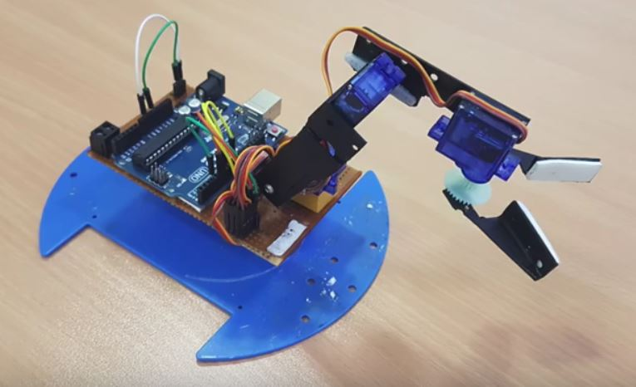
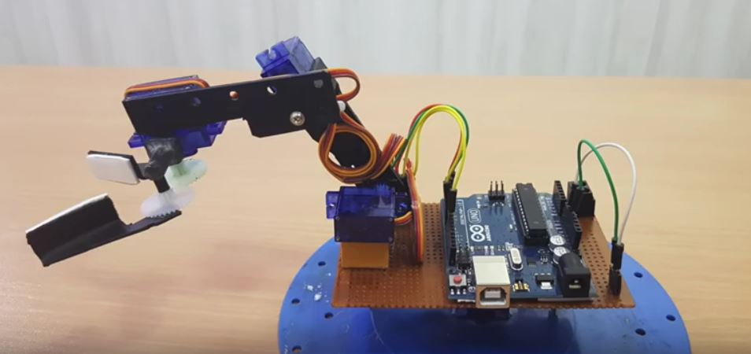
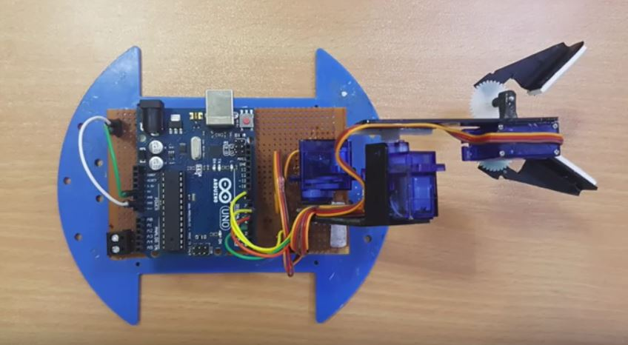
SNAPSHOTS OF THE ARM

Slide 6
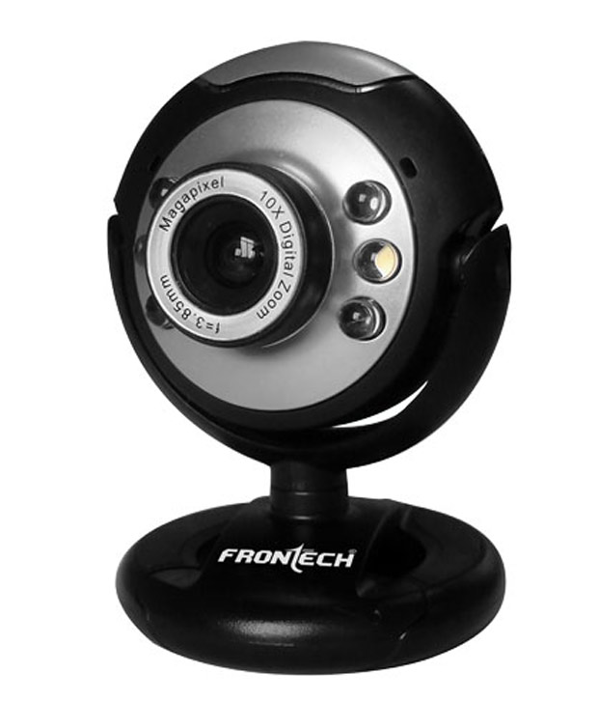
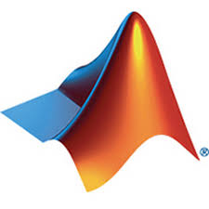

IMAGE PROCESSING MATLAB INTERFACING WITH WEBCAM
cam=webcam(1)
Object that creates a connectivity between the Webcam and the MATLAB Software

Slide 7
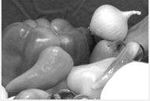
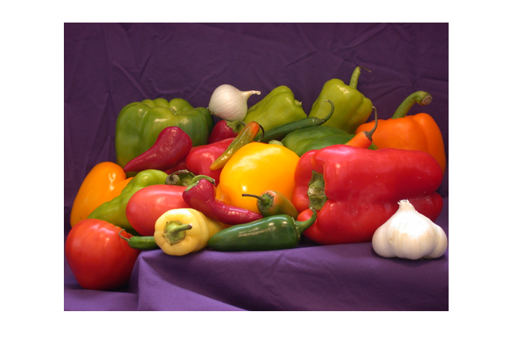
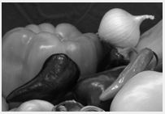
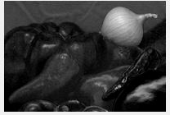
Conversion of an RGB into Separate Filters
RED
GREEN
BLUE
RGB Image

Slide 8
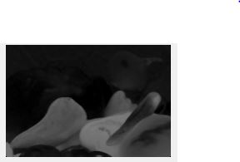
COLOR DETECTION
For an example , the user wants to detect the Red regions present in the image , then using the syntax :
neg_img=imsubtract(orig_img(:,:,1)-gray_img);
bw_img=im2bw(neg_img,0.21);
the original RGB will be converted to negative image of red filter , and then
Applying the threshold value of 0.21 , it will be converted to Black n White image .
This way , the red region in image will be WHITE and rest everything will be Black.

Slide 9
Final Processing…
For the Color Detection of the object that the Arm has been holding , we will figure out the Black n White image for all the three filters and compare the number of white pixels in each one .
Once the filter with the max white pixels has been figured out , a stimuli for the arm to approach the container of the detected color , is given .

Slide 10
Explaination of the Arm movement
Arduino and Servo Motors are interfaced with MATLAB using the object creation method .
Syntax : a=arduino(); s=servo(a,’D6’);
0-179 degres of rotaton of the servo is calibrated between 0-1
Hence , 0.1 corresponds to a rotation of 18 degress and so on..
Inorder to give a command for rotation to the servo motor ,
writePosition(s,0.1);
In the same manner , we will control all the four servos according to the required movement.

