Slide 1
Final Project PowerBI
Joshi, Sanjay
Deep Azure@McKesson
Dr. Zoran B. Djordjević

Slide 2
Introduction
My Topic is PowerBI, and when I searched on internet I found PowerBI desktop software to create beautiful drill down reports and publish them to PowerBi portal, then I realized this cannot be that simple and found that you can create report with live stream data using Event Hub and Analytical Stream Job. So I created two demos, the main demo is obviously using the greatest and latest technology using event hub and stream analytic job to report live stream data and other short demo just to show how to make beautiful graphs, and drill down , slice/dice the data using desktop version of BI on static data and publish them in PowerBI portal.

Slide 3
Software code
Software Code For Analytic stream job query
SELECT System.Timestamp AS WindowEnd, COUNT(*) AS FraudulentCalls
INTO "fraudstreamoutput"
FROM "fraudstream" CS1 TIMESTAMP BY CallRecTime
JOIN "fraudstream" CS2 TIMESTAMP BY CallRecTime
ON CS1.CallingIMSI = CS2.CallingIMSI
AND DATEDIFF(ss, CS1, CS2) BETWEEN 1 AND 5
WHERE CS1.SwitchNum != CS2.SwitchNum
GROUP BY TumblingWindow(Duration(second, 1))
Software Code date_dim table in PowerBI desktop
Date_dim = ADDCOLUMNS ( CALENDAR (DATE(2000,1,1), DATE(2025,12,31)), "DateAsInteger",
FORMAT ( [Date], "YYYYMMDD" ), "Year", YEAR ( [Date] ), "MonthNo", FORMAT ( [Date], "MM" ), "YearMonthNo", FORMAT ( [Date], "YYYY/MM" ),
"YearMonth", FORMAT ( [Date], "YYYY/mmm" ),
"MonthShort", FORMAT ( [Date], "mmm" ), "MonthLong", FORMAT ( [Date], "mmmm" ), "WeekNo", WEEKDAY ( [Date] ), "WeekDay",
FORMAT ( [Date], "dddd" ), "WeekDayShort", FORMAT ( [Date], "dddd" ), "Quarter", "Q" & FORMAT ( [Date], "Q" ), "YearQuarter",
FORMAT ( [Date], "YYYY" ) & "/Q" & FORMAT ( [Date], "Q" ))

Slide 4
Demo1
Event Hub live stream & PowerBI Analysis
Data is being generated in every form today, there are several tools available in the market to analyze the data but Microsoft PowerBI provides interface with Azure and provide ability to analyze the live stream data. In power BI you can almost connect to all the data sources like relational databases, live Facebook feed, tweeter feed, text/CSV and as well as data created by event hubs and analyze them in one central places in real time.
We will present a use case of real-time fraud detection based on phone-call data and. We will Bring streaming events into an instance of Azure Event Hubs and then send the real time data to power BI engine to examine the data in real time.
In this example, we will consider fraudulent usage to be calls that originate from the same user but in different locations within 5 seconds of one another. For example, the same user can't legitimately make a call from the US and Australia at the same time.
Overview of the Technology:
To Solve the problem, I have created an even hub in Azure portal that will read the data in real time by using a client application that will generate a phone-call data including fraud calls . Some of the records that the client app produces look like fraudulent calls. That data will then send to PowerBI engine to analyze in real time to detect the fraudulent calls.
High Level Steps:
Download the client program to generate the sample data
Configure even hubs in Azure portal
Create a Stream Analytics job to manage streaming data
Run a client application to generate the live telephone fraud call data
Create a query in Analytics job in Azure to transform the data ingested by event hub
Configure the output in analytic job in Azure to send the transform data to powerBI
In Powerbi portal create a dashboard to process the output of stream analytic query
Data source
Test data generator application
http://download.microsoft.com/download/8/B/D/8BD50991-8D54-4F59-AB83-3354B69C8A7E/TelcoGenerator.zip
Hardware used
Windows 7 64 bit
Software used:
Azure portal ( tool)
PowerBI portal ( tool)

Slide 5
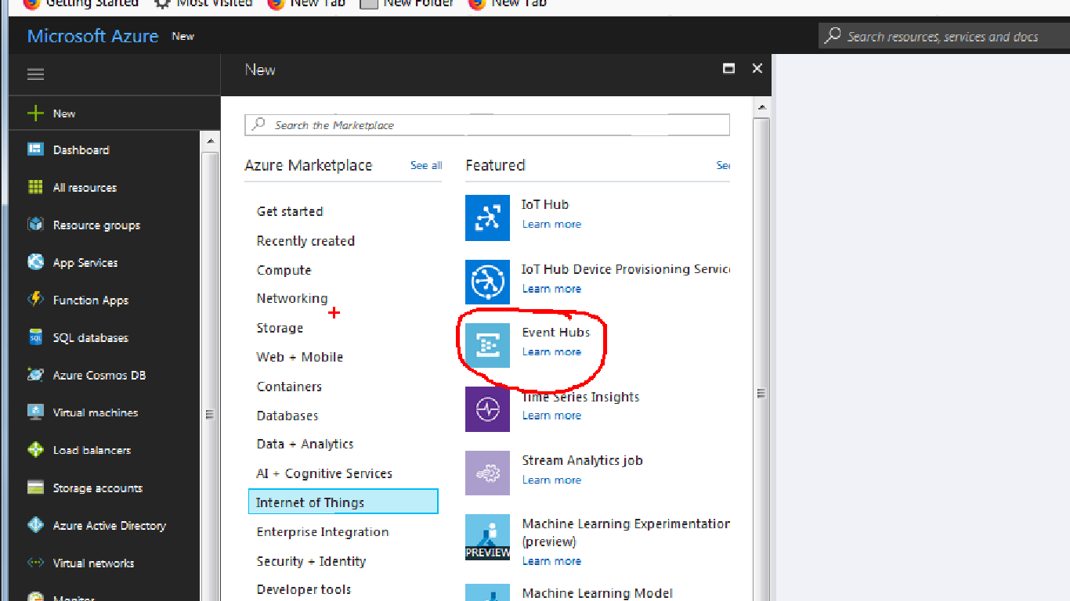
Create eventhub
Login to Azure portal and click on the new and select the ‘Internet of thing ‘ blade and select even hub to create a event hub

Slide 6
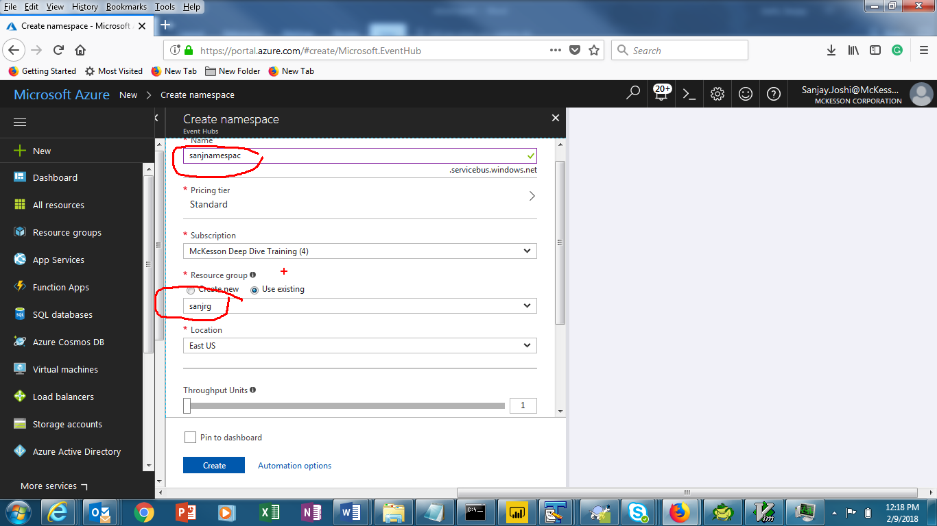
Create eventhub
The following screen will appear to create a namespace , select name , provide resource group name and select location and hit create button as seen below

Slide 7
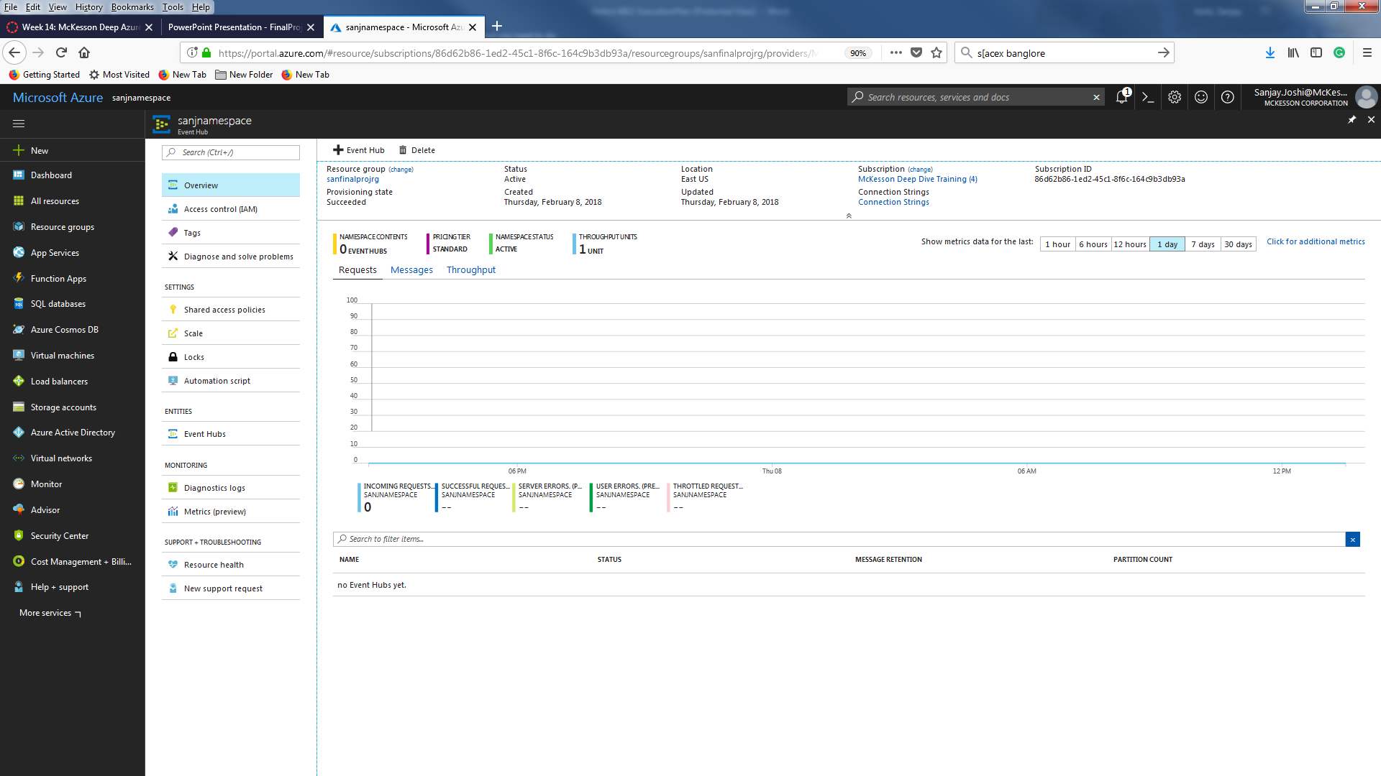
Create eventhub
It will take few seconds to create namespace, select the namespace you created ( You may find it by searching under all resources or you could have pinned it dashboard for easy access). The following screen will appear

Slide 8
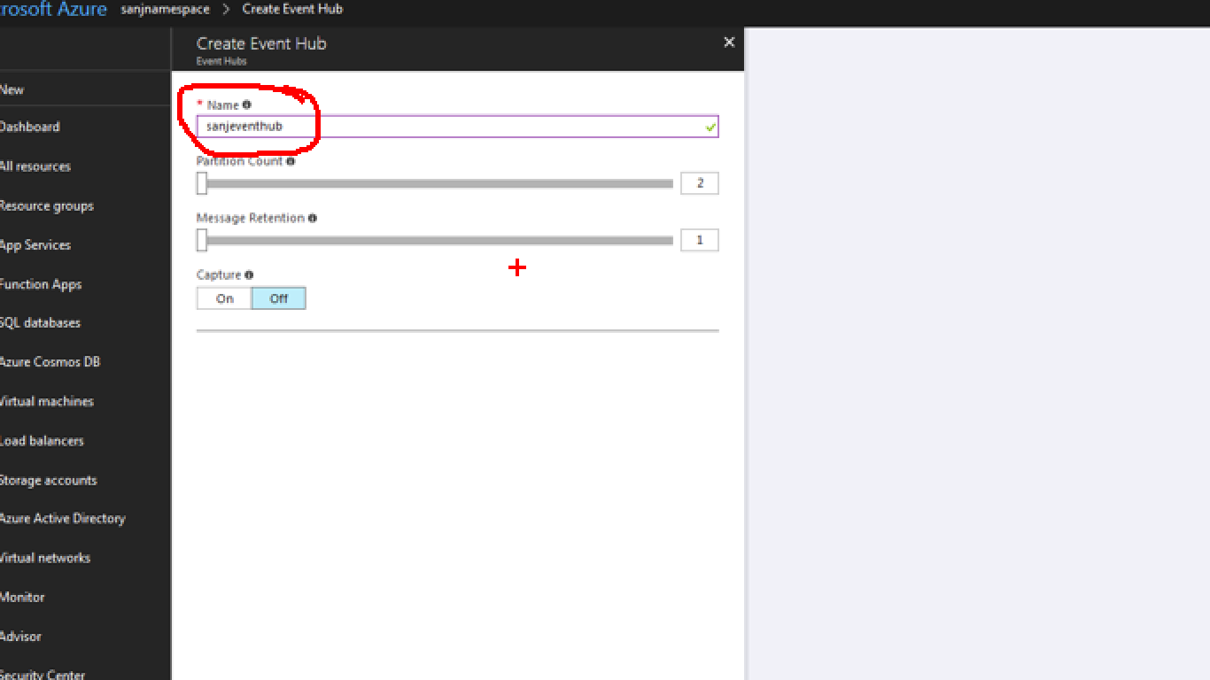
Create eventhub
Click on +Event hub icon to create the even hub following screen will appear , provide the name and hit the create button

Slide 9
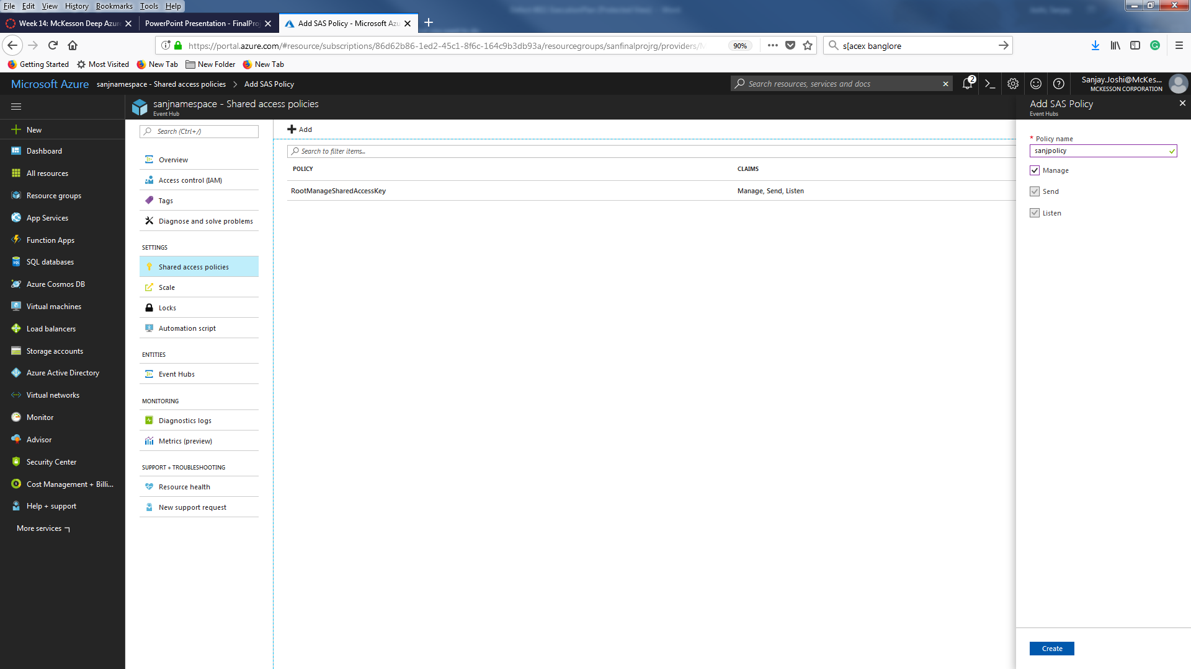
Create eventhub( SAS POLICY)
Click on the Shared access policy blade under setting and hit +Add button to create new policy , don’t touch the default RootMangedSharedAccesskey .
Provide Name and click on Mange checkbox to get all ( send and listen access) and hit the Create button

Slide 10
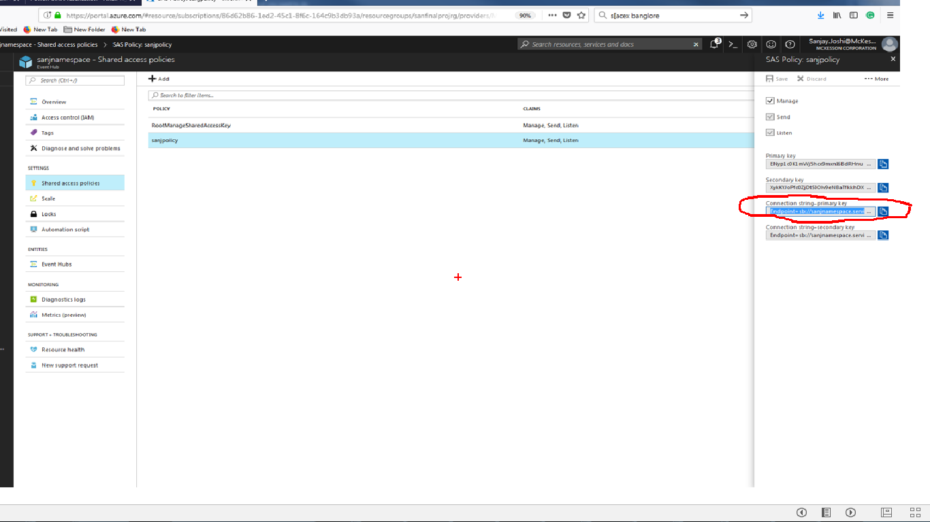
Create eventhub( SAS POLICY)
It will create new policy . Click on the policy you created to capture the Primary connection string value and save it to notepad

Slide 11
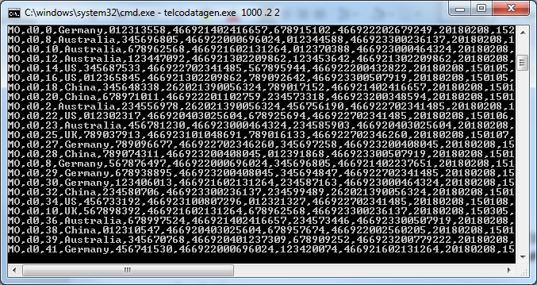
Setup client application
Now setup the job that will generate the fraud telecom data . Download the TelecoGenerator.zip from flowing link.
http://download.microsoft.com/download/8/B/D/8BD50991-8D54-4F59-AB83-3354B69C8A7E/TelcoGenerator.zip
extract the file to a folder and open the ‘telcodatagen.exe.config’ file in notepad or textpad and replace the value for eventhubname and connection string , you can get these value we saved in notepad
<?xml version="1.0" encoding="utf-8"?>
<configuration>
<appSettings>
<!-- Service Bus specific app setings for messaging connections -->
<add key="EventHubName" value="sanjeventhub"/>
<add key="Microsoft.ServiceBus.ConnectionString" value="Endpoint=sb://sanjnamespace.servicebus.windows.net/;SharedAccessKeyName=sanjpolicy;SharedAccessKey=ENyp1c0K1mWj5hcx9mxnI6BdRHnuHSzV5nQonPkq1pA="/>
</appSettings>
Save the config file and run command to generate the data for 2 hours with .2 seconds interval
telcodatagen.exe 1000 .2 2
It will generate the sample data like this and this data is being ingested by evenhub we created

Slide 12
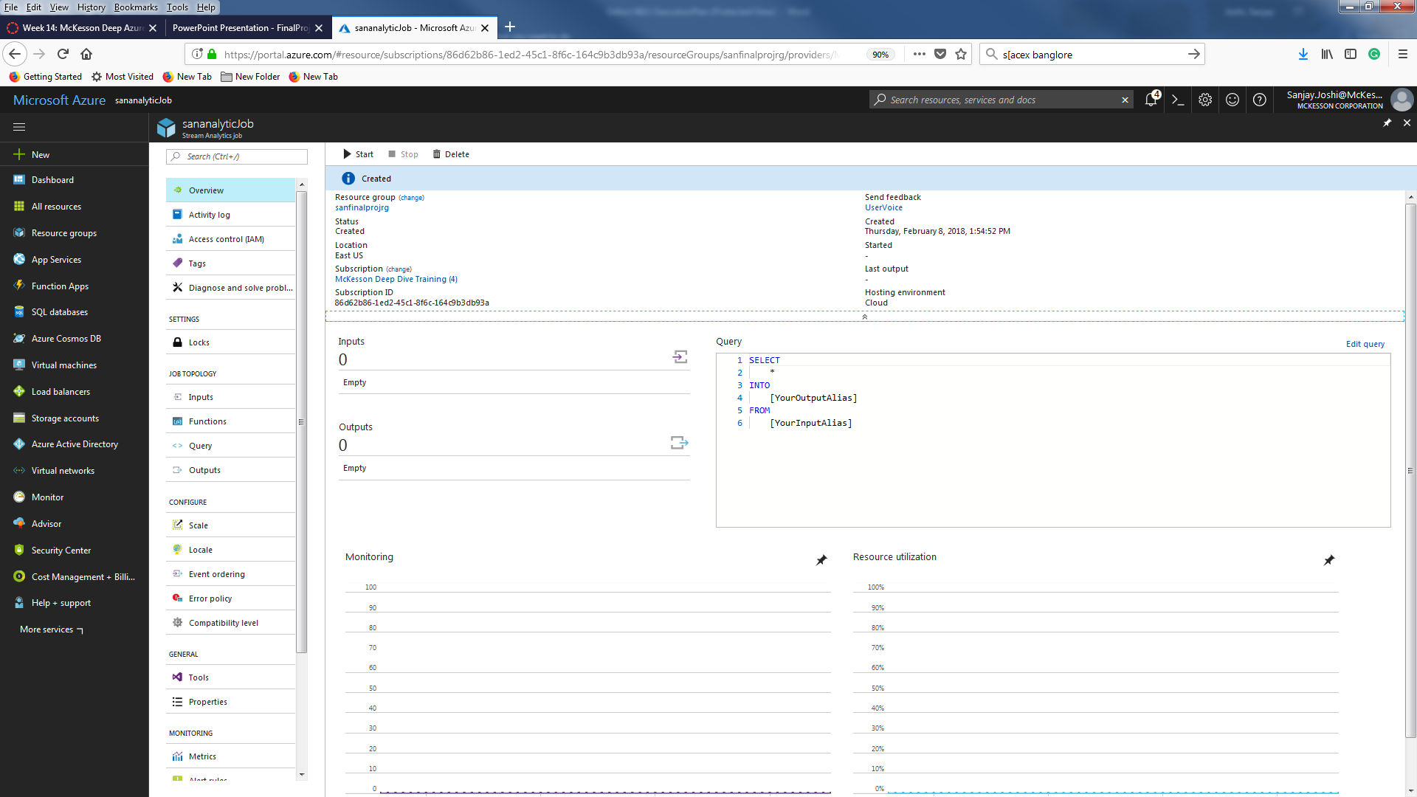
Create stream Analytic Job
In the Azure portal, click New > Internet of Things > Stream Analytics job. Provide job name , resource group and hit create button .
The following screen will appear

Slide 13
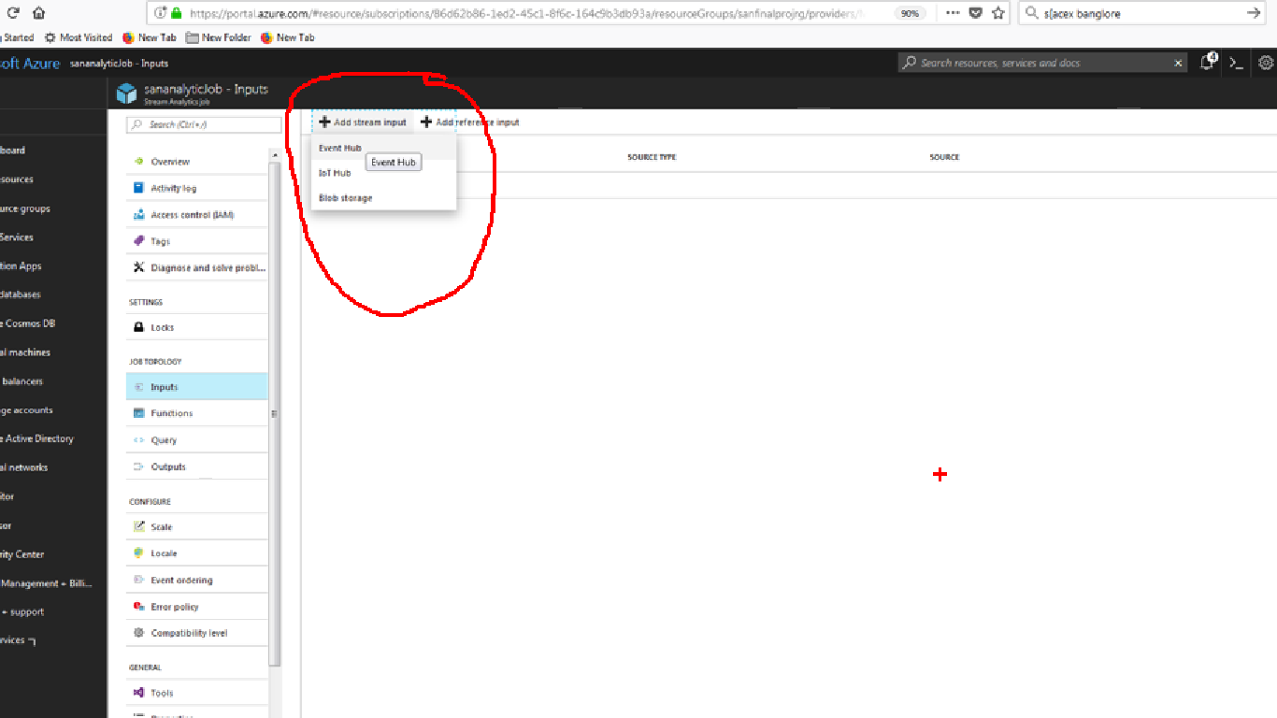
Create stream Analytic Job( Configure Input)
Under Job category click on input and click on +Add stream input and select eventhub

Slide 14
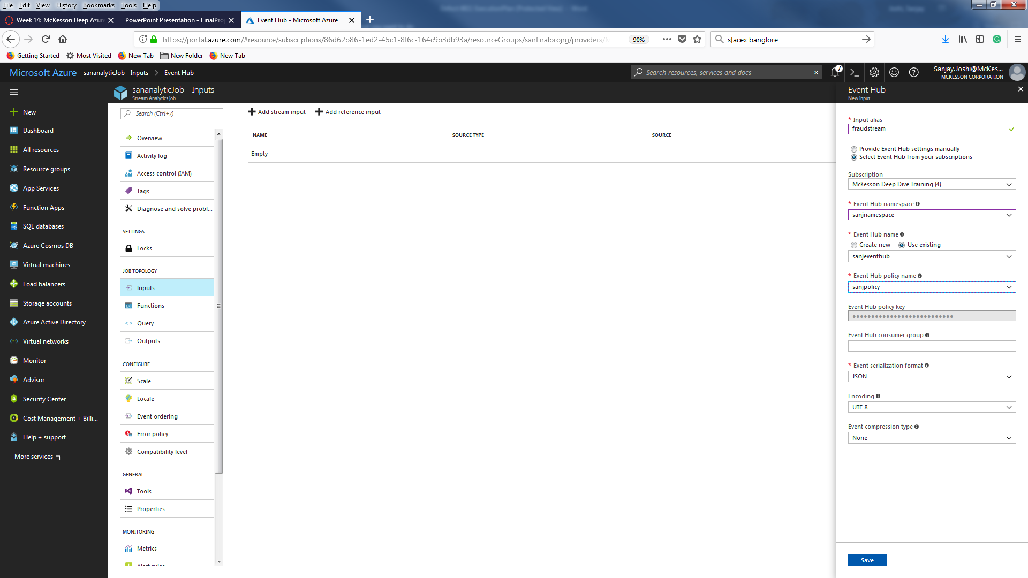
Create stream Analytic Job( Configure Input)
Provide input alias In this example ‘fraudstream’ , select your event hub namespace you created before ( ‘sanjnamespace’) choose you resource group and also select the policy you created when creating the event hub and hit save button . The screen will look like this

Slide 15
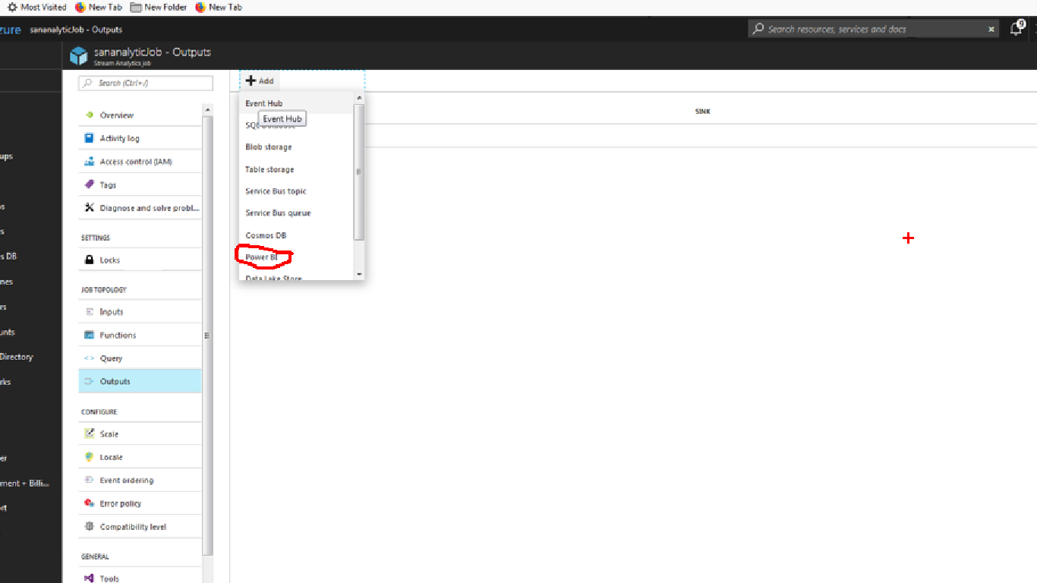
Create stream Analytic Job( Configure output)
Now click on the output blade under job topology and hit the +add button and select the power BI

Slide 16
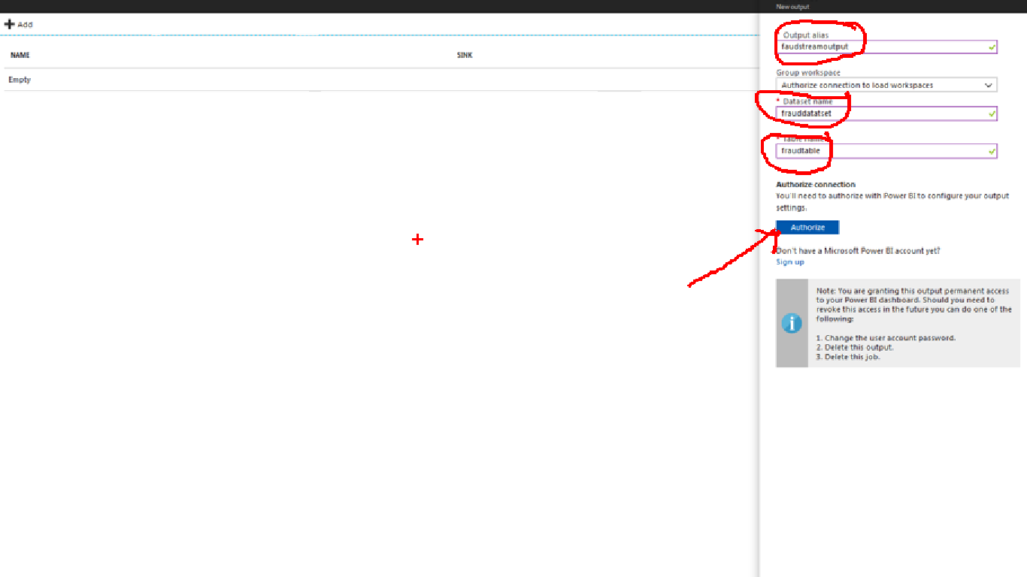
Create stream Analytic Job( Configure output)
Provide output alias dataset name and table_name and hit the Authorize button to Authorize your Power bi portal credential .

Slide 17
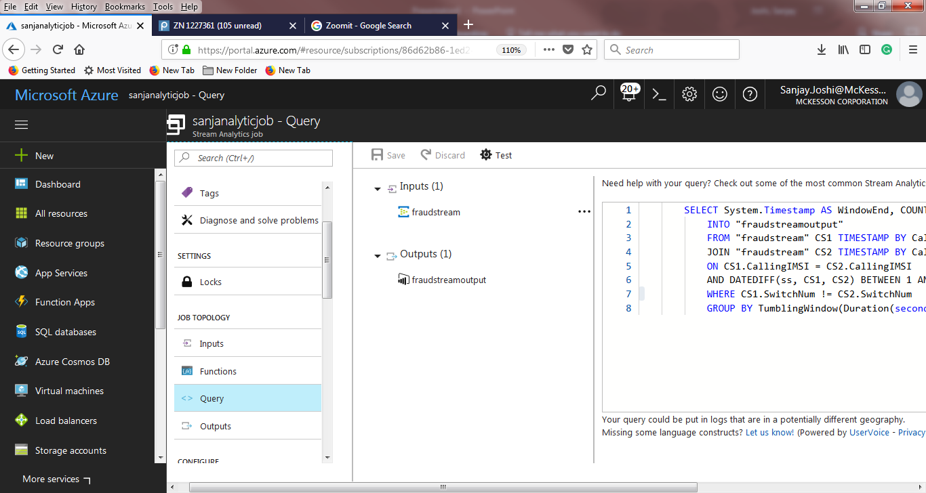
Create stream Analytic Job( Configure query)
Now click on the query page and paste the following query .
SELECT System.Timestamp AS WindowEnd, COUNT(*) AS FraudulentCalls
INTO "fraudstreamoutput"
FROM "fraudstream" CS1 TIMESTAMP BY CallRecTime
JOIN "fraudstream" CS2 TIMESTAMP BY CallRecTime
ON CS1.CallingIMSI = CS2.CallingIMSI
AND DATEDIFF(ss, CS1, CS2) BETWEEN 1 AND 5
WHERE CS1.SwitchNum != CS2.SwitchNum
GROUP BY TumblingWindow(Duration(second, 1))

Slide 18
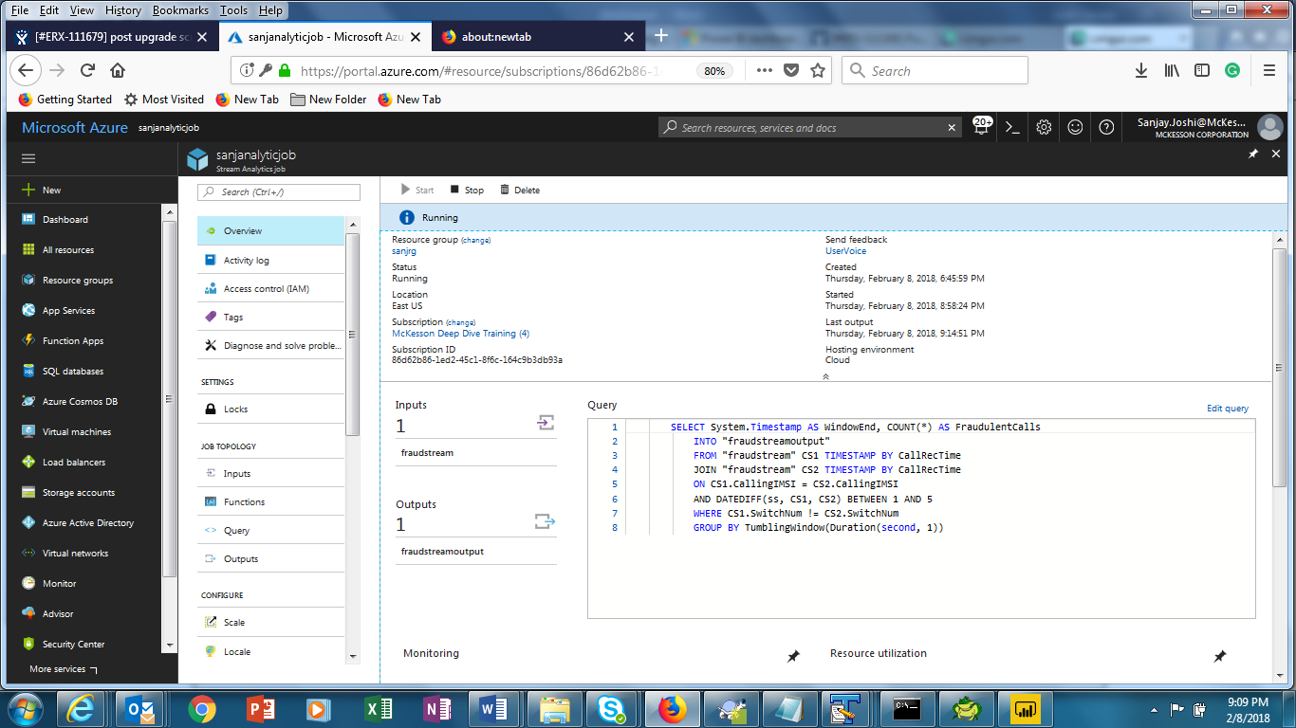
Start stream analytic job
Now go back to portal and select your Analytic stream job and start the analytic job by clicking start button
It will say starting and finally give you ‘running’ message like this

Slide 19
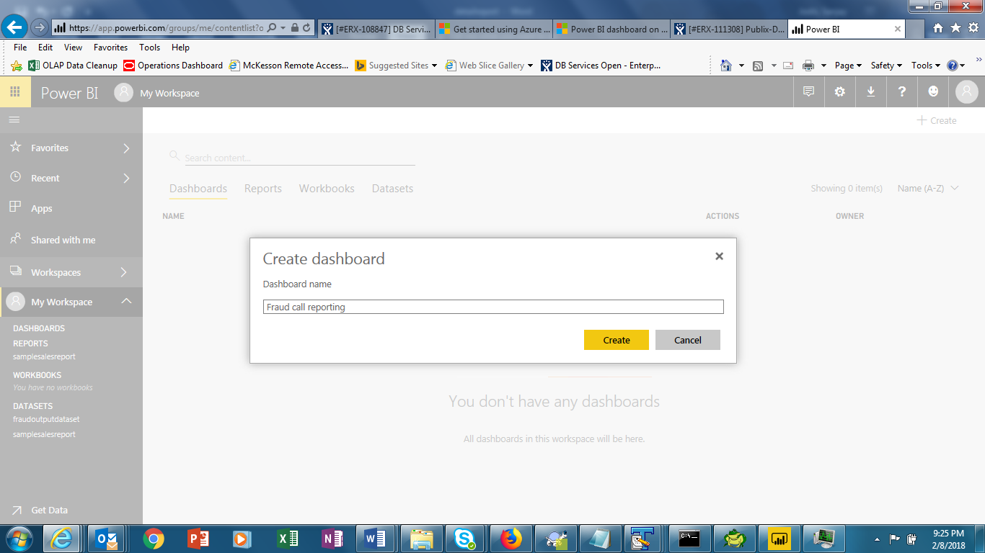
Set dashboard in POWERBI Portal
Login to powerbi portal and under My workplace click on create and select dashboard

Slide 20
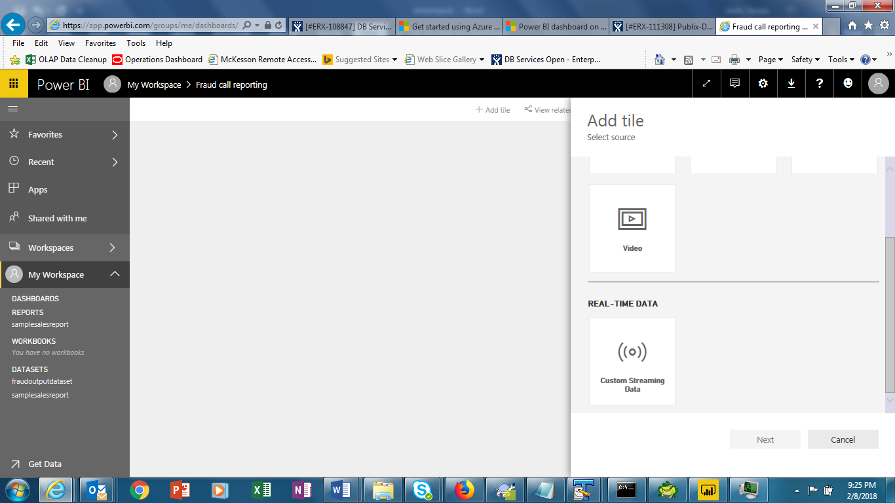
Set dashboard in POWERBI Portal
And click on add tile on next page and choose real time data ( custom streaming data)

Slide 21
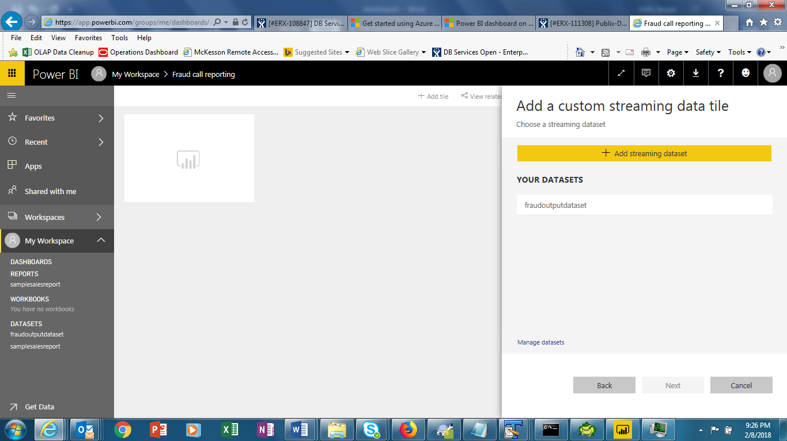
Set dashboard in POWERBI Portal
In next screen select your data set

Slide 22
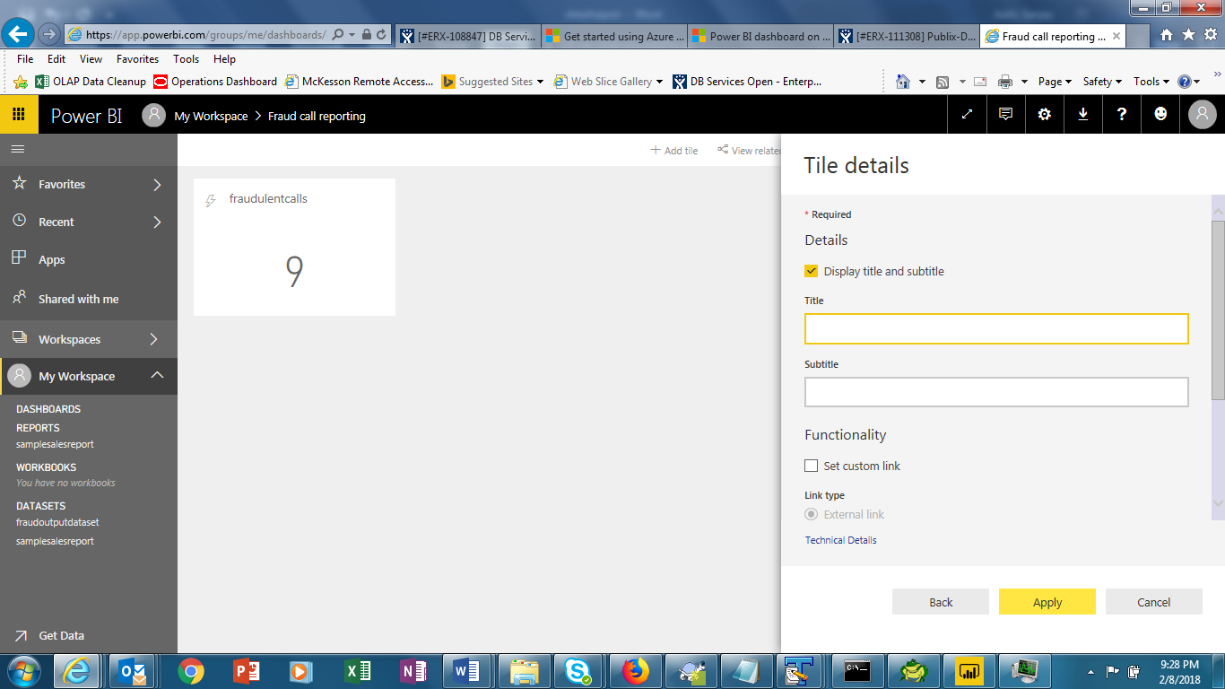
Set dashboard in POWERBI Portal
And click on the value field and select the fraudulentcalls
Provide tittles and subtitles in next screen

Slide 23
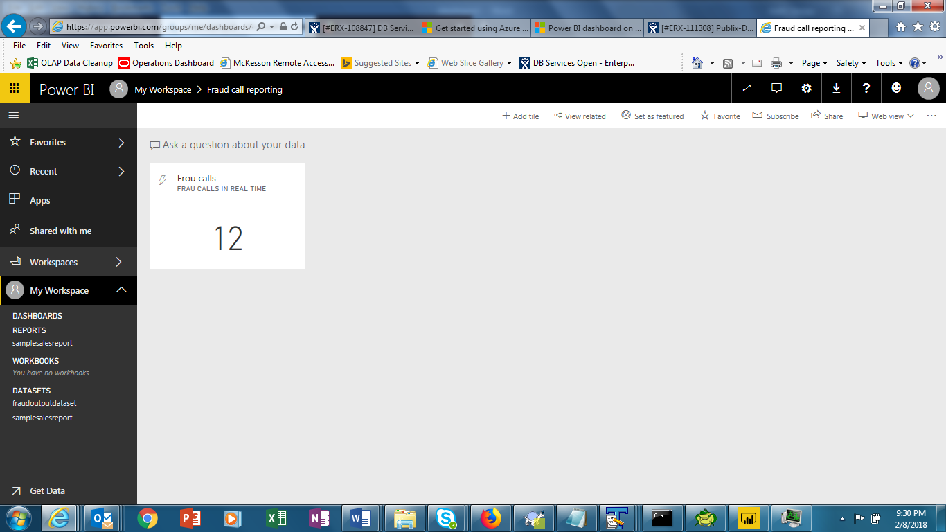
Set dashboard in POWERBI Portal
And hit apply
It will show the frauds call getting generated in real time in dashboard
Another screenshot immediately taken after 2 seconds

Slide 24
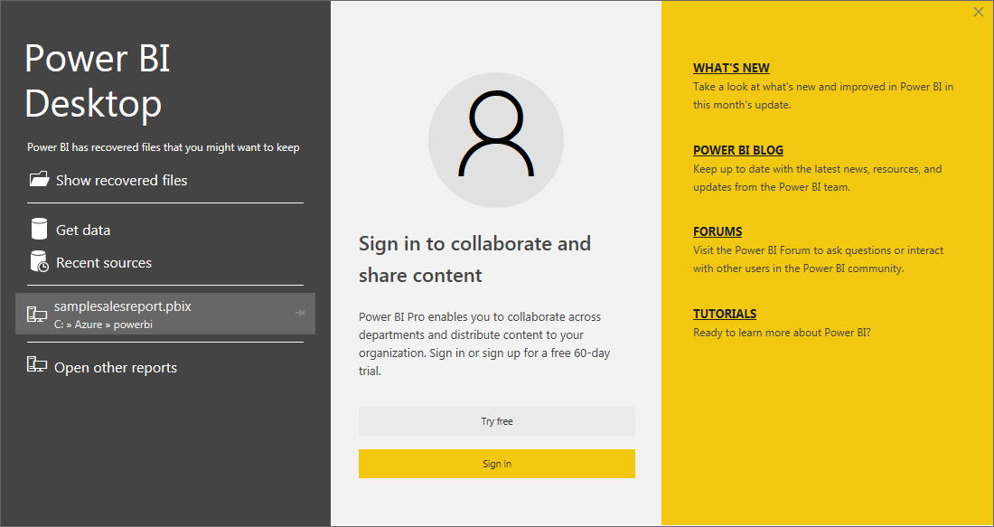
Demo2
Desktop Version with static data
Another use of powerBI to create beautiful and easy to access dashboard with drill down capability .
Download the powerbi desktop version from Microsoft and install it
Launch the powerbi deskop
Get the sample sales data from http://go.microsoft.com/fwlink/?LinkID=521962
Save it to local folder and CSV file .

Slide 25
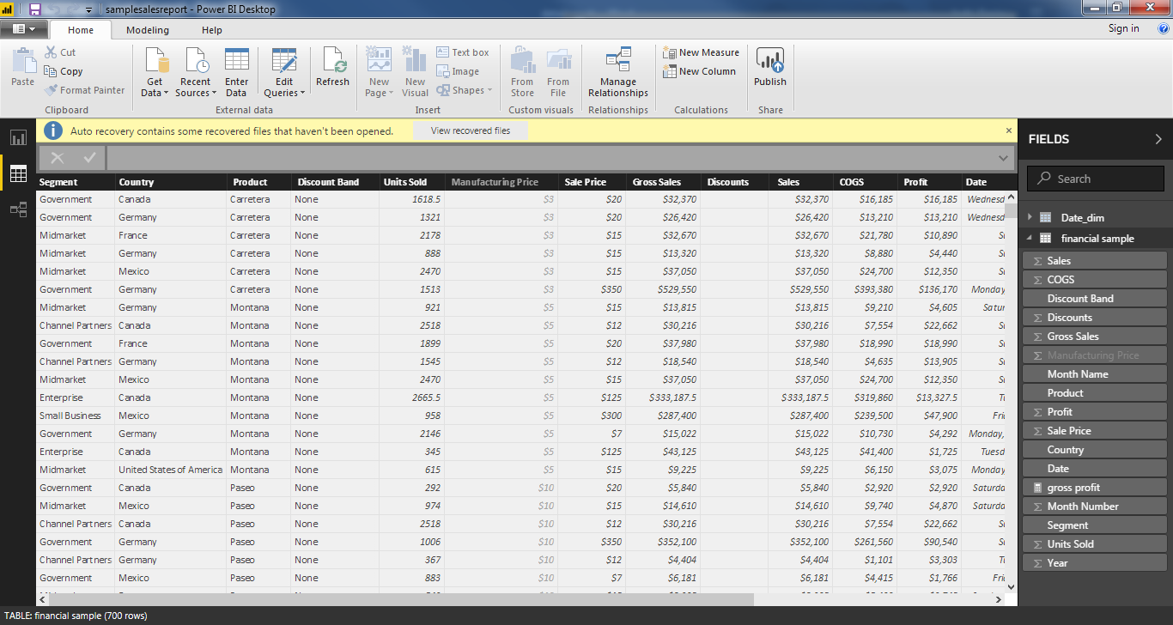
Demo2
Desktop Version with static data
Then click on the get data on powerBI desktop and select your downloaded csv file
The data will look like this. This is sales data is by product , by county .
To allow drill down analysis click on the modelling and select new table to create a new table and paste the following code in expression window
Date_dim = ADDCOLUMNS ( CALENDAR (DATE(2000,1,1), DATE(2025,12,31)), "DateAsInteger", FORMAT ( [Date], "YYYYMMDD" ), "Year", YEAR ( [Date] ), "MonthNo", FORMAT ( [Date], "MM" ), "YearMonthNo", FORMAT ( [Date], "YYYY/MM" ), "YearMonth", FORMAT ( [Date], "YYYY/mmm" ), "MonthShort", FORMAT ( [Date], "mmm" ), "MonthLong", FORMAT ( [Date], "mmmm" ), "WeekNo", WEEKDAY ( [Date] ), "WeekDay", FORMAT ( [Date], "dddd" ), "WeekDayShort", FORMAT ( [Date], "dddd" ), "Quarter", "Q" & FORMAT ( [Date], "Q" ), "YearQuarter", FORMAT ( [Date], "YYYY" ) & "/Q" & FORMAT ( [Date], "Q" ))

Slide 26
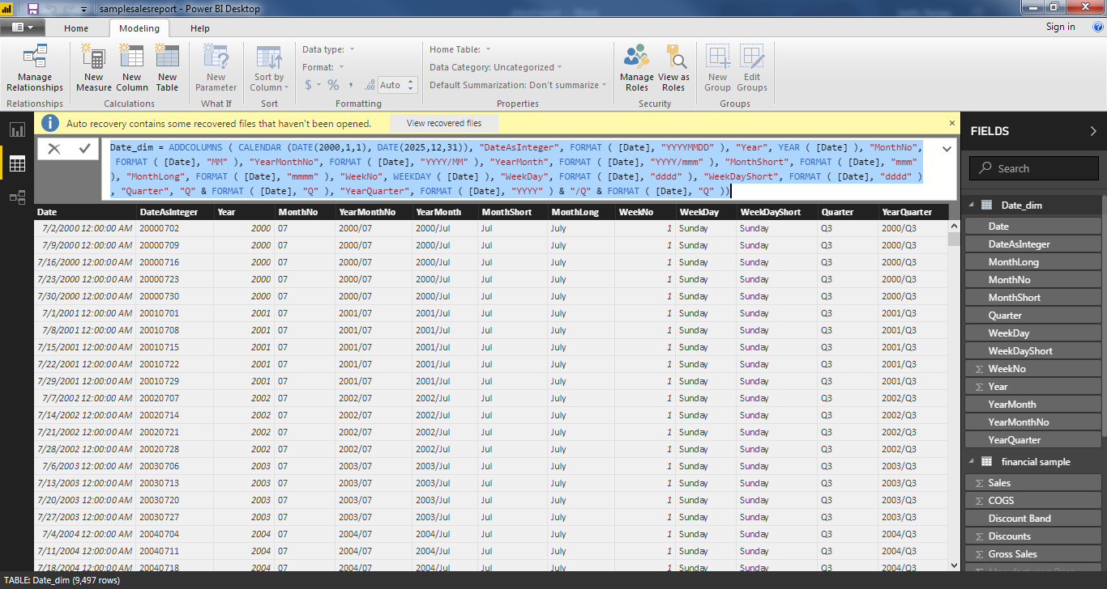
Demo2
Desktop Version with static data
It will create a date_dim table

Slide 27
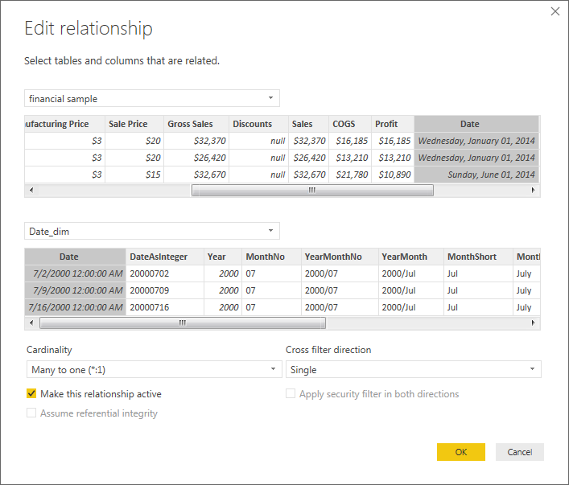
Demo2
Desktop Version with static data
We need to create a relationship between date_dim and sales table .Click on the manage relationship and click new to create relationship and select the date column from sales sample table to date_dim table and choose many to 1 ( many records from sales table mapped to one record in date dim)

Slide 28
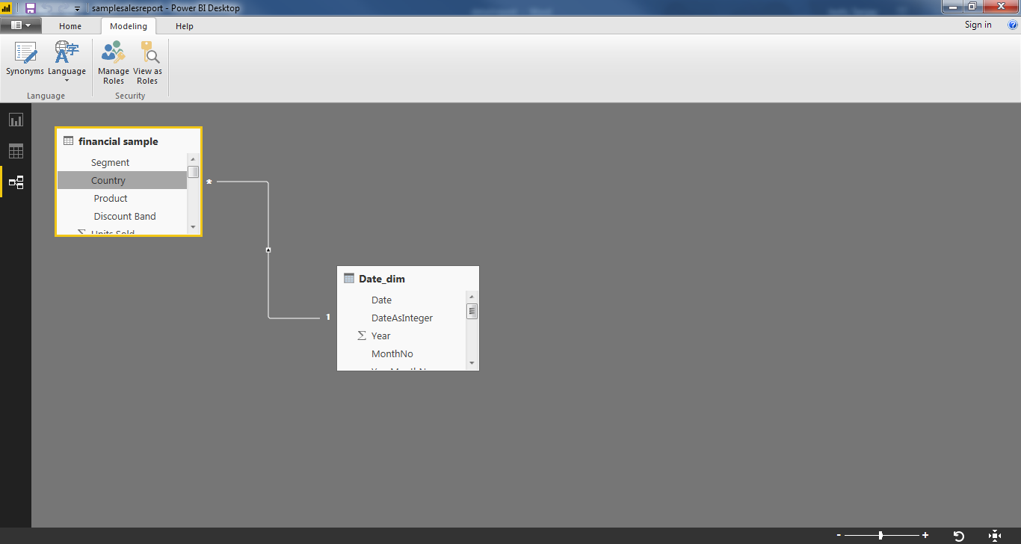
Demo2
Desktop Version with static data
Now click on the graph icon and we have many options to create different graph under visualization , select map graph since we have data available for different country . On location put country and under size put sales.
Then choose funnel graph and under group select product and under vale select profit .
Similarly you can add other graphs in your dashboard by selecting different values.
Final choose the slicer to slice and dice the data and choose yearquarter from date_dim.
You graph will finally look like this .

Slide 29
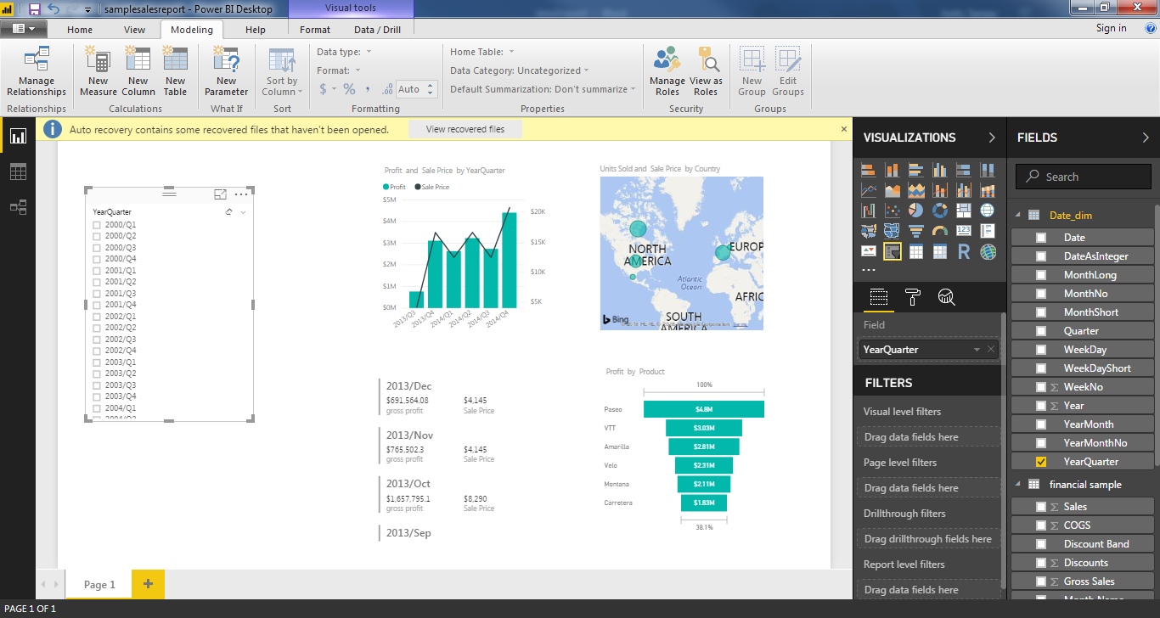
Demo2
Desktop Version with static data

Slide 30
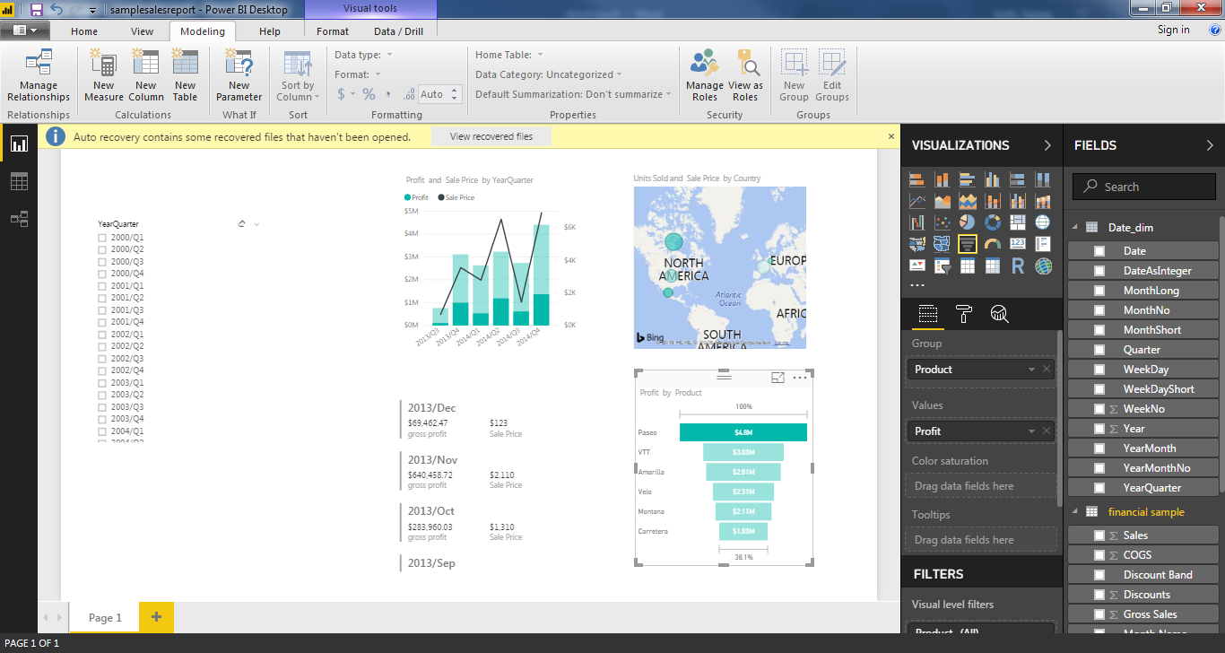
Demo2
Desktop Version with static data
All the graph are interconnected means if you click on one particular value on any graph other graphs will change that value . for example on funnel bar I clicked on topmost product ( paeso) and other graph changed

Slide 31
YouTube URLs, GitHub URL, Last Page
Two minute (https://youtu.be/LD0UTGJpCoQ):
15 minutes (lhttps://youtu.be/9eayxqI06UA):
GitHub Repository with all artifacts: https://github.com/sjoshi71/project

