Slide 1
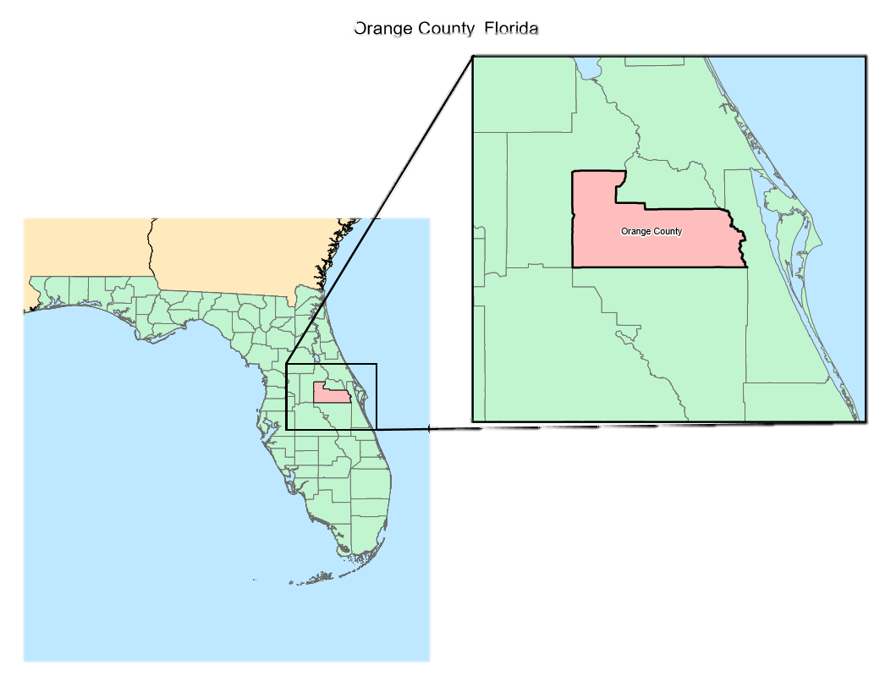
Sabinaya Joshi
Racial Population Distribution and Income Level in Orange County, Florida

Slide 2
research question
Where are the three majority of the race groups (White, African American and Asian residents) located?
What are their income levels in those areas ?

Slide 3
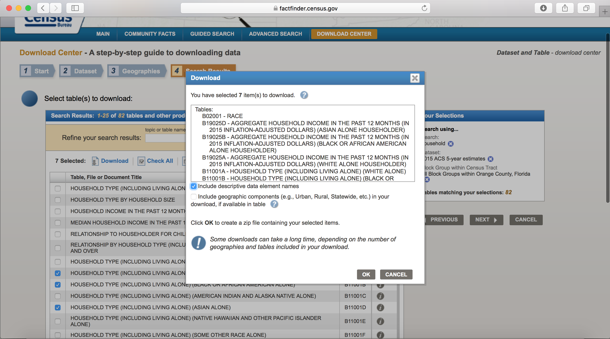
Data

Slide 4
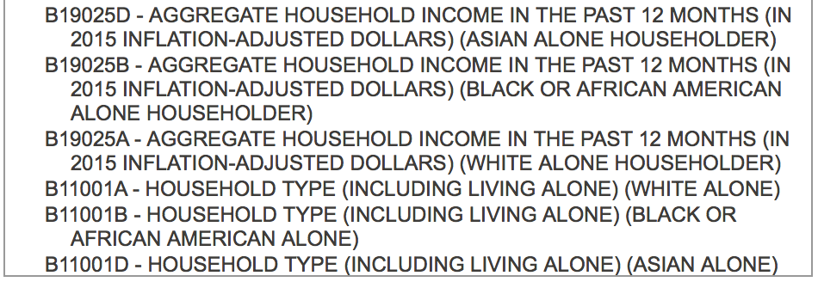
Data

Slide 5
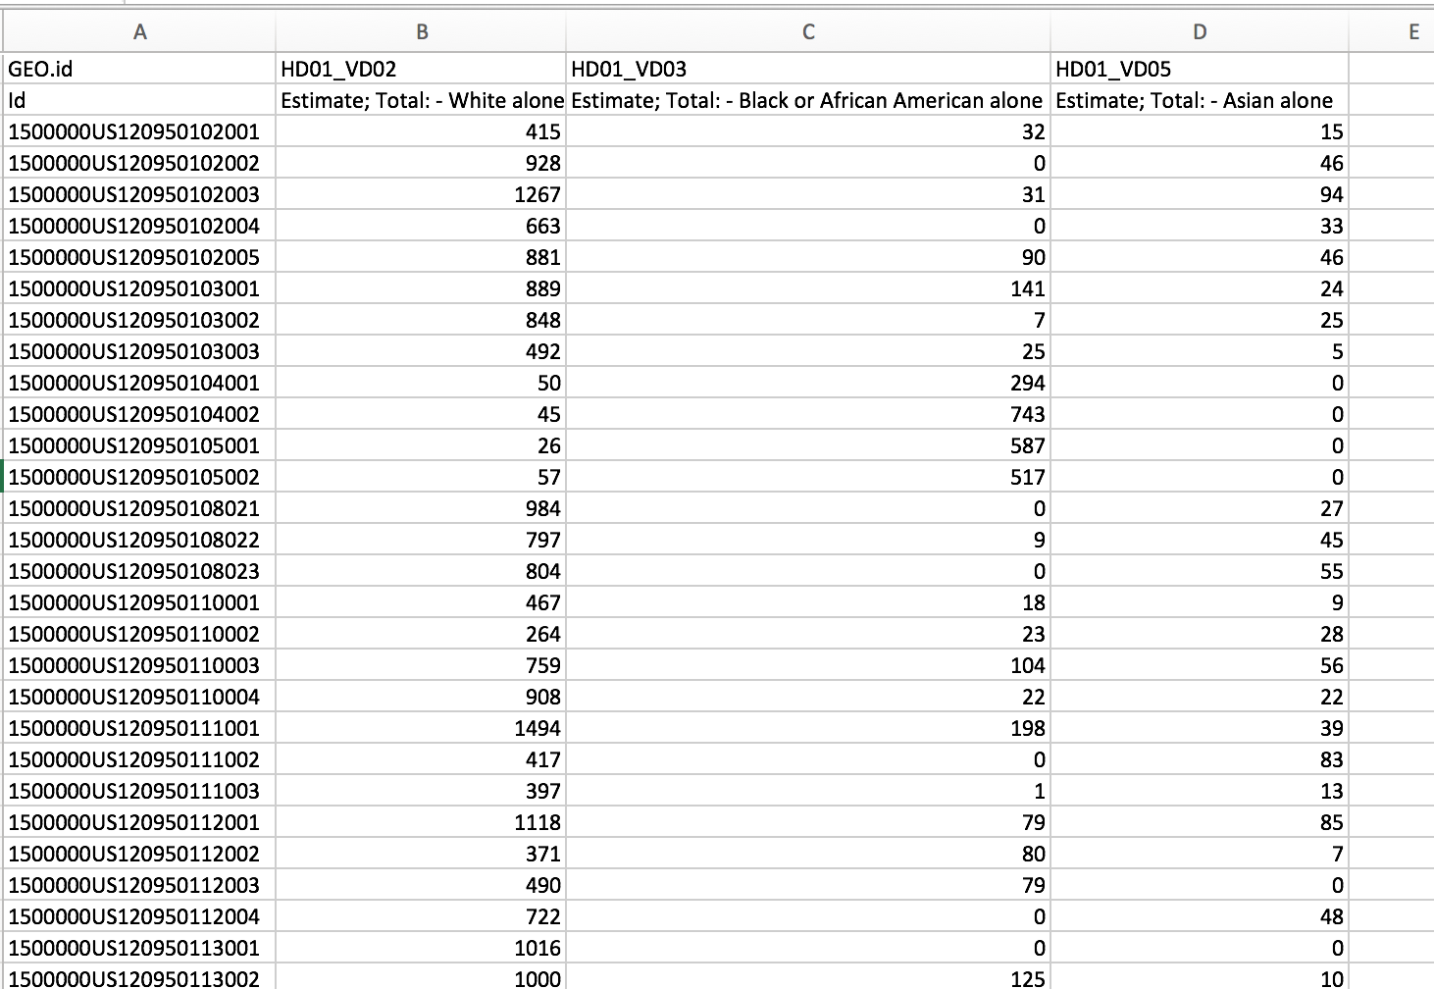
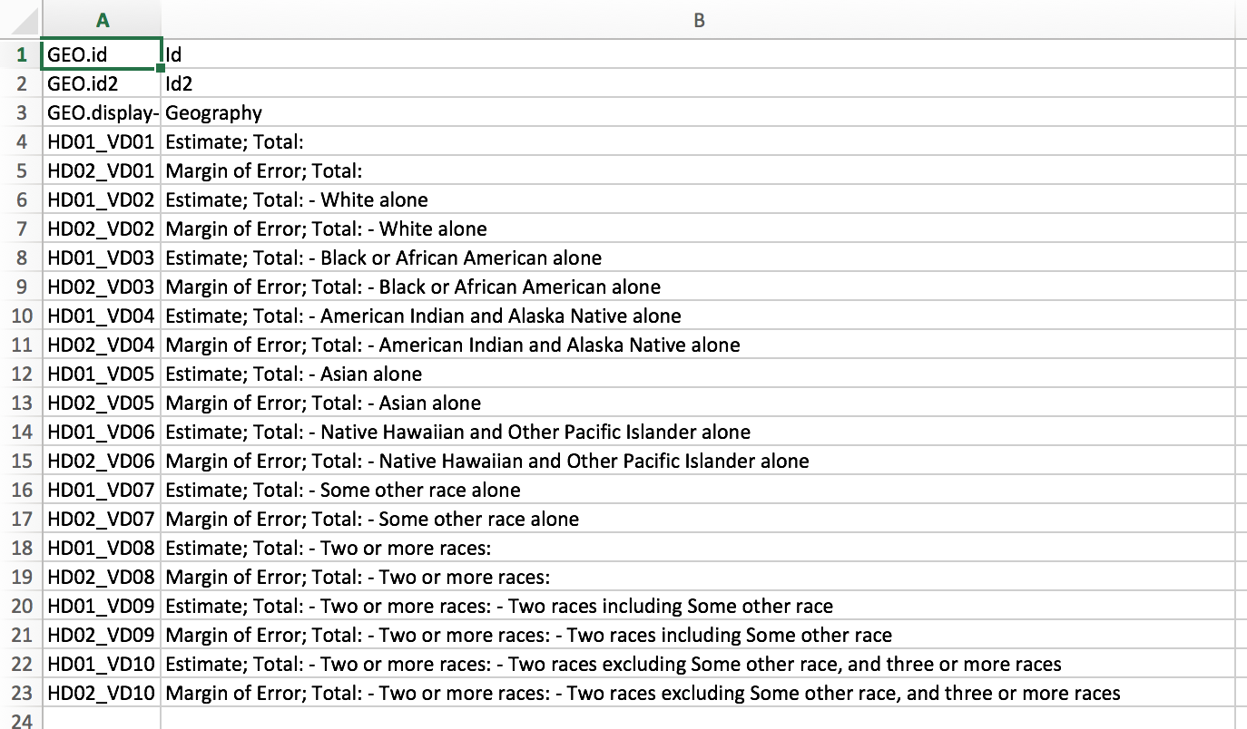
Metadata

Slide 6
SHAPEFILES
Block Groups : 600 to 3,000 people
Smallest area for a sample data
TIGER/line
Counties
Roads
Lakes
UTM 17N

Slide 7
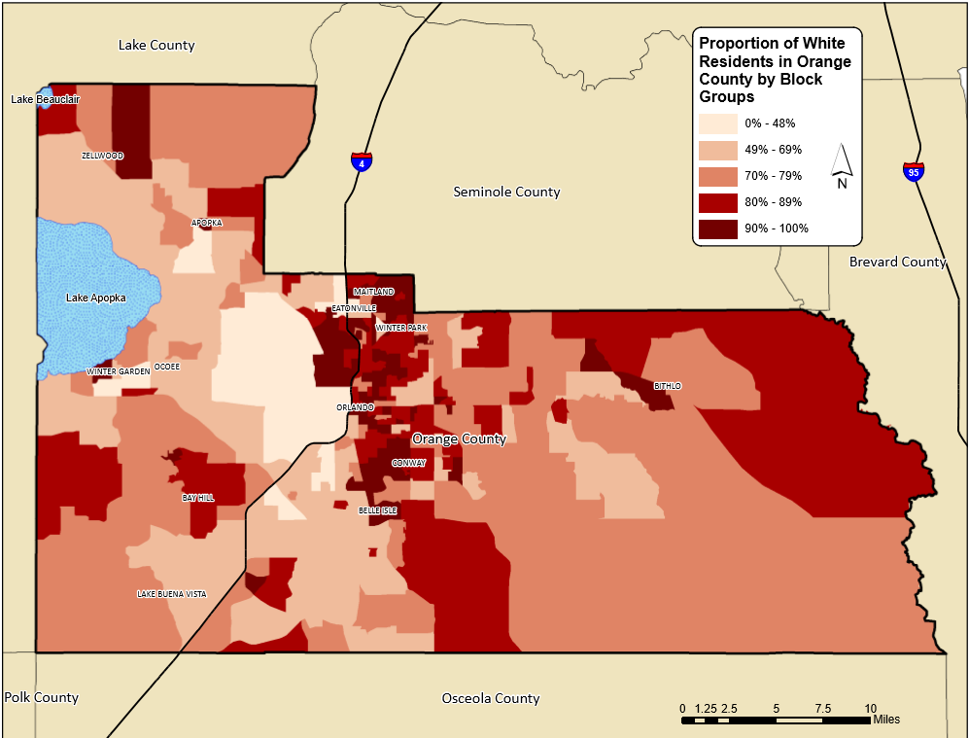
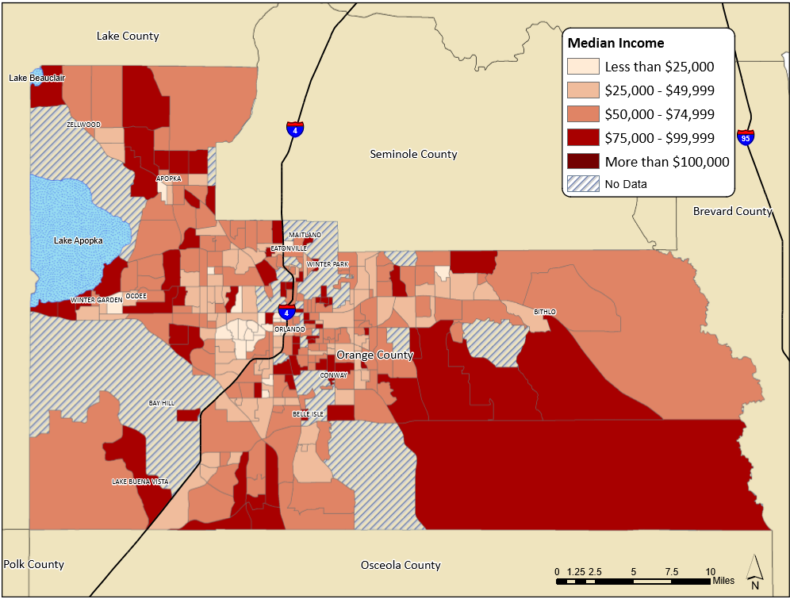
Proportion of White Residents in Orange County, Florida
Median Income Among White Residents in Orange County, Florida
Source : 2015 American Community Survey 5-year data

Slide 8
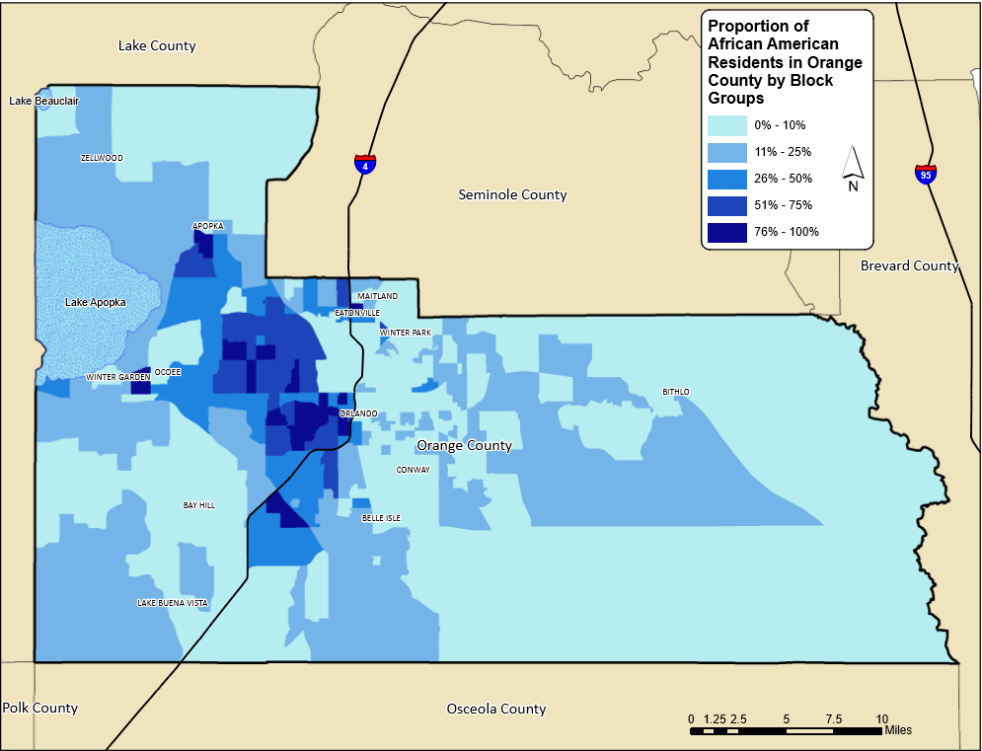
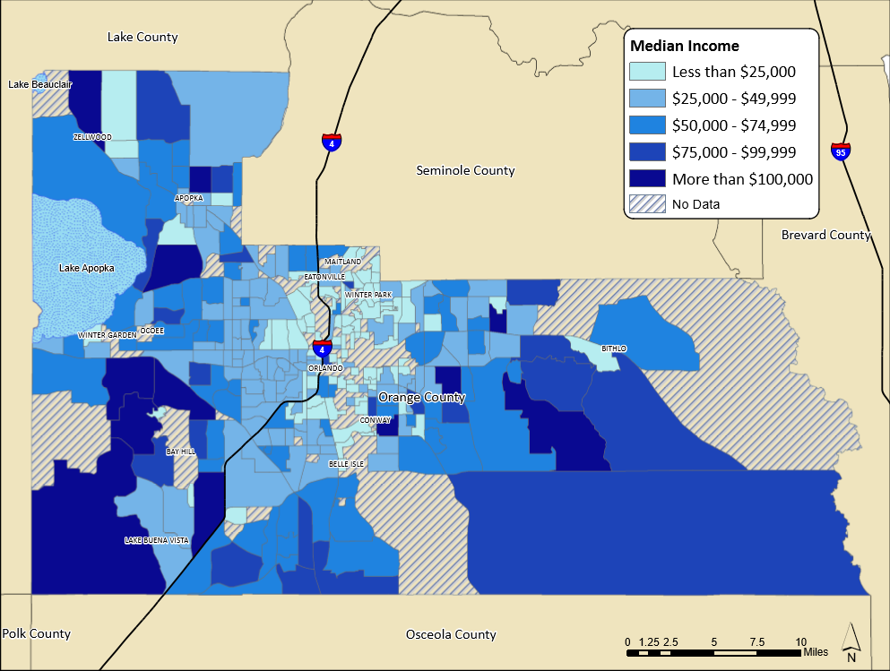
Median Income Among African American Residents in Orange County, Florida
Proportion of African American Residents in Orange County, Florida
Source : 5-year American Community Survey 2015 data

Slide 9
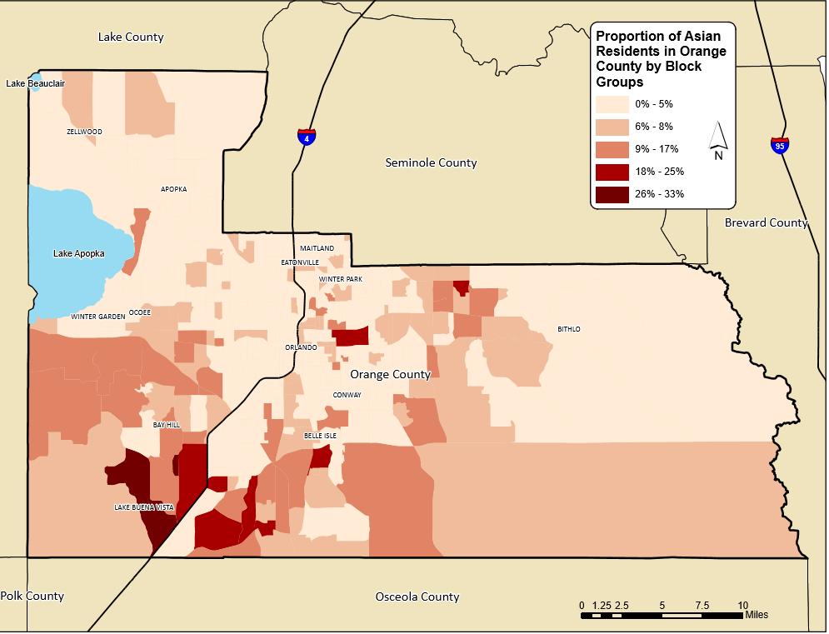
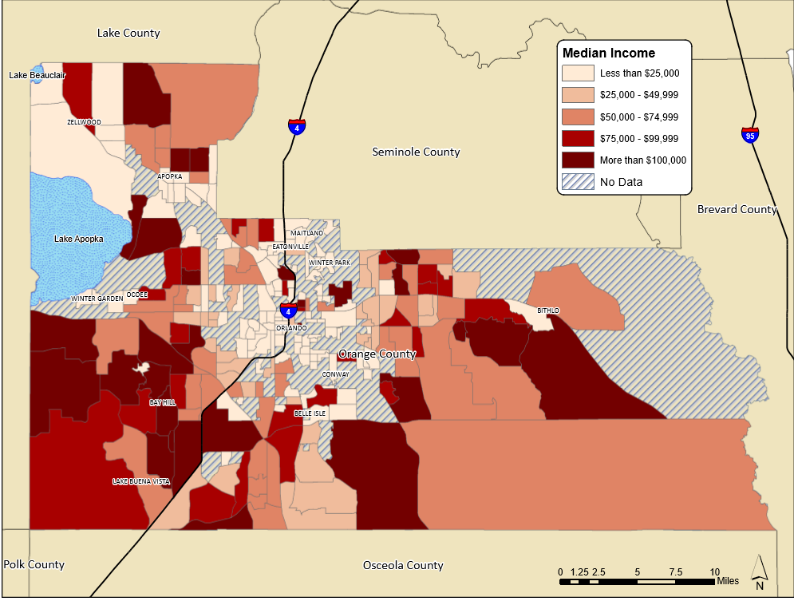
Proportion of Asian Residents in Orange County, Florida
Median Income Among Asian Residents in Orange County, Florida
Source : 5-year American Community Survey 2015 data

