Slide 1



Mental Model Updating
&
Pupil Response
Sungjoon Park & Britt Anderson
Park & Anderson, 3268

Slide 2

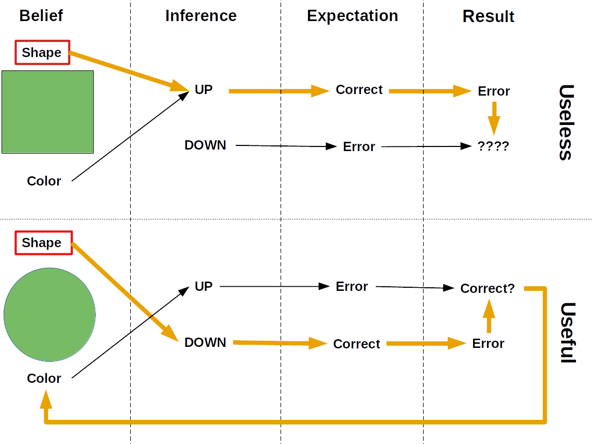
New
Model
Old
Model
Learning
Rate
Prediction
Error
Should B_{t+1} ≠ B_{t} ?
How does the epistemic value of the surprise influence model change?
Reliability
Does the reliability of the feedback affects the degree of model change?
Park & Anderson, 3268

Slide 3
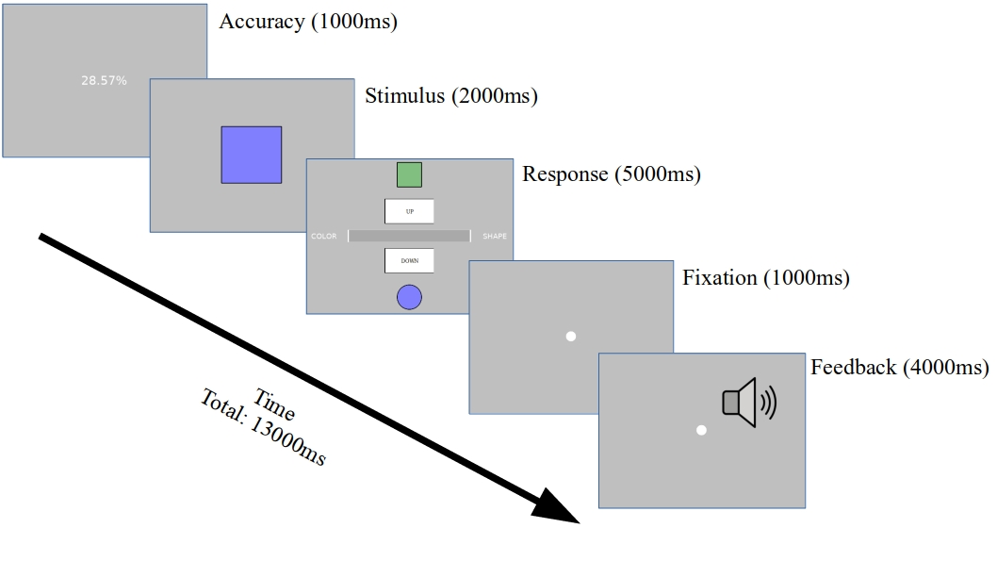
N = 8 (1 Male)
Trials = 576
3 Sessions
3 X 2
Within Participant
Design
3 Surprise Types:
- Correct
- Useless
- Useful
2 Reliability:
- Low: 75%
- High: 90%
- ½ Chance to switch every 2 blocks
Low
High
Low
Inspired by Schwartenbeck, et al. (2016)
Park & Anderson, 3268

Slide 4


LMER Model & Analysis
Peak Pupil Dilation ~ Surprise * Reliability + (Surprise * Reliability | Participant : Session)
ICC | R²m | R²c
0.182 | 0.013 | 0.198
Belief Change ~ Surprise * Reliability + (Surprise * Reliability | Participant : Session)
ICC | R²m | R²c
0.145 | 0.099 | 0.336
Park & Anderson, 3268

Slide 5
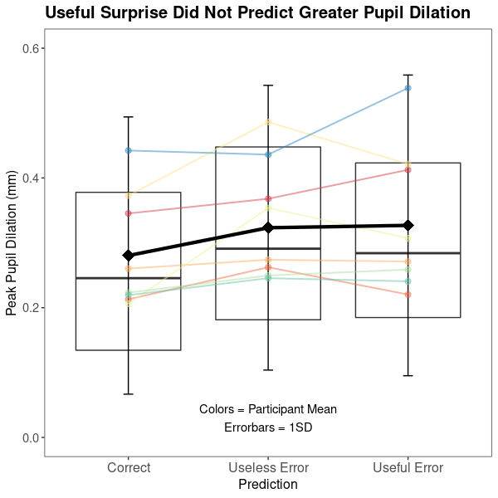
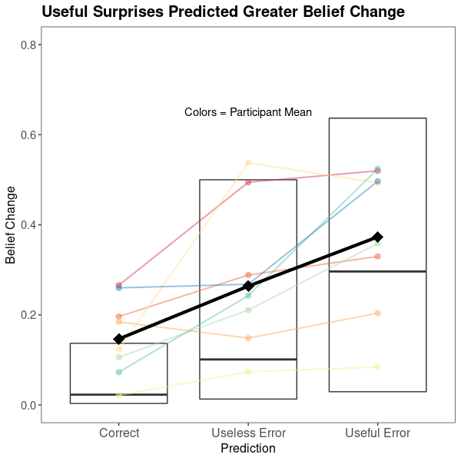
p = 0.005
p < 0.001
p = 0.003
p = 1.0
p = 0.015
p = 0.002
Phasic Pupil Dilation Is Not Sensitive To The Utility of Prediction Errors
Park & Anderson, 3268

Slide 6
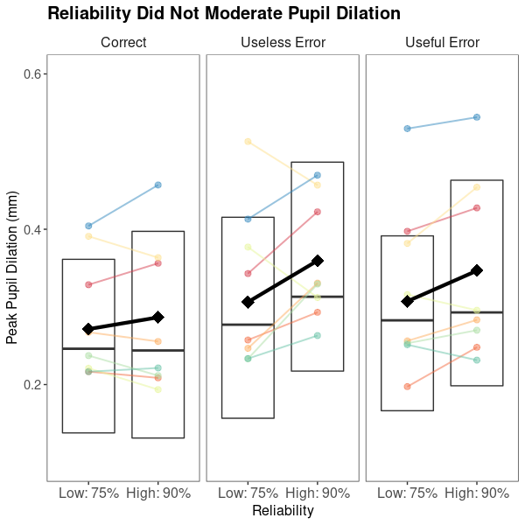
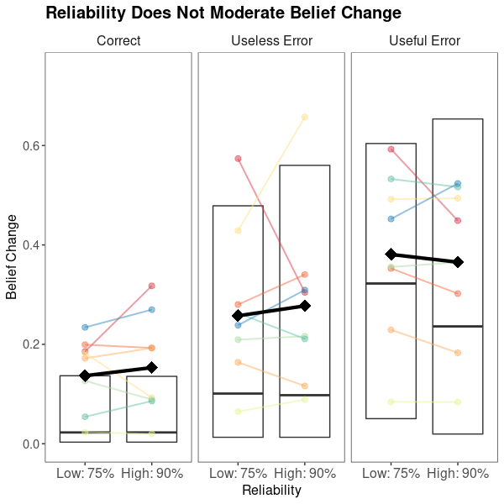
p = 0.529
p = 0.374
p = 0.216
p = 0.343
p = 0.655
p = 0.534
Regardless of the reliability of feedback, degree of pupil dilation or belief change did not differ
Park & Anderson, 3268

