Slide 1
Multi Level CATIA
V6R2009x

Slide 2











Supply Chain with different Levels
OEM on Level Rx
OEM on Level Rx
OEM
OEM
Design in V6
Design in V6
Supplier on Level Rx+1
Supplier on Level Rx-1
Partner 2
Partner 1
Migrate Level Rx to Level Rx+1
OEM
V6

Slide 3
Multi Level Access Solutions
Remote Access V6 / V6
Data Exchange V6 / V6

Slide 4
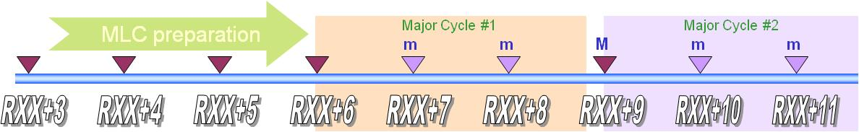



1. Remote Access: Multi Releases Support
Provides Critical Flexibility to Implement and Adapt V6
to Customers Evolving Needs and Environment
DS Fundamentals for CATIA/ENOVIA Compatibility
  ENOVIA will support only CATIA release equal or upper level
    ENOVIA release N support CATIA release N, N+1, N+2, etc
  CATIA release from lower level are not supported as it leads to
  unacceptable constraints for application evolutions (see next slide)
  These rules are only valid in a same Major Release Cycle, between
  Minor V6 Releases (DS R&D will precise which releases are ‘Major’ vs.
  ‘Minor’)

Slide 5










1. Remote Access: Multi Releases Support
Candidate V6R2010x
Provides Critical Flexibility to Implement and Adapt V6
to Customers Evolving Needs and Environment
Major cycle n
Major cycle n+1
Major
release
mlc
release
mlc
release
Major
release
V6Rx
V6Rx+n
V6Rx+p
V6Rx+p+1
…
V6Rx
V6Rx+n
V6Rx+p
V6Rx+p+1
Upgrade
Upgrade
Migrate
A major cycle is common to all
(infrastructure, modelers, applications)
Possible connection
Notes:
Qqs reformatages, 2 ou 3 clarifications

Slide 6
1. Remote Access: Multi Releases Support
Provides Critical Flexibility to Implement and Adapt V6
to Customers Evolving Needs and Environment
ENOVIA Database Upgrade
  Strategy is to upgrade clients first
  When client have all been upgraded on a given level (or upper),
  server can be upgraded
  No -or very limited- influence to user’s day-to-day business
    Upgrade of Client can be done one by one ; other Clients are unaffected
    Server upgrade for a MLC release can be handled within 24 hours downtime

Slide 7
1. Remote Access: Multi Releases Support
Candidate V6R2010x
Provides Critical Flexibility to Implement and Adapt V6
to Customers Evolving Needs and Environment
Major cycle
CLIENT/SERVER SYNCHRONIZED BUT SOME DATA HAS BEEN CREATED IN Rx+2
All the Rx functionalities are fully accessible
Rx user can read data created in Rx+p but a check is done during open and maybe some data will be declared unreadable:
  If data does not contains new features, specifications are also readable and the part is fully editable in Rx
  If data contains new features: the part is visible and its geometry can be referenced in Rx but specifications are not readable
Major
release
mlc
release
mlc
release
Major
release
V6Rx
V6Rx+n
V6Rx+p
V6Rx+p+1
…
CLIENT IN ADVANCE
Functionalities existing in Rx: no change: they can be used as usual
New Rx+p functionalities:
  If they do not require new metadata unknown in Rx: these commands can be used
  If they require new metadata unknown in Rx, these data cannot be saved: these commands should be grayed (no impact for end user)
V6Rx
V6Rx+n
V6Rx+p
V6Rx+p+1
Upgrade
Upgrade
Migrate
A major cycle is common to all
(infrastructure, modelers, applications)
Possible connection
Notes:
Qqs reformatages, 2 ou 3 clarifications

Slide 8
Multi Level Access Solutions
Remote Access V6 / V6
Data Exchange V6 / V6

Slide 9


2. Data Exchange V6 / V6: Support Customized Data Model
Based on 3DXML strategic DS exchange standard
  3DXML for review
    Dedicated to Digital Mock-up review
    Review available through 3DXML player or 3DLive products
  3DXML with authoring
    dedicated to data exchange between multiple enterprises or multiple geographical sites of the same enterprise.
    Same technology used for On demand or Automated Exchanges
    Allows smooth transition from one mode to another
3DXML for review
3DXML with authoring
Data description with light representations
Data description with light representations
PLM Briefcase containing metadata and geometry

Slide 10
2. Data Exchange V6 / V6: Support Customized Data Model
Enables to Accommodate Data Exchanges
Between Various V6 Implementations with Different Customizations
3DXML with Authoring files are composed of two parts:
  Core data (CD):
  This is the core description of the object, that can be shared with all other enterprises.
  Extended Enterprise (EE):
  Additional enterprise-specific information needed to integrate the object into enterprise processes.
3DXML with authoring
3DXML with Authoring
Lifecycle (ex: maturity)
P&O attributes (ex: user/project/org)
All Custom attributes
Data description with light representations
EE:
Enterprise-specific data
CD:
Core data
shared with other
enterprises
Naming attributes (PLMExternalID, V_Name)
All modeler attributes
All relation design
All streams (Representation)
PLM Briefcase containing metadata and geometry

Slide 11
2. Data Exchange V6 / V6: Multi Releases Support
Provides Critical Flexibility to Implement and Adapt V6
to Customers Evolving Needs and Environment
Exchange of data between different ENOVIA servers
  Upward exchange is supported up to 2 releases up
    Upward exchange will be supported over major release cycles
  Downward exchange is supported with rules
    Major release cycles: Minimum content supported in downward exchange
      Product Structure
      Exact Geometry without specification access
    Minor release cycles: rules will be applied according to available content in release N-1
      Transfer ownership is rejected by default
      In case of release up, transfer ownership can be forced UI wise
      In case of release down, transfer ownership can be forced UI wise with following risks:
        Definitive loss of missing information in target release (possible risk)
        Possible consistency loss between different copies of this object at various partners’ sites
        only a detach + re-import can solve
      In such a case where object has lost information, any site ownership transfer is rejected

Slide 12

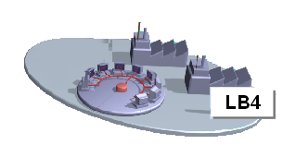
2. Data Exchange V6 / V6: Multi Releases Support
OEM should encourage their suppliers
to use a V6 Release within the same Major Release Cycle as theirs
Rx-2
This not supported as of today.
Previous major cycle
Supplier
Same major release cycle
Unknown metadata attribute in lower release level are ignored ; such objects are tagged => restrictions on transfer ownership.
Rx-1
Supplier
Stream compatibility rules at runtime will detect and process any unknown feature situation ; Stream is not editable in this case.
OEM
Rx
CD
Supplier
OEM Rx
Rx+1
During import, new metadata attributes in upper release level are filled with default values.
Supplier
3DXML/Briefcase coming from the next major cycle is not supported.
Unknown metadata attribute in lower release level are ignored ; such objects are tagged => restrictions on transfer ownership.
Stream compatibility rules at runtime will detect and process any unknown feature situation ; Stream is not editable in this case.
During import, new metadata attributes in upper release level are filled with default values.
If 3DXML / Briefcase comes from a previous Major cycle, conversion tool needs to be run prior to Import. Limitations expected.
Rx+2
Conversion tool needs to be run prior to Import. Limitations expected.
Plan to be confirmed
Supplier
Next major cycle

Slide 13
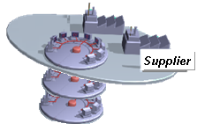
2. Data Exchange V6 / V6: Multi Releases Support
Suppliers can communicate with OEMs within the same Major Release Cycle and use converters otherwise
Upward and Downward conversion for Rx-2 and Rx+2
Rx-2
Previous major cycle
OEM
Same major release cycle
Rx-1
OEM
Rx
OEM
Supplier should have a server for Rx-1 or Rx or Rx+1
Rx+1
OEM
Upward and Downward conversion for Rx-2 and Rx+2
Rx+2
OEM
Next major cycle

Slide 14

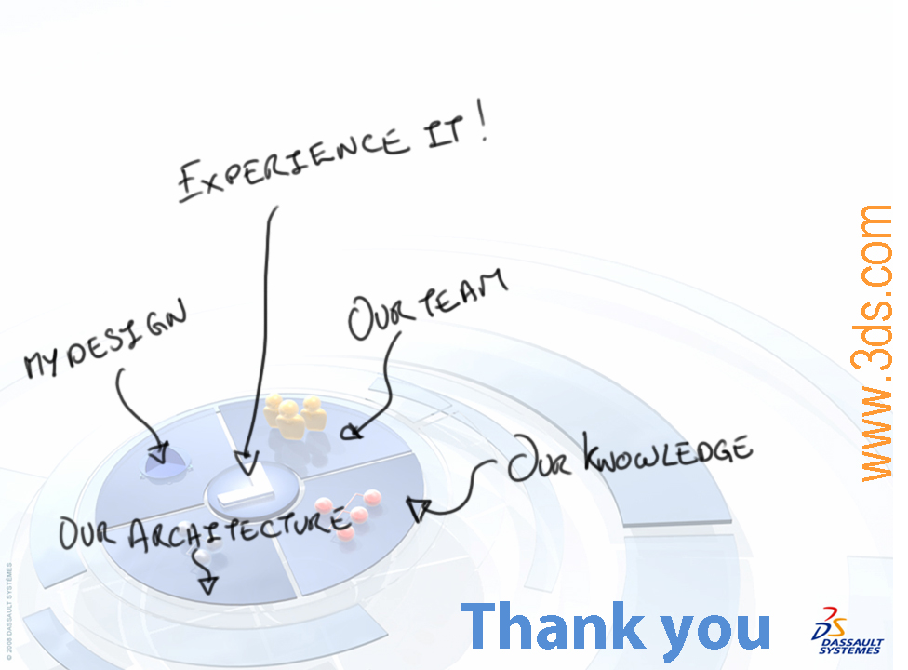
Notes:
[The signature should start automatically]

