Slide 1
Building a JetBot with L298N

Slide 2
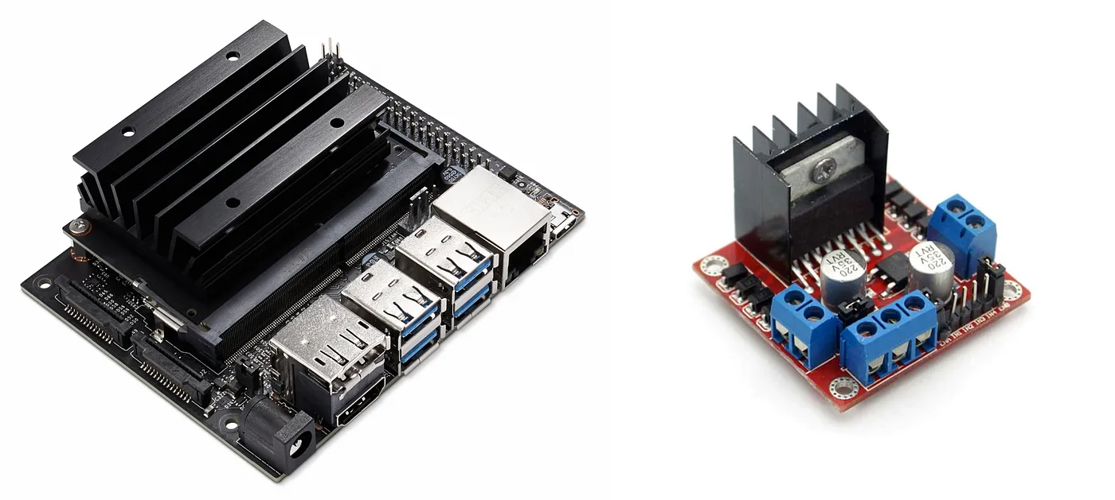
Hardware Connection
Jetson Nano L298N motor driver

Slide 3
Along with the previous mentioned hardware , the following are to be done :
Setting the wifi module:
Open the upper part of the jetson nano
Attach the wires from the antenas to the wifi module and place it inside the jetson
Finally assemble them together

Slide 4
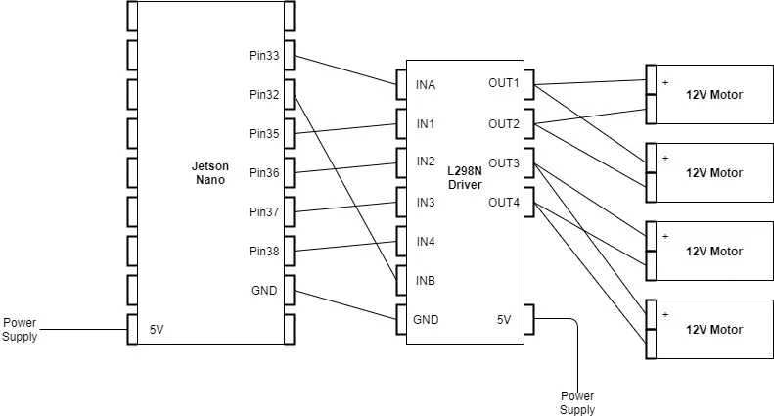
Hardware connection between Jetson Nano and L298N Motor Driver

Slide 5
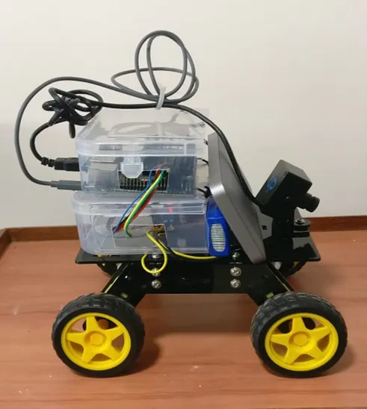
Add a camera to the Jetson module for this JetBot. So, the finally the whole hardware setup will be looking like this:
Hardware Setup of the JetBot Project

Slide 6
https://github.com/NVIDIA-AI-IOT/jetbot/tree/master/notebooks/basic_motion
The above link contain the code for the basic motion of the jetbot.

