Slide 1
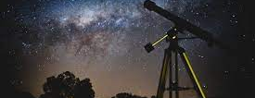
THE HISTORY OF ASTRONOMY

Slide 2
The beginning
Who are we?
Where did we came from and where are we going?
How and why was the Universe born?

Slide 3
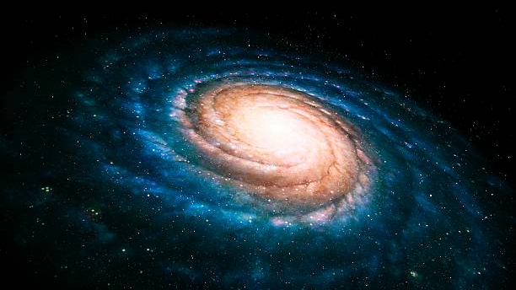
WHAt actually is astronomy?
Astronomy is a branch of natural science that studies about the outer space.
Is the study of celestial beings.

Slide 4
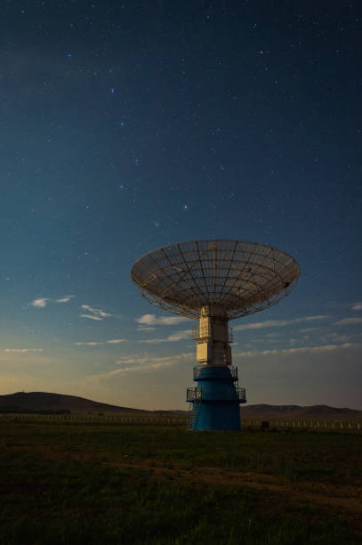
Classifications
Modern astronomers falls into two fields
1. Theoretical astronomy 2. Observational astronomy

Slide 5
Classification of astronomy.
Planetary astronomy
Solar astronomy
Steller astronomy
Galactic astronomy
Extra-galactic astronomy

Slide 6
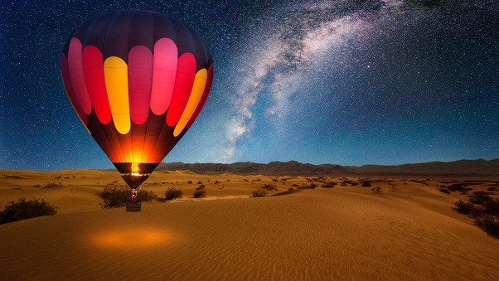
Astronomers in ancient times.
The Egyptians (2002 BC)
The Chinese (2000 BC)
Mesopotamia (1683 BC)
The Babylonians (1200 BC)
The Greeks

Slide 7
Astronomers in history
276 BC
Eratosthenes
169BC
Hipparchus
168 AD
Ptolomy
384 BC
Aristotle

Slide 8
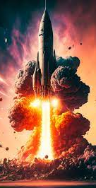
People that contributed to astronomy.
Copernicus (1543 A.D.)
Tycho and Johannes Kepler
Galileo Galilei (1609 A.D.)
Isaac Newton (1642 A.D.)

Slide 9
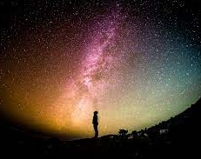
Modern astronomy.
Edwin Hubble (1923)
The launch of different satellites, invention of high quality telescopes has increased our understanding of our outer space.

Slide 10
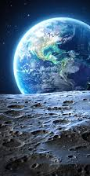
Thank you!

