Slide 1
Default Clustering Risk Premium and its cross-market asset pricing implications
Discussion by Sungjune Pyun
Yonsei University School of Business

Slide 2
Summary of the paper
This paper studies “Default clustering risk premium”
This paper provides a novel way of estimating the risk premium
-- This paper uses CDX and single-name CDS to derive the default clustering risk premium
The DCRP seems to be priced among individual stocks.

Slide 3
Overall impression
The findings of this paper seems reasonable:
Investors worry about default clustering, particularly after the 2008 Global Financial Crisis
That this is a “priced” factor seems natural.
Two comments
View on market segmentation?
➔ It seems this paper implicitly assumes that the two markets are integrated.
2. Model is written in a way so that it is difficult to digest

Slide 4
Segmentation between bond and stock markets
There is evidence that these two markets are integrated
Ma (2019 JF) – Nonfinancial firms act as arbitraguers and contribute to market integration
Sandulescu (2022 WP) – the two markets are non-trivially integrated
Yet, there is also evidence that they are disintegrated
Kapadia and Pu (2012 JFE) – Liquidity generates arbitrage
Chordia et al (2017 JFQA) – Different factors priced for stocks and bonds
Choi and Kim (2018 JME) – similar to the above
It seems this debate is yet inconclusive. It would be helpful to take a clear stance on whether this paper wants to:
1) involve in this debate
2) ignore if/if not the two markets segmented

Slide 5
The model
The model needs some work and is not written in a way that readers outside the field can digest:
Variables are often not clearly defined
Sometimes expressions are unnecessarily overly complicated

Slide 6
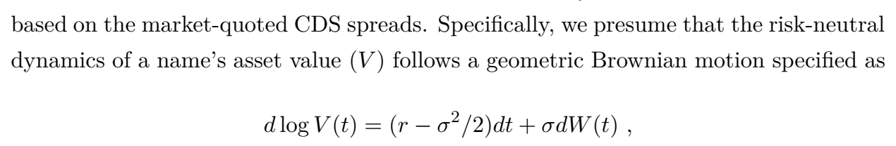
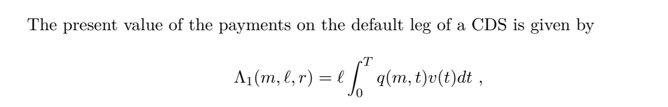
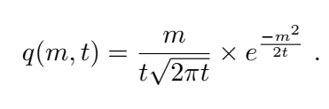
The Model
m is distance to default but is not clearly defined…

Slide 7
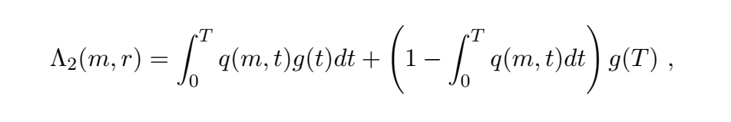
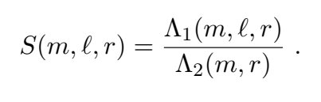

The Model
Credit spread is a univariate function of the distance to default (m).
Then why not begin with express S just as a function of m at the first place?
You are not doing any comparative statics (with respect to r and l).

Slide 8

The Model (1)
It looks like distance to default is standardized (has a unit variance)?

Slide 9
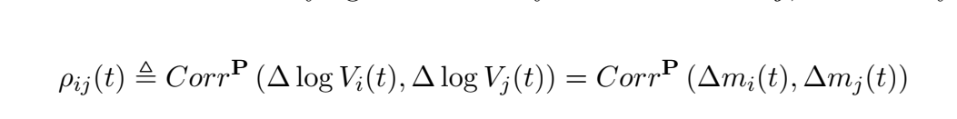
The P-measure
The p-measure correlation is: correlation in the firm value or correlation in the distance to default.
Also, it looks like all you need is the following:
Correlation of assets is time varying while volatility is constant.
DCC-GARCH (used in this paper) assumes heteroscedasticity.
The first equation is direct. The second equation requires one more step. Using CDS is one more step (3 steps!)
Why can’t you estimate this directly from high-frequency stock returns? Your first equation suggests that you can do that!

Slide 10
DCRP
DCRP = market quoted tranche spread – model-implied tranche spread (based on simulation)
Market quote is probably that of CDX
The model-implied spread is probably the p-measure computed from CDS
But From current writing,
(1) It is NOT AT CLEAR why this measures the default clustering risk premium
(2) It is NOT AT ALL Clear why you mentioned the model and the P measure
This seems to be explained in the next paragraph:

Slide 11
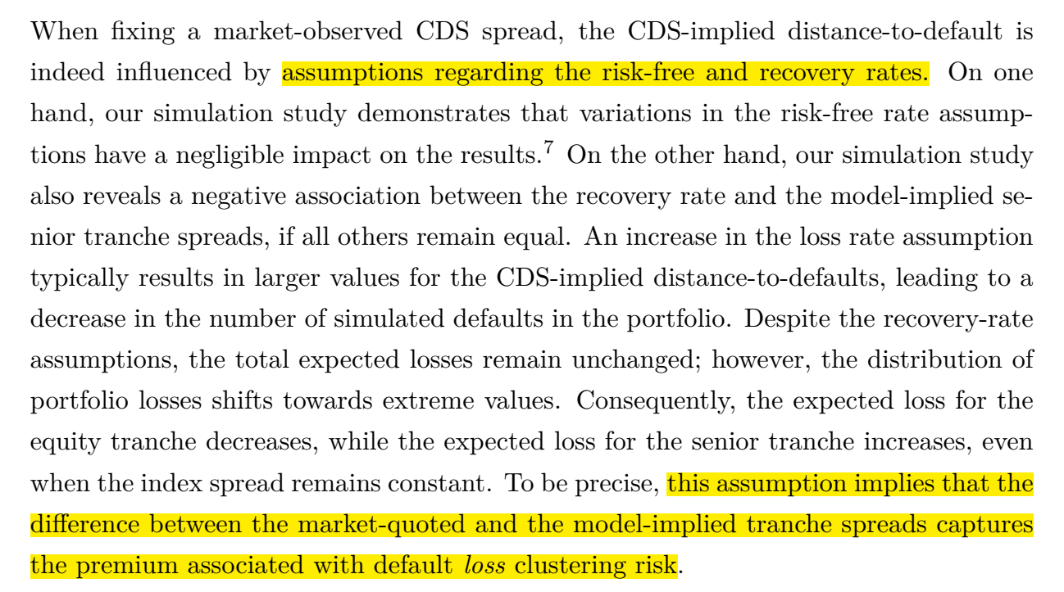
The model
I don’t understand how the last sentence implies what you state.

Slide 12
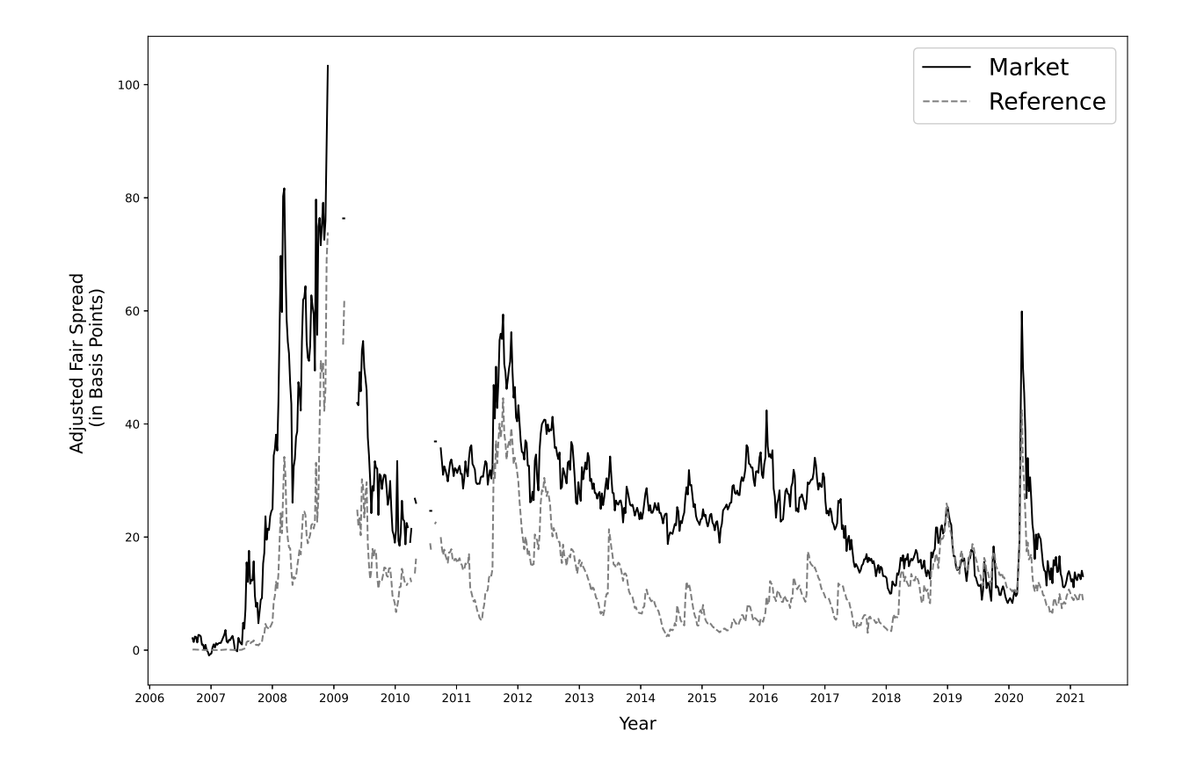
Measurement

Slide 13
Empirical analysis
It is not clear to me why the pricing of the default clustering risk premium is tested in the equity market.
It seems rather natural to test how bond investors price this type of risk, because, assuming market segmentation, you are deriving the premium from the bond market.
Furthermore, that correlation risk premium is priced in the market is already known.
Driessen, Menhout, Vilkov (2009 JF) in equity market
Mueller, Stathopolous, Vedolin (2017 JFE) in currency market
Bond market? – pricing of bond factors is now a fiasco after BBW.
➔ Why not focus on bond markets?

Slide 14
Empirical analysis
In the equity market, there are many other well-known results that should be highly correlated with DCRP.
Volatility risk (Ang, Hodrick, Xing, and Zheng 2006)
Left jump risk (Bollerslev Todorov 2011)
Downside VRP (Fenou et al 2017)
VRP in cross-section (Barguett, Gourier, Leippold 2019)
These measure all seems to increase during times of market turmoil
We also know default correlation will go up during this time.

