Slide 1

Course Structure
Allocations Overview
Master Data
MyRequest Templates
Cost Allocations
Statistical Key Figures
Reporting
Direct MCA
Reporting

Slide 2

Cost Center Allocations - Overview
Allocations are used today to transfer expenses between markets / factories / functions from a management accounting standpoint impacting OCC of the receiving market / factory / function
These allocations are often performed using manual journals which is inefficient
The impact on Free Cash Flow (FCF) by market should be considered for cross-market allocations
Why do we use allocations?
Allocation of costs is unknown
When the purchase requisition / purchase order is created, the allocation of costs between the markets / factories / functions / brands is not known
Allocation of costs is variable
The allocation of costs may change throughout the year, and it is not practical to try to achieve this in the purchase order
Allocation of costs is based on a separate calculation
The allocation of costs may be achieved through calculation of another key measure – for example market research across all brands is allocated using net revenue

Slide 3

Cost Center Allocation - Introduction
Cost Center Allocation Cycles
Ability to collect costs against a cost center and allocate these costs to multiple cost centers / WBS elements based on the rules defined in the cycle
The cycles are executed on a monthly basis by BSC as per the rules defined – eliminating the need to submit journals each month through the MyRequest system (note: GSC cycles are executed by GSC Finance)
Allocation cycle entries in S/4 HANA will generate FI postings and therefore are visible in FI reports. They can be performed in a specific ledger only (for example IFRS ledger only for management accounting allocations) if needed, or can impact all ledgers
For markets, BSC will create allocation cycles in SAP on receipt of a MyRequest template
The rules defined in the cycle can be:
A fixed amount or fixed % which is updated periodically
A Statistical Key Figure – a key of allocations populated in SAP such as headcount per cost center, square meters per cost center etc.
Based on split of costs between cost centers / profit centers / WBS elements in other accounts

Slide 4
Management Allocations Simplification
Corporate FP&A have issued a new communication on management accounting allocations.
From 1st April 2020, we will stop allocating shared costs across different Market / Factory / Leaf Origin / Function hosted within the same legal entity.
As part of Transformation, IT, Indirect Procurement, Treasury, Tax, Security and AIT functions across JTI will be Verticalized under respective Global Functions. With this upcoming Verticalization, virtually every entity will host a combination of Market / Factory / Leaf Origin and Global Functions.
In order to avoid the proliferation of management allocations, to align cost accountability with the ARCI model, and to ensure efficient planning and actuals posting processes, the following guidance will be implemented starting on 1st of April 2020:
Newly verticalized functions will not allocate their costs to other functions they provide service to, and they should not receive any management allocation for shared costs (such as rent, utilities and P&C support and other service costs).
Rent, utilities, P&C services and all other service costs will not be allocated between the different management accountabilities hosted within an entity (e.g. Market / Factory / Leaf Origin / Function / Region).
Existing management allocations of rent, utilities, P&C services and other service costs outside the verticalized scope will also cease, to reflect the above guidance.
Benefits include:
Reducing overall transactional processes and complexity when planning which currently results in minimal benefit for JTI.
It will lead to increased cost transparency and ownership.

Slide 5
Management Allocations Simplification Examples
Example 1: Building rent costs are managed by General Service in entity XXXX. General Service in entity XXXX is a function reporting hierarchically to Market General Manager. Building rent costs should be therefore planned and reported fully with the Market OCC within the same entity.
Example 2: Payroll team in entity YYYY is reporting hierarchically to Factory General Manager. Therefore, Payroll service costs and departmental costs will be planned and reported fully with Factory OCC within the same entity2
Example 3: Local IT in entity ZZZZ is verticalized under Global IT function. Full costs of local IT department and IT infrastructures will be reported under Global IT function within the same entity.
Note: the CIEM (Community Investment in Emerging Markets) process is not in scope of this guideline and is expected to continue as is

Slide 6
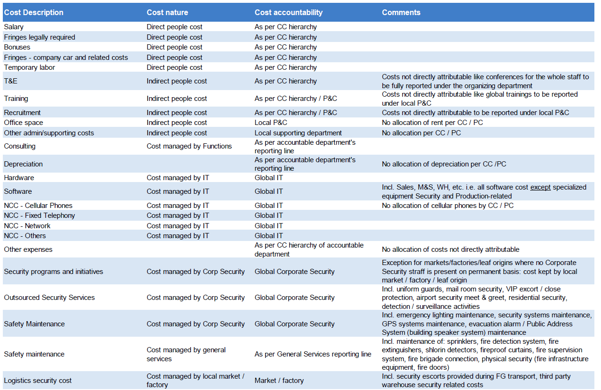
Cost Accountability Matrix

Slide 7


Other Allocation cycles and their usage in JTI
We have seen examples of profit center allocation cycles, cost center allocation cycles and CO-PA allocation cycles in use at JTI over the last 15 years. However, in S/4HANA we will no longer maintain all different types of cycles …..
Profit center allocation cycles
will no longer be used due to the removal of branded profit centers and increased usage of CO-PA in S/4HANA
CO-PA allocation cycles
will not be used as they can only be recorded with document currency as USD, thus creating issues for FX restatement
Cost center allocation cycles
will continue to be used and can allocate costs to cost centers and WBS + cost center

Slide 8
Cost Center Accounting
Cost Center Allocation - Introduction
Cost center allocations will be used for Opex where:
It is not practical / possible to split the costs between the relevant markets / factories / functions when the expense is originally recognized
There is a recurring requirement to allocate the costs between relevant markets / factories / functions
It is deemed necessary for management accounting purposes to allocate the costs

Slide 9
Cost Center Accounting
Cost Center Allocation - Maintenance Process
Followings are process flow for Cost Center Allocation Cycle Maintenance;
Market
My Request
GBS
SAP S/4
Request for CC cycle creation creation/change is submitted by a market
Request is processed and cycle is created/changed in S/4 PROD
Market
SAP S/4
GBS
SAP S/4
Market
SAP S/4
Market checks the results of cost center allocation and impact on P&L
GBS executes CC allocation cycle at the period end
Market updates SKF values on periodical basis if needed

Slide 10
Cost Center Allocations for OpEx
1. Goods receipt for electricity costs
2. Total balance on General Services cost center
DR/CR | Account | Cost center | Profit Center | Amount EUR
CR | GRIR |  | France Market | (1000)
DR | Electricity | General Services | France Market | 1000
Cost Center Report:
Cost Center: General Services
Reporting Period: 1 to 3 2019
Cost element | Actual Amount
Electricity | 1000 EUR
3. Allocation cycle
4. Allocation cycle postings
Cost Center Allocation Cycle:
DR/CR | Account | Cost center | Profit Center | Amount EUR
CR | Electricity | General Services | France Market | (500)
DR | Electricity | IT Dept | Global IT | 200
DR | Electricity | WWDF France | WWDF France | 300
Sending cost center
General Services
Receiving cost centers
IT Dept, WWDF
Sender rule
Posted amounts
Receiver rule
Fixed percentage
Receiver 1 %
20%
Receiver 2 %
30%

Slide 11
Cost Center Allocations for OpEx
Distribution – the same underlying account is used to perform the allocation
Assessment – a secondary cost account is used, therefore the costs are still visible on the original account and only the cost centers are impacted
Distribution
Assessment
Cost Center A
Cost Center B
Cost Center A
Cost Center B
Account
511310 100 USD
Account
511310 -30 USD
Account
511310 30 USD
Account
511310 100 USD
Account
920000 -30 USD
Account
920000 30 USD
Allocation
Allocation

Slide 12
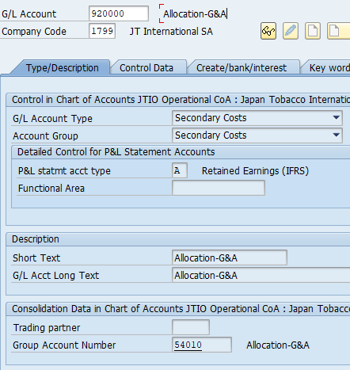
Secondary cost accounts in S/4 HANA
In SAP ECC, secondary cost elements exist only in the CO (Controlling) module
At JTI they are used mainly by GSC for product costing assessment cycles, and also by markets using assessment cycles for opex or marketing allocations
Secondary cost elements are also used currently for indirect MCA entries
In S/4 HANA secondary cost elements become GL accounts, however they can only be used for allocation purposes
This will mean that where an assessment cycle is used, it will be possible to view the accounting document for this, and it will be visible in GPM reports in all relevant currencies

Slide 13
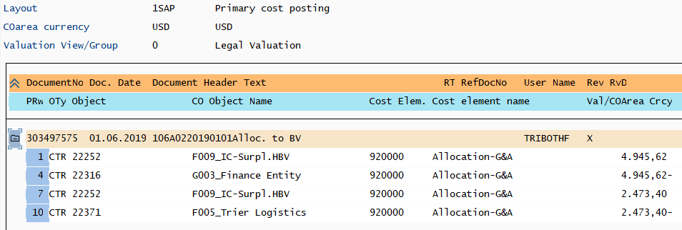
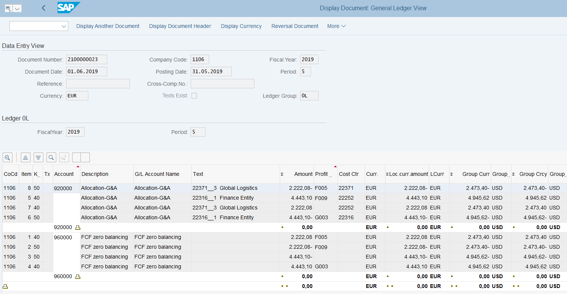
Controlling Transactions Reflected in G/L (1/2)
Controlling document from a Cost Center Allocation cycle – posted in Cost Center Accounting in CO
Accounting document from the above CO transaction – posted in General Ledger in FI
All FI documents are subject to Document Splitting – refer to Document Splitting explained later in this document.

Slide 14
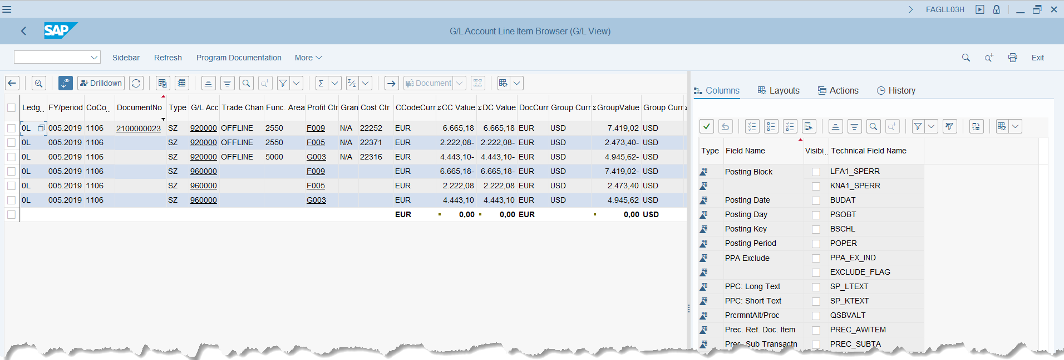
Controlling Transactions Reflected in G/L (2/2)
All G/L items can be displayed using G/L Account Line Item Browser, which reflects the real-time information stored in ACDOCA table. The above example is showing the same document from previous slide originated from Cost Center Allocation.
Users can use the “Sidebar” functionality to slice and dice the information and provide analysis on the “fly”.

Slide 15
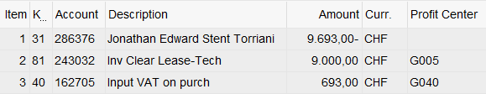
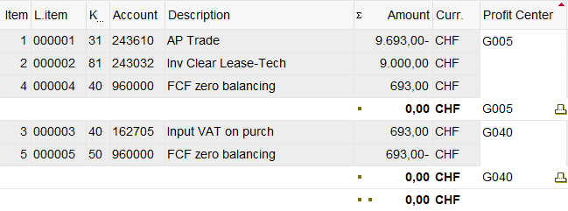
Document splitting at a glance
Document splitting functionality enables population of Profit Centers (PC) where line items have to be split to inherit proper PC characteristics according to pre-defined rules.
In document splitting, the system may creates additional clearing lines.
In JTI with PC being reorganized to represent Market/Factory/Function, Document Splitting enables Free Cash Flow by Market, which is compiled by using GL movements by PCs.
A Basic example of Document Splitting ¹⁾
Document in Entry View (what was originally posted)
Document in Ledger View (after document splitting)
Item 1 which didn’t have PC on input now is assigned with a PC – note the “Account” shown on ledger view is the G/L account instead of vendor as on Entry View.
Items 4&5 are created to make the total balances posted to each PC to be come zero.
As a result, every G/L item is now assigned with a PC and the total account balances per PC is always zero.
¹⁾ Note in this example only shows that PCs are assigned during Document Splitting. There are different scenarios and many Document Splitting rules set up to determine how the PCs are determined/assigned and how the amounts should be split to different PCs. These are explained in Free Cash Flow course.

