Slide 1

Course Structure
Allocation Overview
Master Data
MyRequest Templates
Cost Allocations
Statistical Key Figures
Reporting
Direct MCA
Reporting

Slide 2
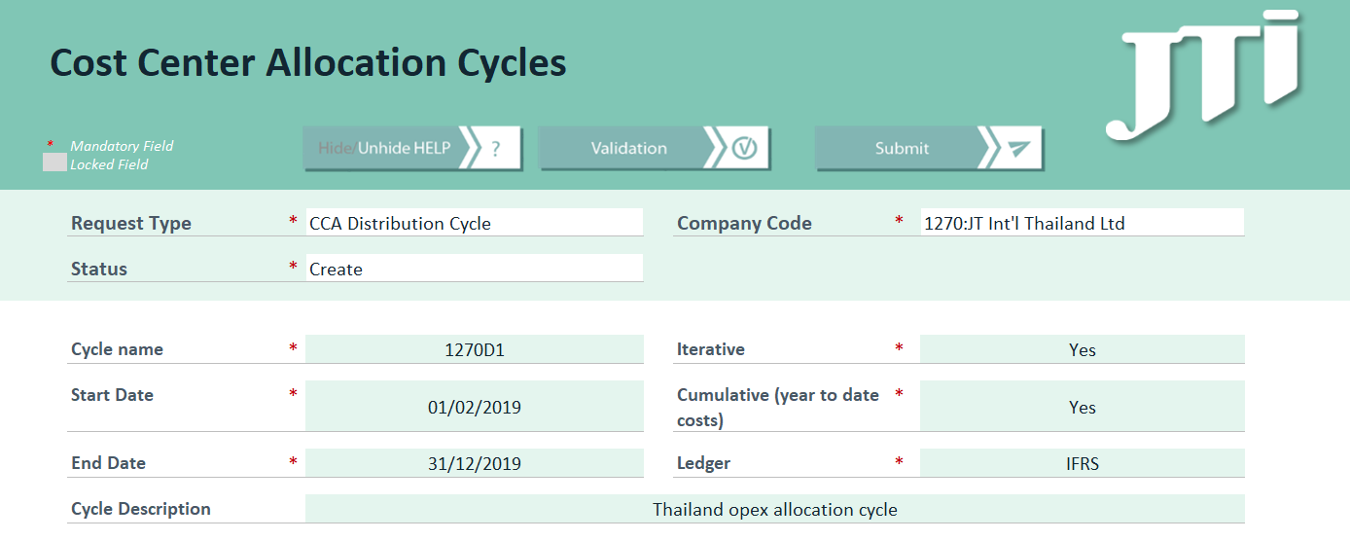
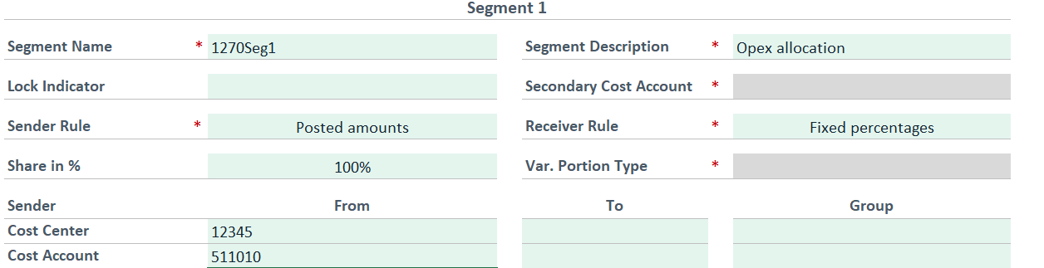
Cost Center Allocations – My Request
MyRequest is the replacement of the SRT system
There will be a MyRequest template specifically for creation or changes to cost center allocation cycles
This template has fewer selection choices than the previous SRT template for allocation cycles to help markets
The template will also contain guidance in the help section, and a number of validations to check the details before submission
Further training on templates will be provided by BSC

Slide 3
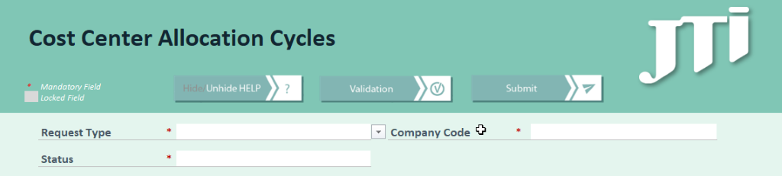

Cost Center Allocations Template
MyRequest Template
MyRequest template ‘Cost center allocation cycles’ should be used for creation of both distribution and assessment cycles both for markets and Global Leaf locations. Other GSC factories are out of scope for it as they are creating cycles themselves without BSC involvement
Request Type: Determines the type of a cycle and type of the location (Market or Global Leaf / GSC)
Company code: Determines the entity where allocation is going to take place. Any Cost center allocation cycle can only be performed in one company code.
Status: Determines if this is to create a new cycle or to make changes. If changes are to be made one request per cycle being changed should be submitted and must list all the changes to the relevant segment(s) – providing the cycle and segment names.

Slide 4
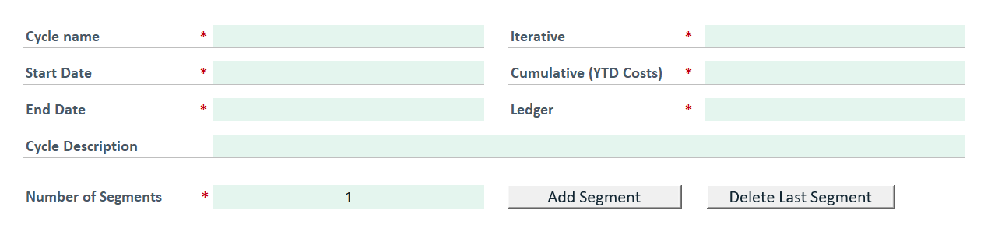
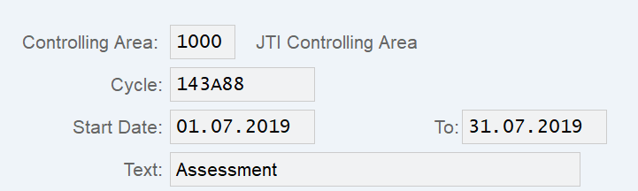
Cost Center Allocations Template – Cycle Name and Structure
MyRequest Template
Cycle name: A proposed naming convention is the last 3 digits of the entity code, for example, for 2102, the cycle name would start with 102. Then either A or D for Assessment or Distribution followed by a sequential numbering system…01, 02, 03 etc. 102A01
Start/End Dates: Determine the validity of the cycle, i.e. the period when cycle will be accepted by the system to be run. The same cycle can be used for multiple years if required. Cycles must be valid in the period they are due to be executed. If changes are to be made to a cycle it might be a good idea to change the valid from dates to ensure historical data of the old cycle is traceable.
Number of Segments: Determines how many segments this cycle should have. To make the field for segments visible, you need to press on the button ‘Add segment’. Depending on how complex the cost allocation needs to be will determine the number of Segments that will need to be used. More than one segment will be required. For example one segment could be used to equally allocate admin overhead costs to all department cost centers and the second allocating IT costs based on the number of headcount per department.
KSU3 – Display Assessment Cycle

Slide 5
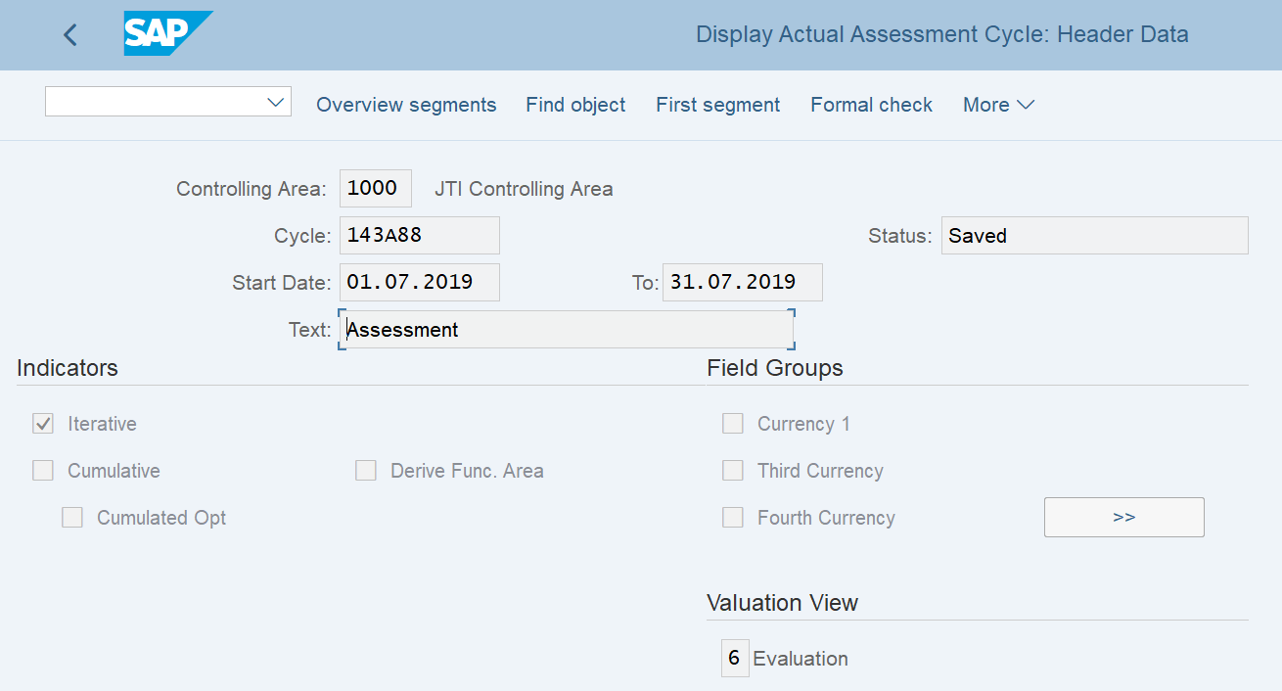
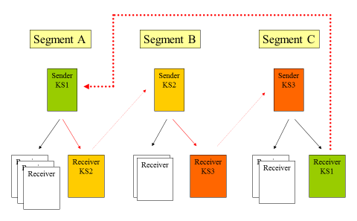
Cost Center Allocations Template - Iteration
MyRequest Template
Iteration: You can process allocation cycles iteratively or non-iteratively. When you process an allocation cycle iteratively, the result of one segment is then used by the other segments and processed further. The segments are processed dependent on each other. It is possible that a cost center is also a cost receiver so the cycle must re-run until all the costs in said cost center are allocated. Cost centers that were already credited can thus be re-debited during cycle processing..
In the below example, the cycle begins with Segment A and costs from cost center KS1 are allocated to Receiving cost center KS2. The cycle then moves on to Segment B where the costs are then allocated from cost center KS2 to receiving cost center KS3. The final Segment (C) is then process by the system. Here we can see that cost center KS1 is a receiver of costs so the cycle must start over again with Segment A until all the costs have been allocated. This is an example of iteration
KSU3 – Display Assessment Cycle

Slide 6
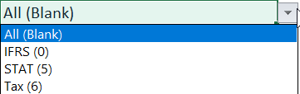
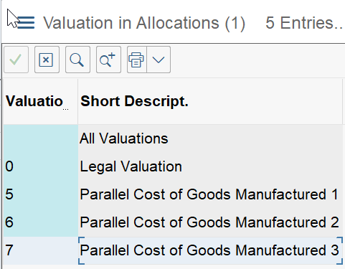
Cost Center Allocations Template – Cumulative Costs and Ledgers
MyRequest Template
Cumulative (YTD Costs) : Used for Tracing factor ‘Variable portions. For example, Costs of $100 for the periods of January and February are allocated using a 75/25% split to Cost center 2 & 3. In March there is an extra $50 costs on Cost center 1 so that the total YTD costs total $150.
The system cumulates the calculated allocation amounts per receiver. It then posts them in the current period, minus the amounts already allocated to each receiver in the previous periods. This ensures that the postings in the prior periods remain unchanged. Therefore in our example the split changes to 50/50%. Cost center 2’s portion on the YTD costs are now 50% of 150 = 75. It has already been allocated 75 so no further posting is required. However cost center 3’s portion of the YTD costs are now 75 but it has only been allocated 25 so far, therefore in March Cost center 3 will be debited 50
KSU3 – Display Assessment Cycle
PARAMETER | Amount
YTD Actuals on Cost Center A | 150
Already allocated to Cost Center B | 75
Already allocated to Cost Center C | 25
 | NEW RATIO | EXPECTED AMOUNT
CC 2 | 50% | 75
CC 3 | 50% | 75
POSTING |  | Amount
CR | CC 1 | 50
CR | CC 2 | 0
DR | CC 3 | 50
Ledger: Determines the target ledger where the results of allocation should be posted in Accounting.
0 = IFRS
5 = STAT
6 = TAX

Slide 7
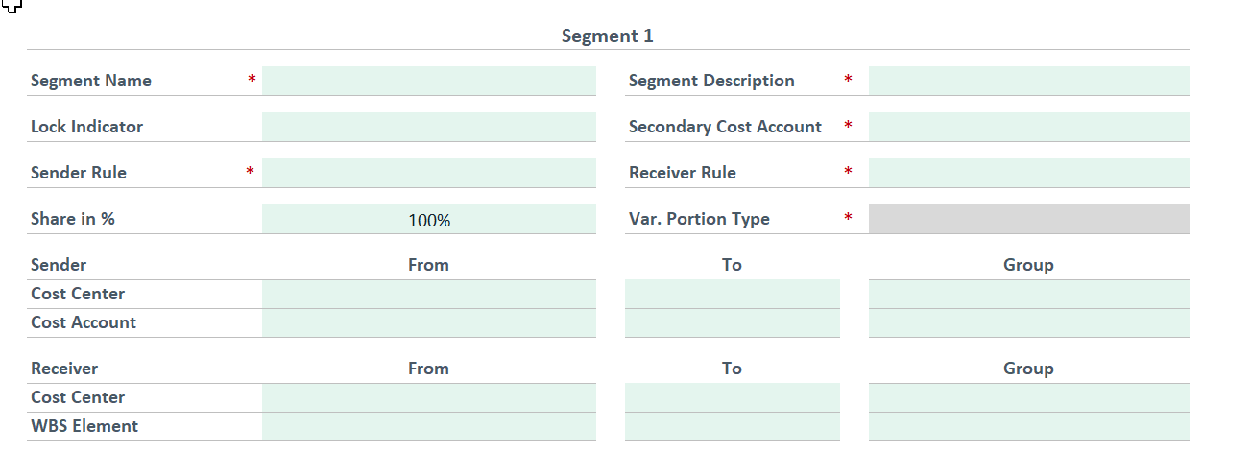
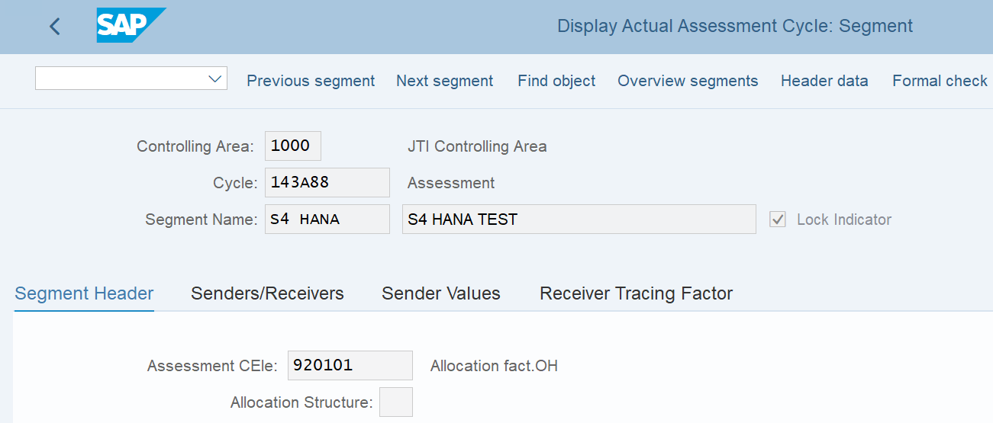
Cost Center Allocations Templates - Segments
MyRequest Template
Segment name: Short name of the cycle segment, 10 characters.
Segment description: Longer name of the cycle segment, 30 characters
Lock Indicator: This functionality can be used if a Segment is no longer required but the rest of the cycle is still required. The allocation cycle will run all segments except for all those with the lock indicator. This can only be selected where the MyRequest template is to change a cycle (do not expect to lock a segment on creation of a cycle)
KSU3 – Display Assessment Cycle
Secondary Cost Account: Should only be selected for assessment cycles and determines a secondary account via which the assessment will be performed. This means the original cost elements are not recorded on the receivers. This field will be greyed out if using a Distribution Cycle as secondary cost accounts are not required

Slide 8

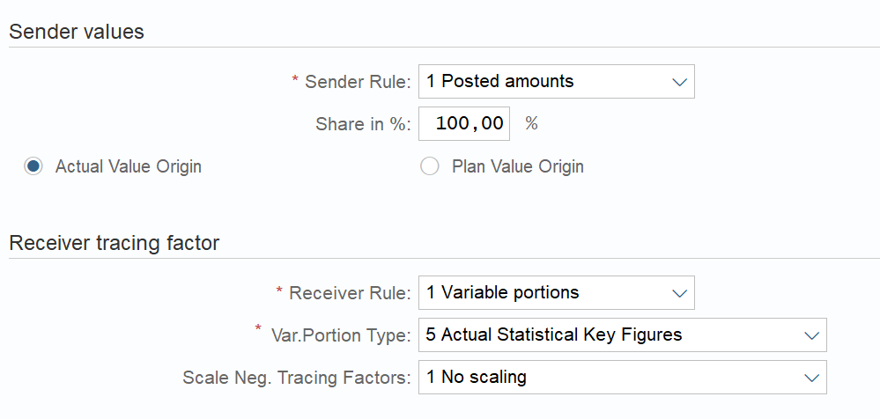
Cost Center Allocations Templates – Sender Rules
MyRequest Template
Sender Rule: Determines which amounts on sender should be taken into consideration for the allocation:
A). Posted amounts - actuals which have been collected on a cost center. When you define the allocation rule for the sender, you can determine what percentage of the sender balance should be credited with the allocation amount.
B). Fixed amounts* – exact values input into the cycle independently on what actuals are. Each time the allocation cycle is carried out, the same amount is assessed/distributed from the sender. The allocated amount does not depend on the current balance of the sender.
Share in %:. Determines the percentage of posted amounts on sender cost centers which is applicable for the allocation
*The “Sender Value” section of the MyRequest Template should then be complete if Fixed Amounts are to be allocated so that the required Fixed amount is outlined in the CCA
KSU3 – Display Assessment Cycle

Slide 9
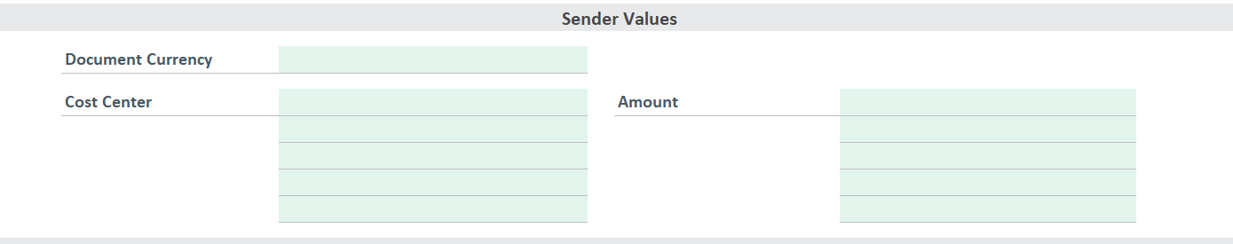
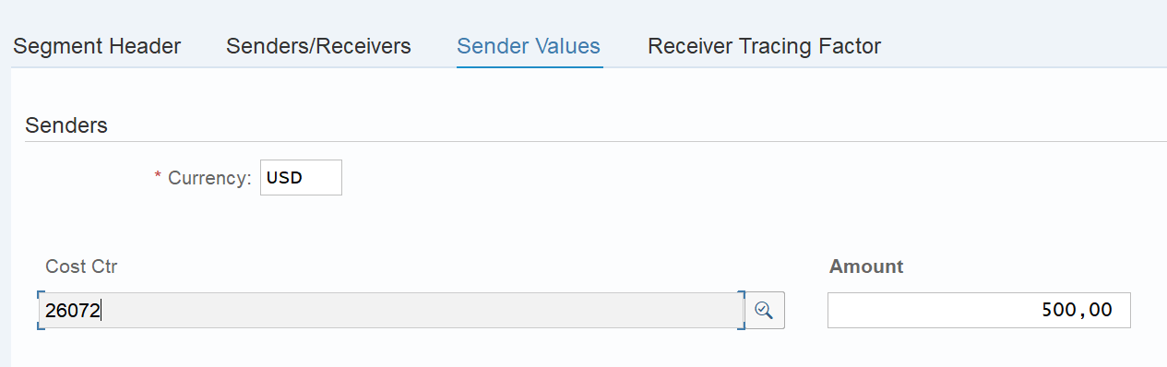
Cost Center Allocations Templates – Sender Values
MyRequest Template
Fixed Amounts:
The “Sender Value” section of the MyRequest Template should then be complete if Fixed Amounts are to be allocated so that the required Fixed amount is outlined in the CCA. The entered currency is document currency so the system will calculate LC1, LC2 and LC3 based on the M rate
Currency: The document currency that will be used by SAP when posting the allocation
Cost Center Amount: The exact amounts to be allocated by receiving cost center in document currency. The amount in other currencies (LC1, LC2 and LC3) will be determined using the spot rate
KSU3 – Display Assessment Cycle

Slide 10

Cost Center Allocations Templates – Receiver Rules
Receiver Rule: Determines how the proportion for the allocation should be calculated:
Fixed percentages – percentage values specified for each receiver
Variable portions – result in dynamic calculation of ratios based on either Statistical Key Figures (SKF) being input or reference figures posted on particular G/L accounts with cost centers acting as a receiver in the cycle
Variable Portion Type: Should only be populated if ‘Variable portions’ receiver rule is selected and determines what should be the basis for the dynamic proportion calculation:
Actuals costs – are costs that are posted during normal business to certain cost centers/elements. For example is CC2 receives $15 for water and CC3 receives $5 during the month for the same. A cycle can be created to allocate costs from CC1 to allocate those costs based on the % of actual costs on the receiving cost centers. In this case if CC1 has $30 of water costs the cycle would assign 75% or those costs to CC2 (15/20 = 75%) and 25% to CC3
Actual SKF – are pre defined weighting factors that can be used to allocate costs. For example, headcount. If CC1 wants to allocate IT costs to CC2 and CC3 based on headcount, these SKF can be created in the system before the cycle is run. Say CC2 has 2 people and CC3 has 3 people the system will allocate 40% (2/5 = 50%) to CC2 and 60% (3/5=60%) to CC3.
MyRequest Template
KSU3 – Display Assessment Cycle

Slide 11
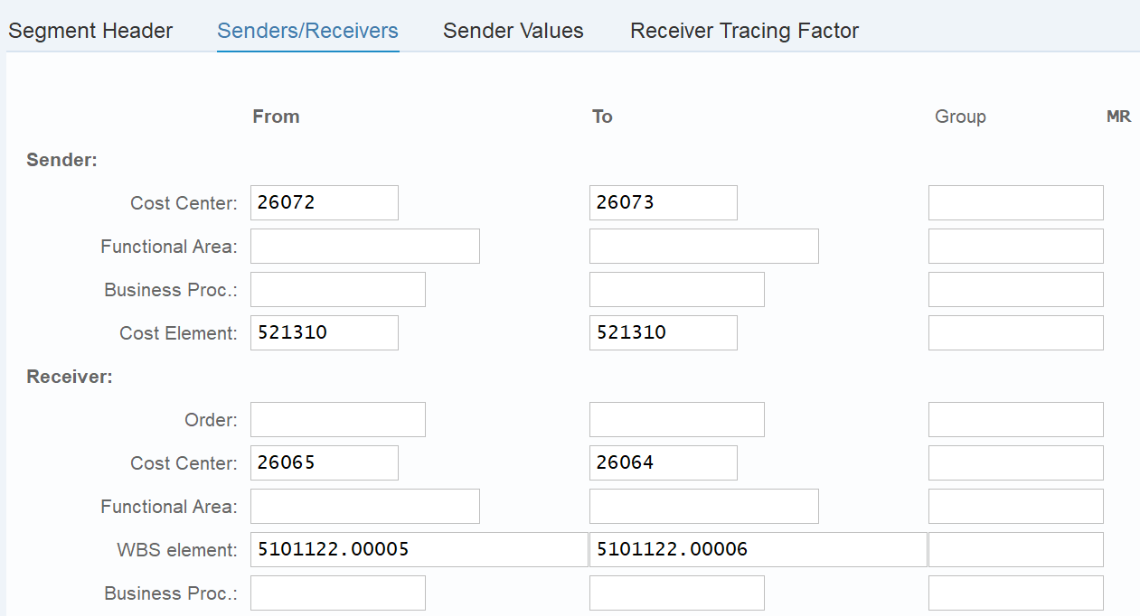
Cost Center Allocations Templates – Allocation Rules
MyRequest Template
Sender Cost Center: Determines cost center, range of cost centers or cost center group, i.e. set of cost centers, where costs should be removed from
Sender Cost Account: Determines the account, range of accounts or group of accounts where costs to be allocated were posted. For distribution cycles it also determines accounts within which distribution is going to happen
Receiver Cost Center: Determines the cost center, range of cost centers or cost center group, i.e. set of cost centers, where costs should be removed to
Receiver WBS Element: Determines the WBS element, range of elements or WBS element group where costs should be removed to
If a range is used please remember that ALL cost centers within that range will be included in the cycle.
If there are a large number of unsequential cost centers it is advisable to create a Cost Center Group via ITSP
KSU3 – Display Assessment Cycle

Slide 12
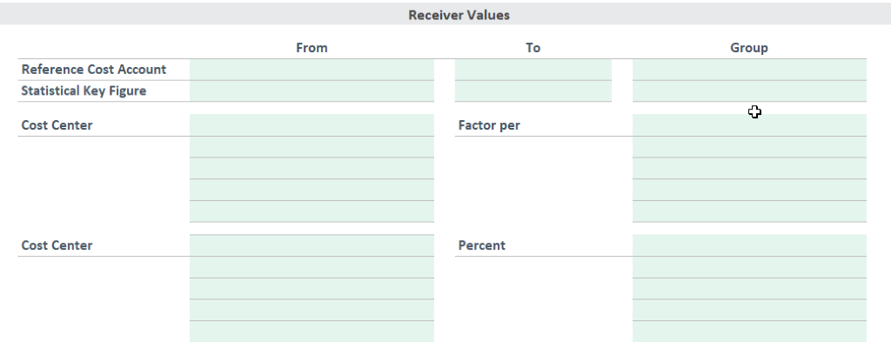
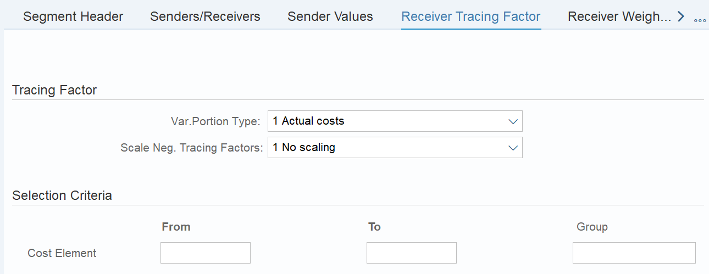
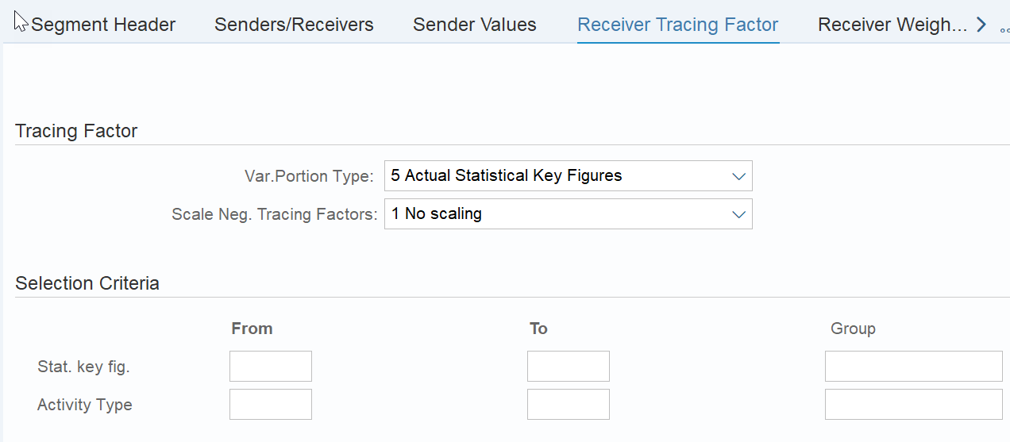
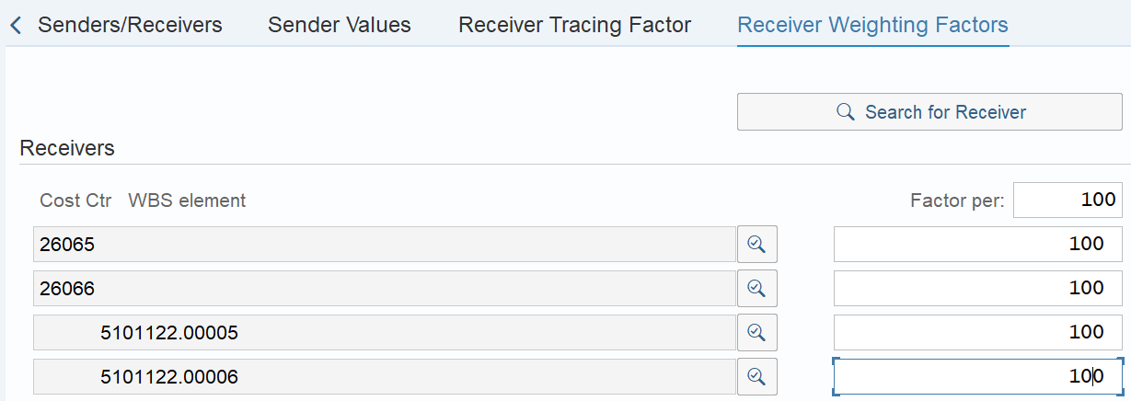
Cost Center Allocations Templates – Receiver Values
MyRequest Template
Reference cost account: this uses the normal day to day postings to the named G/L account as the weighting basis for the new cost center allocation cycle. So if CC2 receives $5 on cost element for rent and CC3 receives $15 for rent, the new cost allocation cycle can use this weighting for allocations costs of, for example leasing admin costs proportionality from CC1 (5/20 = 25%) to CC2 and (15/20= 75%) to CC3
Statistical Key Figure: are pre defined weighting factors that can be used to allocate costs. For example, headcount. If CC1 wants to allocate IT costs to CC2 and CC3 based on headcount, these SKF can be created in the system before the cycle is run. Say CC2 has 2 people and CC3 has 3 people the system will allocate 40% (2/5 = 50%) to CC2 and 60% (3/5=60%) to CC3.
KSU3 – Display Assessment Cycle
Cost Center/Factor Per: Represents a multiplier which can be applied to the already calculation proportion by ‘Actuals costs’ or ‘Actual SKF’, increasing or decreasing the weight of a particular cost center. The default value is 100, equal for all receiving cost centers. Recommendation is just to use it as is.
Cost Center Percentage: Represents the share of each receiving cost center in the result of allocation if receiver rule is selected as ‘Fixed percentage’

Slide 13
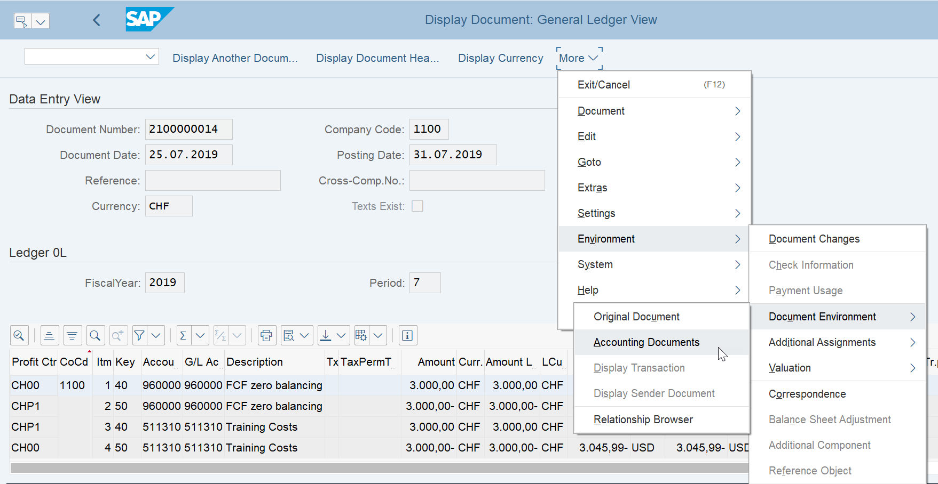
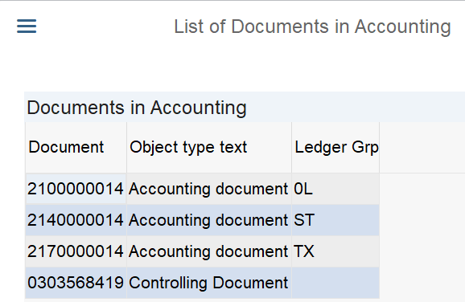
Cost Center Allocations Templates – Receiver Values
FB03L – Display Docuement
Cost center allocations:
Document type SZ will be used, and the postings will create accounting documents in S/4HANA
Distribution cycles impact the same GL account as where the costs were originally incurred
Assessment cycles impact a secondary cost element, such as 920000
If the cost center allocation cycle transfers costs from one market to another, there will be an entry to the FCF zero-balancing account (960000)
It is possible to create a cost center allocation cycle that impacts all ledgers, or that only impacts one ledger. Please consider what is appropriate for your entity and ensure your CO colleagues are aware of what they should use

Slide 14
Cost Center Allocation cycles – Segments vs Separate Cycle
Below are some examples of when an additional segment within one cycle should be used or when creating a new cycle is more appropriate.
ADDITIONAL SEGMENT | NEW CYCLE
As an example, if it is required to allocate 50% of costs from cost center A to cost center B, and then 100% of costs from cost center B to cost center C (including the cost allocated from cost center A). Where there are high dependencies, it is better to use an additional segment in the same cycle | If there is a mix of distribution (costs allocated on same underlying account) and assessment (costs allocated on secondary cost elements) as this can’t be combined in one cycle If requirement needs more than the SAP recommended 50 segments (although technical limitation is 998 segments) If there is the requirement to use different treatment of iteration / cumulation or ledger impact since this is applied to the whole cycle and not per segment
From an overall cycle management perspective, it is recommended to use separate cycles if different types of costs are being allocated. Remember that over time it is also possible that some of the allocations may cease and although you can lock a segment within a cycle, the segment is still visible which can sometimes lead to some confusion on why some costs haven’t been allocated.

Slide 15
Cost Center Allocation cycles – Changes
MyRequest Template
MyRequest template ‘Cost center allocation cycles’ is also used to make changes to already created cycles.
To make changes one request per cycle being changed should be submitted and must list all the changes to the relevant segment(s).
Cycle and Segment names will need to be provided

Slide 16
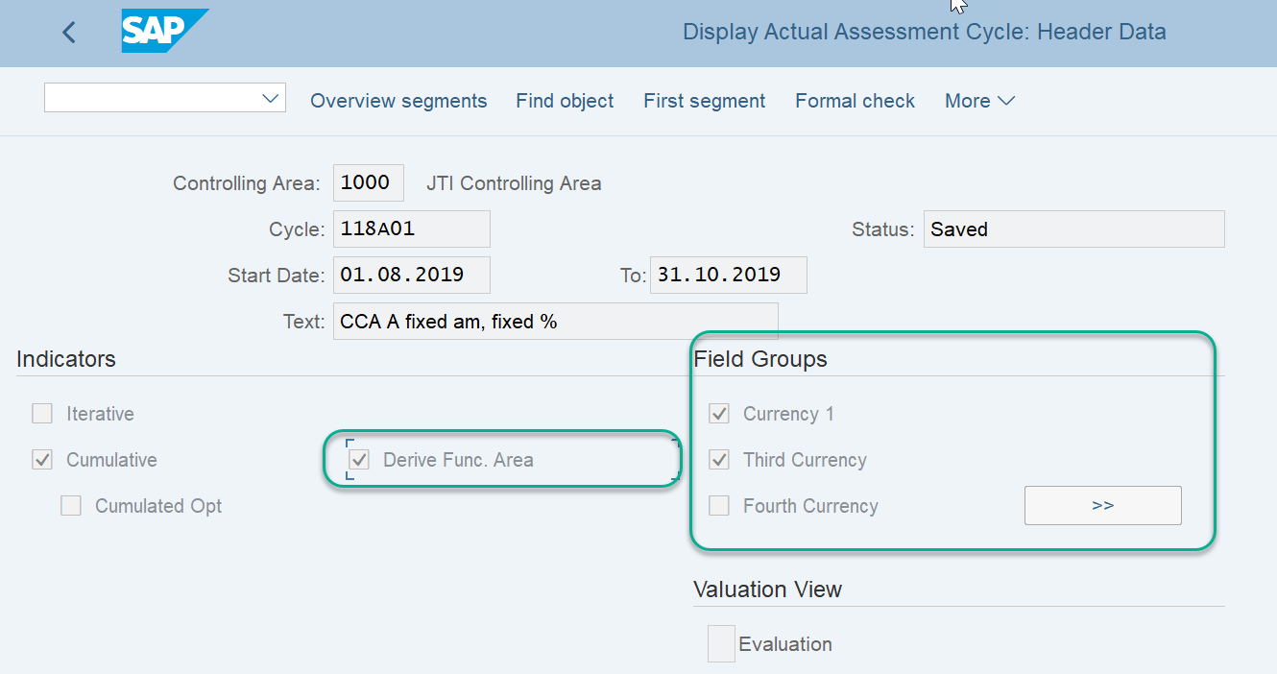
Creating Cost Center Allocations – BSC (and GSC) - Further steps
MyRequest template ‘Cost center allocation cycles’ does not include all fields that are required for Cost Center Allocation Cycle creation. There are 2 further aspects of information that need to be assigned to cost center allocation cycles.
These further steps will be completed and performed by BSC (or GSC if maintaining own cycles) after receipt of a MyRequest template for creation and upon creating the cycle in KSU1/KSV1
These further steps are ensuring the following information is also correct and completed:
Derive Functional Area is checked
Select Currencies Field Groups have the required selection criteria

Slide 17
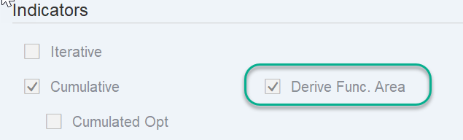
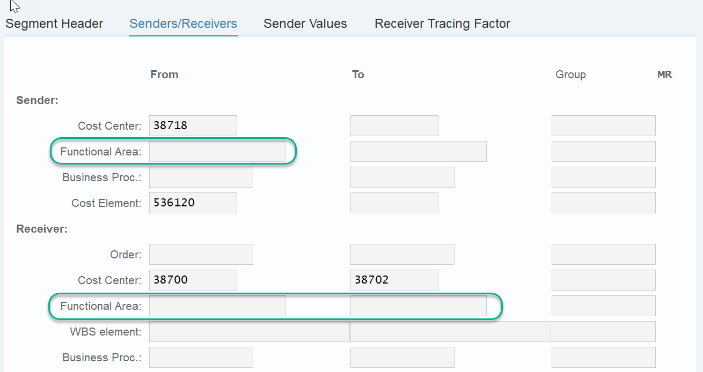
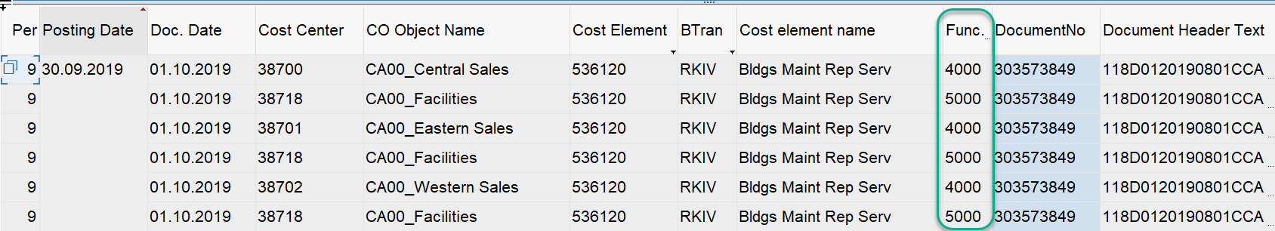
Creating Cost Center Allocations – BSC (and GSC) - Derive Functional Area check box
BSC colleagues (or GSC, when maintaining their own cycles) must ensure that the “Derive Func. Area” check box has been checked, if this has not already defaulted as being checked then this must be completed manually. (If BSC use a cycle which has this checked to copy from, then the new cycle will also have this checked. If they are creating a new cycle from fresh they will have to manually check this box)
This allows for the Functional Area for the Receivers to be automatically derived, in the resulting postings, from the Receiver cost objects, for example, Cost Center (as shown here).
If this is not ticked the system will derive the functional area from the sending cost object (e.g. cost center) for the posting against the receiver, even if the receiving cost object has a different functional area. For management reporting purposes, this could mean that the costs will be displayed in the wrong line in the market P&L, since the combination of JTIG and functional area drives where income and expenses appear in the market P&L.
In the example shown here the sender cost center has FA 5000 but we can see the posting shows the correct derivation of FA from the Receivers CC of 4000. If the cycle was not maintained correctly and Derive Func. Area was not checked, the system would use FA 5000 for postings as it would take the FA from the Sender cost center, which of course would not be correct in this example

Slide 18
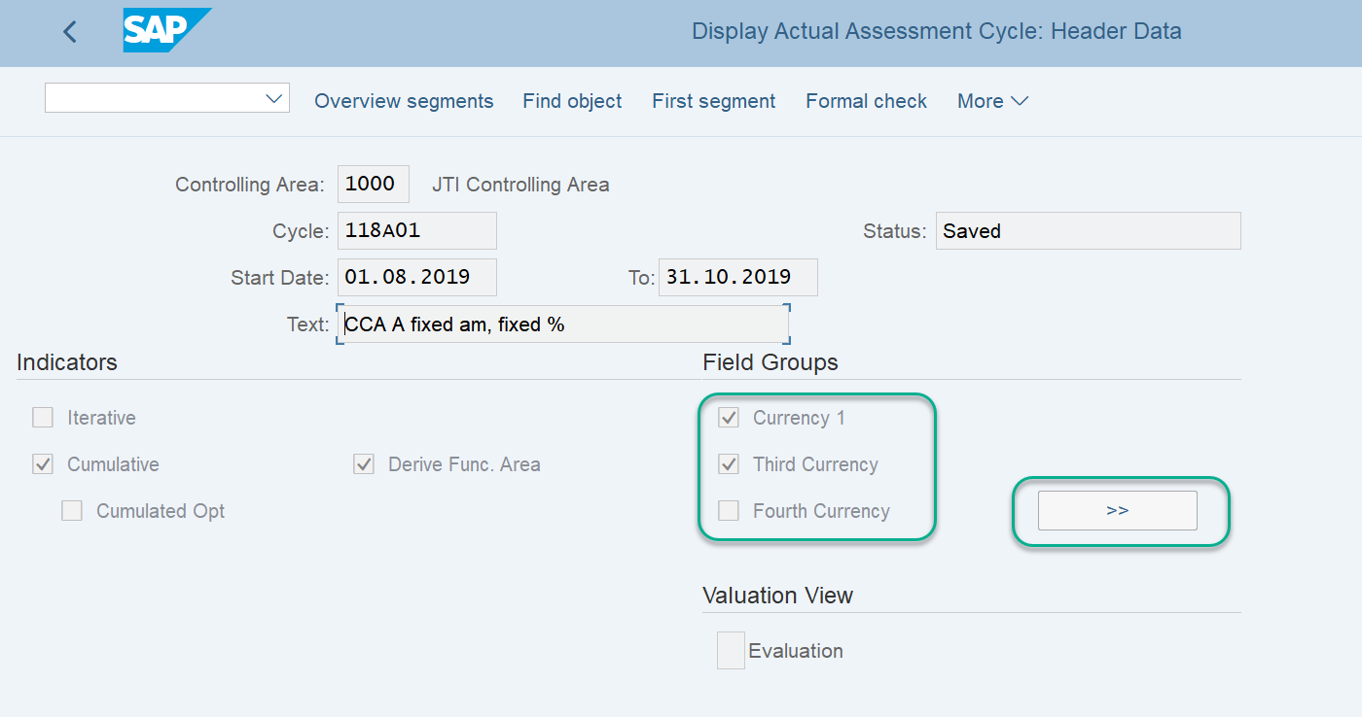
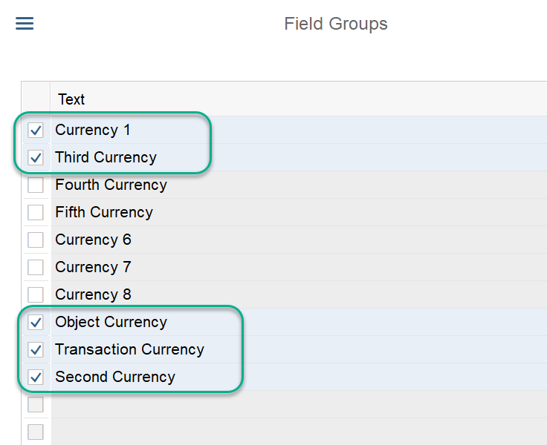
Creating Cost Center Allocations – BSC (and GSC) - Currencies
BSC (or GSC, when maintaining their own cycles) colleagues must also ensure that the following currencies are selected within the currency field groups:
Currency 1
Third Currency
Object currency
Transactional currency
Second Currency
If BSC (or GSC colleagues) use a cycle which has the correct currencies to copy from, the new cycle will pull across the same correct currencies. If they are creating a new cycle from fresh they will have to manually ensure that all the currencies are selected.
If these currencies are not all selected then the system will select a different FX rate and potentially there will be a slight balance left on the CC

Slide 19
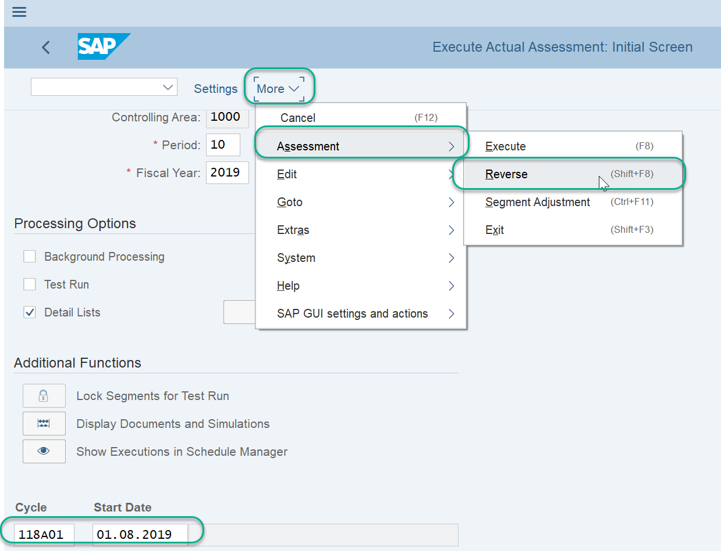
Creating Cost Center Allocations – BSC (and GSC) - Error handling
If a cycle has been run without the correct Derive Functional Area functionality and/or incorrect currencies selected BSC (or GSC colleagues) must Reverse the cycle.
No changes should be made to the cycle until the cycle is reversed. If changes are made to the cycle before it is reversed it will use the new cycle details and information to reverse the postings made so the initial incorrect posting will still remain.
Once the cycle has been reversed the changes to the cycle can be made. It is then ok to proceed to run the cycle with the new information having been saved to the cycle, thereby correcting the initial incorrect postings.

Slide 20
Exercises:
Exercise 1.3: MyRequest Template - Prepare MyRequest Templates for an Assessment cycle and Distribution Cycle
Exercise 1.4 & 1.5: KSU3 – Display Assessment Cycle
KSV3 – Display Distribution Cycle

