Slide 1

Course Structure
Allocation Overview
Master Data
MyRequest Templates
Cost Allocations
Statistical Key Figures
Reporting
Direct MCA
Reporting

Slide 2
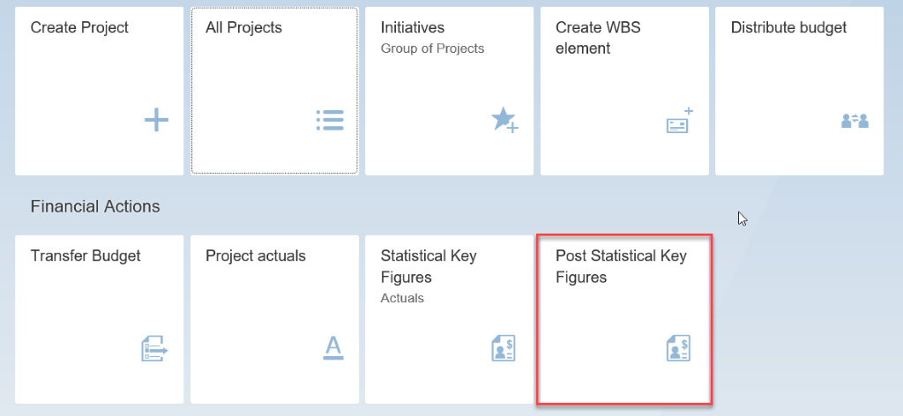
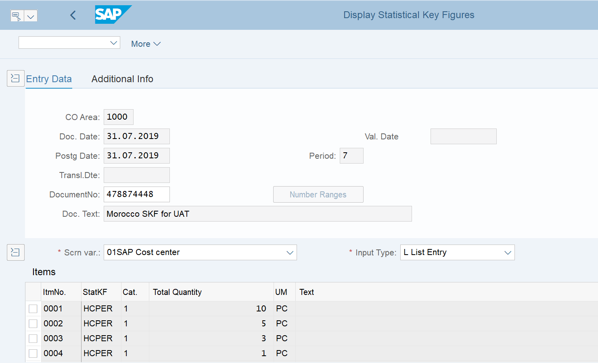
Statistical Key Figures
Statistical key figures can be used within cost center allocation cycles to define the basis on which the costs should be allocated. As an example, costs can be allocated between cost centers based on FTE or headcount per cost center, or based on square meters per cost center
In S/4 HANA, markets will have access to update the SKF values themselves, rather than BSC maintaining this on receipt of a MyRequest template. However, the creation and update of a cost center allocation cycle will continue to be performed via MyRequest .
Statistical Key Figures are created in SAP Fiori via the App “Post Statistical Key Figures) or via KB31N in SAP GUI

Slide 3
Statistical key figures for Opex allocations
In S/4 HANA market finance teams will have access to update the SKF values directly in SAP
For particular types of costs the allocation percentage between cost centers is variable from period to period
Automated allocation?
How to split?
There is a tool in SAP that can help with this called a Statistical Key Figure, and these are already in use at JTI today
Statistical key figures can be used to help calculate Opex allocations
Who uses SKFs today?
This is mainly GSC who use proportions such as square meters, headcount or another appropriate allocation key to calculate the cost split between several cost centers
SKF

Slide 4
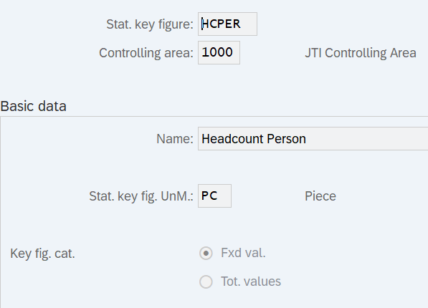
Cost Center Accounting
Cost Center Allocation - Statistical Key Figures
In order to use SKF for allocation, users need to prepare the master first.
KK03
IT BTS is an owner of SKF master data creation process
SKF can be created for any physical parameter which allows to allocate costs proportionally. Once created it can be used within CC cycles.
Due to simplicity of master data (only name, type and unit of measure) SKF is create upon request from a local FP&A, GBS Interco team or GSC without additional approvals
SKF Master data once created is normally not changed anymore
Market
ITSP
IT BTS
SAP S/4
Incident is submitted for new SKF creation
SKF is created in S4 PROD and test systems

Slide 5
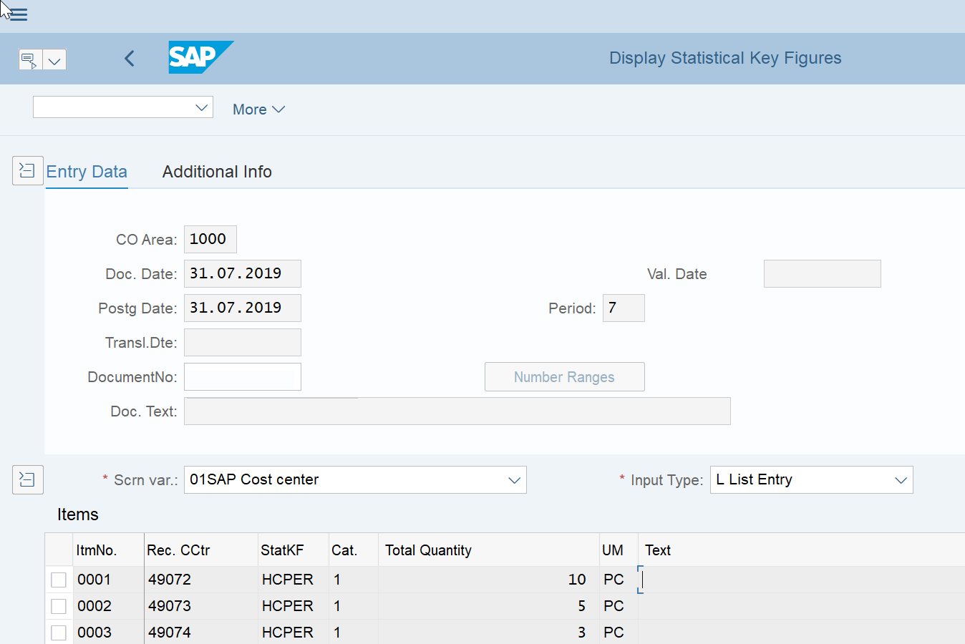
Statistical Key Figures
Document date/Posting date: This should be the last date of the month in which the cost center allocation cycle using the SKF will be executed
Screen Variant: If you are allocating to cost centers, then you should select screen variant cost center. It is also possible to include a WBS element in an SKF
Receiving Cost Center: The cost centers that will receive costs from your cost center allocation cycle
Statistical Key Figure: The allocation key that will be used to allocate the costs, such as FTE, headcount, square meters, sales quantity / volumes, sales revenue, fixed percentage
Total Quantity: The values per the SKF for each cost center, which will result in the weighting that will be allocated to the cost centers. In the above example, there is a total of 18 headcount, which means that 50% is allocated to cost center 49072, 25% to cost center 49073 and % to cost center 25066

Slide 6
Statistical Key Figures (SKF)
It is important to consider that if the SKF has category 2 – Total value, this should be updated monthly. If the SKF has category 1 – Fixed value, the values on the SKF will be used in the cost center allocation cycle each month until you change the SKF
SKF code | SKF category | SKF description | Examples
HCFTE | 1 - Fixed value | Headcount FTE | Canteen costs allocated based on FTE employees, such as for locations with factory / market / global functions on the same site
HCPER | 1 - Fixed value | Headcount Person | Business travel and accident insurance allocated based on headcount per cost center
M2 | 1 - Fixed value | Square meters | Office related costs allocated based on square meters occupied, such as for locations with factory / market / global functions on the same site
GLTQTY | 2 - Total value | Sales quantity/volumes | Service costs to be allocated to other markets based on sales volumes (and potentially also cross-charged as part of a service agreement)
GLTREV | 2 - Total value | Sales revenue | Service costs to be allocated to other markets based on sales volumes (and potentially also cross-charged as part of a service agreement)
FPRCNT | 1 - Fixed value | Fixed Percentage | Costs to be allocated based on % calculated during A&SP
TR_VOL | 1 - Fixed value | BSC: volume of processed transactions | Costs of business service centers (BSCs) to be billed to other entities

Slide 7
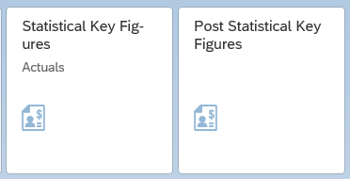
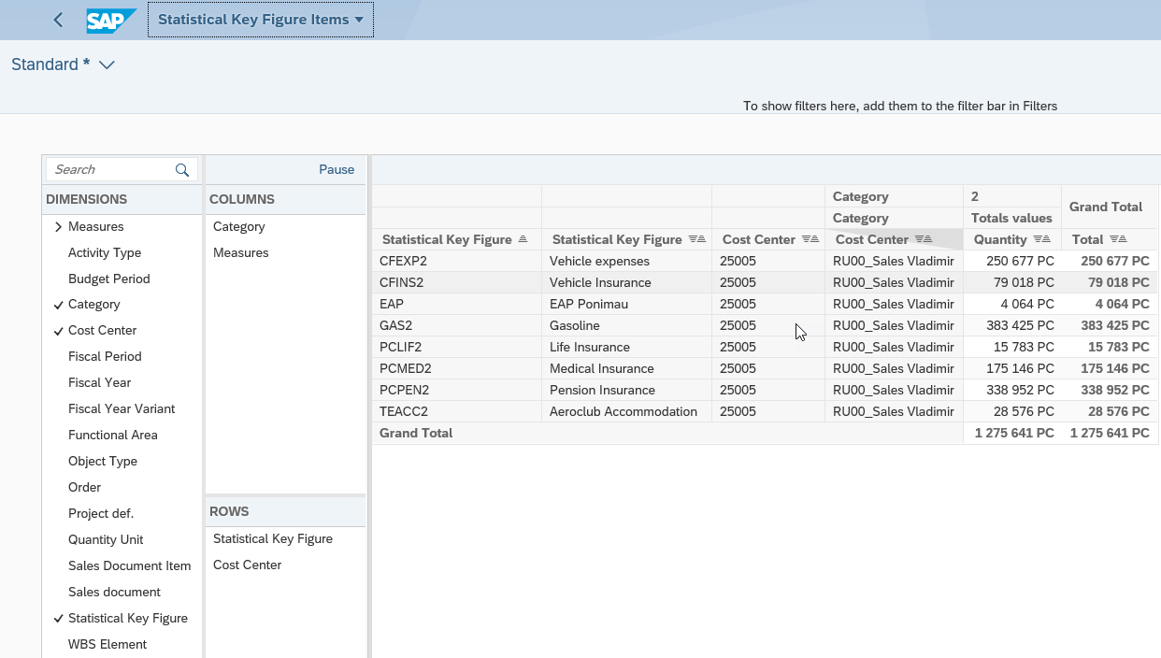
Cost Center Accounting
Cost Center Allocation - Statistical Key Figures
Once the SKF master is ready, users need to input values for the SKF master.
Display
Input
As SKF values are controlled by markets, the actual input is performed locally by FP&A and not centrally like cost center cycles run
The input is performed via Fiori app, report to control input values is also on Fiori. Standard transaction KB31N is also available and is included into the roles
Period opening for SKF value input is controlled among other CO activities centrally by GBS

Slide 8
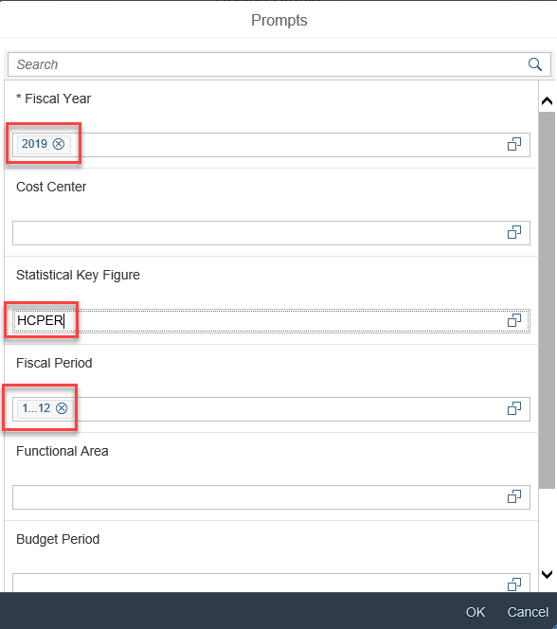
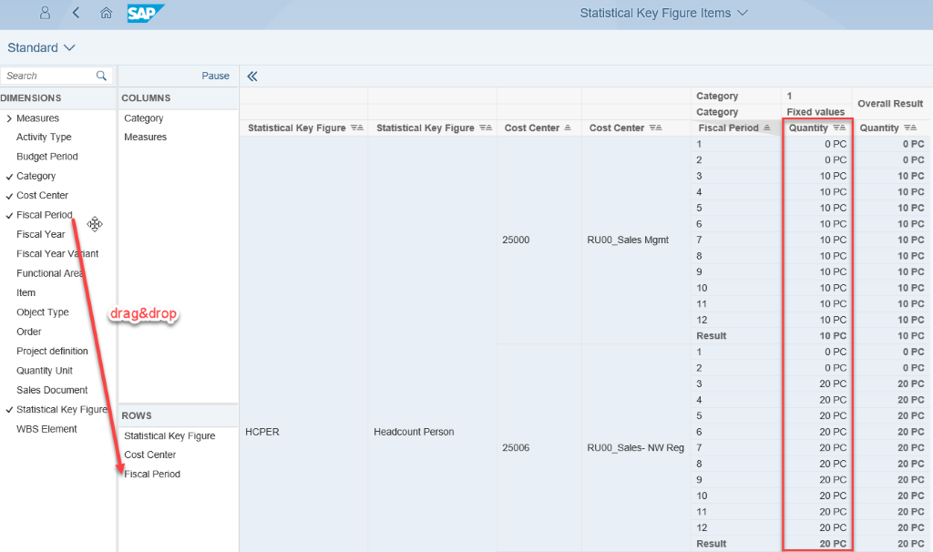
How to check SKF - Fiori
Statistical key figures can be check by using the Fiori App “Statistical Key Figures - Actuals”. You will be redirected to the required application

Slide 9
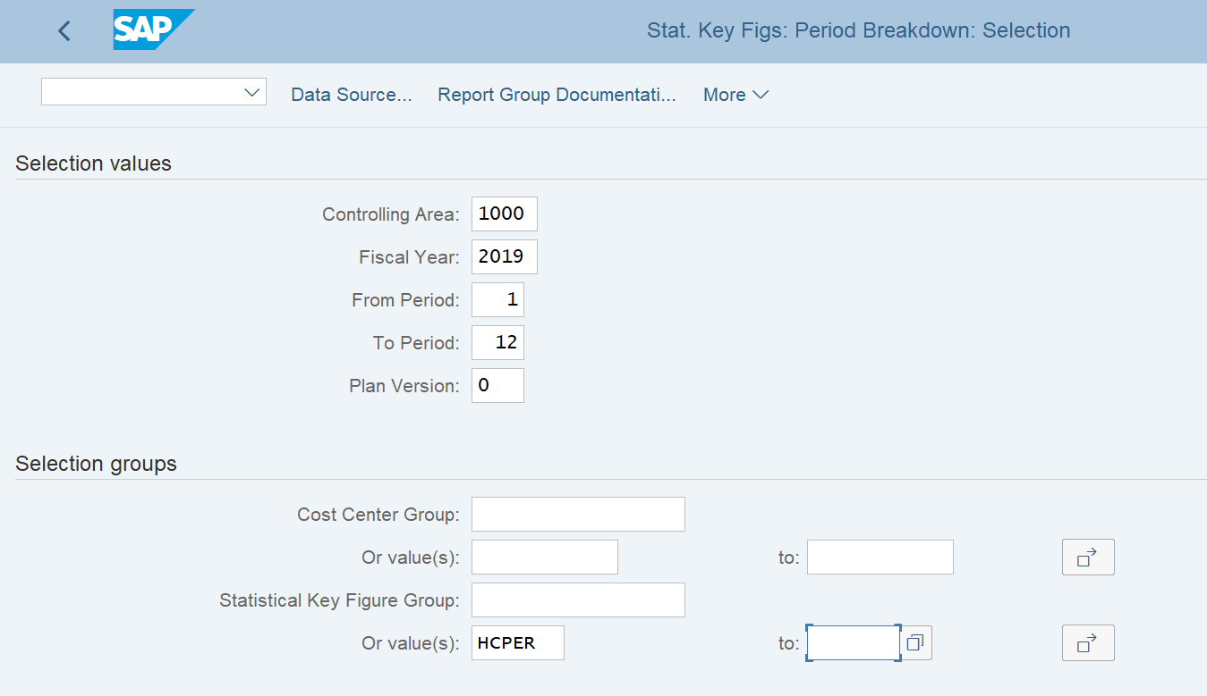
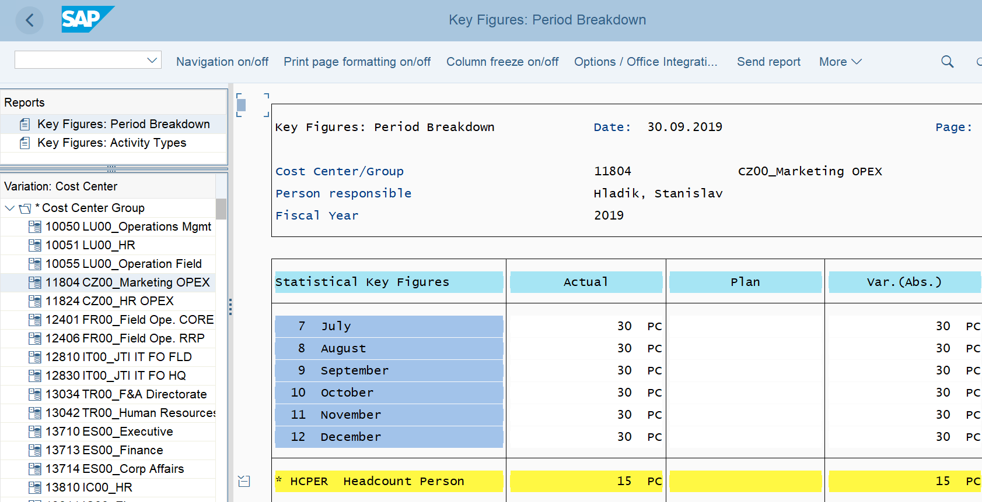
How to check SKF - GUI
Statistical key figures can also be checked in SAP GUI using transaction S_ALR_87013645

Slide 10
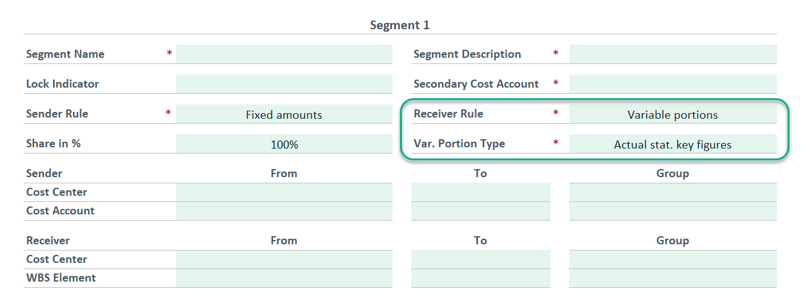
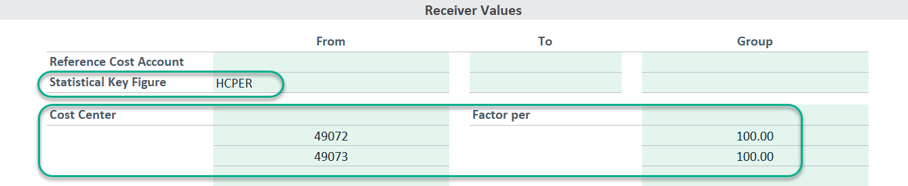
SKF in MyRequest Template
Users need to indicate in the MyRequest Template that Statistical key figures will be used by completing as follows:
The receiver rule is set to “variable portions”
The variable portion type is “Actual statistical key figures”
Under receiver values you should enter the SKF code, and enter the cost centers that are receiving costs via the cost center allocation cycle
Once the above cycle has been created by BSC, the system will use the SKF values to determine the % split between the different cost centers. This may mean that if nothing else in the cycle changes except the values for the SKF each month, then you only need to update the SKF and you do not need to submit a MyRequest template to BSC

Slide 11
Statistical key figures for Opex allocations
The SKF is linked to a distribution cycle which allocates IT costs to cost centers B and C
Costs are recorded against cost center A
The SKF is updated for number of people per department
Costs are transferred to cost centers B and C based on SKF weighting
Cost Center Report:
Statistical Key Figure:
DR/CR | Account | Cost center | Amount EUR
CR | IT costs | Cost center A | (4000)
DR | IT costs | Cost center B | 1000
DR | IT costs | Cost center C | 3000
Cost center: A
Reporting Period: 2 2019
Name | FTE per department
Unit of Measure | Persons (PRS)
Cost element | Actual Amount
IT costs | 4000 EUR
Cost center | Amount | UOM
Cost center B | 5 | PRS
Cost center C | 15 | PRS

Slide 12
Exercises:
Exercise 1.6: Post Statistical Key Values - In SAP Fiori, post statistical key values

Slide 13
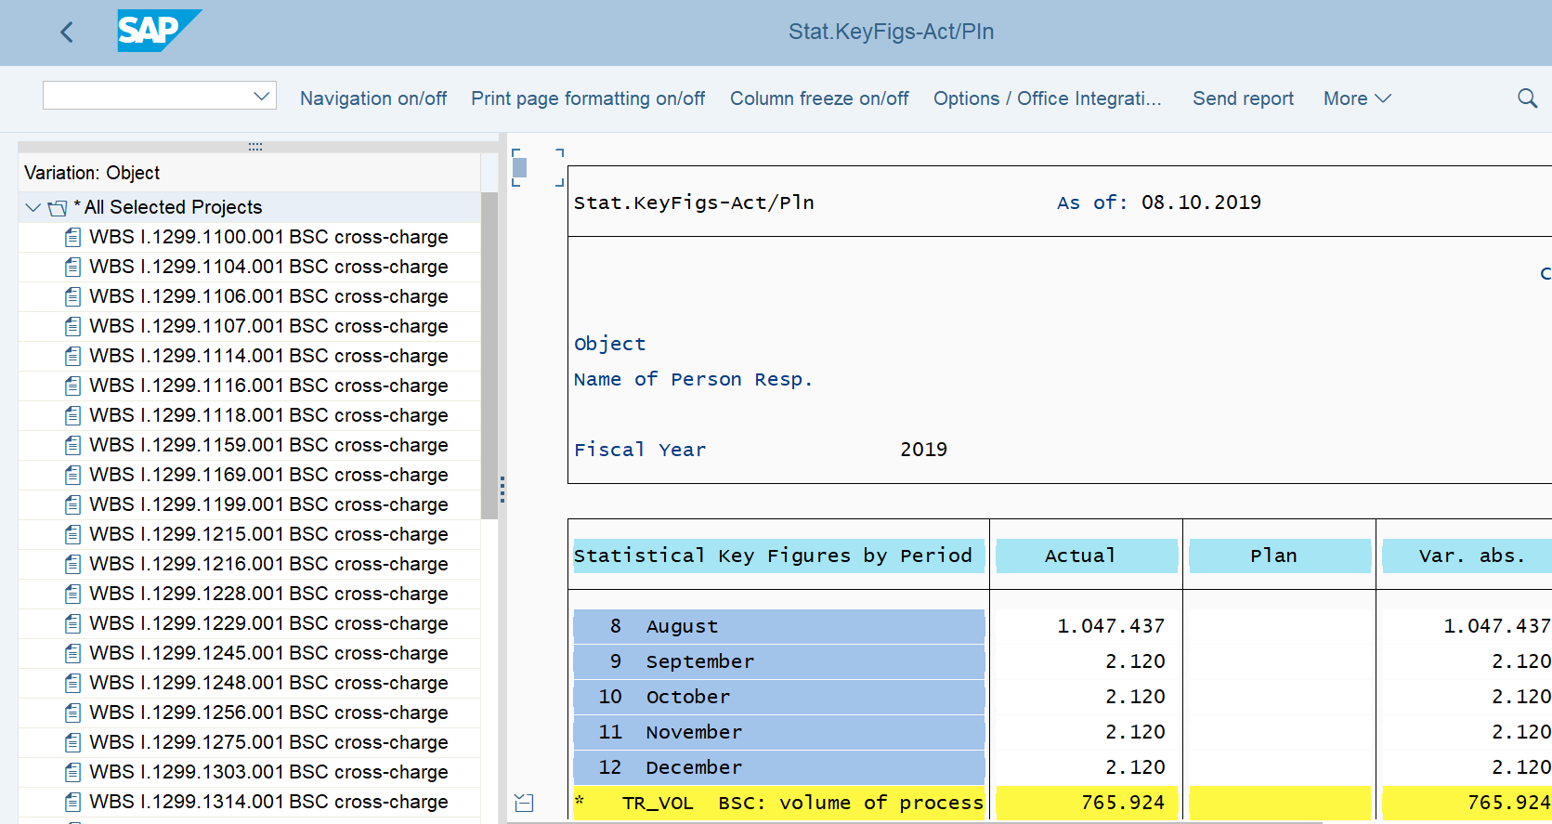
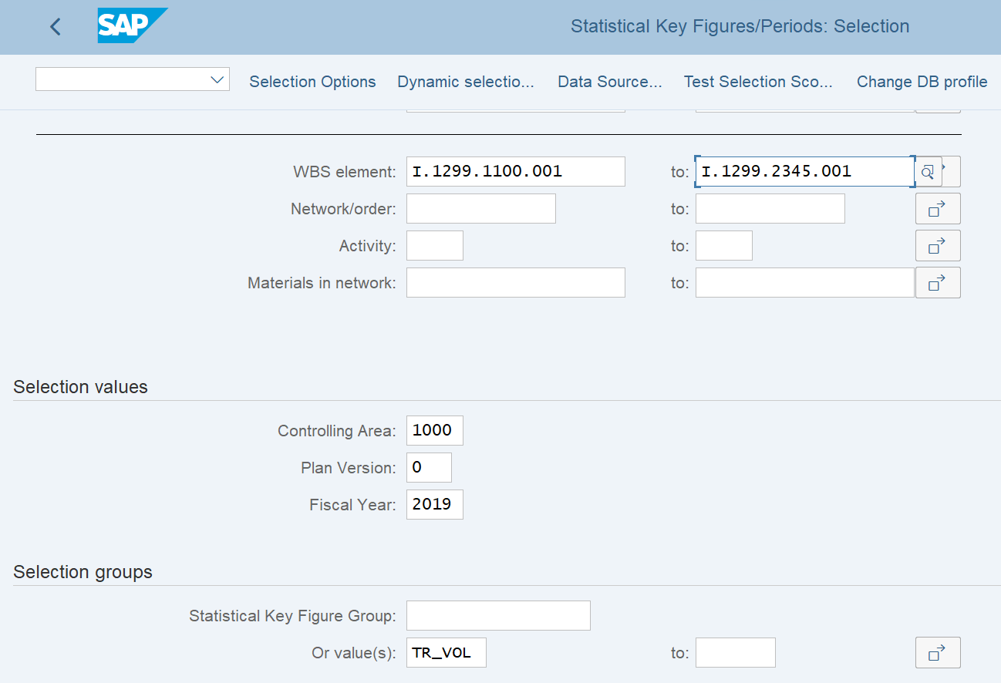
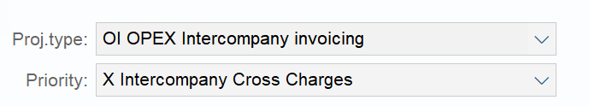
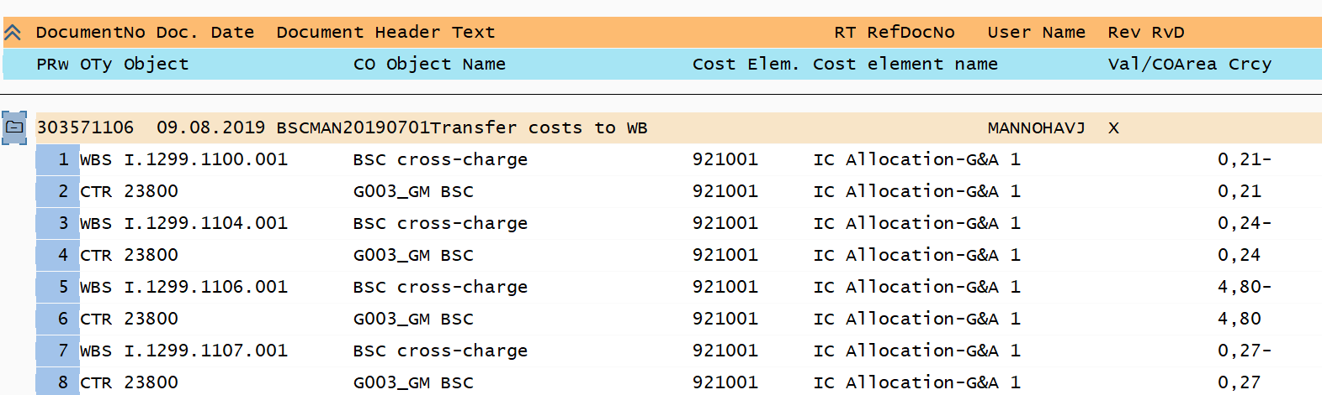
S_ALR_87013548: SKF to WBS for Intercompany
Statistical Key figures are used in cost center allocation cycles to send costs to intercompany WBS elements to include in an intercompany cross charge. This could also be used for opex cost tracking if desired, and the SKF values can be viewed using transaction S_ALR_87013548
S_ALR_87013548 – Statistical Key Figure Actuals
S_ALR_87013548 – Statistical Key Figure Actuals
KSB5 – Display Actual Cost Documents

