Slide 1

Course Structure
Allocation Overview
Master Data
MyRequest Templates
Cost Allocations
Statistical Key Figures
Reporting
Direct MCA
Reporting

Slide 2
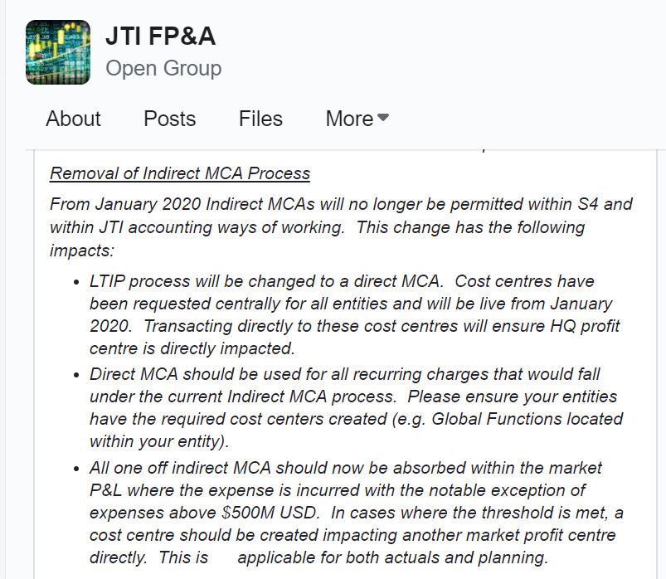
Direct MCA - Update
An update to the A&SP20 instructions was communicated on Workplace to advise a materiality threshold of $0.5MM should be applied for one time direct MCA entries
Costs below this threshold should be absorbed by the market who incurred the costs
For recurring costs, or costs above the threshold, a direct MCA cost center should be created
Cost centers for LTIP specifically have been requested centrally and will be available in S/4 HANA

Slide 3
Direct MCA
Since it will not be possible to book a ledger specific journal in the CO module in SAP, we will switch from using indirect MCA to direct MCA entries – direct MCA is already used in some markets
Direct MCA is where a cost center is created within an entity that maps to the target profit center for the entries
Indirect MCA
Entity | DR / CR | Account | FA | Profit Center | Amount $
1178 - Russia | CR | Salaries | 5000 | Russia Market | (1,000)
1178 - Russia | DR | Salaries | 5000 | MCA | 1,000
1799 – JTI SA | CR | Salaries | 5000 | MCA | (1,000)
1799 – JTI SA | DR | Salaries | 5000 | LTIP | 1,000
Transitory PC is used – entries offset
Direct MCA
Entity | DR / CR | Account | FA | Profit Center | Amount $
1178 - Russia | CR | Salaries | 5000 | Russia Market | (1,000)
1178 - Russia | DR | Salaries | 5000 | LTIP | 1,000
1799 – JTI SA
1799 – JTI SA
Entry is booked in IFRS ledger only
No entries required in JTI SA

Slide 4
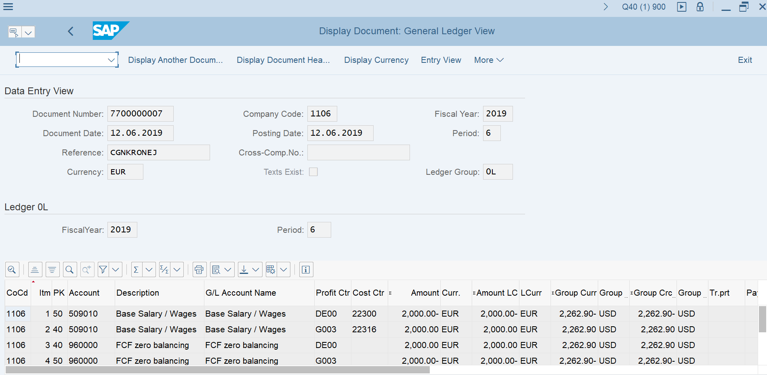
Direct MCA
Please ensure that ledger 0L is selected in the MyRequest template
When the document is posted, the document type in SAP should be Y0 and the document number will start with 77
Ledger should be 0L
Costs should be moved from one PC to another
FCF zero-balancing account will be impacted – this is only visible in the General Ledger view

